Slide 1
Denitsa Vasileva, Team Bulgaria
Review: Liquid Layers
BULGARIA
Notes:
‹#›

Slide 2
Problem 2: Liquid layers
Water and vegetable oil do not mix and form two layers in a beaker. It is possible to fill the beaker with many more layers of immiscible fluids. How many layers can you obtain? Investigate the motion of the interfaces if the beaker is disturbed or shaken.
Partially fulfilled

Slide 3
Overview
Theory
Experiment
Results
Agreement between theory and experiment
Conclusions
Green = very good
Yellow = average
Red = needs improvement

Slide 4
Reporter
Definition of main parameters (immiscible fluids, density and polarity)
Theoretical explanation as to why different polarity layers remain separated
Lack of experimental method
Did not have a hypothesis and sources of error
Did not account for surface tension as a reason for separation of the layers
Differentiating between layers only due to polarity, density differences not observed
Insufficient number of liquid layers obtained
Only one method for disturbing the tower shown
Non-uniform force applied for stirring the mixture
Didn’t show any experimental setup.
Lack of quantitative investigation.
No clear conclusions
Poor explanation on amount of layers obtained - claimed to be infinite
Claimed a layer can’t evaporate from the tower

Slide 5
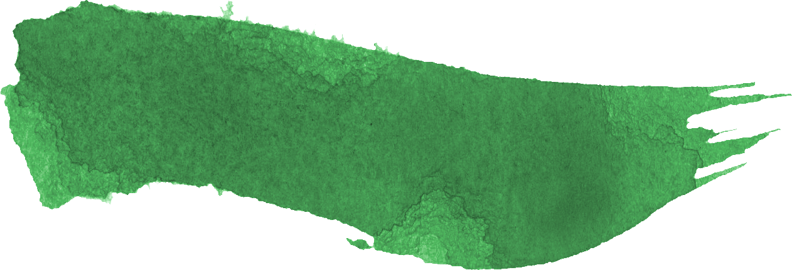
Opponent
Asked important questions such as the method of shaking of the tower
Highlighted the importance of constant mixing and not uncontrolled one
Suggested methods that reporter hadn’t mentioned
Didn’t prioritise the questions
Didn’t focus on the experiment but on theoretical questions
Didn’t address all missing points in the report
Addressed experimental setup, which was missing in reporter’s presentation
Claims that the used substances were enough.
The hydrogen bond is not relevant.

Slide 6
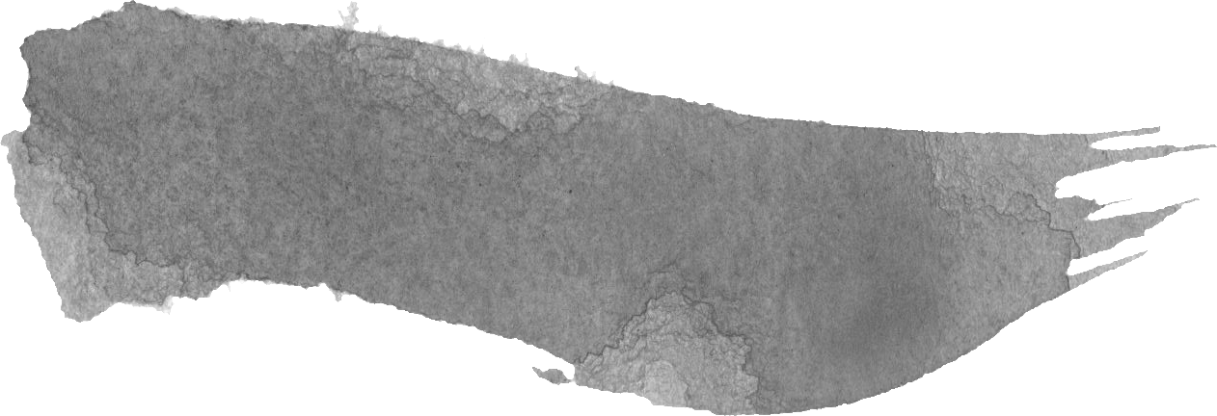
Discussion
The optimal height of the tower was discussed.
The motion of the shaked beaker
Repetition of the experiment
Unclear answers of the reporter
The questions weren’t prioritised.
Opponent asked clarifying questions in the discussion (method of inserting the fluids)
There is a difference between the used methods of disturbing since it will probably produce different results.

Slide 7
Missed points
Establishing more different methods to test the stability of the tower
Investigating the evolution of the tower for prolonged period of time (months)
Quantitative measuring of the mixing of the layers.
Sources of error

Slide 8
Clash
Point of discussion: The motion of the beaker
Reporter: Claimed no difference between shaking and disturbing.
Opponent: Claims there is a difference between shaking and disturbing the tube.

Slide 9
Thank you!

