Slide 1
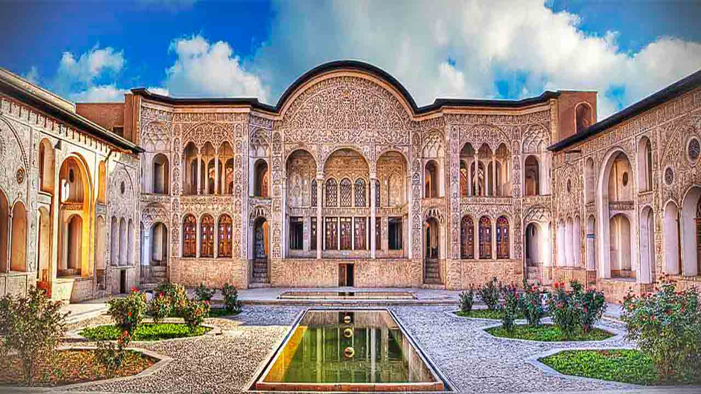


Problem# 12
Zinc Layers
ARTIN radmatin
Rev
Online IYNT 2021
IRAN Team

Slide 2
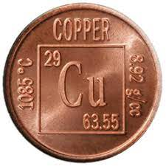
Problem No. 12
If a copper coin and small granules of zinc are immersed into a solution of zinc sulphate and then heated, a layer of zinc appears on the coin. What is the thickness of the zinc layer?
What other metals can be covered with zinc in such an experiment? Investigate and explain the effect.
IRAN Team

Slide 3
Some Weak and strong points of Rep
Strong Points
Weak Points
1-A complete theory
2-An interesting experiment
3-Using of different coins
4-
5-
1-Not a good explanation on the base of problem
2-Explaning very fast and didn’t wait for a complete perception of
3-Not a complete conclusion
4-Not a good timing
5-Not a good explanation on questions

Slide 4
Some Weak and strong points of Opp
Strong Points
Weak Points
1-Good questions
2-Focusing on the most important point of problem
3-
4-
5-
1-
2-
3-
4-
5-

Slide 5
Discussion No 1
Opp:
a
Rep:
b
Rev opinion:
a
Rev opinion:
b

Slide 6
Discussion No 2
Opp:
a
Rep:
b
Rev opinion:
a
Rev opinion:
b

Slide 7
Discussion No 3
Opp:
a
Rep:
b
Rev opinion:
a
Rev opinion:
b

Slide 8
Questions for Rep
1-How did you measure the thickness of layer ?
2-Can other metals be used?
3-Why we can not use some metals for this experiment?
4- Can you please have a explanation on the table in conclusion ?

Slide 9
Questions for Opp
1-What is analysis to be divided into two?

Slide 10

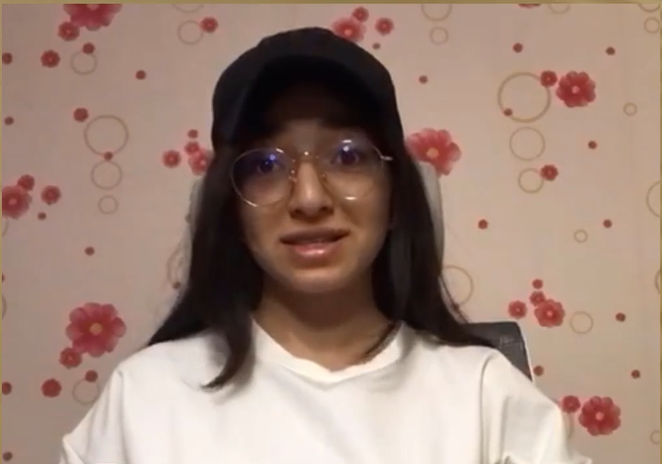
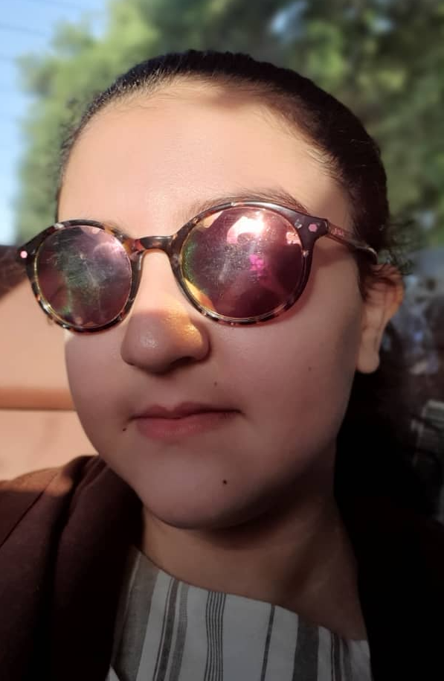
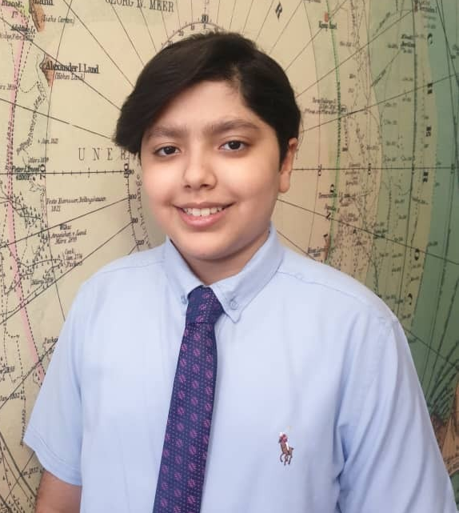
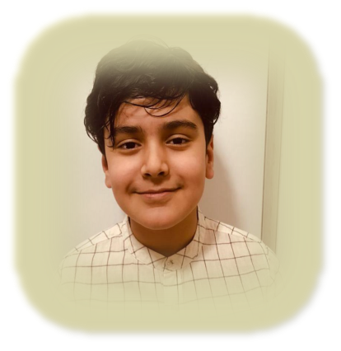


Thanks for your attention
IRAN Team

