Slide 1



Problem# 14
Epidemiology
Opponent:
AmirAli Safari
Online IYNT 2021
IRAN Team

Slide 2

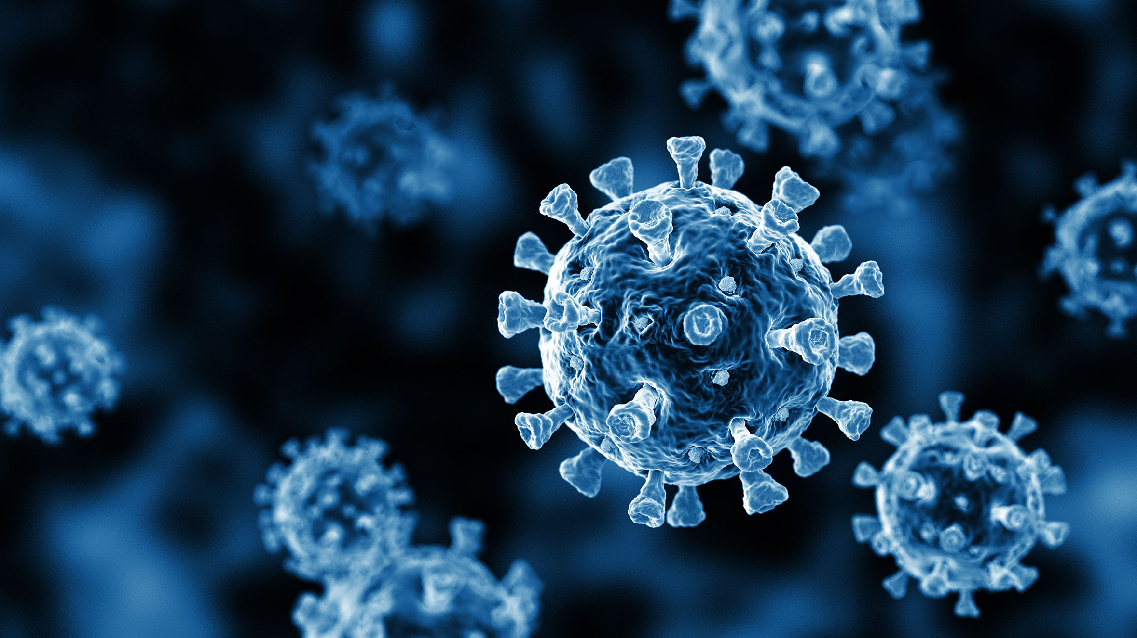

Problem No. 14
The human society has been profoundly affected by the COVID-19 pandemic. Propose a study involving analysis of available epidemiological data for the pandemic.
IRAN Team

Slide 3
Some Weak and strong points of Rep
Strong Points
Weak Points
1- mention to different countries
2- collect information from different countries
3- the dates was ok and new
4-
5-
1- didn’t mention to his country’s data
2- didn’t mention to what is covid-19 completely
3- pages didn't have numbers
4- dates are so much more according to the different types of covid 19
5- the pandemic’s speed didn’t mention
6- lots of parameters weren’t investigated.
IRAN Team

Slide 4
Discussion Points
What is the difference between Epidemic and Pandemic?
How Does Epidemiological data obtain?
4-Which underlying diseases are more dangerous for covid-19 and why ?
5-Can you explain the effect of Alpha virus and Delta virus on age?
6-Is infection more in teenagers in case of Delta virus?
7-How is storm of Cytokines?
8-Why is excessive smoking dangerous?
IRAN Team

Slide 5
Discussion Points
10-How many kinds of vaccine are in world?
11-How many kinds of Covid-19 tests are in world?
12-What is the early clinical sign which can cause death more than others?
13-In what areas is the virus less prevalent ?
14-Why is the virus less prevalent in hot and dry areas?
15-How many kinds of T-lymphocytes are and how they work?
16-Where is the place of production and maturity of T-lymphocytes?
17-Can too much immunity for women be a problem and if so, how?
18-Why Are Cardiovascular and Diabetes problems more dangerous than others?
19-How does mRNA in vaccine work ?
IRAN Team

Slide 6
IRAN Team

