Slide 1
15TH PROBLEM Hearing range REPORT
Alexandra Thereianou
Team Alliance-Greece
1

Slide 2
CONTENTS
PROBLEM
THEORY
1ST EXPERIMENT
2ND EXPERIMENT
3RD EXPERIMENT
DEDUCTIONS
CONCLUSION
2

Slide 3
OUR PROBLEM STATEMENT
There is a considerable variation in the range of frequencies that can be heard by humans. We will investigate the lowest and highest audible frequencies, that humans can hear, depending on their age, gender and the influence of otitis. Moreover, we will investigate how hearing of loud music can cause a drop of hearing ability.
3

Slide 4
THEORY
4

Slide 5
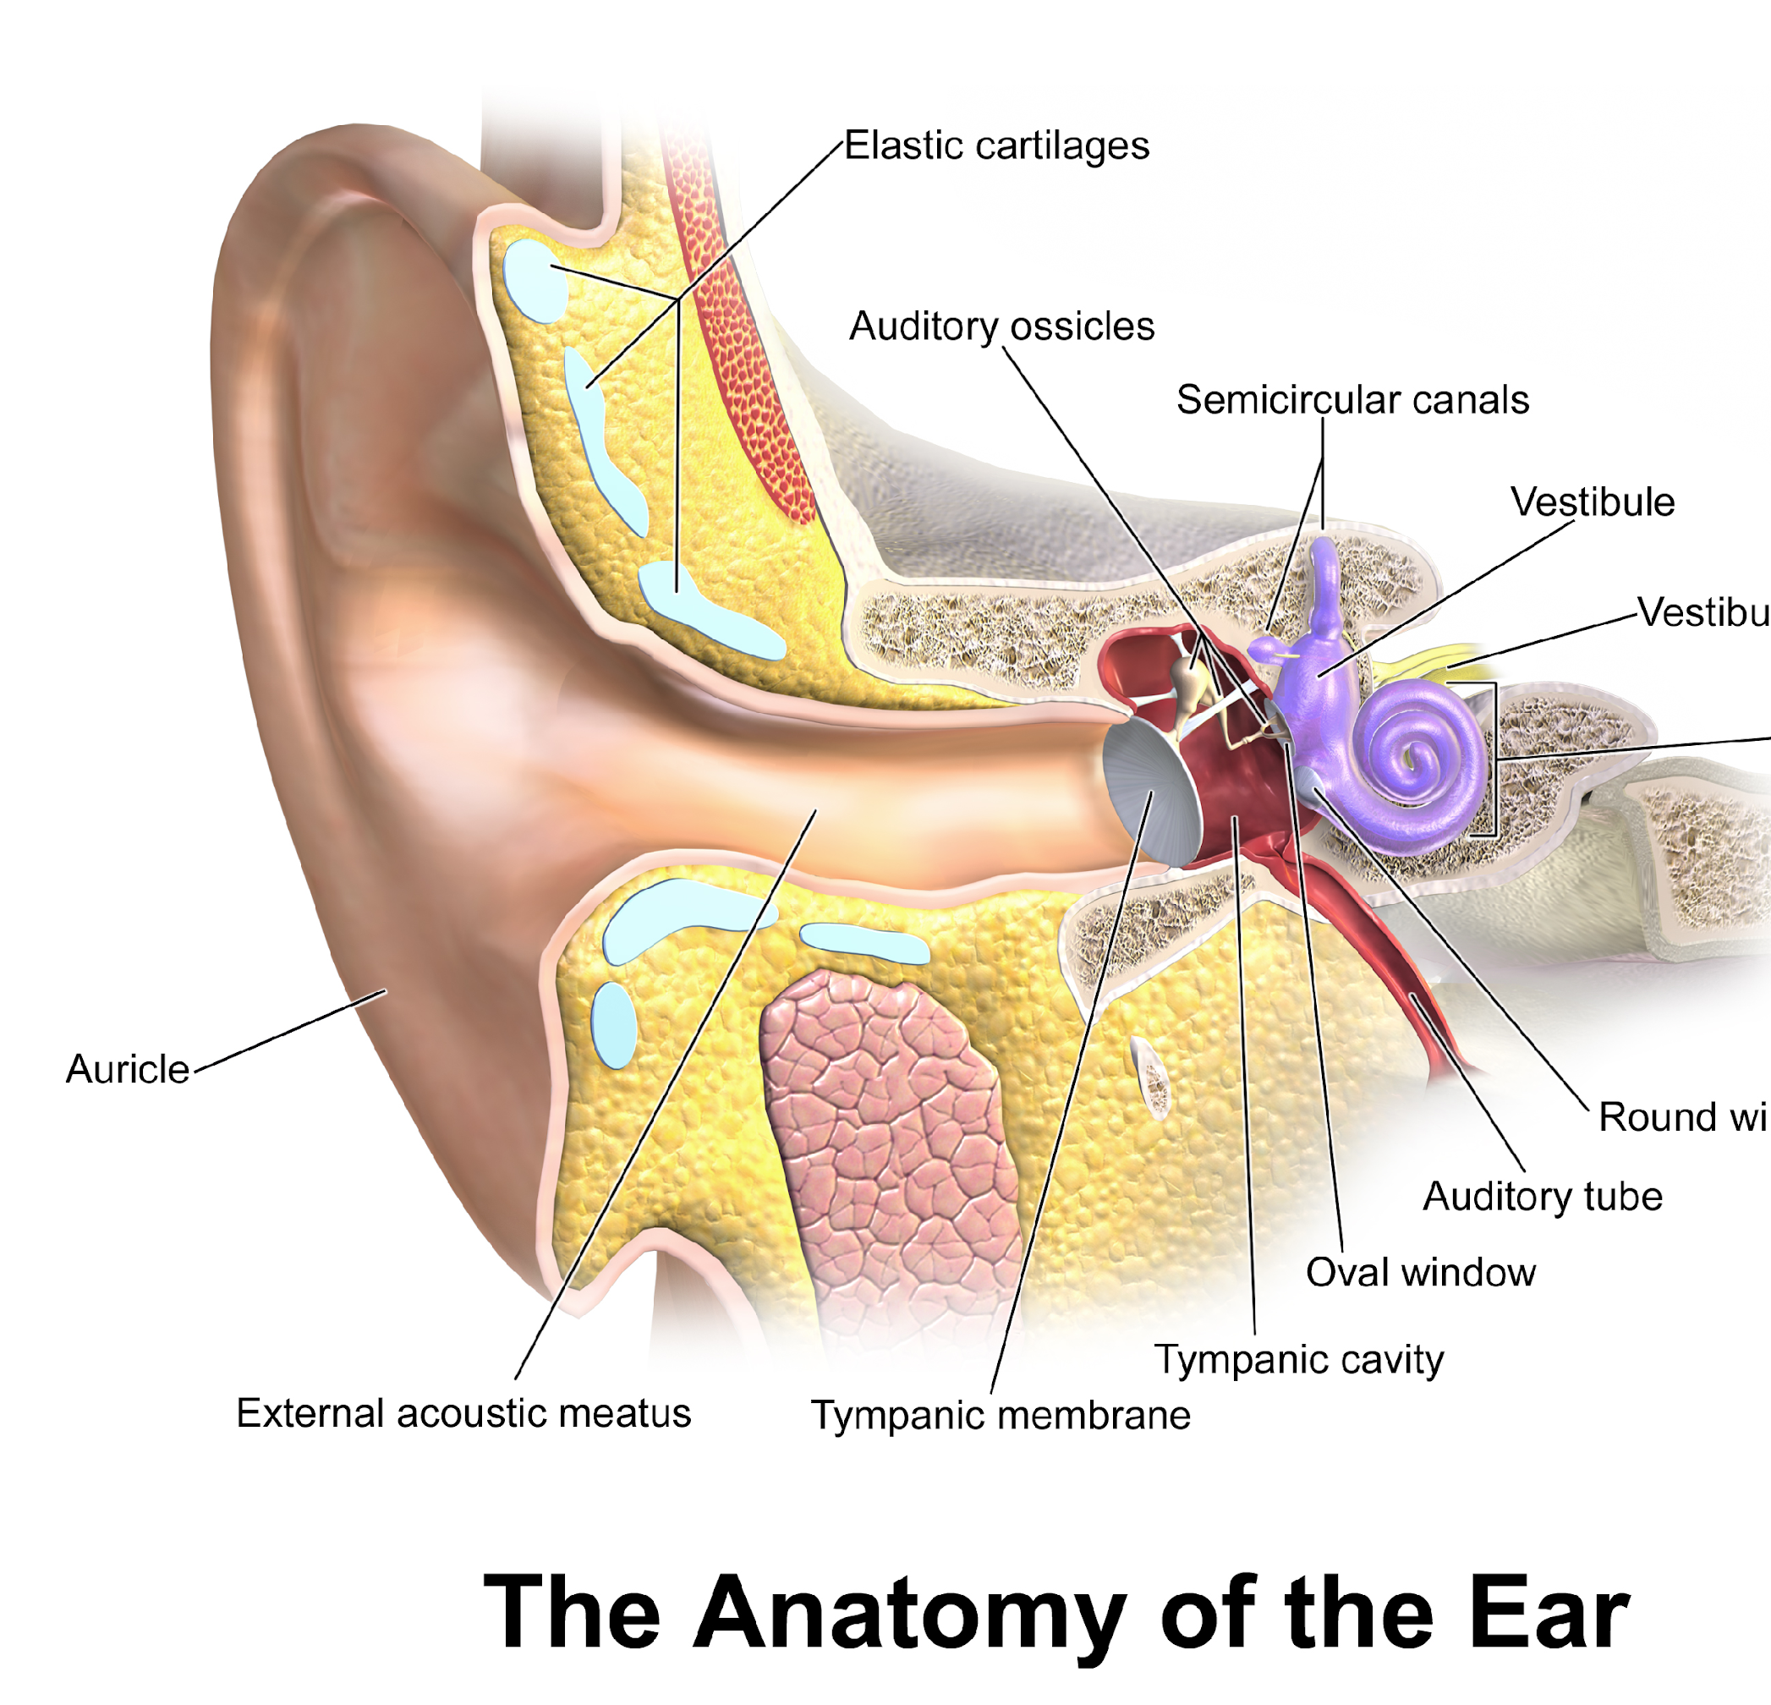
EAR
The ears are organs that provide two main functions — hearing and balance — that depend on specialized receptors called hair cells.
5

Slide 6
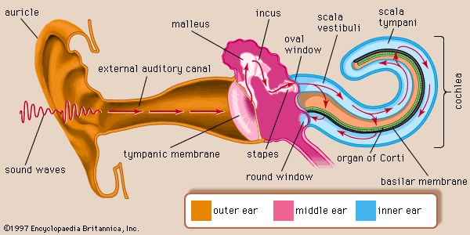
MECHANISM OF HEARING
A vibrating object creates pressure waves in the surrounding air
They are collected by the pinna and the auditory canal
The eardrum vibrates with the same frequency
From the eardrum the vibrations pass through the hammer, anvil, stirrup that amplify them
Vibrations are transferred to the oval window
Pressure waves in the fluid within the cochlea are formed
The basilar membrane vibrates and the hair cells on it alternately brush against and draw away from the overlying shelf
When a hairs cells projections are bent a neural signal is produced
6

Slide 7
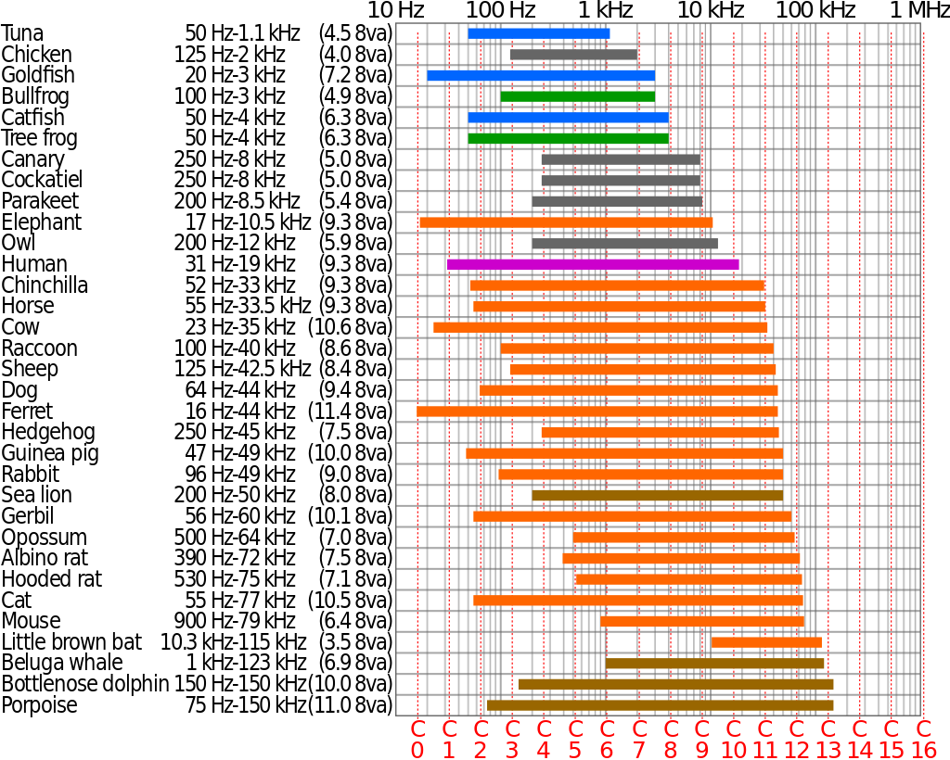
HEARING RANGE
Hearing range describes the range of frequencies that can be heard by humans or other animals
The human range is commonly given as 20 to 20,000 Hertz (Hz)
7

Slide 8
FACTORS THAT AFFECT HEARING/HEARING LOSS
Age (a decline in hearing can develop from the increase of age since come up changes in the inner ear or changes in the nerve pathways from the ear to the brain)
Noise exposure: Loud sounds can damage sensitive structures in the inner ear and cause noise-induced hearing loss-can be temporary or permanent
Gender: Women of all ages have better hearing than men at frequencies above 2000Hz. The better pure-tone audiometry thresholds of women at high frequencies are the poorer capacity to hear at low frequencies have
Diseases: (Otitis)
Prescription Drugs (Diuretics, antibiotics)
OTC Pain Relievers (aspirin)
High Fever
Weightlifting
8

Slide 9
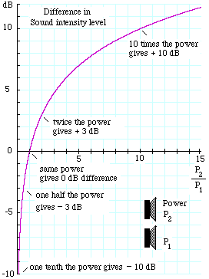
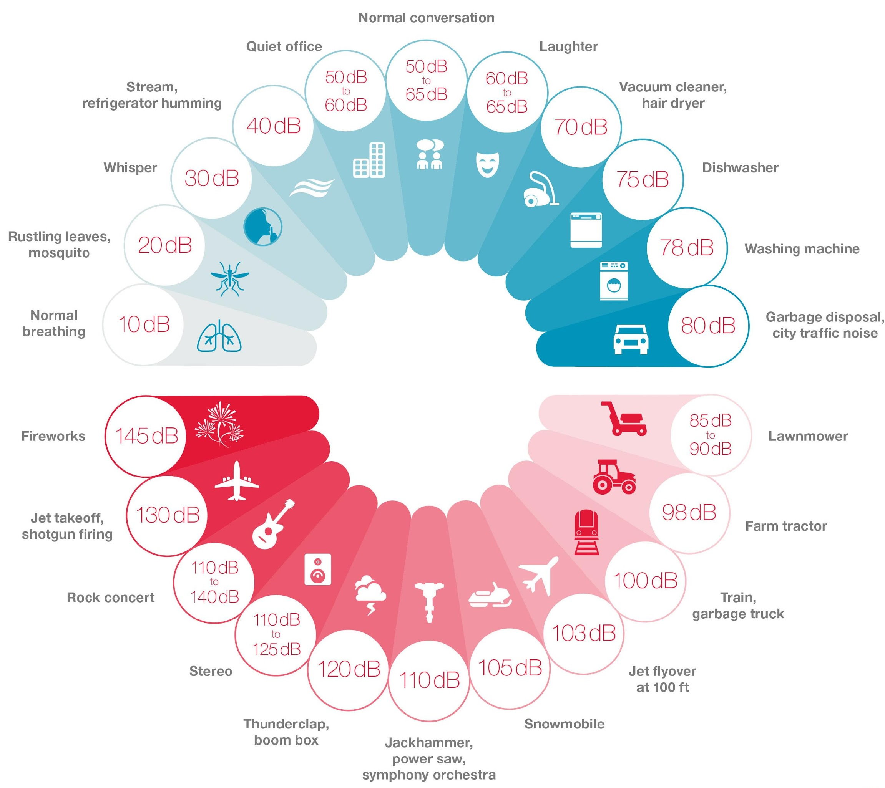
DECIBEL (DB)
A unit used to measure sound intensity and other physical quantities
Its logarithmic scale is convenient to represent the entire range of human hearing
9

Slide 10
EXPERIMENTS
10

Slide 11
1ST EXPERIMENT
11

Slide 12
1st Hypothesis: Younger people will start hearing first and will hear higher frequencies than older people
2nd Hypothesis: Women will start hearing second but they will hear higher frequencies than men
BOTH HYPOTHESES ARE BASED ON THE THEORY
12

Slide 13
CONSTANTS
Utilization of Headphones
Device (cell phone)
No occupation that affects the ears and the hearing
No disease that affects the ears and the hearing
13

Slide 14
INDEPENDENT VARIABLES
AGE
GENDER
14

Slide 15
PROCEDURE
We uploaded in the social media a link with the following questionnaire and asked the people to note in which frequencies they started to hear and in which they stopped hearing the frequencies, defining several parameters.
Preview Survey : Efthymia Papaioannou (questionpro.com)
15

Slide 16
RESULTS
16
women
men

Slide 17
17

Slide 18
2ND EXPERIMENT
18

Slide 19
3rd Hypothesis: People that suffered from otitis will appear a reduced ability to hear lower frequencies
19

Slide 20
CONSTANTS
Age
Headphones
Utilization of Smartphone
20

Slide 21
Independent variable :
Otitis
Dependent variable :
Frequencies they are able to hear
21

Slide 22
14 females
10 males
There was at least 1 person in each age group
22

Slide 23
23

Slide 24
3RD EXPERIMENT
24

Slide 25
4th Hypothesis: Hearing of loud pop-music will make the hearing of lower noises harder
25

Slide 26
CONSTANTS
Age (14-24)
Soundproofed room
Headphones
26

Slide 27
PROCEDURE
20 Volunteers in the ages of 14-24 (half male and half female) were asked to hear pop music wearing headphones for 4 hours (in the same volume, 90 decibel).
Then, they asked to state when they started hearing the applying noise (which measured using an Arduino).
Noise used:
Breathing (10 decibel)
Rustling leaves (20 decibel)
Whisper (30 decibel)
Low-voice conversation (40 decibel)
28

Slide 28
RESULTS
1st time (right after they stopped listening to music)
4 males and 2 females were unable to detect sounds of 10 decibel
1 female volunteer showed a temporary hearing threshold shift (of 30 decibel), since she was unable to detect all the noises under 30 decibel
2nd time (after ten minutes)
The six participants still cannot detect the sounds of 10 decibel
the female volunteer can now detect all the sounds up to 10 decibel
3rd time (after twenty minutes)
All the participants are able to detect all the tested sounds
29

Slide 29
NOTIFICATION
Because it was not possible all the 260 participants to use the same headphones and same smartphones, we made the same experiment ourselves, utilizing the different brands of headphones and smartphones used by the participants, to calculate the deviation and then correctly put the error bars to the diagrams.
30

Slide 30
Headphones | Start Hearing | Stop Hearing
Samsung | 35 | 18000
Xiaomi | 42 | 17900
Huawei | 48 | 17600
Sony | 60 | 17600
Apple | 67 | 17100
We can see that there are differences, depending the mark of the headphones used by the participants. The biggest difference observed is between the Samsung and the apple, 5/100 deviation. So, taking into consideration this difference, along with the fact that the newest models will have better speakers than the older ones, we put error bars of 5/100.
We should mention that the phones and headphones were not more than 4 years old
31

Slide 31
EVALUATION OF THE ERRORS
We urged all the participants to utilize headphones and to make the environment in a quiet room, to avoid outer noises. But since was impossible all the 260 in total participants to be in the same room to observe where they conducted the experiment, we based on their reliability (except the experiments where they were in the same room, that we determined)
Also, the outcomes might have influenced by how new or old are the headphones and which model they used (therefore we put the error bars, since we believe that there might be an error rate of 5 or less percent)
Each person presents differences in hearing
32

Slide 32
CONCLUSIONS
The ability of hearing is decreasing by age. From the graphs we can deduct that persons that:
8-24 (20-19400 Hz), 24-30 (100-17000), 30-40 (220-15000), 40-50 (250- 12000), 50-60 (330-11000), 60-80 (400-8500)
Females show a better ability to hear higher frequencies than men, while men can hear lower frequencies than women (the difference is calculated around 2/100)
Hearing of loud music can cause a temporary hearing impairment (in our experiment the participants could not hear noises under ten decibel, but after 20 minutes the ability came back completely)
Otitis can cause a drop of the ability of hearing of 20/100 in all ages
33

Slide 33
Bibliography
https://www.youtube.com/watch?v=VxcbppCX6Rk
https://global.widex.com/en/blog/human-hearing-range-what-can-you-hear
https://www.szynalski.com/tone-generator/
https://www.ncbi.nlm.nih.gov/books/NBK10924/
https://sphweb.bumc.bu.edu/otlt/mph-modules/bs/bs704_nonparametric/BS704_Nonparametric4.html
https://www.socscistatistics.com/tests/mannwhit ney/default2.aspx
https://sphweb.bumc.bu.edu/otlt/mph-modules

Slide 34
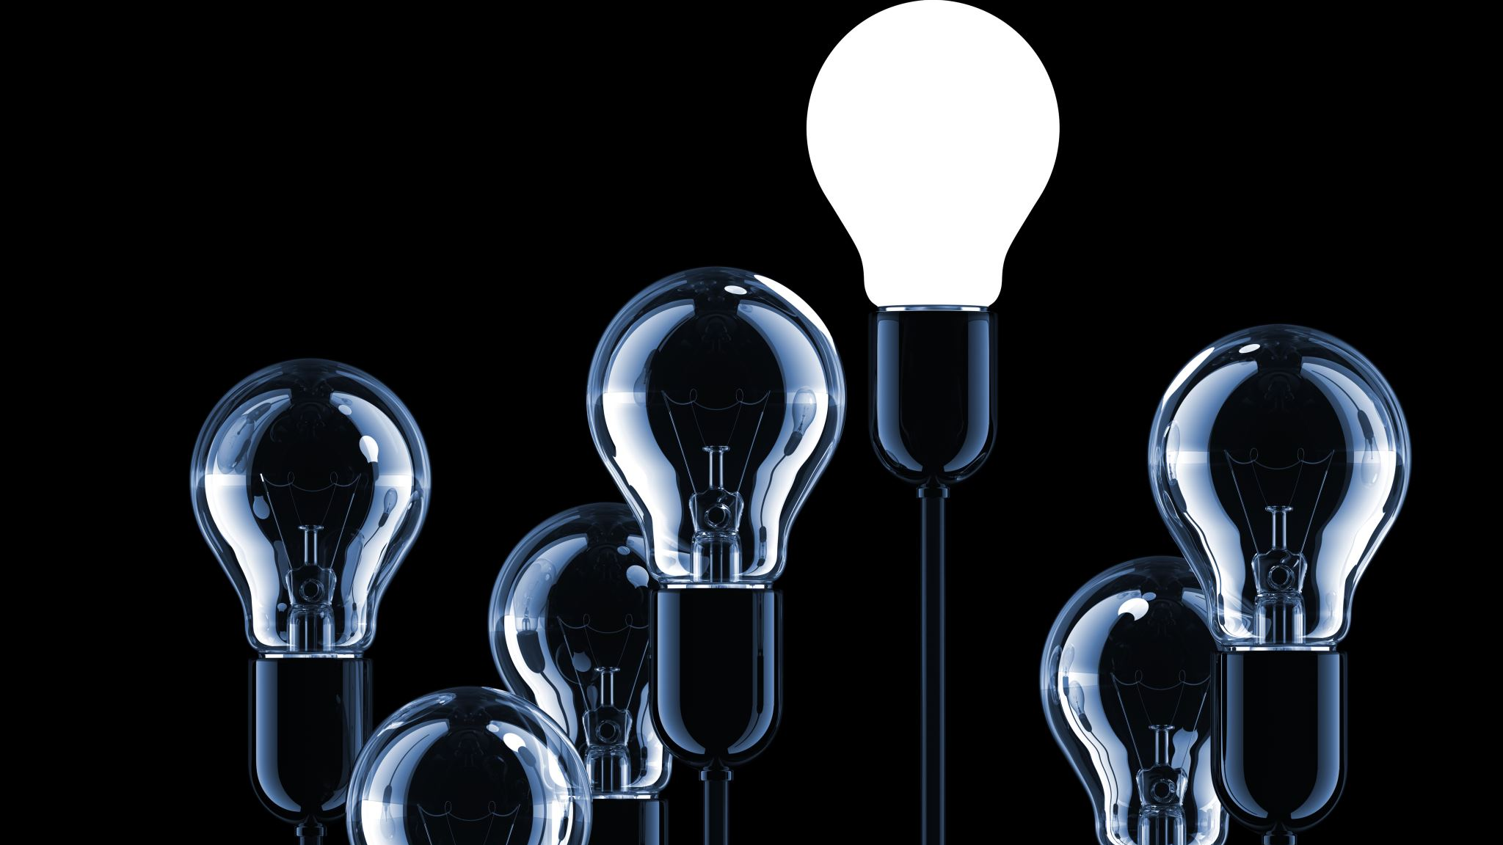
THANK YOU FOR YOUR ATTENTION!

Slide 35
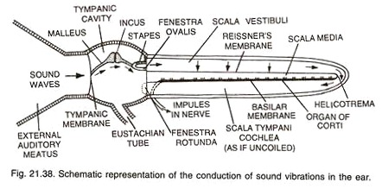
MECHANISM OF HEARING
The sound waves are collected by the external ear.
They pass through the external auditory meatus to the tympanic membrane which is caused to vibrate.
The vibrations are transmitted across the middle ear, incus and to the stapes bones. The latter fits into the fenestra ovalis.
The perilymph of the internal ear receives the vibrations
From the perilymph the vibrations are transferred to the scala vestibuli of cochlea and then to scala media. Thereafter, the movements of endolymph and tectorial membrane stimulate the sensory hairs of the organ of Corti.
The impulses thus received by the hair cells are carried to the brain

