Slide 1
Problem 16.
Weak signals
IYNT 2021
Team Nitro
Notes:
Hello, my name is Mihnea Grigore from Team Nitro and I’m going to present to you Problem 16. Weak signals.

Slide 2
Controlling signal-to-noise ratio is important in many measurements to distinguish a meaningful signal from statistical fluke. Propose a problem requiring experiments to detect very weak signals.
Problem statement
Notes:
The statement of the problem
Controlling signal-to-noise ratio is important in many measurements to distinguish a meaningful signal from statistical fluke. Propose a problem requiring experiments to detect very weak signals.

Slide 3
Test people’s accuracy in detecting common examples of weak signals.
Proposed problem
Notes:
This is our proposed problem statement:
Test people’s accuracy in detecting common examples of weak signals.

Slide 4
Theoretical Part
Theory
Hypotheses
Experimental Part
Materials and Methods
Results and Discussion
Summary
Conclusions
Errors and limitations
References
Final Part
Notes:
We split the problem into 3 parts, the theoretical part, the experimental part and the final part.

Slide 5
Theoretical Part
slides 5 - 10
Theory
Hypotheses
Notes:
The theoretical part

Slide 6
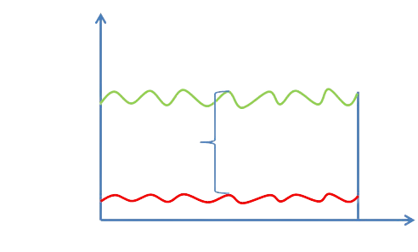
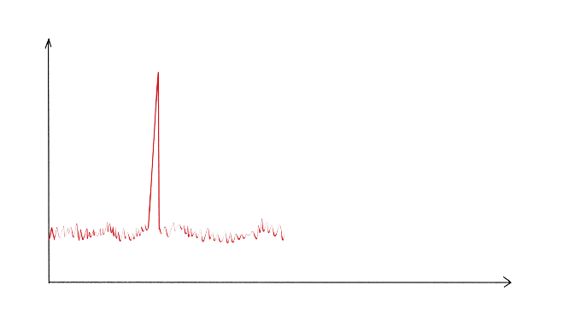
Theory
1. What is signal to noise ratio
The signal-to-noise ratio
To understand this better imagine two people speaking to each other
In this case, we'd call it a signal-to-noise issue
Signal
Received Signal
Strength
Power (dBm)
SNR (dB)
Power (dBm)
Noise
Noise Floor
Time(sec)
Time(sec)
Notes:
What is signal to noise ratio?
The signal-to-noise ratio is defined as the ratio between the desired information or power of a signal and the unwanted signal or power of background noise. A ratio greater than 1:1 indicates that there is more signal than noise.
To understand this better imagine two people speaking to each other inside a large room full of people. A few of other persons have identical voice patterns as one of our people. As you would imagine, determining who is saying what would be tough.
In this case, we'd call it a signal-to-noise issue, or the equivalent of a signal-to-noise ratio that falls below permissible limits.

Slide 7
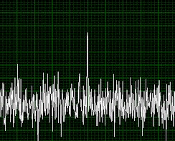
Theory
2. What is statistical fluke
Statistical fluke
A classical example
The main goal of statistics
weak signal
Humans are notoriously incompetent at estimating these types of probabilities…
In our case, we have to determine if a irregularity in our sound to ratio noise graph is a statistical fluke or a detection of a weak signal.
Statistical fluke
(Signal to Noise Ratio Graphic)
Notes:
What is a statistical fluke?
Statistical fluke is a result that you get simply by luck, not because there is some correlation or cause and effect.
A classical example of this is that if you have a pretty small number of people in a room, below 30 and there are 2 of them sharing same birthday. This happens by sheer chance, and is not evidence of previous selection to ensure that there are 2 people with same birthday.
The main goal of statistics is basically differentiate a fluke from actual correlation.
Humans are notoriously incompetent at estimating these types of probabilities… which is why scientists when they see something unusual in their data, always try to quantify the probability that it is a statistical fluke. You would not want to be wrong.

Slide 8
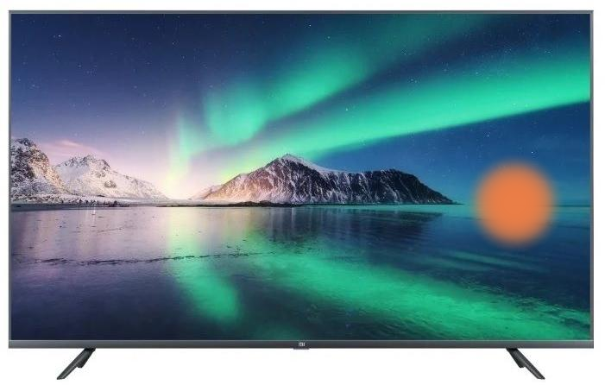
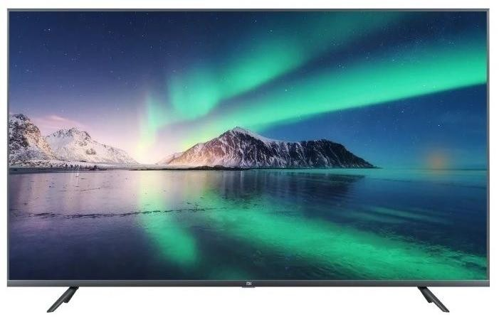
Theory
3. Signal detection theory
What does Signal detection theory refer to:
Decision making under conditions of uncertainty
Trying to figure out at what point a signal is strong enough that we are able to notice it
clear and strong signal.
You are watching the tv and see two orange dots.
This graphic has multiple irregularities.
Statistical fluke or weak signal
fairly weak signal
Notes:
What does signal detection theory mean?
It refers to
Making decisions under conditions of uncertainty and
Trying to figure out at what point a signal is strong enough that we are able to notice it
Imagine you are watching the tv and you see two orange dots.
This would be a clear and a strong signal
This would be a fairly weak signal
and you have to decide whether those are flukes or weak signals detected.
This graphic has multiple irregularities and you have to decide whether those are flukes or weak signals detected,

Slide 9
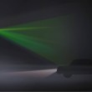
Theory
3. Signal detection theory
Real life example:
You are driving and you are waiting at a traffic light on a foggy day.
In this case there are a few options
 | Yes | No
present | hit | miss
absent | False alarm | Correct rejection
Notes:
Here we have a real life example:
Let’s say you are driving and you are waiting at a traffic light on a foggy day. You have to decide when the light turns green and you have to start driving. It is really hard to see the green light and you have to decide how strong the signal has to be for you to say “yes ok the light is definitely green and let me start driving.
In this case we have a few options:

Slide 10
Hypotheses
Experiment 1 – Visual.
Hypotheses:
There will be people getting False Alarms
The light from the screen would be visible at 2 or 3 sheets left on the phone
2. Experiment 2 – Sound based.
Hypotheses:
There will be people getting False Alarms
The Sound based weak signal will be harder to detect
Notes:
The Hypotheses.
For the first experiment, the visual one we have two hypotheses. These are: There will be people getting false alarms and the light from the screen would be visible at 2 or 3 sheets of paper left on the phone.
For the second experiment, the sound based one, we also have two: There will be people getting false alarms and the sound based weak signal will be harder to detect

Slide 11
Experimental Part
slides 11 – 23
Materials and methods
Results and discussions
Notes:
The experimental part

Slide 12
Materials and methods
There will be two experiments, each of them containing common examples of weak signals which I could recreate.
The experiments:
1. Visual experiment
2. Sound based experiment
Materials I used in the experiments:
A phone(I will use the screen for the Visual experiment)
Paper(I will use it to cover the phone’s screen in the Visual experiment)
A pair of headphones (I will use it for the Sound based experiment)
Notes:
We will do two experiments, each of them containing common examples of weak signals which we could recreate
These experiments will be a visual one and a sound based one.
The materials we will use in these experiment are a phone, sheets of paper and a pair of isolating headphones.

Slide 13
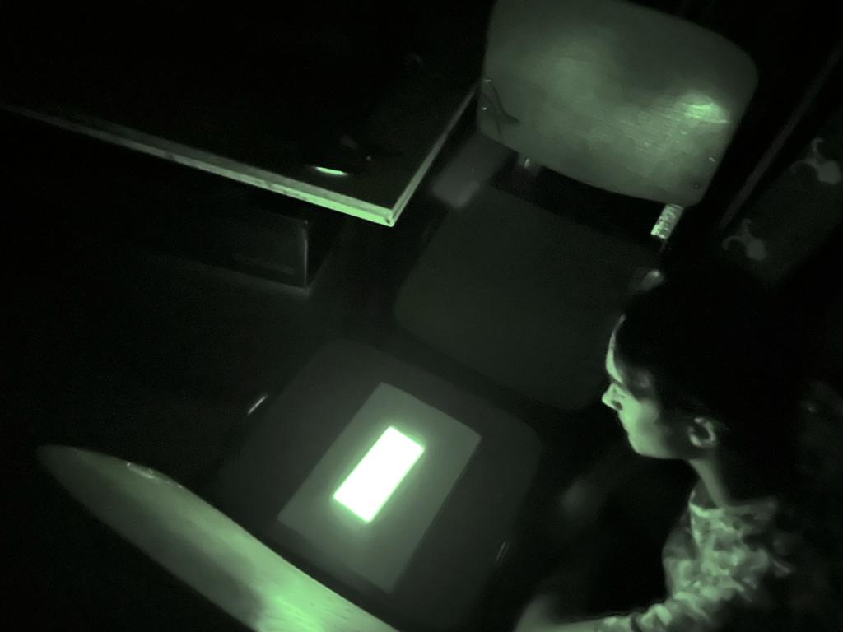
Results and discussions
1. The first experiment(Visual experiment)
Steps of this experiment:
Set a phone to it’s highest luminosity.
Display a bright, solid color image on the phone.
Place sheets of paper over the phone until the light can’t be seen anymore.
Test a large group of people
Example:
Notes:
These are the basic Steps of the visual experiment:
Firstly, Set a phone to it’s highest luminosity.
Then, Display a bright, solid color image on the phone.
After this, Place sheets of paper over the phone until the light can’t be seen anymore.
Lastly, Test a large group of people by taking one peace of paper from over the phone at a time and having them tell you when they see the light

Slide 14
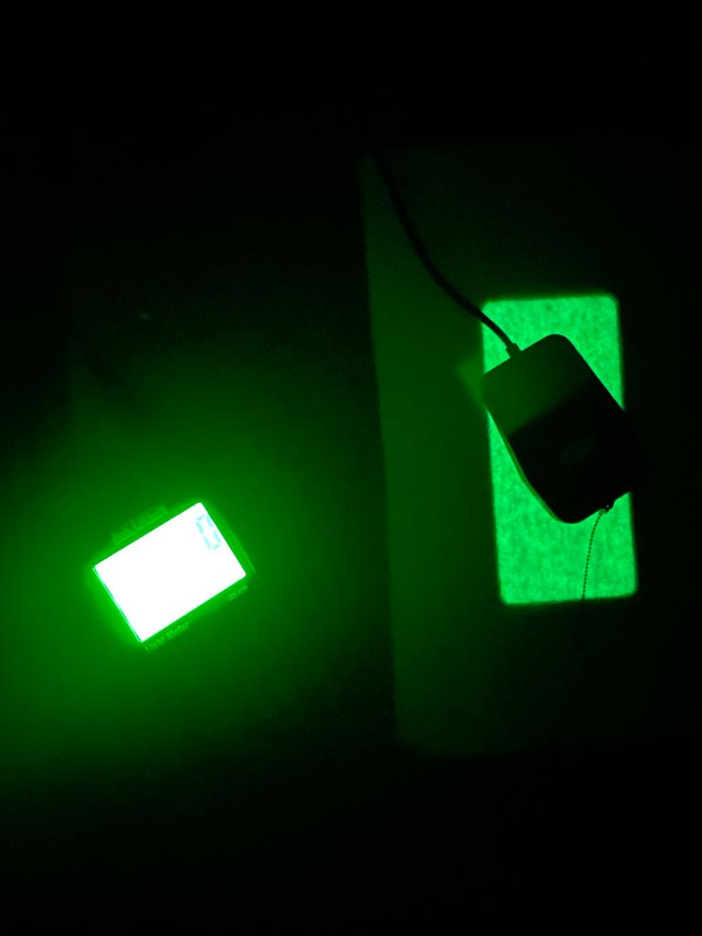
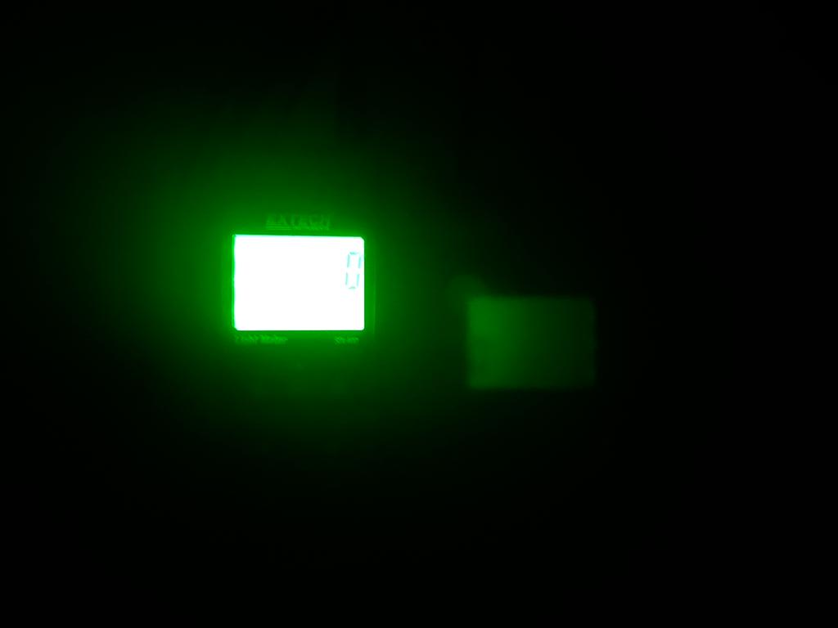
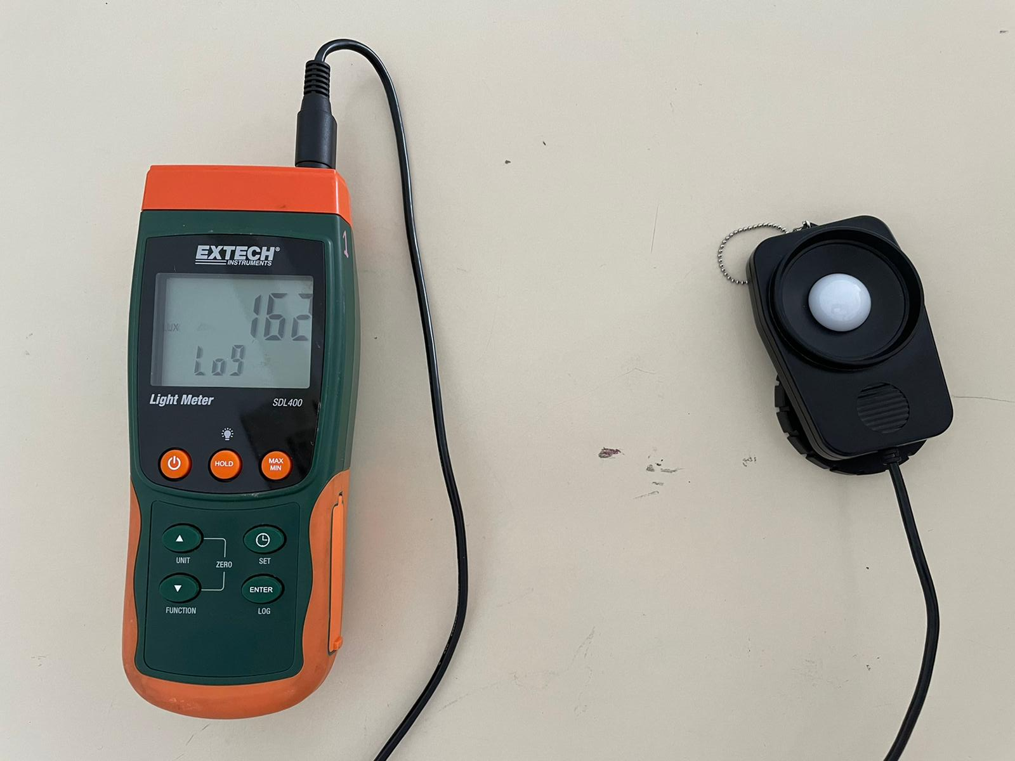
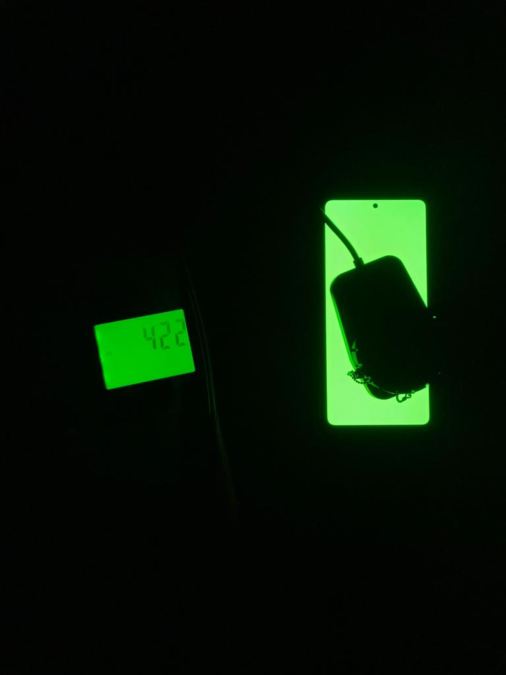
Results and discussions
1. The first experiment(Visual experiment)
We measured the luminosity level in complete darkness.
We tested a total of 30 persons between 15 and 17 years old.
10 sheets of paper
0 luxe in the room
162 luxe in the room where we tested the subjects
0 sheets of paper
Notes:
We measured the luminosity level in complete darkness to eliminate all the unwanted light sources. We tested a total of 25 persons between 15 and 17 years old.

Slide 15
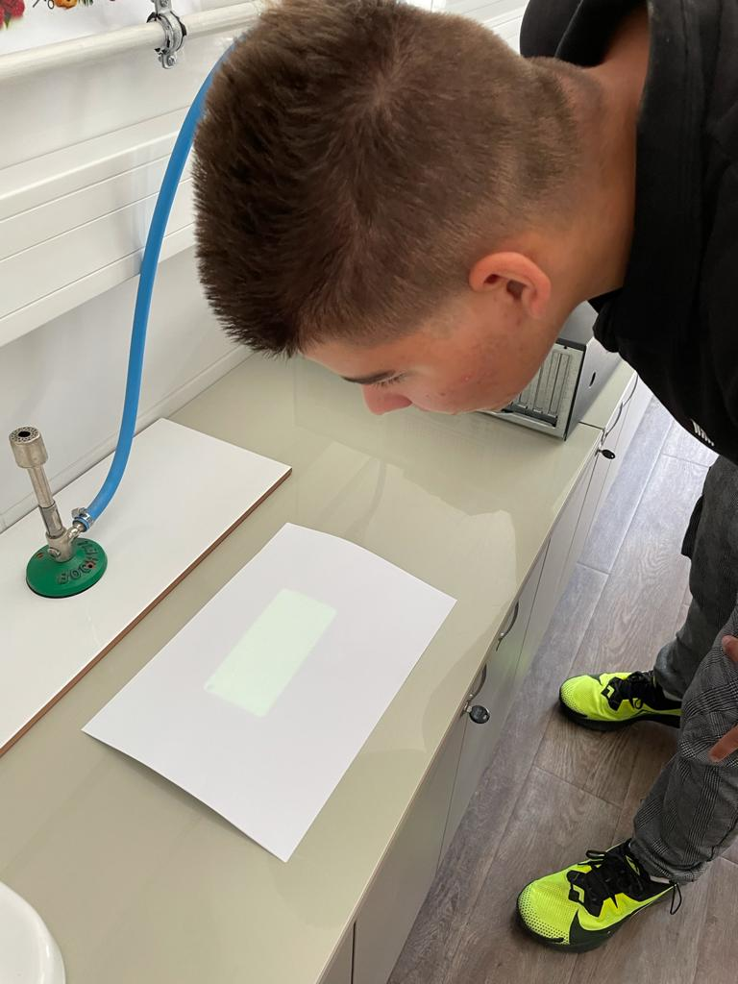
Results and discussions
1. The first experiment(Visual experiment)
At 10 sheets of paper over the phone the luxe meter showed 0 luxe
The light became visible at 5 sheets over the screen
5 sheets of paper
7 sheets of paper
Notes:
At 10 sheets of paper over the phone the luxe meter showed 0 luxe, that means that there were less 1 luxe, so in normal lit room you couldn't see any light coming from the phone.
The light became visible at 5 sheets over the screen in the normal lit room

Slide 16
Results and discussions
1. The first experiment(Visual experiment)
Notes:
So in this chart the noise floor is represented by the blue line. The signal can be detected from when the orange line crosses the blue line, meaning the signal being stronger than the noise floor. The grey lines are representing the number of people detected at a certain signal strength.

Slide 17
Results and discussions
1. The first experiment(Visual experiment)
These are the results I got:
Notes:
As we can see 94% of the persons examined answered they can see the light with 5 or less sheets of paper left on the screen. The rest of 6% said they can see the light with 6 or 7 sheets of paper over the phone.

Slide 18
Results and discussions
1. The first experiment(Visual experiment)
The person under examination would have been correct if they said they can see the light when 5 or less sheets of paper were left.
Here we have a table with the results
Number of people | Sheets of paper | Result
28 people | 5 or less | hit
2 people | 6 or 7 sheets | False alarm
Why did 6 people get a False alarm?
Notes:
The light was visible trough 5 or less shits of paper. So the person under examination would have been correct if they said they can see the light when 5 or less sheets of paper were left.
Here we have a table with the results and if the responses of the people were correct:
So, Why did 6 people get a False alarm?
One of the possibilities is the phenomenon I think we have all experienced, when you look closely or for a extended period of time without blinking to an object you start seeing spots of different colors. I think this is what caused them to get a False alarm.

Slide 19
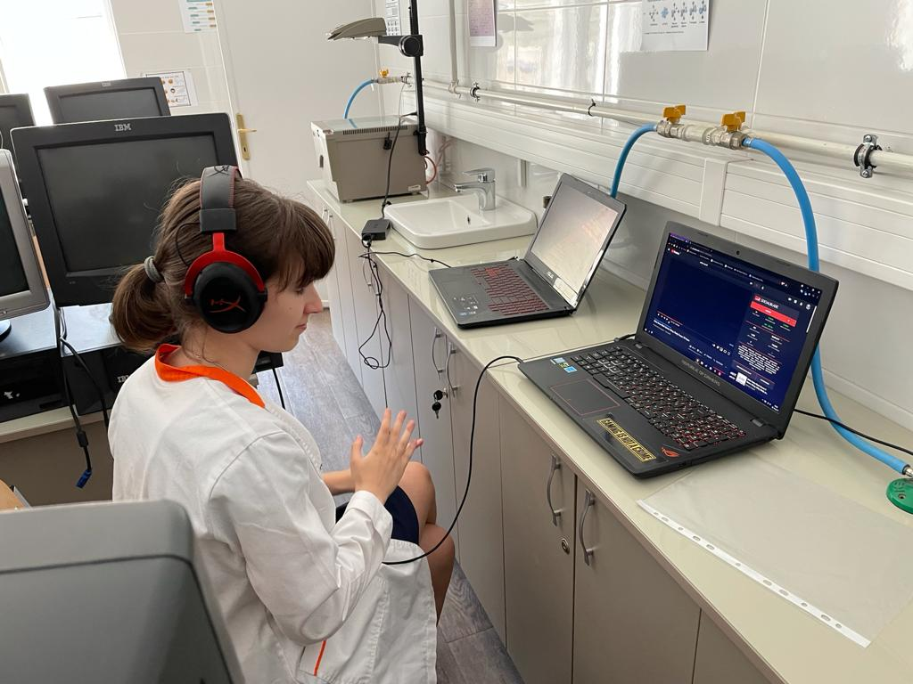
Results and discussions
2. The second experiment(Sound based experiment)
What were the steps of this experiment:
Set the volume on the headphones to the minimum.
Play white noise in the headphones
Have persons listening to that white noise and slowly increase the volume until they confirm that they hear the sound.
Notes:
These are the basic steps for the sound based experiment:
Firstly set the volume of the headphones to the minimum
Then, play white noise trough the headphones.
Lastly, have persons listening to that white noise and slowly increase the volume until they confirm that they hear the sound.

Slide 20
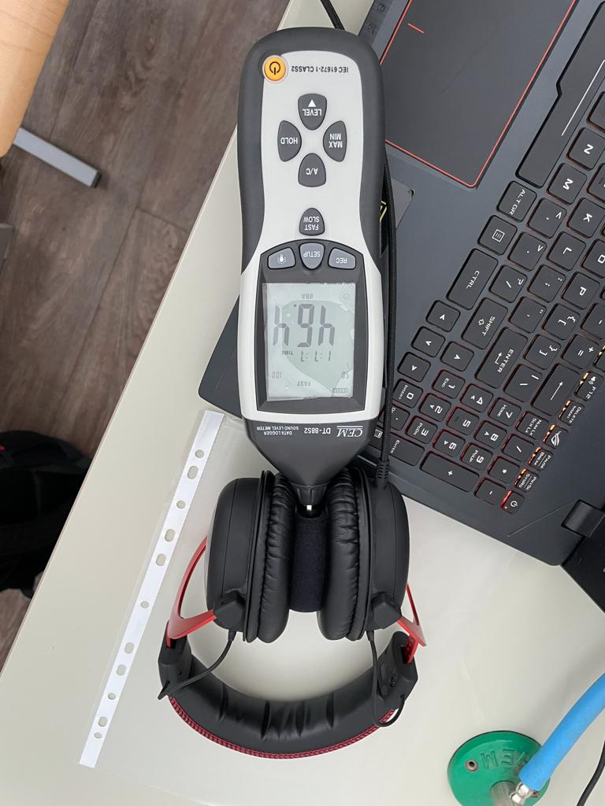
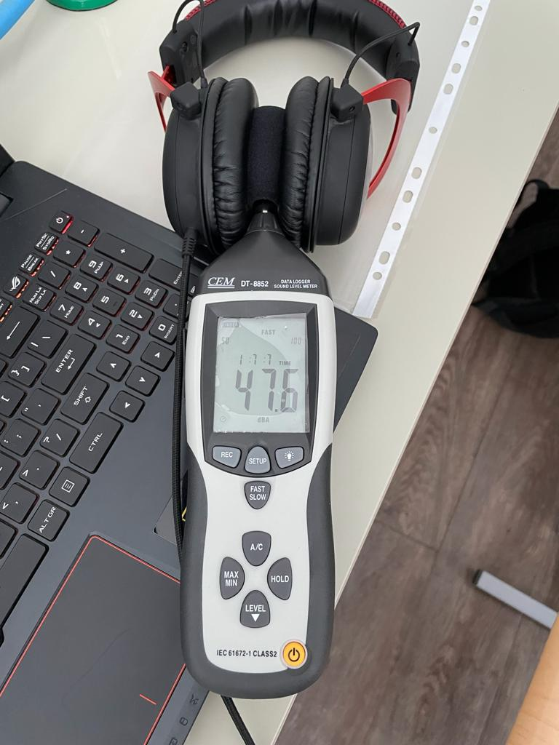
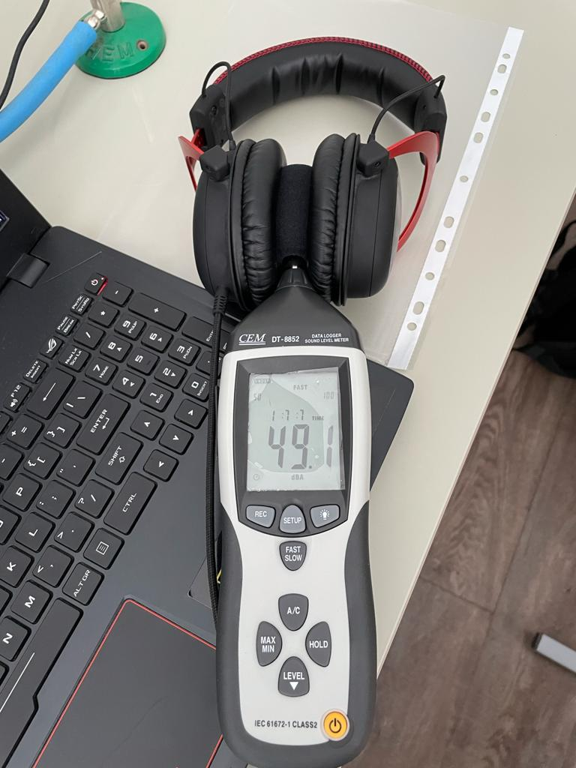
Results and discussions
2. The second experiment(Sound based experiment)
We measured the background noise in the room , the noise coming from the headphones at 0.005% volume, and the noise produced by the headphones at 0.04%.
headphones turned off
0.04%(the volume that could be have been heard)
0.005%(the minimum volume)
Now, from here we can calculate the signal to noise ratio at 0.04% volume:
SNR: S-N=white noise(0.04% volume)-background noise
S-N=49.1-46.4
SNR=2.7 dB
Notes:
We measured the background noise in the room , the noise coming from the headphones at 0.005% volume, and the noise produced by the headphones at 0.04%.
Now, from here we can calculate the signal to noise ratio at 0.04% volume, that is the volume from which you could hear the sound.:
We subtract the noise from the signal, so we have 49.1 dB minus 46.4 dB.
From here we get that the SNR is 2.7 dB.
SNR: S-N=white noise(0.04% volume)-background noise
S-N=49.1-46.4
SNR=2.7 dB

Slide 21
Results and discussions
2. The second experiment(Sound based experiment)
Notes:
So in this chart the noise floor is represented by the blue line. The signal can be detected when the orange line crosses the blue line, meaning the signal being stronger than the noise floor. The grey lines are representing the number of people detected at a certain signal strength.

Slide 22
Results and discussions
2. The second experiment(Sound based experiment)
We started the experiment with a volume of 0.005% and started to increase it.
These are the results I got:
Notes:
As we can see on the chart, 97 % of the persons which were under examination confirmed that they heard the sound at 0.04% or more volume. The rest of 3% said that they heard the sound before 0.04% so at 0.03% or lower.

Slide 23
Results and discussions
2. The second experiment(Sound based experiment)
To be correct you should have said that you hear the sound from 0.04% or more volume.
Here is the table with the results and if the responses of the people were correct:
Number of people | Sheets of paper | Result
28 people | 0.04% or more | hit
2 people | 0.03% or less | False alarm
Why did 3 persons get a False Alarm?
Notes:
The sound could be heard from 0.04% or more volume, So the person under examination would have been correct if they said they can see hear the noise at 0.04% or more.
Why did 3 persons get a False Alarm?
The only reason he could have answered incorrectly could have been his ears ringing or hearing something else from the outside the headphones he thought was the white noise.
Also, this situation would be a statistical fluke for our experiment.

Slide 24
Final Part
slides 24 - 27
Conclusions
Errors and limitations
References
Notes:
The Final Part

Slide 25
Conclusions
We encountered three statistical flukes
Humans can detect weak or very weak signals
Number of people | Sheets of paper | Result
97 people | 0.04% or more | hit
3 people | 0.03% or less | False alarm
Number of people | Sheets of paper | Result
94 people | 5 or less | hit
6 people | 6 or 7 sheets | False alarm
Notes:
As we have seen, we also encountered statistical flukes, where, because of the conditions, some individuals thought they detected a weak signal when there wasn’t one present.
In conclusion, humans are able to detect common examples of weak or very weak signals, but may vary from person to person at what intensity of that specifical signal they can detect it.

Slide 26
Errors and limitations
Errors:
Varying thickness of the paper
The first sheet of paper wasn’t sitting directly on the phone’s display because of the case being a bit taller then the phone.
The headphones were isolating, but they can’t really stop all the sounds, so external sounds may have occurred.
The decibel meter not picking up only the sound produced by the headphones.
Notes:
These are the potential errors.
The Varying thickness of the paper
The first sheet of paper wasn’t sitting directly on the phone’s display because of the case being a bit taller then the phone.
The headphones were isolating, but they can’t really stop all the sounds, so external sounds may have occurred.
The decibel meter not picking up only the sound produced by the headphones.

Slide 27
References
https://en.wikipedia.org/wiki/Radio_noise
https://en.wikipedia.org/wiki/Johnson%E2%80%93Nyquist_noise
https://www.google.com/url?client=internal-element-cse&cx=004984196166817161901:gt3nscsxv5o&q=https://www.khanacademy.org/test-prep/mcat/processing-the-environment/sensory-perception/v/signal-detection-theory-part-1&sa=U&ved=2ahUKEwi5tL7D4_TxAhWngP0HHX5SD1sQFjAAegQIAxAB&usg=AOvVaw3q2jX2FjnTLv-clDutV6dD
https://www.google.com/url?client=internal-element-cse&cx=004984196166817161901:gt3nscsxv5o&q=https://www.khanacademy.org/test-prep/mcat/processing-the-environment/sensory-perception/v/signal-detection-theory-part-2&sa=U&ved=2ahUKEwi5tL7D4_TxAhWngP0HHX5SD1sQFjABegQICBAB&usg=AOvVaw3LGFOx_kMkxIzlYVRkBo9l
Notes:
These are our references.

