Slide 1




Problem#
21
Researcher:
Larisa sistani
Online IYNT 2021
1
IRAN Team

Slide 2
Problem No. 21
What is the minimum concentration of sodium chloride in water solution such that a human detects the presence of salt? Use double blind tasting in your experiments.
2
IRAN Team

Slide 3
Outline
Questions
Theories
Introduction
Observation
Experiments
Results and conclusions
3
IRAN Team

Slide 4
4
Introduction
Most people believe fresh water has no taste of salt. So, determining the range that salt can be felt is so important
Measuring the salinity or the dissolved salt content of water is important as aquatic organisms, livestock, and crops thrive at different salinity levels.
Introduction
Theories
Experiments
Conclusion
IRAN Team

Slide 5


6
key words
&
phrases
salinity
tongue
Introduction
Theories
Experiments
Conclusion
IRAN Team

Slide 6
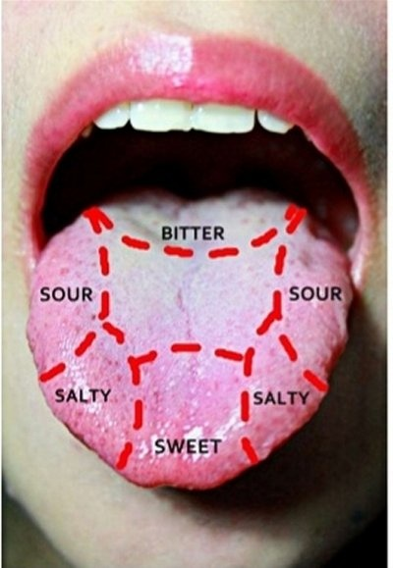
Theories
8
Taste Saltiness is a taste produced primarily by the presence of sodium ions. A sodium channel in the taste cell wall allows sodium cations to enter the cell.
Hence, the more the salt in water, the more sense of
Salinity
What is double bind?
Introduction
Theories
Experiments
Conclusion
IRAN Team

Slide 7
Experiments
11
For this experiment, I used some glasses, a scale and a graduated glass.
First, I pour 2 grams salt in 1 liter water,then I reduced the amount of salt to 1 gram, and I continue this with the other amount of salt.
Introduction
Theories
Experiments
Conclusion
IRAN Team

Slide 8
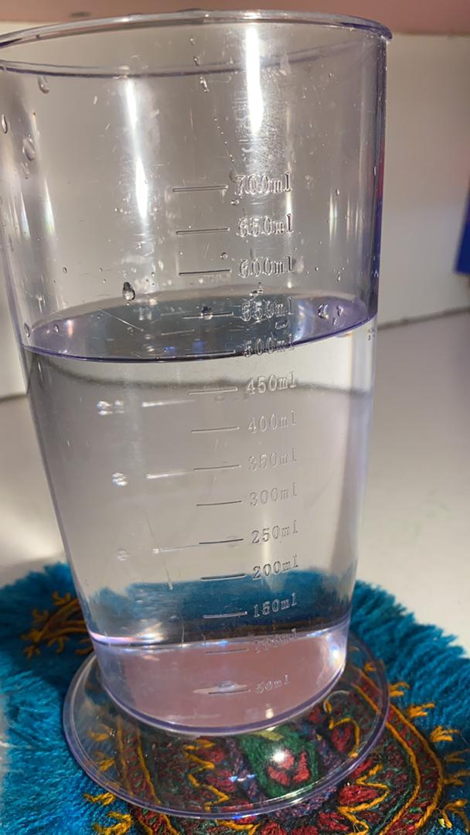
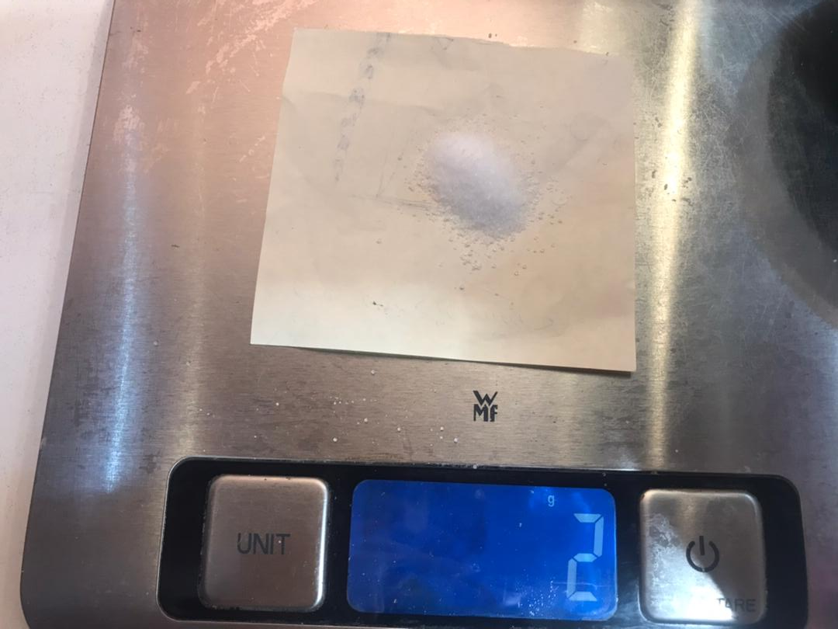
12
Introduction
Theories
Experiments
Conclusion
IRAN Team

Slide 9
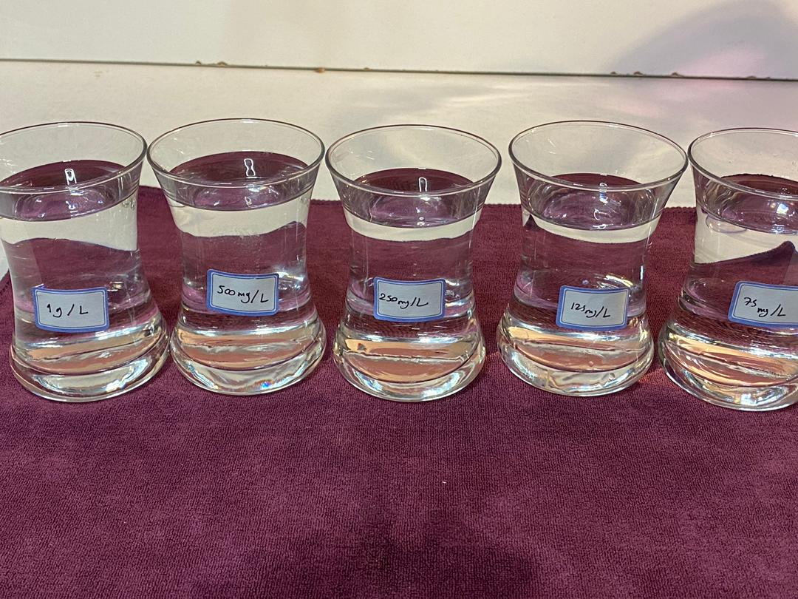
13
Introduction
Theories
Experiments
Conclusion
IRAN Team

Slide 10
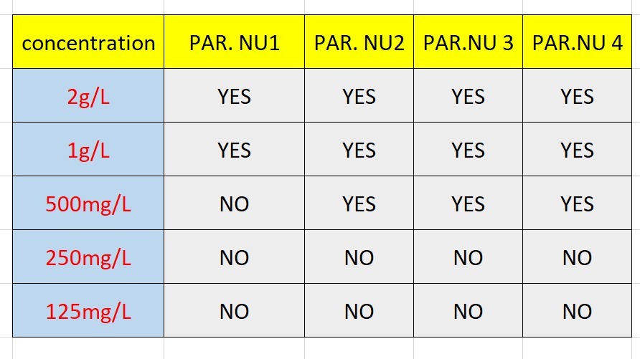
14
Lastly, 4 persons drunk from each glasses and here is the results:
Introduction
Theories
Experiments
Conclusion
IRAN Team

Slide 11
Conclusion
15
Somewhere between 500mg/L and 250mg/L is the range that people can feel the taste of salt.
According to EPA (Environmental protection agency in USA), In order to avoid adverse effects on taste, EPA recommends that sodium concentrations in drinking water not exceed 30 to 60 mg/L, a threshold for taste-sensitive segments of the population. Many individuals will not be able to detect the presence of sodium in this concentration range.
Introduction
Theories
Experiments
Conclusion
IRAN Team

Slide 12


https://www.horiba.com/en_en/water-quality/applications/water-wastewater/measuring-salinity-of-water/
https://www.scientificamerican.com/article/bring-science-home-taste-thresholds/
18
IRAN Team

Slide 13


IRAN Team
20

