Slide 1
9. Distances in open space
China
Zhu

Slide 2
Statement of problem 9
How do astronomers measure distances between the planets of the Solar System, between the stars in our Galaxy, or between the galaxies? Determine the distance between the two space objects of your choice.
Notes:
问了两个问题

Slide 3
between the planets of the Solar System
orbit of planets
Using laser(laser distance measuring)
Notes:
1Exact position of planets in solar system
2Scientist are not necessarily do it ,however,scietificly, it can be done

Slide 4
between the stars in our Galaxy
Trigonometric Parallax
period-luminosity relationship(Cepheid variable stars)
Notes:
Parallax arises due to change in viewpoint occurring due to motion of the observer, of the observed, or of both.

Slide 5
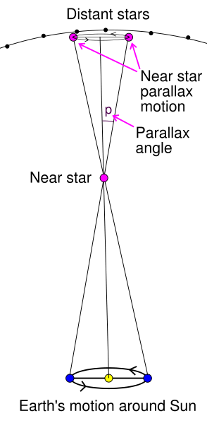
Trigonometric Parallax
Notes:
想测地球和near star 的距离
Charge-coupled Device

Slide 6
Period-luminosity relationship(Cepheid variable stars)
Empirical formula
population I star M = -1.80 - 1.741 lg P
population II star M=-0.35-1.74lgP
M=m+5－5 log d
Notes:
该方法可用于造父变星和在其周围的星
John Goodricke, Harlow Shapley basically they did lots of observation and found that the following formula hold for almost all of Cepheid variable stars.
P 表示 period of light variation
M：absolute magnitude
m：apparent magnitude

Slide 7
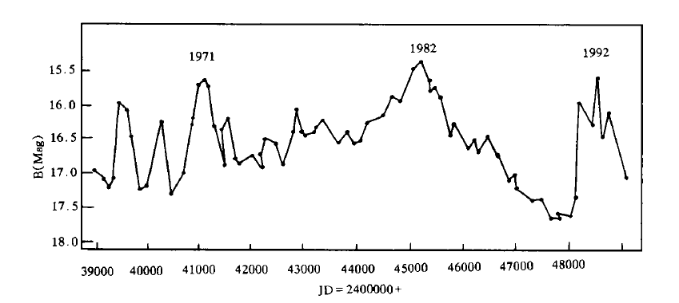

Slide 8
=0.5*0.5^4*(COMBIN(5,A3-1)-2*COMBIN(3,A3-2))+0.5*(0.75*COMBIN(2,A3-3)*0.5^2+0.25*COMBIN(2,A3-2)*0.5^2)
25 7 3
=(49/2^31)*(COMBIN(25,A4-1)-COMBIN(6,2)*COMBIN(19,A4-4))+(15/2^24)*(0.75*COMBIN(18,A4-4)+0.25*COMBIN(18,A4-3))
5 3 2

Slide 9
between the galaxies
period-luminosity relationship(Cepheid variable stars)
Redshifts in spectral lines

Slide 10
三角视差 (distant stars 不动 测star关于distant stars的移动 )
造父变星
超新星？
谱线红移

Slide 11
本底（无光ccd有计数） （曝光0秒 减）
暗流 （加电时间长，噪声）
平场
搜索（暗流 ccd ）豆丁网

Slide 12
Determine the distance between the two space objects of your choice.

Slide 13
two space objects
The Sun and APM 08279+5255

Slide 14
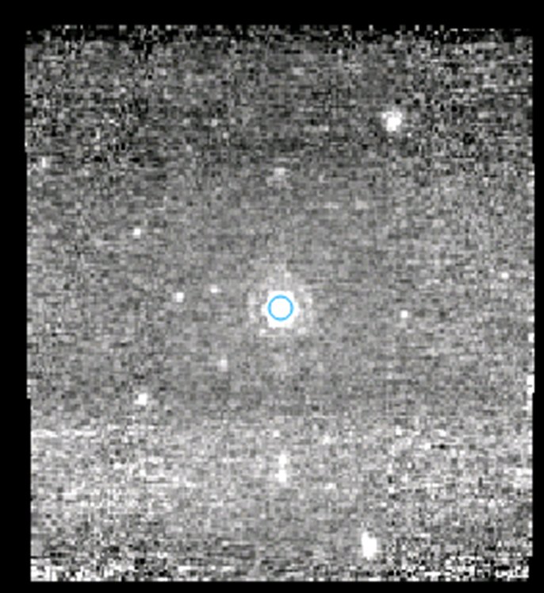
APM 08279+5255
Quasar
Lynx (constellation)
One of the most luminous object in the universe
Notes:
Use the quasar to represent apm 08279+5255

Slide 15
Theory
The distance between the sun and APM 08279+5255 → The distance between the earth and APM 08279+5255
Redshift of spectral line
Expansion of the space
Doppler effect
Hubble’s Law
another empirical formula
Z = H*d /c (Z=(l-$l_{\begin{aligned}0 \\ \end{aligned}}$)/ $l_{\begin{aligned}0 \\ \end{aligned}},$H=74.3±2.1(km/s)/Mpc)
Notes:
Expansion of space the quasar is running away from the earth which leads to Doppler effect and therefore the redshift of spectral lines
H：hubble constant
Z redshift
C speed of light in vaccum
L observed wavelength
Lo rest wavelength
Parsec

Slide 16
Collection of datas
spitzer space telescope
an infrared space observatory
NASA
Notes:
Nanjing 天气不好 air pollution can hardly collect useful data
The Spitzer Space Telescope is an infrared space observatory launched 12 years ago. It is the fourth and final of the NASA Great Observatories program.
credible

Slide 17
Download and Extract data (Spice)

Slide 18
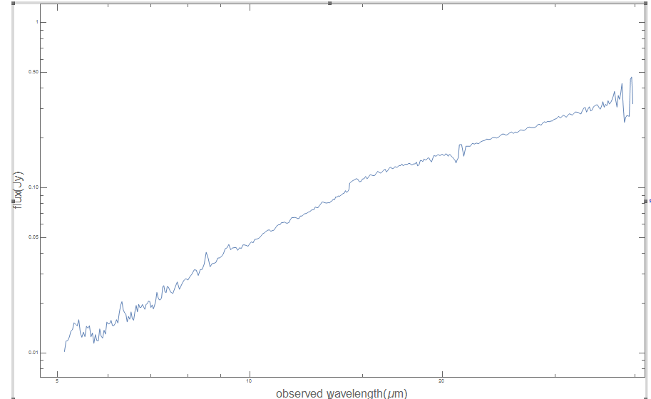
Plot (mathematica)
Notes:
Take the log for both x and y axis
Based on the paper written by B.T.Soifer
I can say that The only spectral features detected are emission lines at
wavelengths of 6.30 and 9.26 m. These features correspond
to the redshifte hydrogen recombination lines Pa
and Pa, respectively,

Slide 19
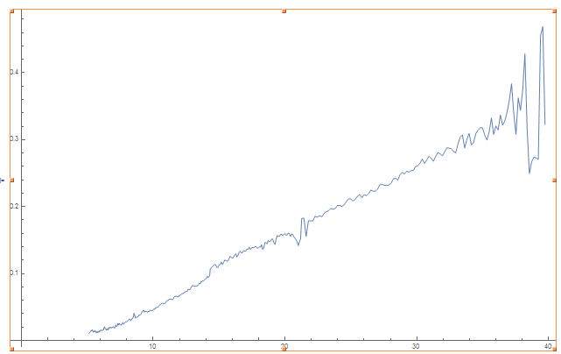

Slide 20
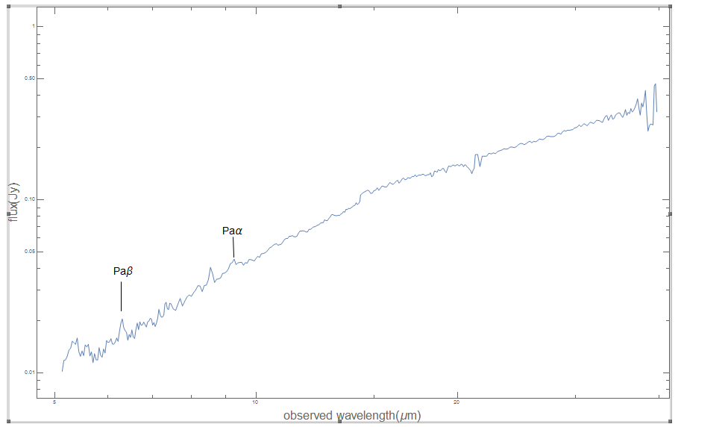
Plot (mathematica)

Slide 21
Observed wavelength
Observed wavelength of Paα:9.26 μm
Observed wavelength of Paβ:6.30 μm

Slide 22
Rest wavelength
Rest wavelength of Paα:1.85 μm
Rest wavelength of Paβ:1.18μm
Notes:
NIST national Institute of Standards and Technology

Slide 23
Z=4.01(paα)
Z=4.34 (paβ)
Average and Bringing it into the Hubble’s law
Average of Z=4.18
D=16.88gpc
Notes:
Theoretically they should be the same

Slide 24
Error analysis
Hubble constant
Interference of other space object
Limits of spitzer

Slide 25
Reference documentation
[1] B. T. Soifer, V. Charmandari. SPITZER INFRARED SPECTROGRAPH (IRS) OBSERVATIONS OF THE REDSHIFT 3.91 QUASAR APM 08279+5255[J]. The Astrophysical Journal Supplement Series，2004 September：151–154
[2] Dondervogel 2．Stellar parallax[G]．https://en.wikipedia.org/wiki/Stellar_parallax,2015/,6.15
[3] Drbogdan．Redshift[G]．https://en.wikipedia.org/wiki/Redshift,2015/,6.15
[4] KasparBot. Cepheid variable[G]．https://en.wikipedia.org/wiki/Cepheid variable,2015/,6.15

