Slide 1
Problem #3
Invent Yourself: chemistry of potatoes
Reporter: Gvantsa Tsutskhashvili
Team: Georgians

Slide 2
About Problem
Different people have different taste.Some of them like fried potato others boiled potato.We have to investigate which way of cooking is healthier?

Slide 3
Plan
Essential nutrients
Potato tuber
Vitamins in potato tuber
Experiments
Fried and boiled potato
Conclusion

Slide 4
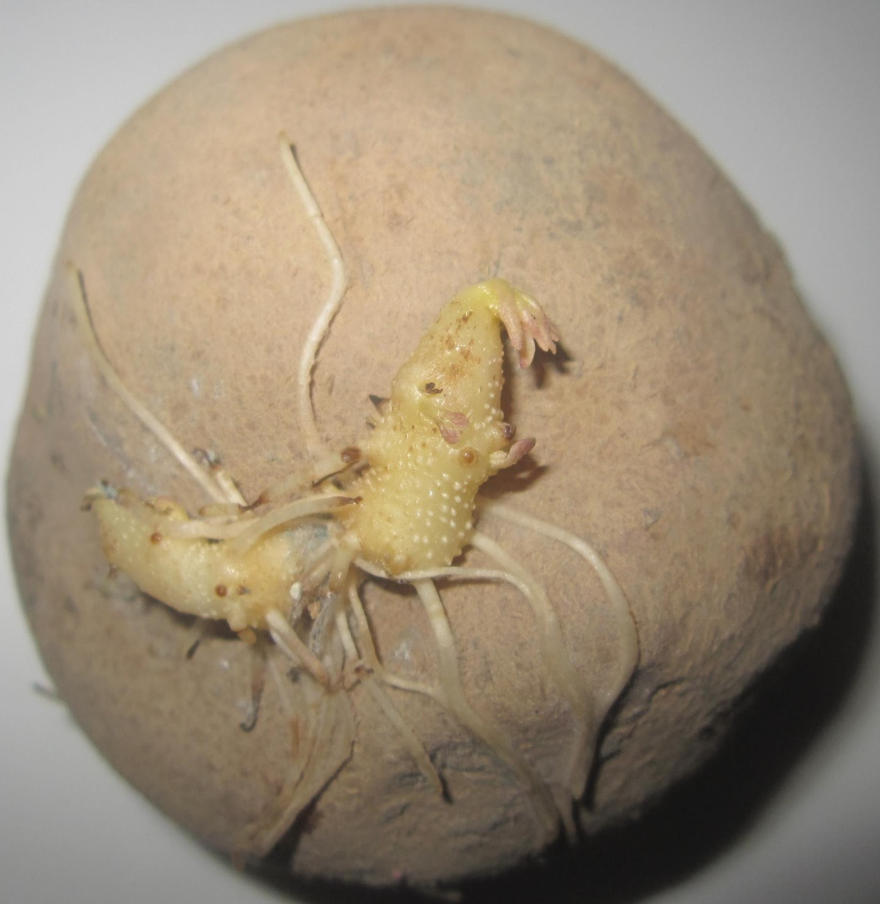
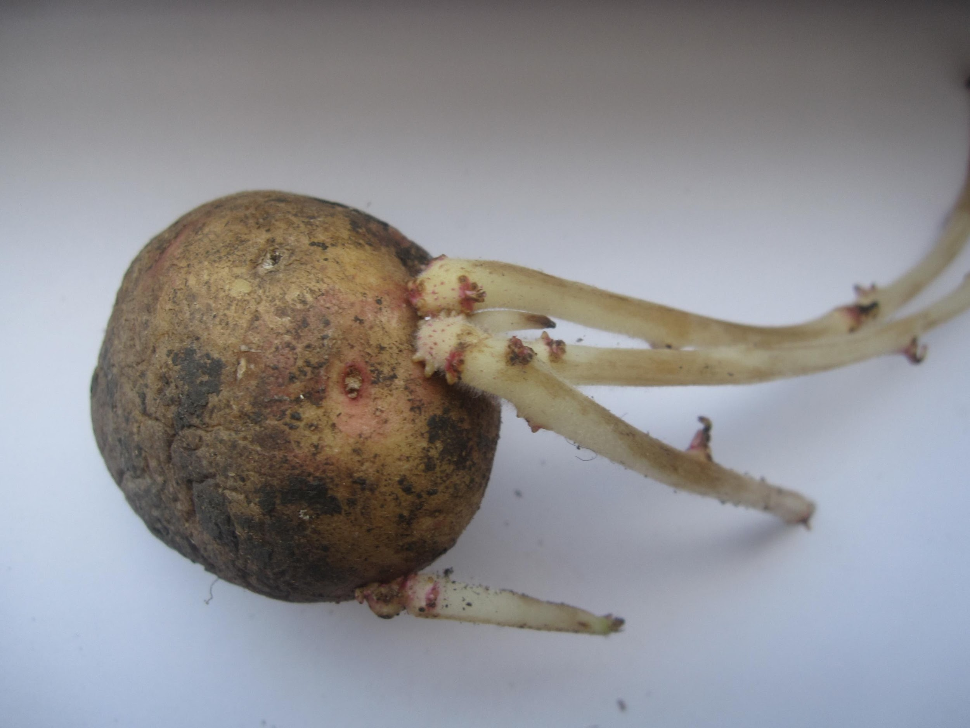
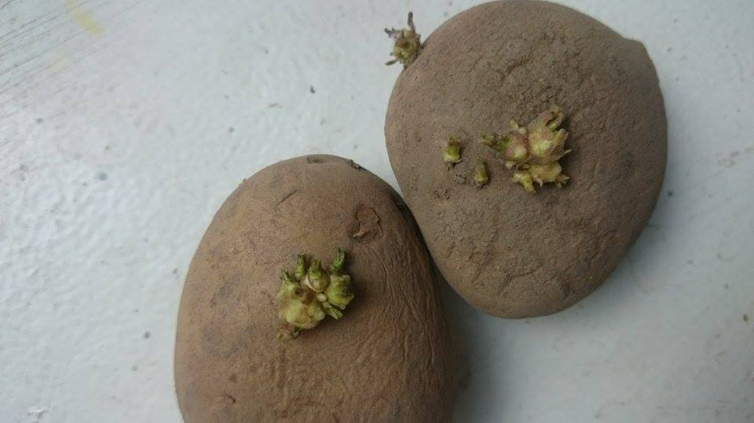
Potato tuber on the sun

Slide 5
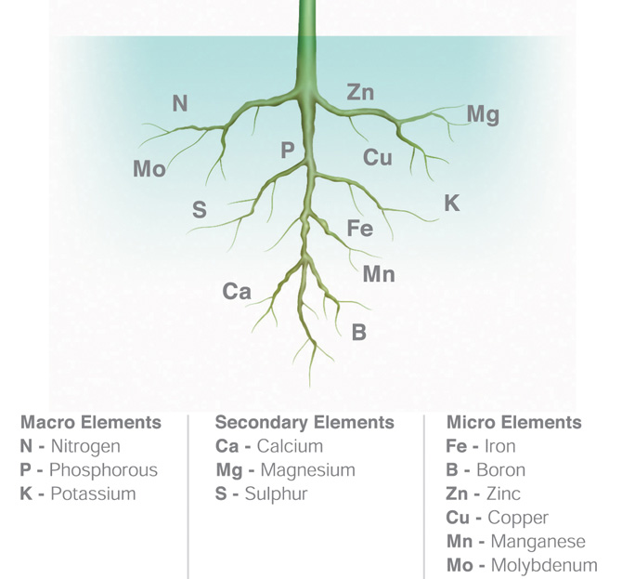
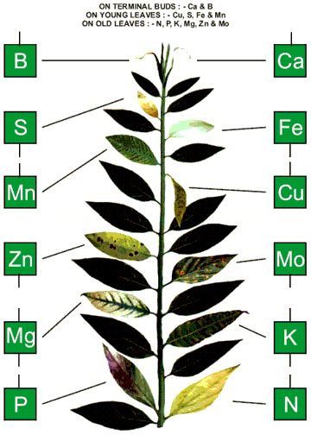
Essential nutrients

Slide 6
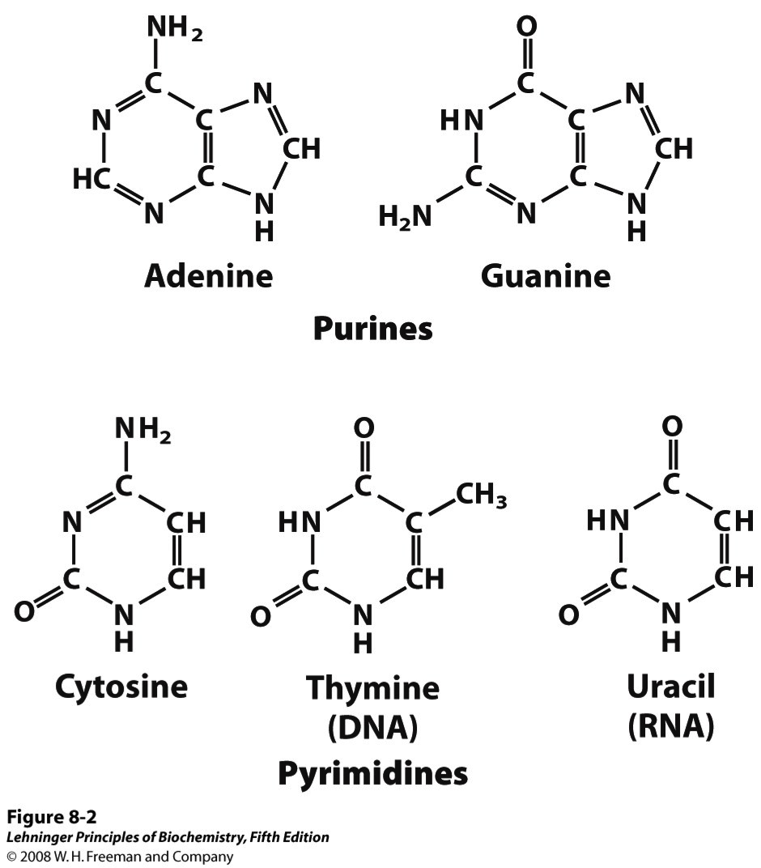
C,N,O,H,P
Carbon
Oxygen
Hydrogen
Nitrogen
Phosphorus

Slide 7
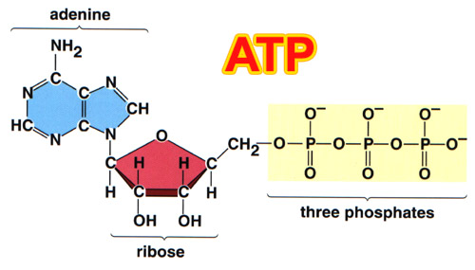
P-phosphorus

Slide 8
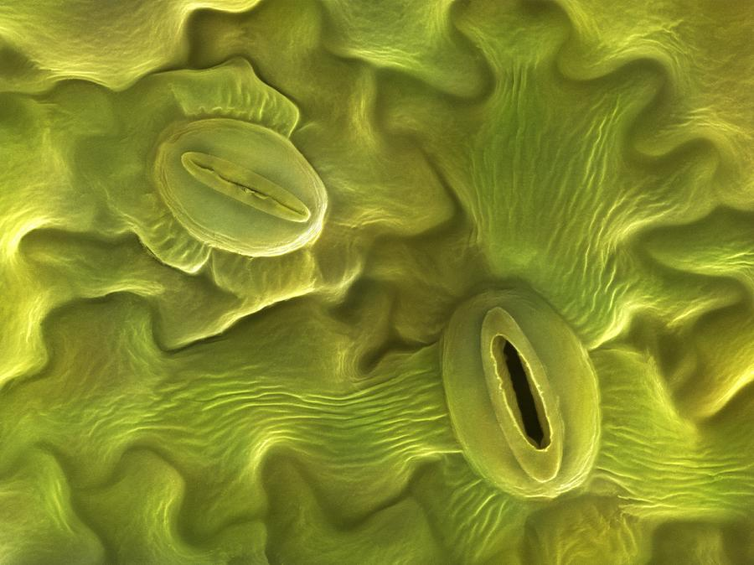
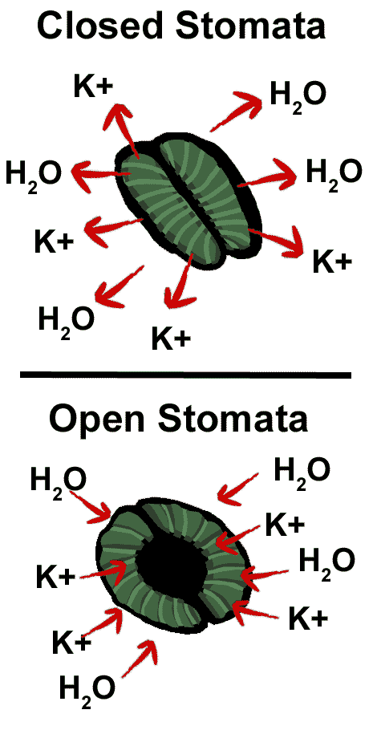
K-potassium

Slide 9
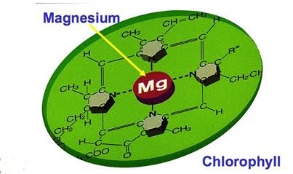
Mg-magnesium

Slide 10
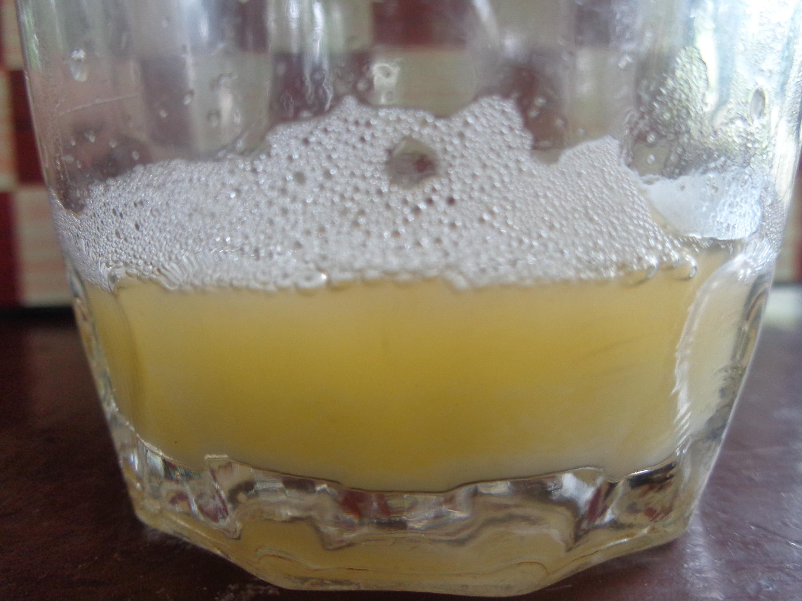
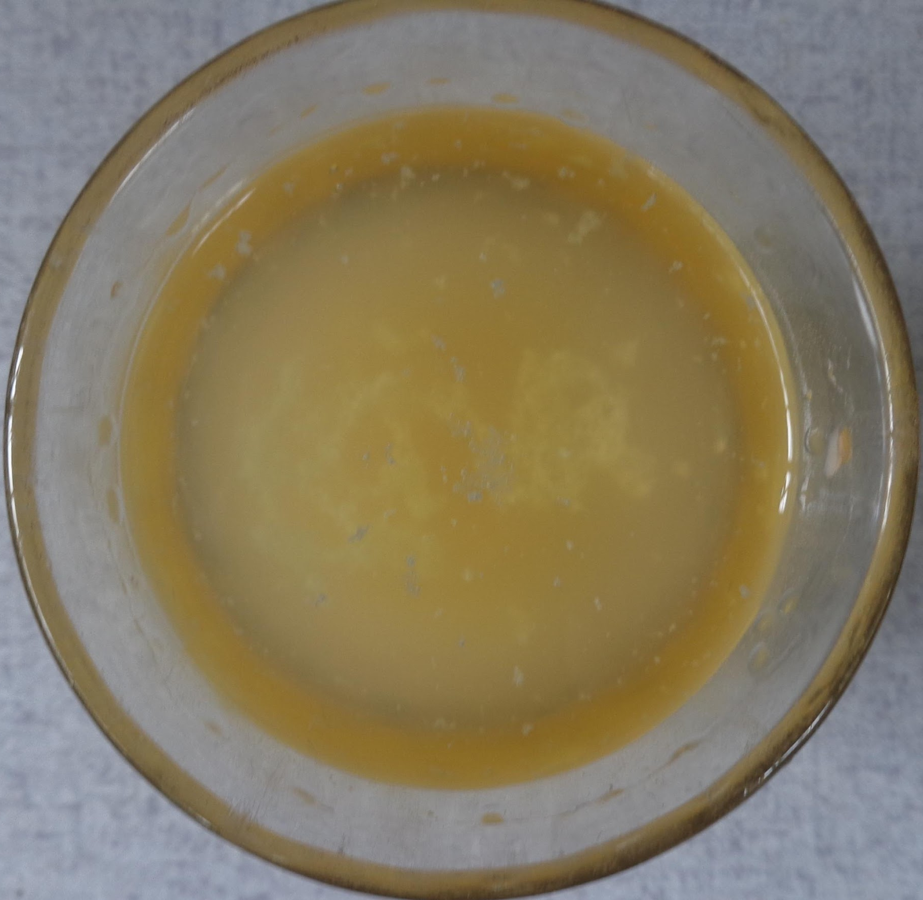
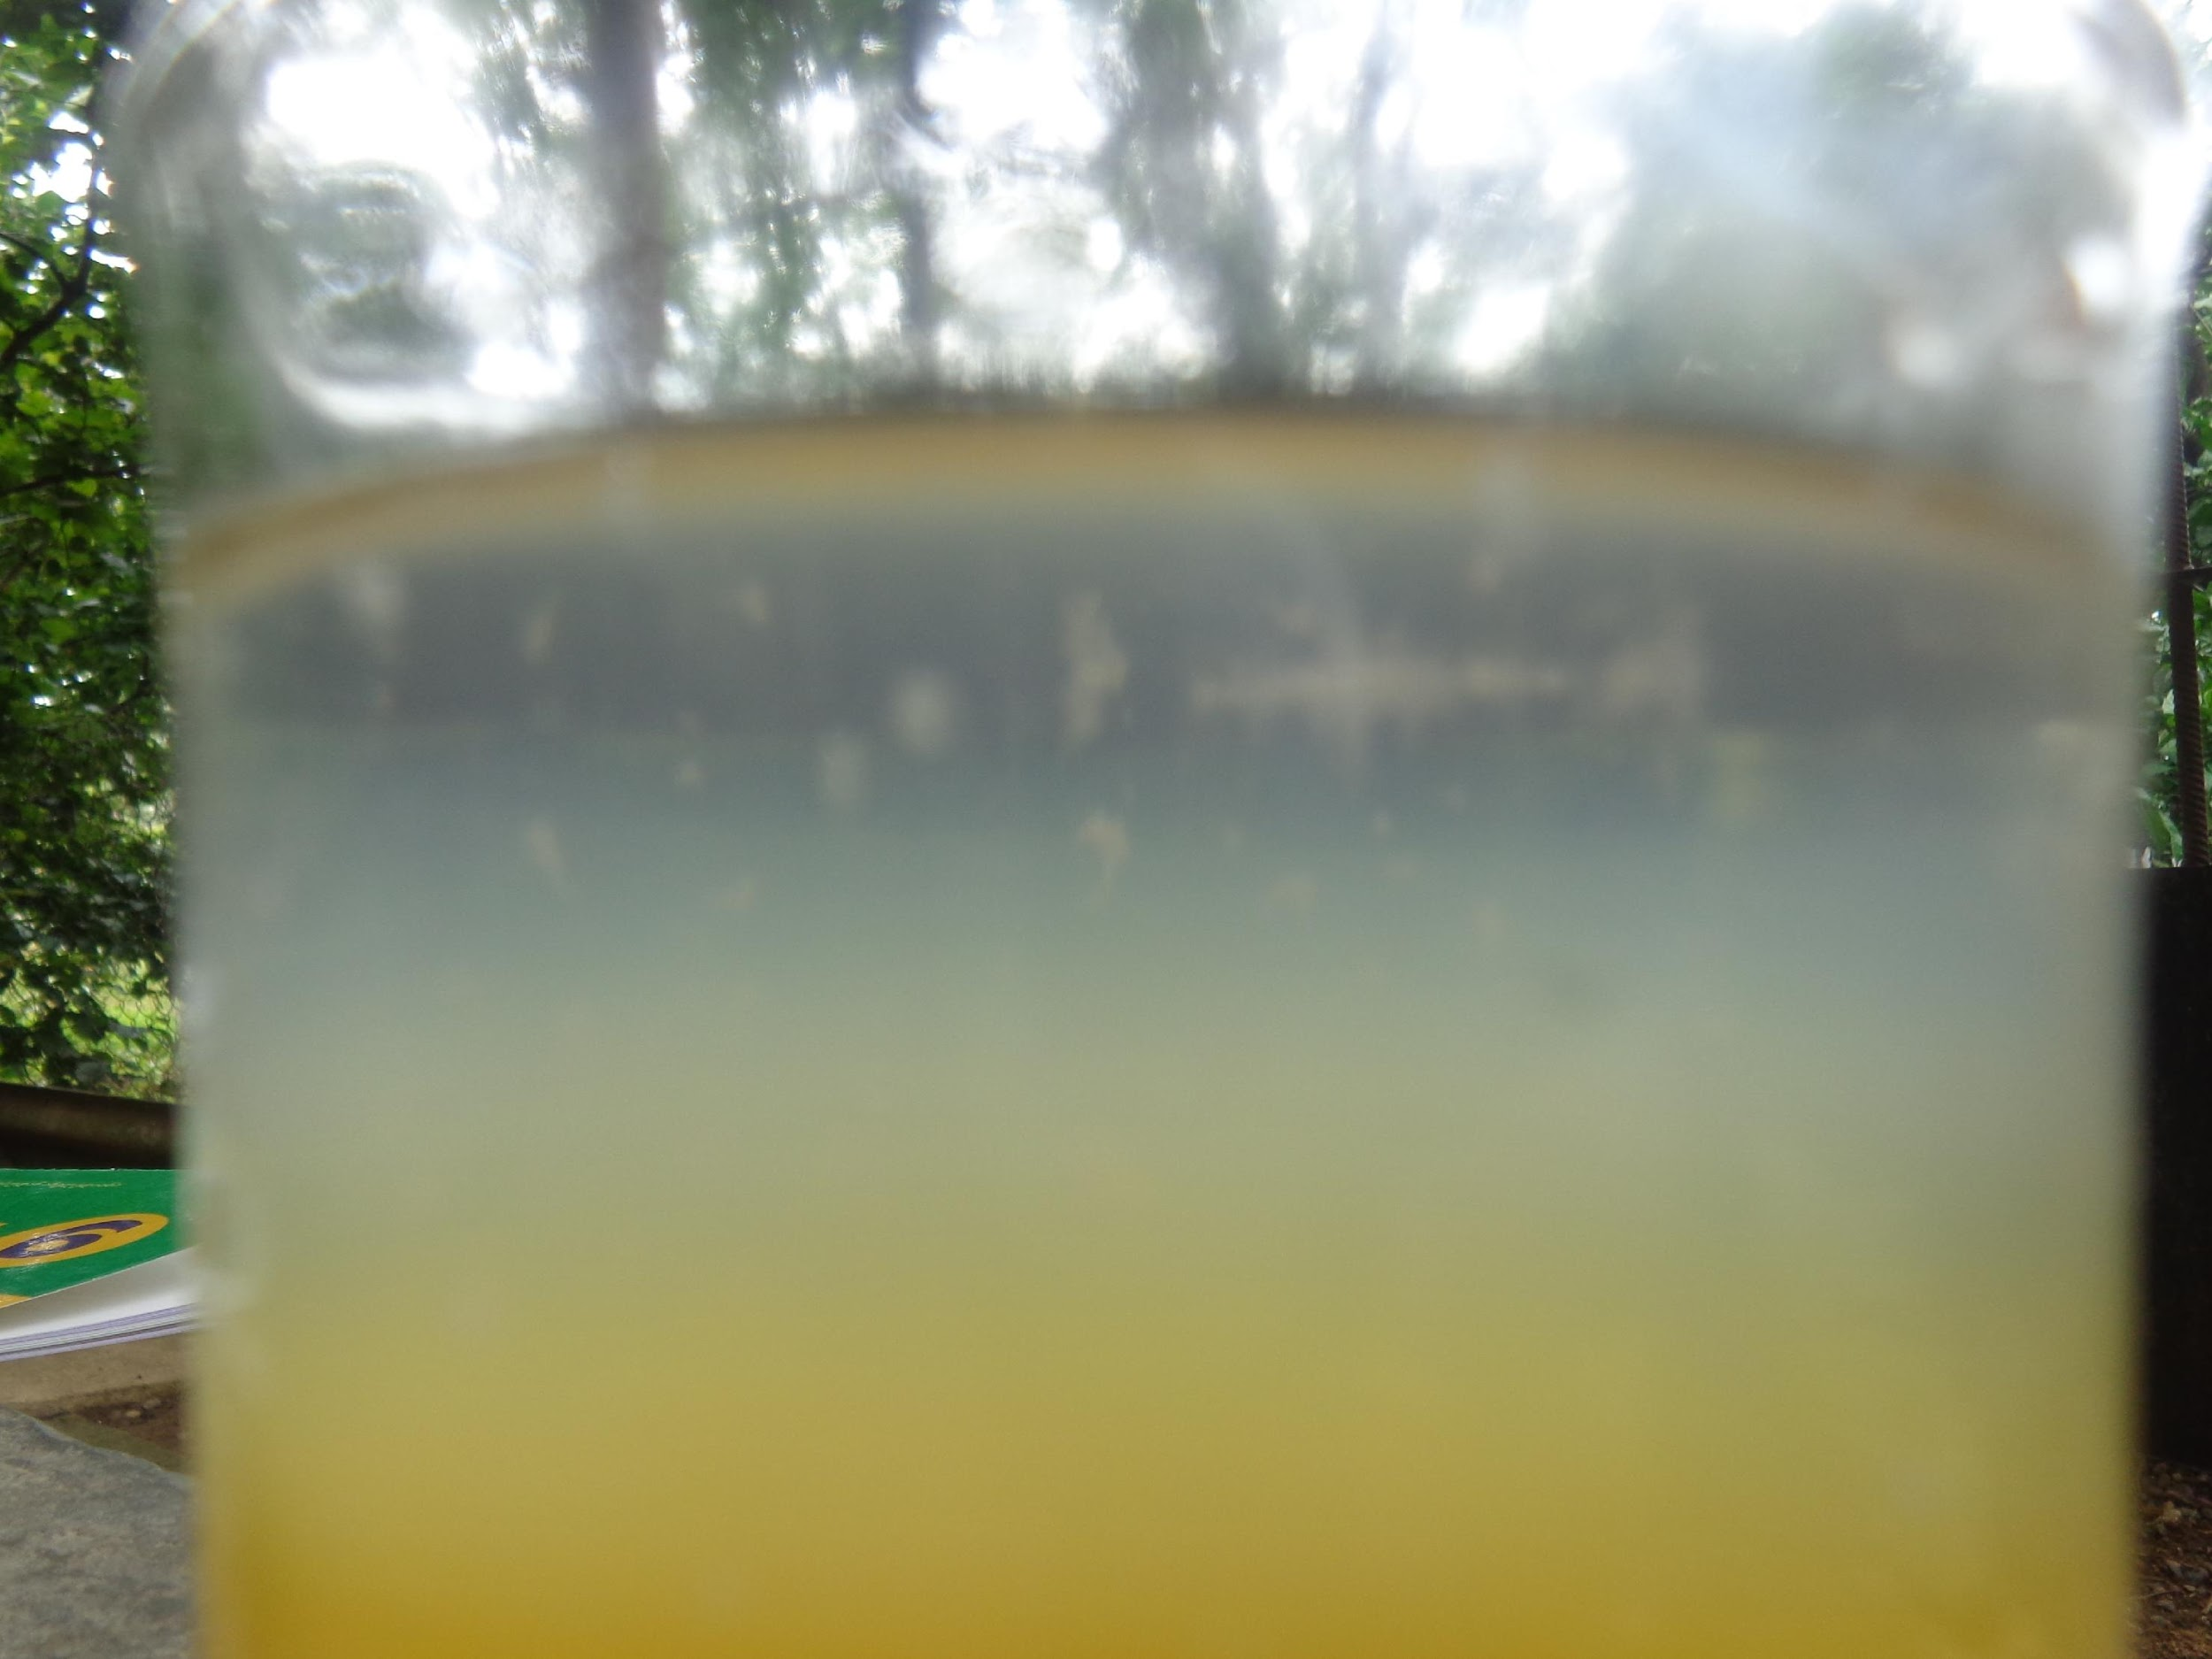
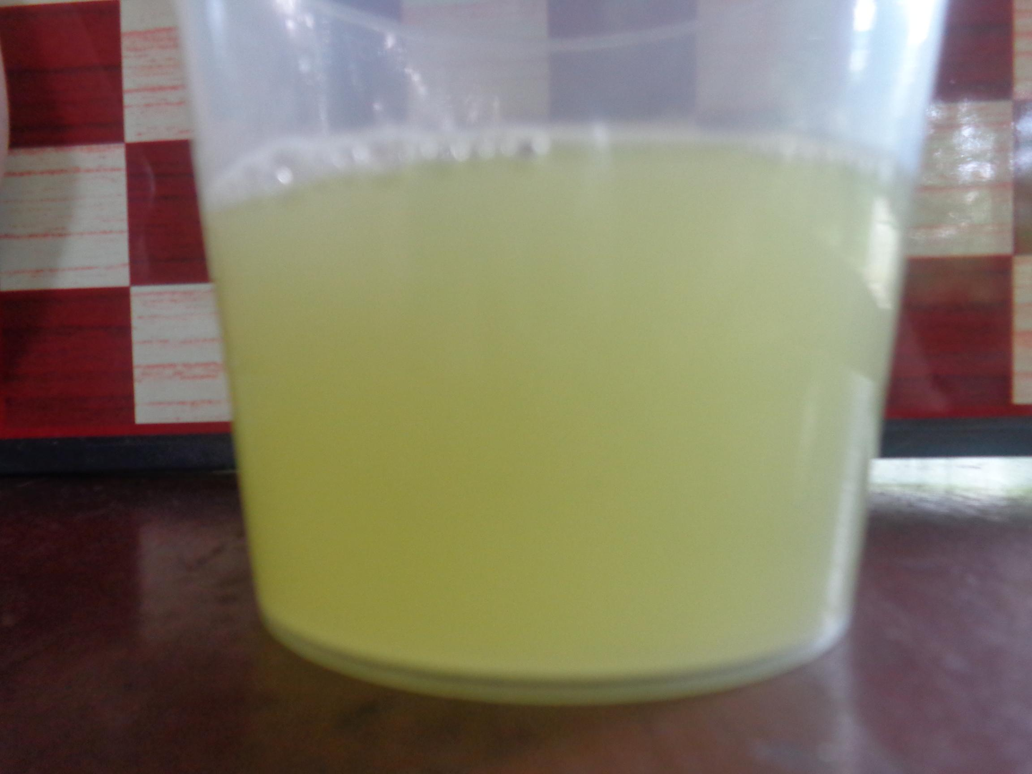
DNA in potato

Slide 11
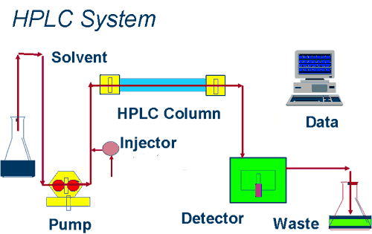
Vitamins

Slide 12
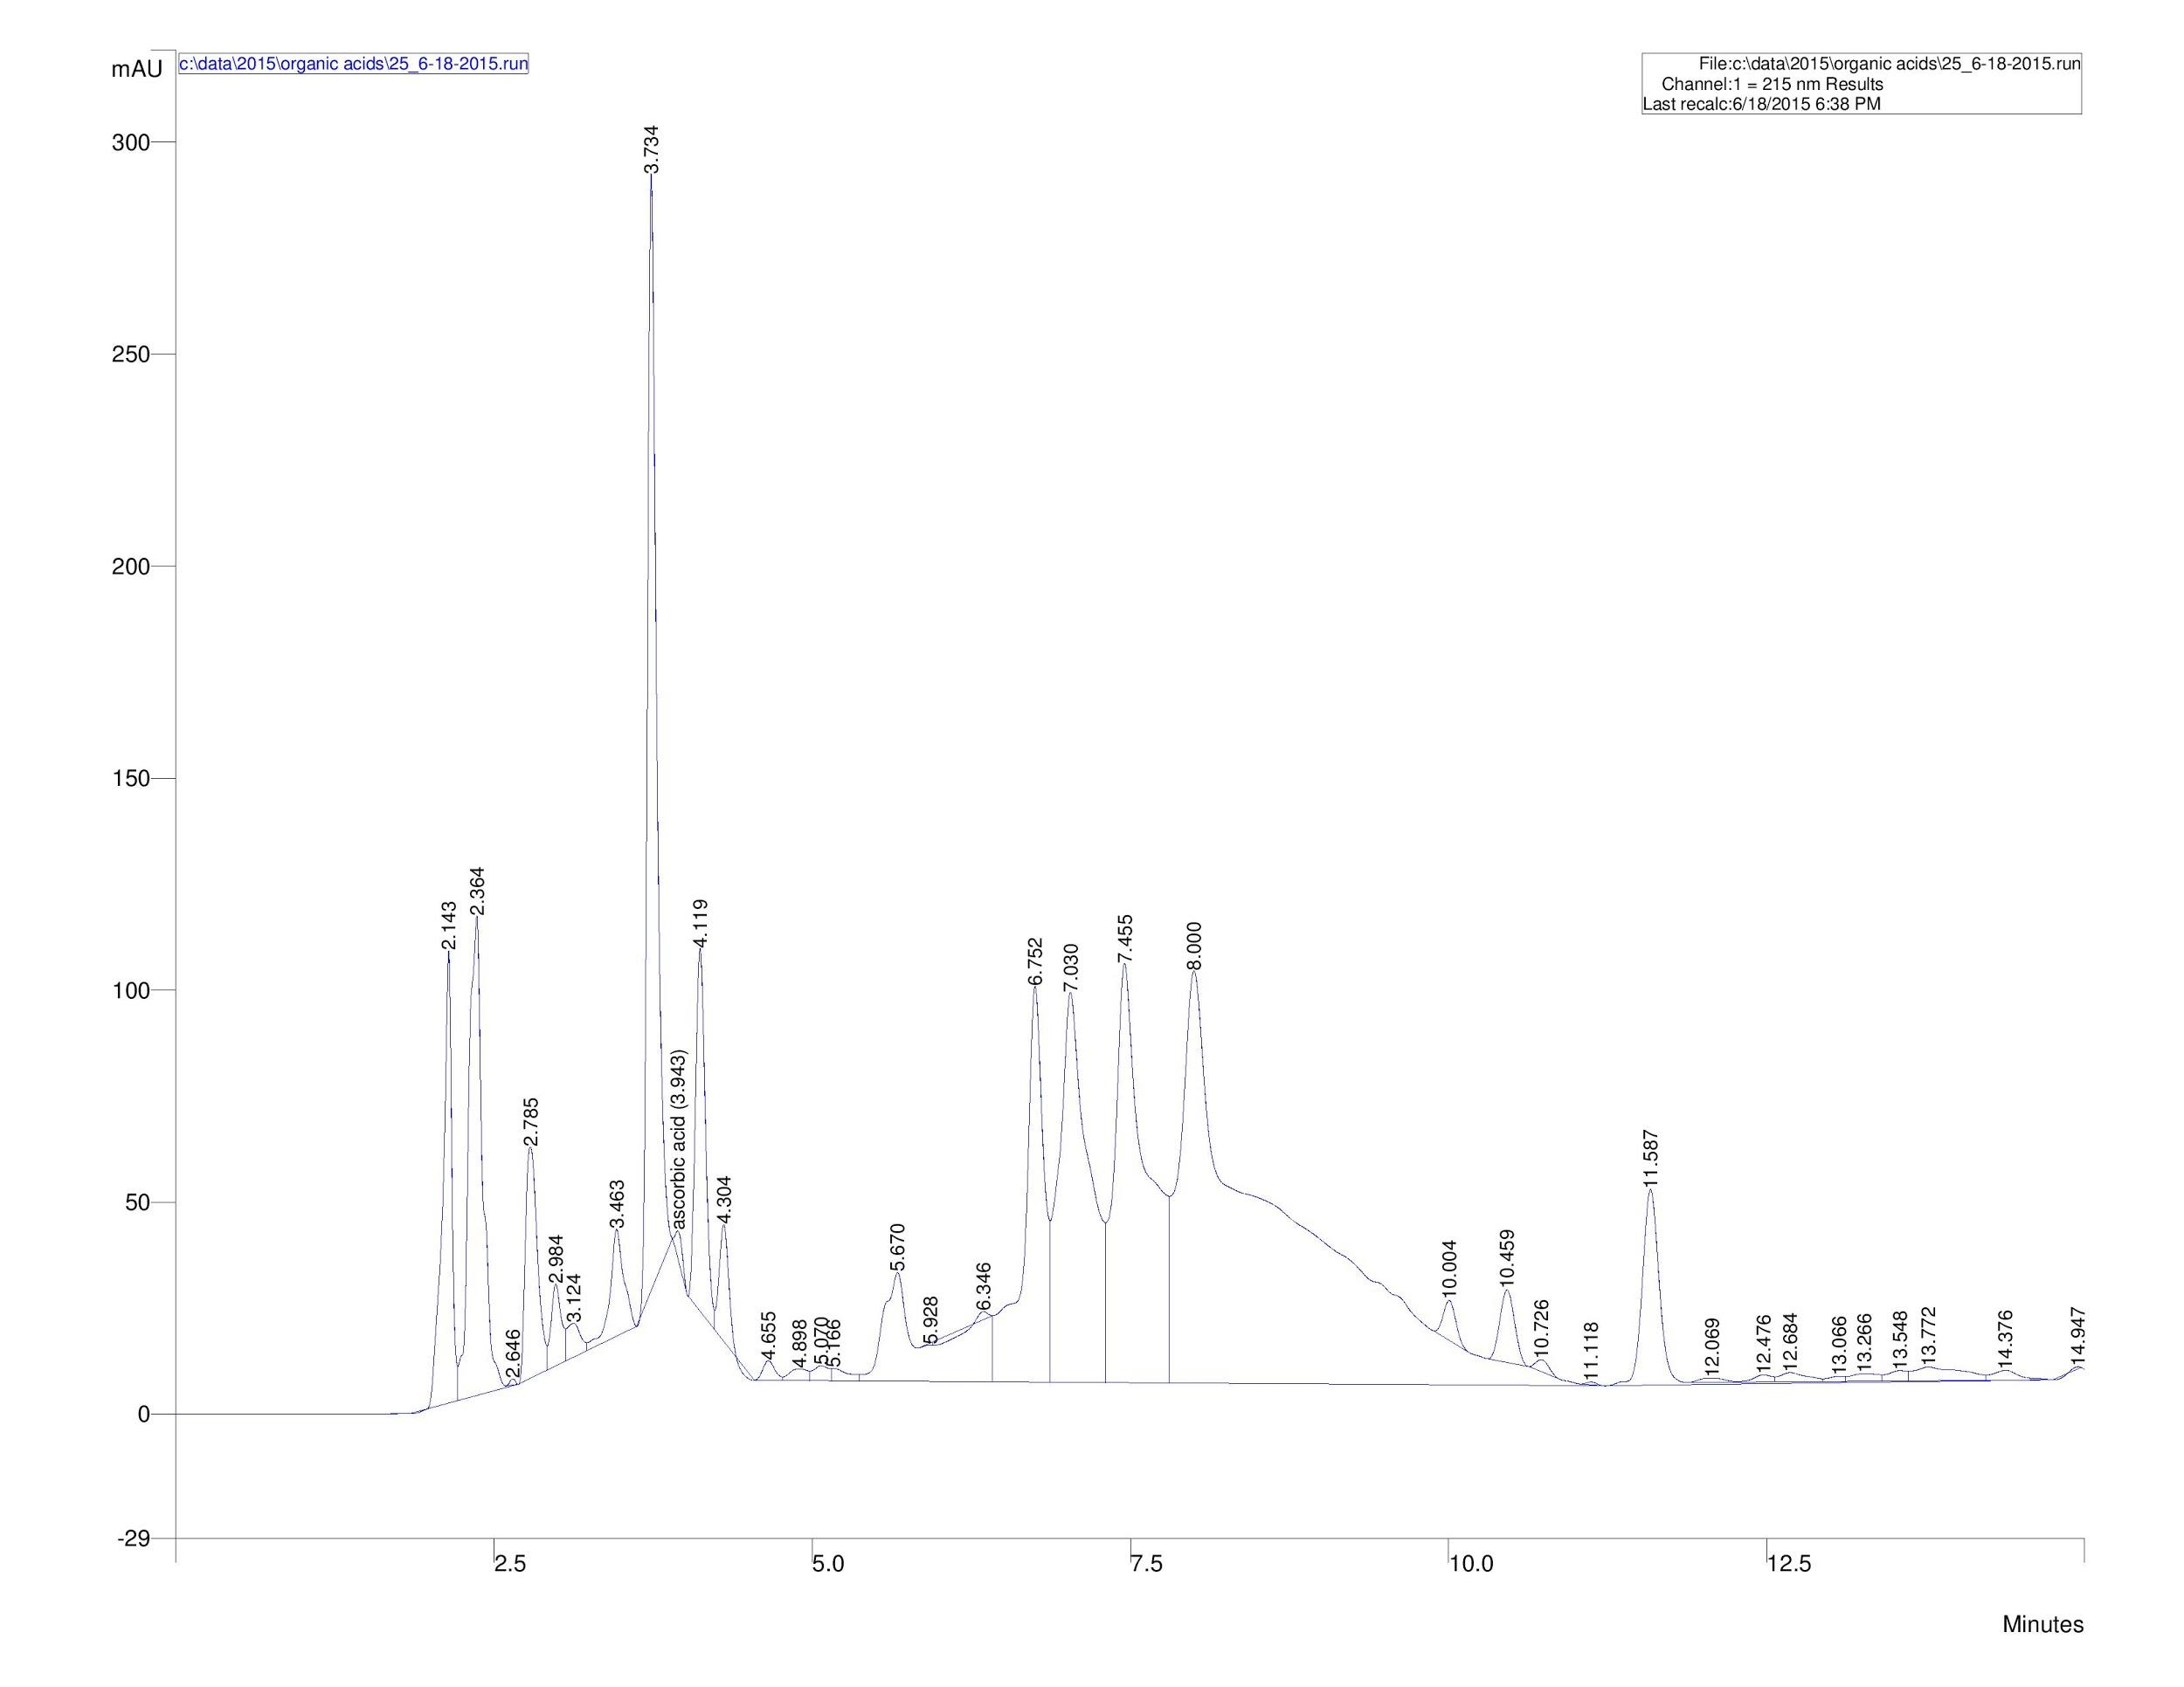
Potatoes boiled during 20 minutes
Mass of vitamins per minute (mg/min)
Time (min)

Slide 13
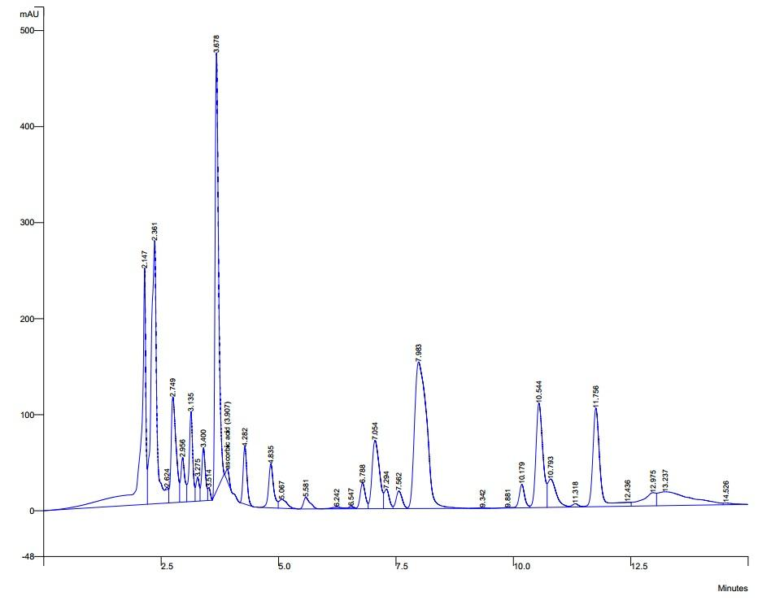
Measuring vitamin C
Potato juice
Potato juice plus vitamin C
Mass of vitamins per minute (mg/min)
Mass of vitamins per minute (mg/min)
Time (min)
Time (min)

Slide 14
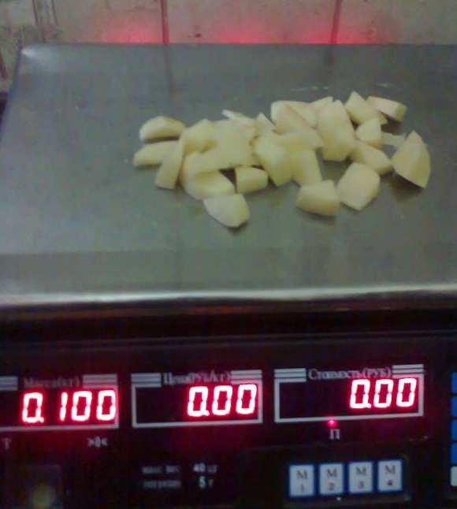
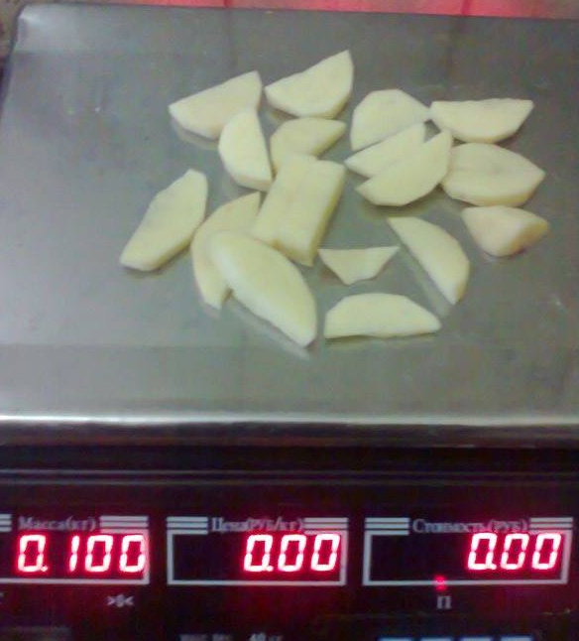
Experiments

Slide 15
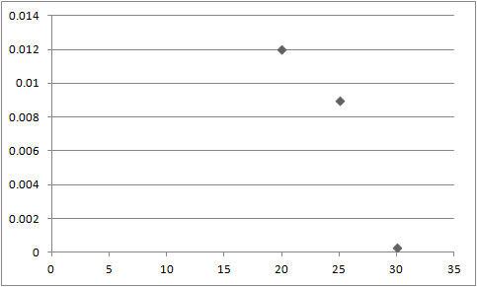
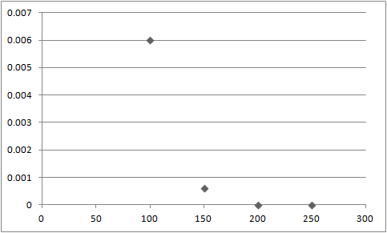
Concentration of vitamin C
Boiled potato
Fried potato
Concentration (g/cm³)
Concentration (g/cm³)
Time (min)
Temperature (ºC)

Slide 16
Conclusion
We prove that some important nutrients(O,H,P,N,C,Mg,K) are in potato tuber
We discover DNA in potato
We discover quantities of vitamins in potato tuber(B1,B2,B3,B6,B9,C)
We investigate which way of cooking preserve more amount of vitamins and conclude that boiled potato is better than fried potato.

Slide 17
References
Campbell, Neil A, and Jane B Reece. Biology. San Francisco: Pearson Benjamin Cummings, 2008. Print. Mauseth, James D. Botany An Introduction to Plant Biology. Sadbury: Jones and Barlett Publishers, 2009. Print.
Mauseth, James D. (2012), Botany : An Introduction to Plant Biology (5th ed.), Sudbury, MA: Jones and Bartlett Learning, ISBN 978-1-4496-6580-7, p. 672
Russell, Peter (2001). iGenetics. New York: Benjamin Cummings.
Bouwkamp, J.C. 1985. Production requirements. In: Bouwkamp, J.C. (ed), Sweet Potato Products: A Natural Resource for the Tropics. CRC Press, Boca Raton, Florida. pp 9-33.
http://www.waters.com/waters/ru_RU/How-Does-High-Performance-Liquid-Chromatography-Work%3F/nav.htm?cid=10049055

Slide 18
Thanks for your
attention

Slide 19
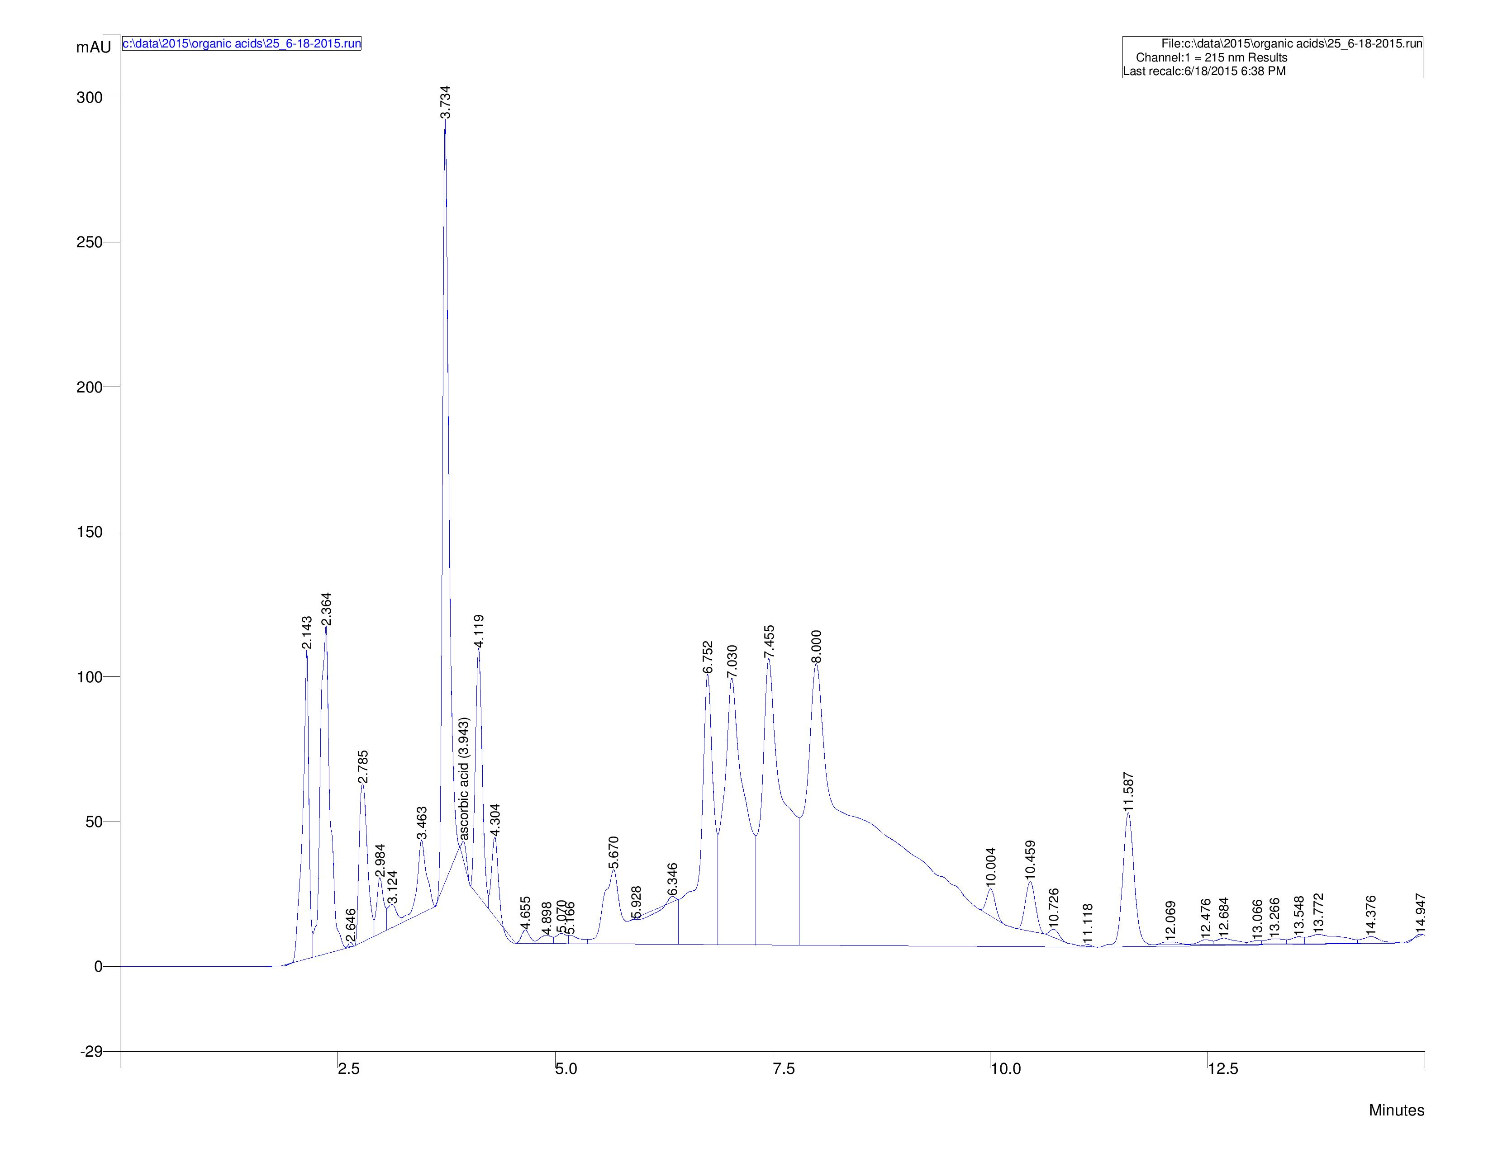
Boiled potato during 20 minutes

Slide 20
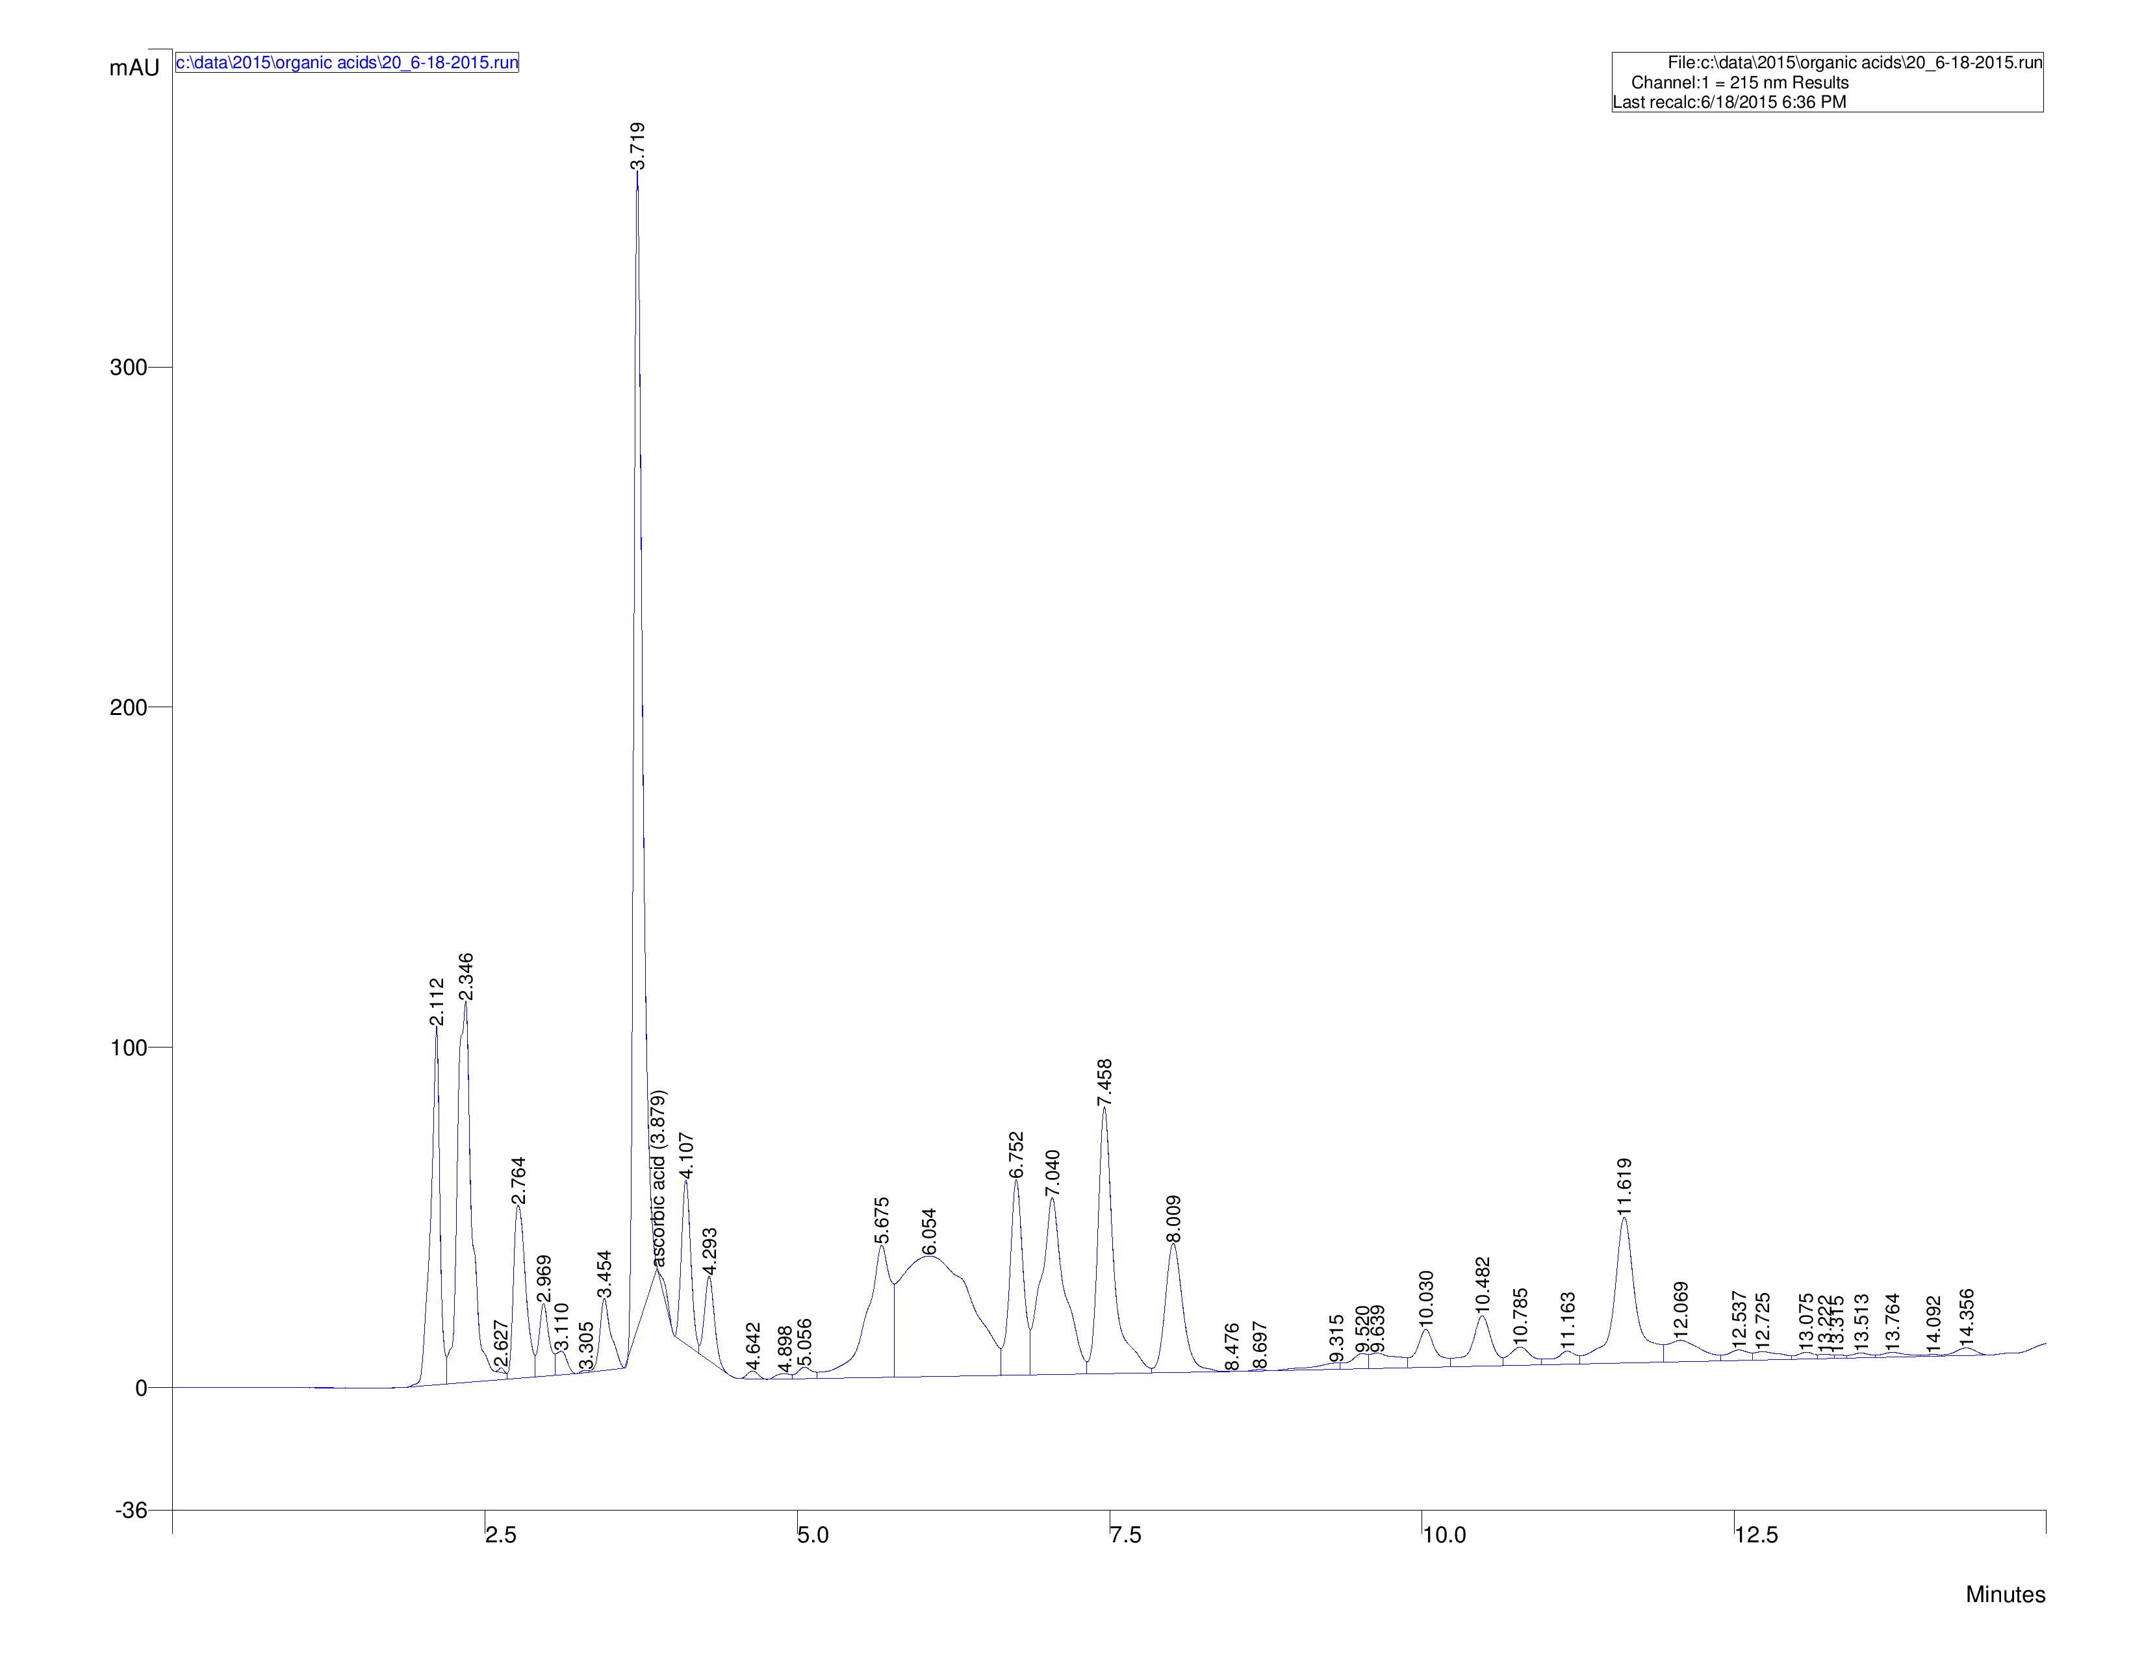
Boiled potato during 25 minutes

Slide 21
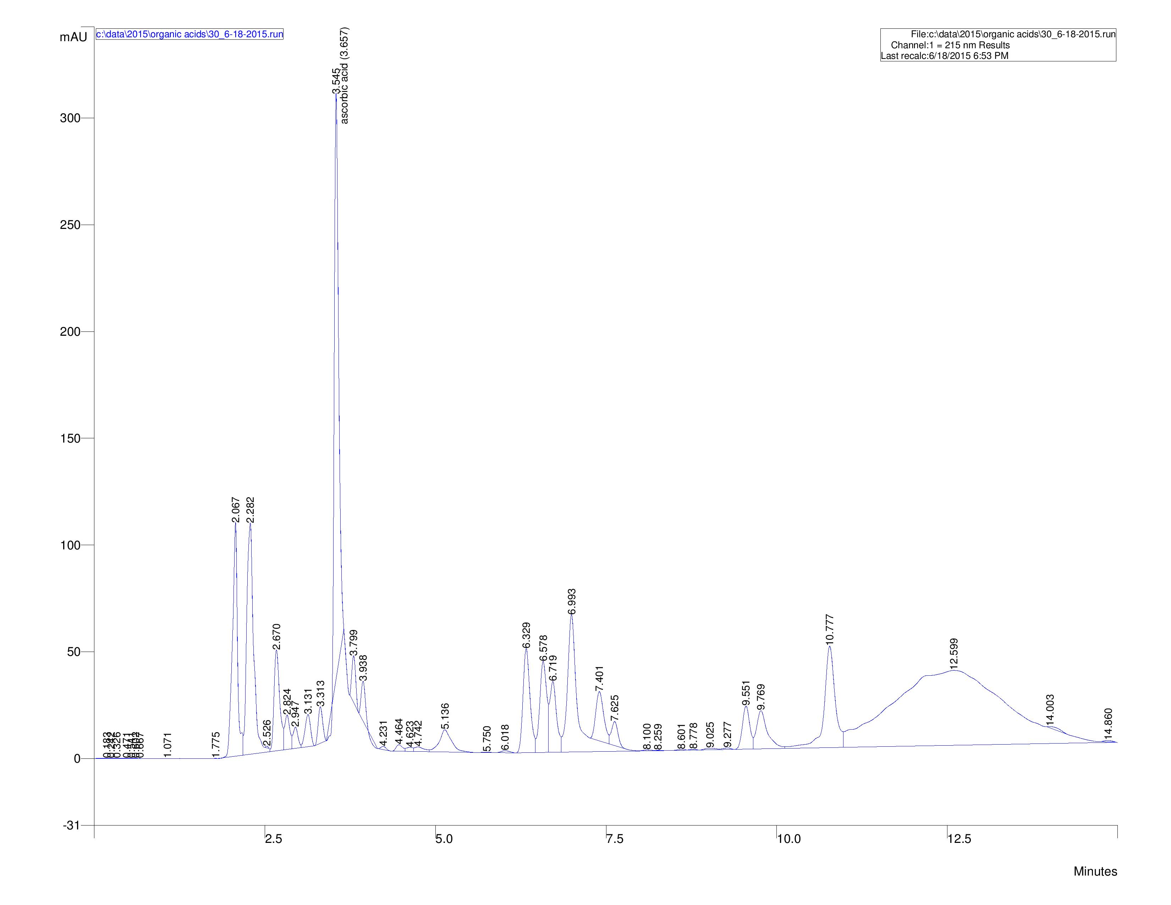
Boiled potato during 30 minutes

Slide 22
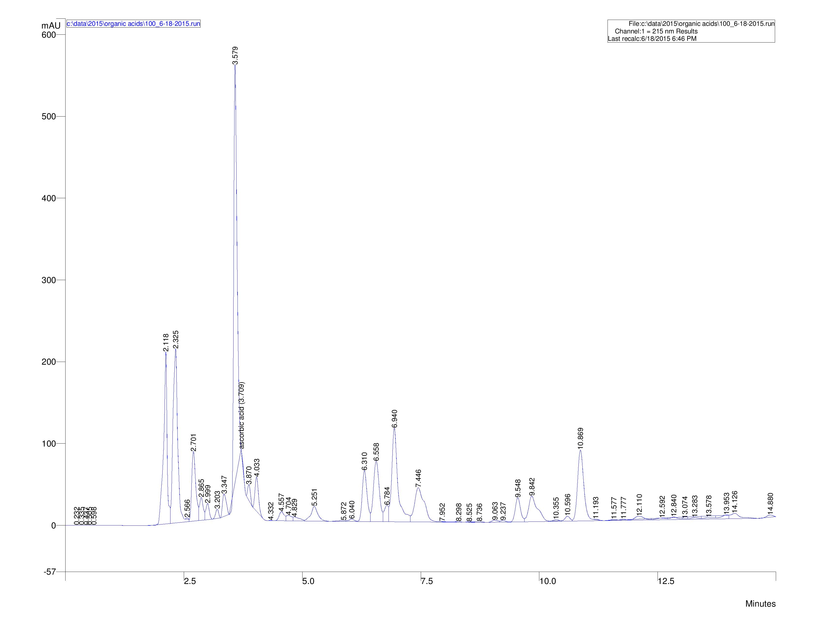
Fried potato on the 100 degree

Slide 23
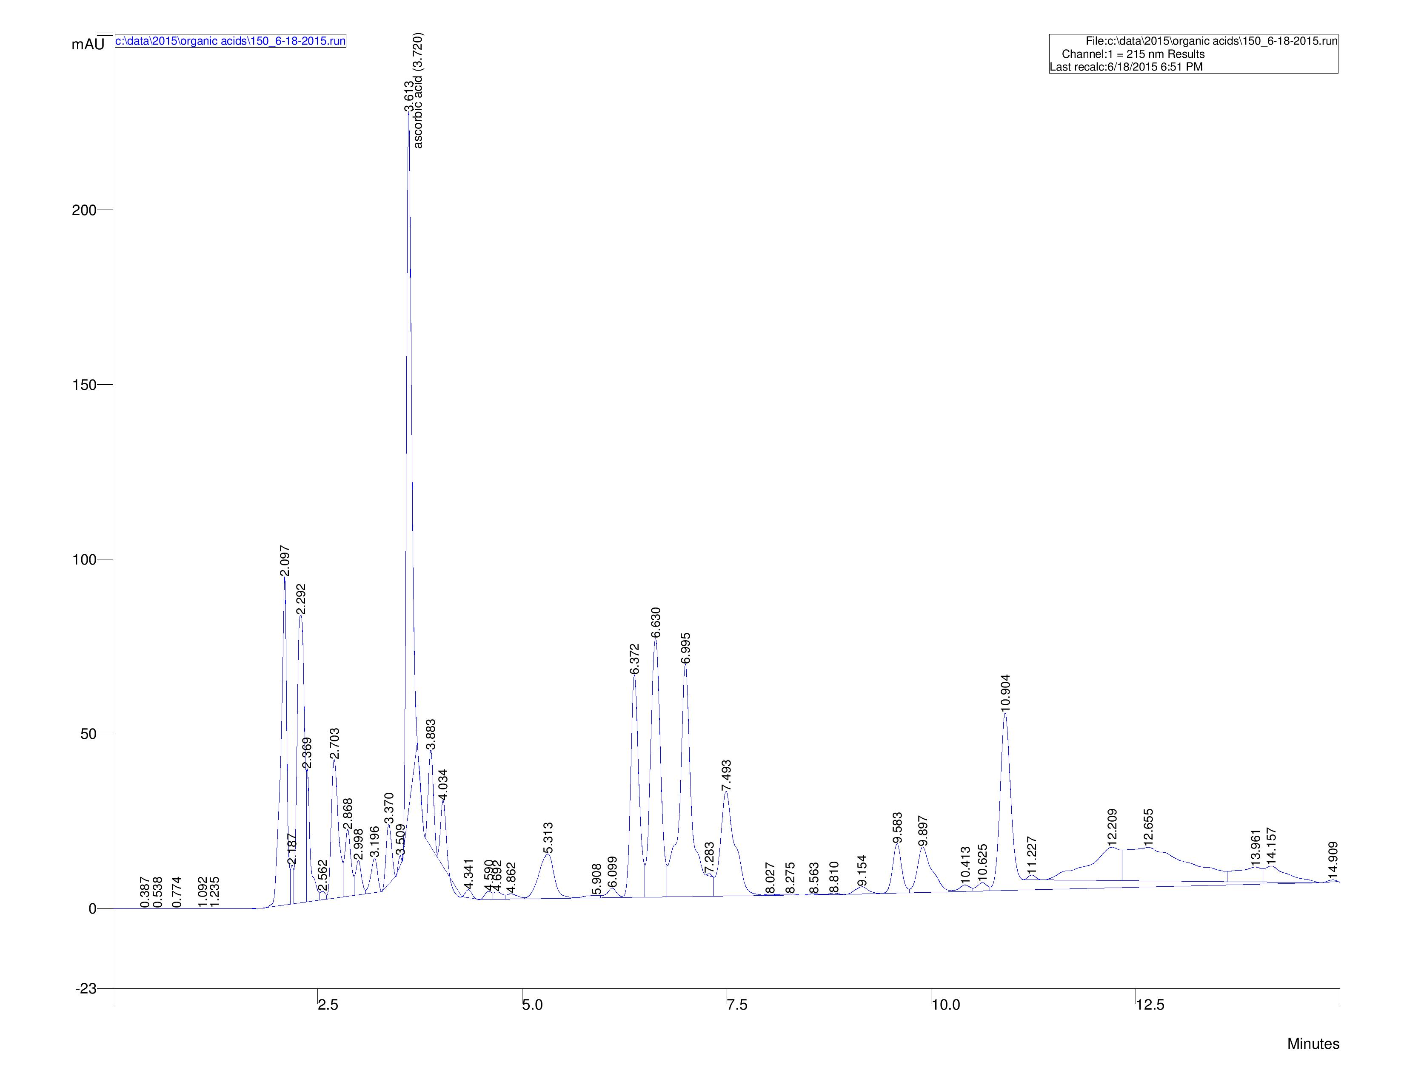
Fried potato on the 150 degree

Slide 24
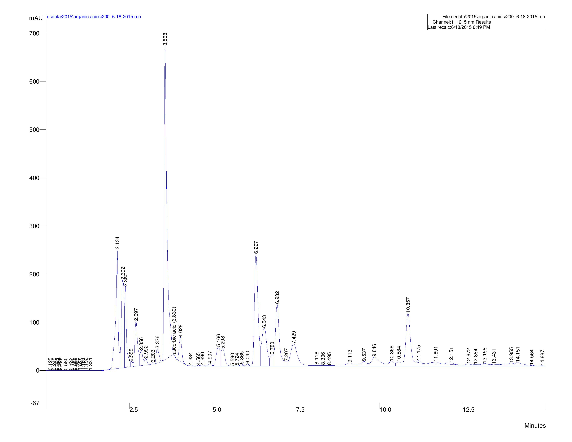
Fried potato on the 200 degree

Slide 25
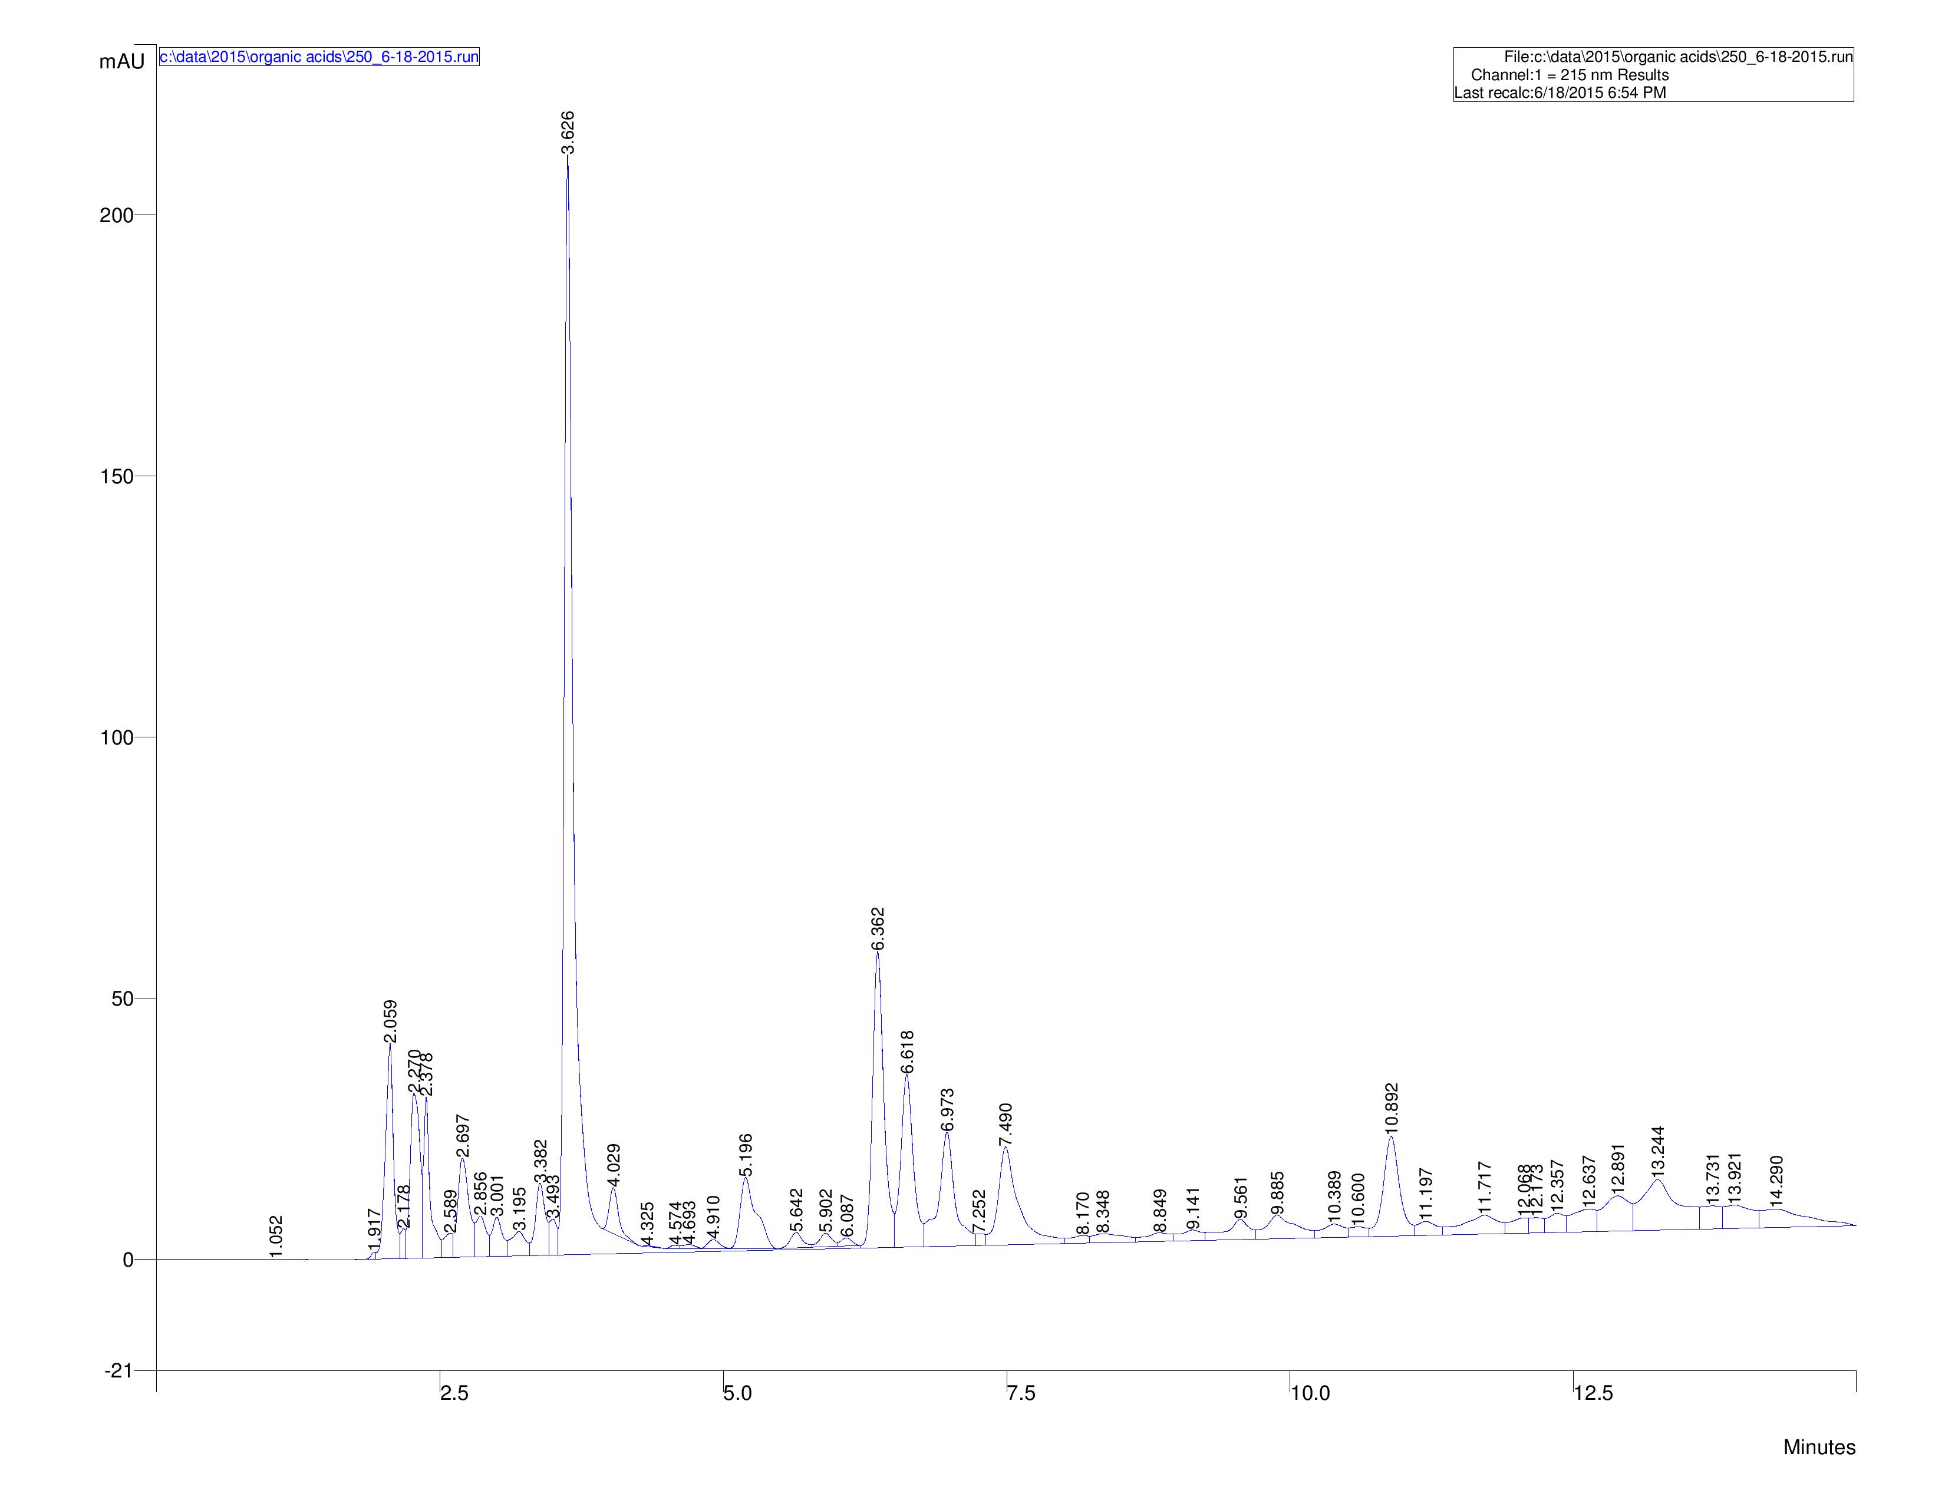
Fried potato on the 250 degree

