Slide 1
PROBLEM 10: ICE HOLE
INTERNATIONAL YOUNG NATURALISTS TOURNAMENT
Croatian team

Slide 2
FORMULATION OF THE PROBLEM
You have drilled two ice holes in a frozen lake on a frosty winter day. One ice hole is close to the shore, while the other ice hole is far from the shore. Surprisingly, the height difference between the ice surface and the liquid water is different for each hole. How can you explain this? How can you use this height difference to determine the local ice thickness?

Slide 3
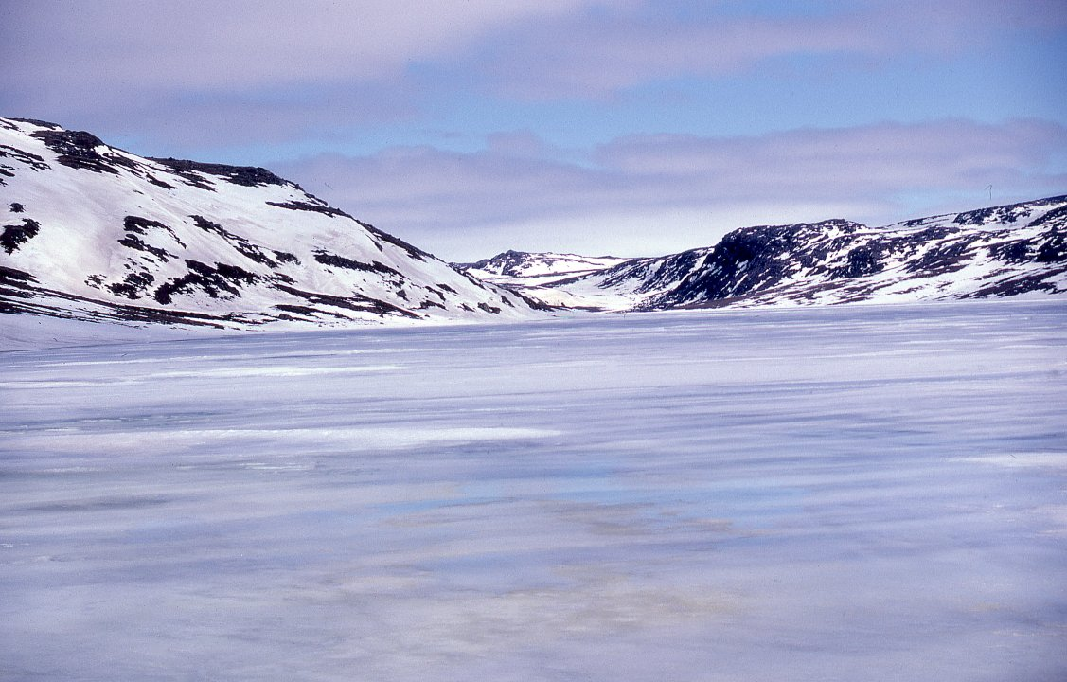
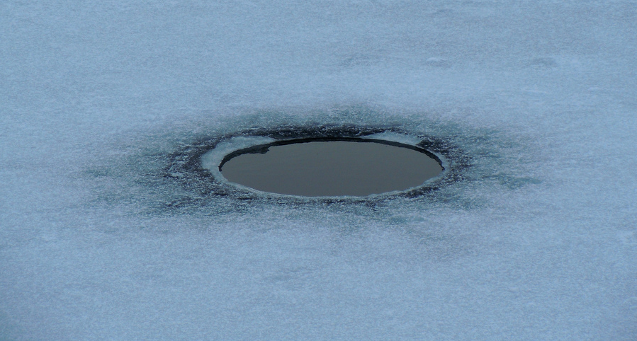
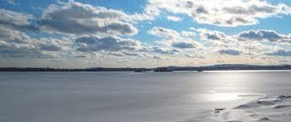
ICE
Creates because of air temperature
Ice forms at 0 °C
The water starts to cool from the surface – the surface water starts to sink – until all the water is cooled to 4 °C – surface water continuous to cool but it stays on the surface – the water starts to freeze

Slide 4
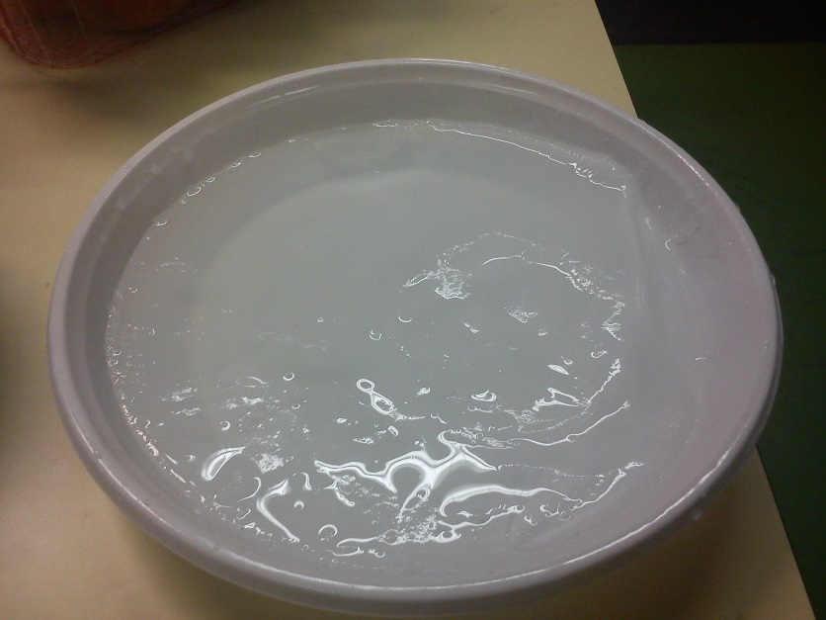
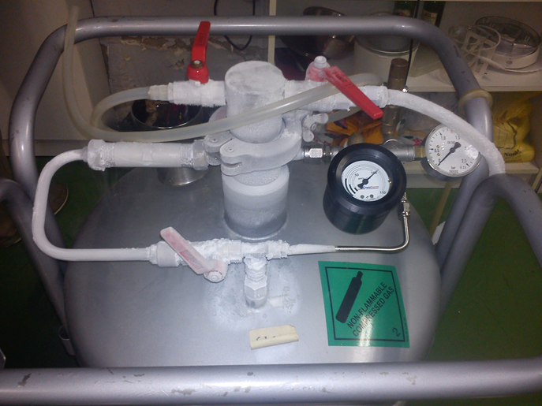
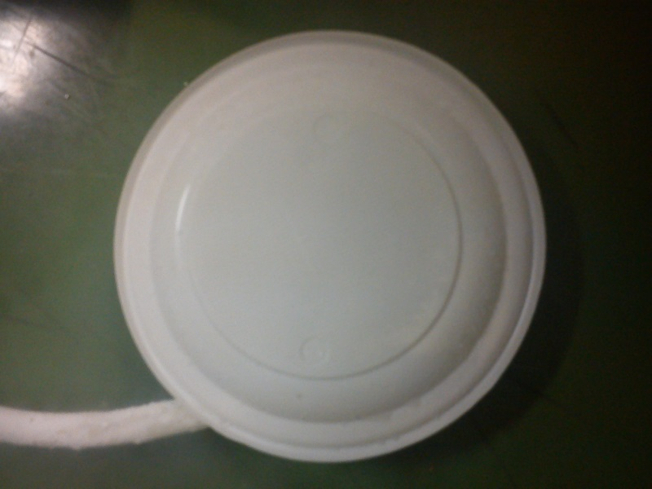
Exsperiment
liquid nitrogen
2 plates
Water
we brought liquid nitrogen with a hose to the plate with water
Covered it with another plate
After 15 minutes we got a icy surface of the water

Slide 5
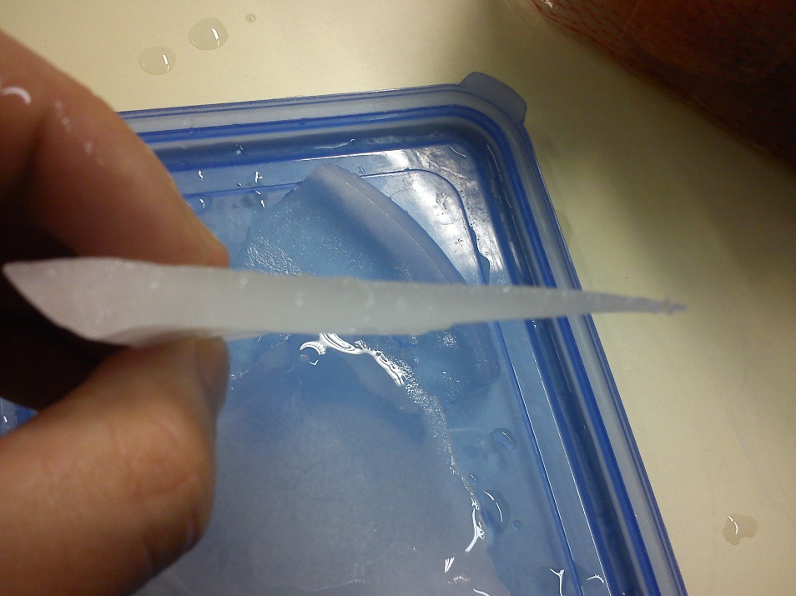
IS THE SURFACE OF THE ICE FLAT?
forms at the edges – to the middle
frozen crust is thicker at the edge

Slide 6
WATER LEVELS IN ICE HOLES
Bulge in the middle→ water is low in the hole
Edges → water is high in the hole
In between → water is in the middle of the hole

Slide 7
THANK YOU FOR YOUR ATENTION!
Presenter: Klara Stojčević

Slide 8
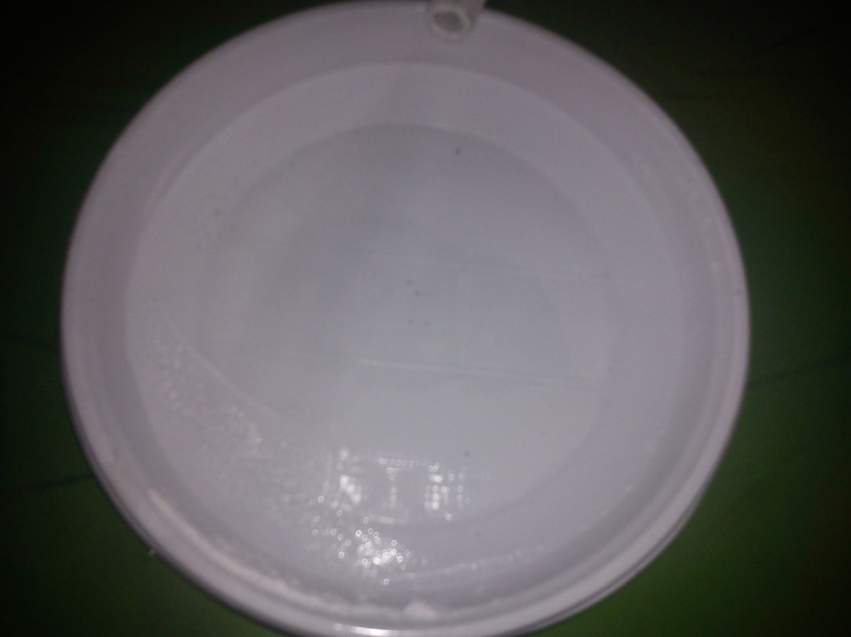
Position of nitrogen inlet

