Slide 1
International Young Naturalists’ Tournament
2. Invent yourself-Biology
Serbian team
Regional Center For Talented Youth II

Slide 2
2. Invent yourself: Biology Topic:
Microorganisms. Suggest an investigation of such cases that allow for a quantitative study and reproducible measurements

Slide 3
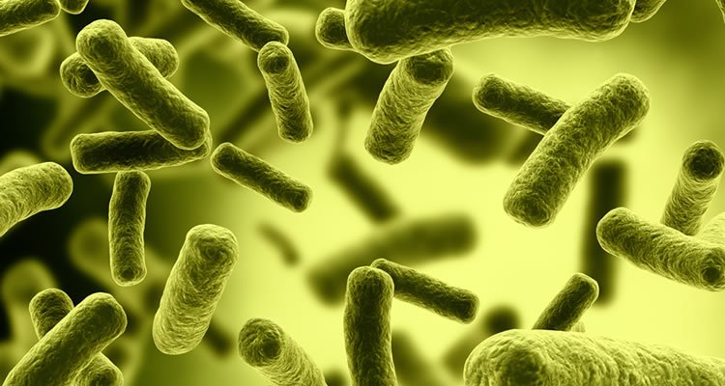
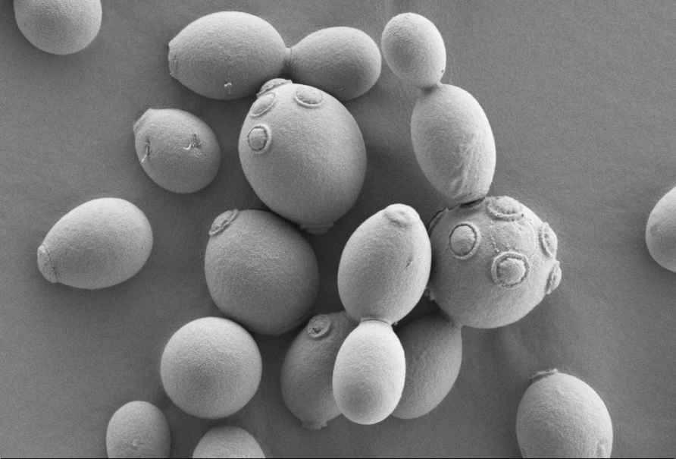
Microorganisms
microscopic living organism
discovered in 1674 by Antonie van Leeuwenhoek
live in every part of the biosphere
include bacteria, archea, protozoa, some fungi, algae, and certain animals, such as rotifers

Slide 4
Suggestion
We have used scientific work for results of resistant bacteria and suggested an investigation about bioremediation with those results

Slide 5
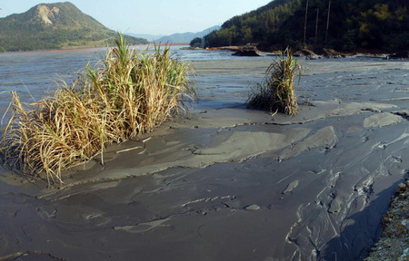
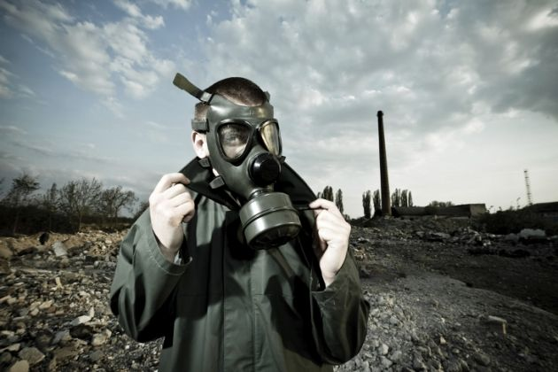
Soil pollution
Pollution of soil with heavy metals is a great ecological problem, due to their strong negative effects on all living organisms, including humans.
Numerous physical and chemical methods are employed in their removal from polluted areas, most of them very expensive and inefficient

Slide 6
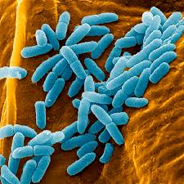
Bioremediation
Bioremediation-using biological agents, such as bacteria or plants, to remove or neutralize contaminants, as in polluted soil or water
Bioremediation is, on the contrary, a very efficient and cost-effective solution to the soil pollution problem
Microorganisms are able to accumulate and immobilize heavy metals, so they are considered a key factor in the process of bioremediation

Slide 7
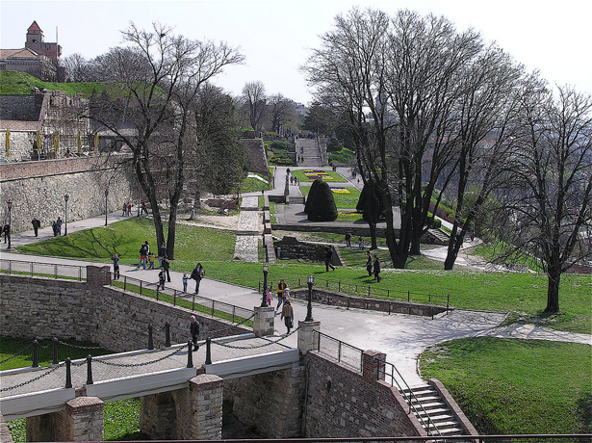
First step
Microorganisms were isolated from potentially polluted soil (in park)

Slide 8
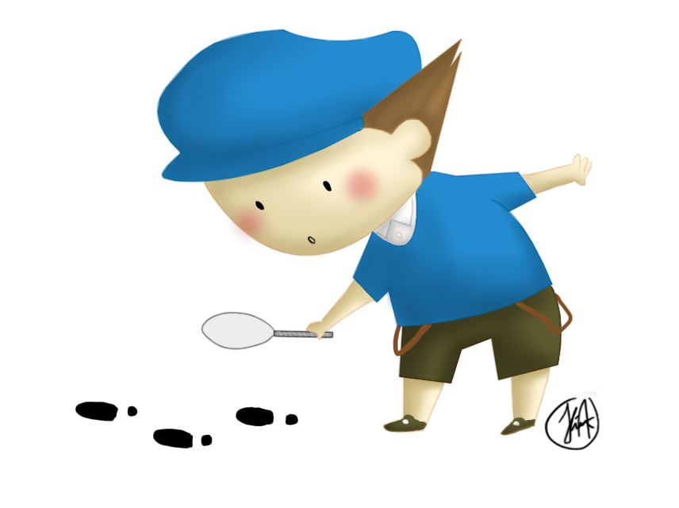
Results of isolation
The chemical analysis of the sample found 30mg/l of lead
Result was within the limits of permitted amounts for this metal

Slide 9
Results
in the presence of 100 mg/l of lead (the legal limit for Pb in soil) 26 bacteria were isolated
which were then tested on two-, five- and ten- fold greater concentration of lead
Concentration of lead (mg/l) | 200 | 500 | 1000
The number of resistant bacteria | 26 | 25 | 22

Slide 10
Conclusion
Conclusion
All 26 resistant bacteria grew up on base in presence of 200 mg/l lead (Pb)
500 mg/l Pb - 25 bacteria
1000 mg/l Pb - 22 bacteria
This research has potential for future investigation based on bioremediation
Microorganisms may be used in removal of heavy metals in soil

Slide 11
References
http://bs.scribd.com/doc/265724003/Izolacija-Bakterija-Rezistentnih-Na-Metale-Iz-Zemlji%C5%A1ta#scribd
Beric T. , Janackovic P. , Biologija 1, Logos, 2014, pages 37-88

Slide 12
Thank you on your attention

Slide 13
Escherichia coli
Yeast
Pseudomonas Aeruginosa Bacteria

Slide 14
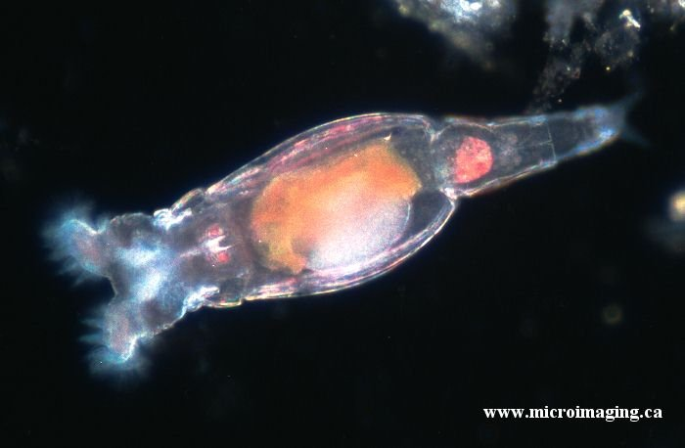
rotifers

