Slide 1
Problem No. 5: “CAR”
Build a model car powered by an engine using an elastic air-filled toy balloon as the energy source. Determine how the distance travelled by the car depends on relevant parameters and maximize the efficiency of the car.

Slide 2
Overview
balloon observations
piston inflation/deflation model
energy input and output
rubber stretching losses
construction
observed motion
parameters
initial conditions (volume, pressure)
jets, nozzles
maximised travelled distance and efficiency
conclusion

Slide 3
PISTON MODEL ~ energy
piston contains all air later used for inflation/deflation
slowly pushed – balloon inflates
released piston – balloon deflates
at every moment ideal gas law equation states:
V_{1f}
V₂₀ = V_{piston}
V_{2f} = 0
V₁₀
p₀ = p_{atm}
p_{f}
$${p_{0}(V}_{10}+V_{20})=nRT=const$$
$${p_{f}V}_{1f}=nRT$$
initial state
final state
$${p(V}_{1}+V_{2})=nRT$$
$$R−gas constant = 8.314\frac{J}{molK}$$
$$dW=−\left(p−p_{0}\right)dV_{2}$$
integrating initial to final state

Slide 4
PISTON MODEL ~ energy
V_{2f} = 0
V_{2f} =$V_{10}+V_{20}$
V_{1f}
maximal available energy
deflation work
same equations valid
V₁₀
p_{f}
p₀ = p_{atm}
$${p_{f}V}_{1f}=nRT$$
$${p_{0}(V}_{10}+V_{20})=nRT=const$$
$$W=\int_{p_{0}}^{p_{f}}{pdV_{1}}+p_{f}V_{f}(\ln{\frac{p_{f}}{p_{0}}−1)+p_{0}V_{10}}$$
known conditions
$\int_{p_{0}}^{p_{f}}{pdV_{1}}$varies for inflation/deflation – determined experimentally

Slide 5
Pressure / volume relation inflation and deflation
pressure
digital pressure sensor
volume
photos taken at known pressure
balloon edge coordinates
balloon shape determined
balloon radius/height function
numerically integrated
shape rotation – body volume

Slide 6
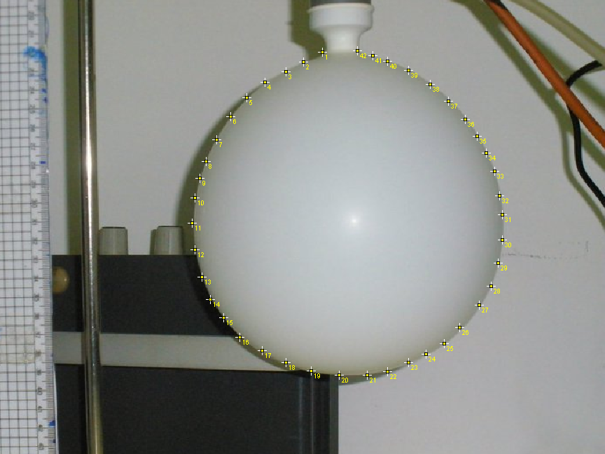
height
radius

Slide 7
Typical pressure/volume relation
deflation curve is under the inflation curve
energy partly lost due to rubber deformations

Slide 8
Baloon stretching – theoretical curve
pressure (force acting on a surfaca)
balloon elastic energy
$U=4π{r0}_{}^{2}κRT\left(2λ^{2}+\frac{1}{λ^{4}}−3\right)$*
$λ=\frac{r}{r0}$ $relative strain$
$κ−rubber property$
work needed to increase radius from $r$ to r+dr under pressure difference $∆P (being overpressure)$
$$dW=∆PdV=∆P4πr_{}^{2}dr=\left(\frac{dU}{dr}\right)dr$$
$$∆P=\frac{4κRT}{r0}(\frac{1}{λ}−\frac{1}{λ^{7}})$$
*Y. Levin, F. L. da Silveira, Two rubber balloons: Phase diagram of air transfer, PHYS. REV. E (2004)

Slide 9
Balloon stretching
$$∆P=α\left(\frac{1}{λ}−\frac{1}{λ^{7}}\right)−single parameter \left(α rubber property\right)fit$$
obtained curve has the expected maximum
due to surface/force relation
explains and confirms the obtained shape of the overpressure/strain curve

Slide 10
Consistency of measurements
the stress-strain curve depends on the maximum loading previously encountered (Mullins effect)
later measurements – rubber already deformed
occurs when the load is increased beyond its prior value
less pressure difference needed to inflate to a certian volume
pV relations
same balloon – multiple usage
initial volume (pressure)
OBSERVATION
pV graph for 1st and 10th measurement greatly differ

Slide 11
Consistency of measurements
1st and 21st measurement vary greatly
rubber deforms after few measurements
10th-25th measurement comparable (similar)
afterwards balloon breaks

Slide 12
Initial volume
surface under the curve enlarges with initial volume
determining part of total input and output energy
efficiency is determined by the deflation and inflation surfaces under the curve
ratio between (initial + final conditions) + surface under the curve

Slide 13
Initial volume
input energy
inflation
inflation/deflation varies
rubber stretching
$$η=\frac{Ed}{Ei}$$

Slide 14
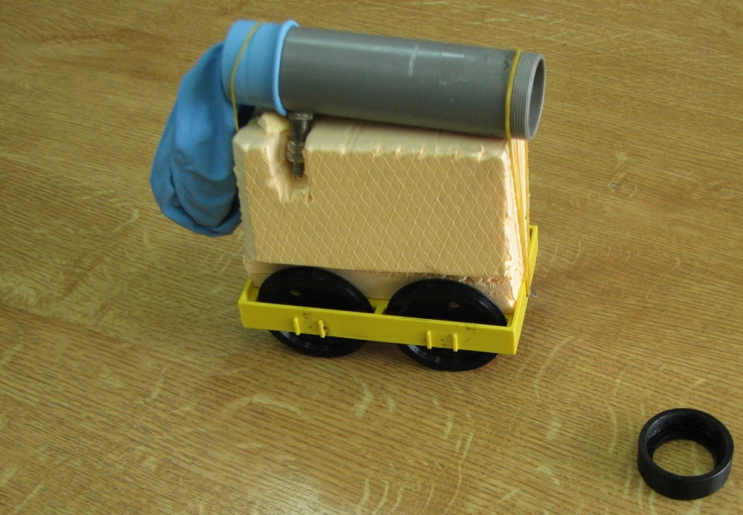
Construction
balloon
plastic tube
cart /
styrofoam
plastic cart (lenght ~ 12cm)
styrofoam
plastic tube (d = 2,9 cm)
metal jets / cardboard noozles
car mass ~120g

Slide 15
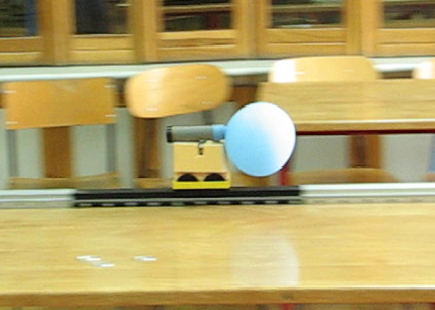
Observed motion - setup
car
rails – with distance scale
rails
car moving straight
position determination
lenght 5 m
video
camera 120 fps
placed 10 m from the rails
analysis
time / distance coordinates

Slide 16
Observed motion
v_{max}
decceleration
deflation
accelerated motion
distance/time graph obtained from video coordinates
program time-distance graph:
5 data points frame – cubic or linear curve fitted
derived: one point in the v-t graph
moves one point to the next frame

Slide 17
Travelled distance
travelled distance: $s=s0+s1$
acceleration path
v_{max} time
distance s₀
determined from the video
decceleration
a determined from the graph
linear fit coefficient
decceleration path
$s1=\frac{vmax2}{2a}$

Slide 18
Basic working principle
input energy is used for inflation
deflation transforms it into kinetic energy of the air molecules
losses due to resistance to movement (mutual collisions)
momentum conservation
simplified model: air behavior
mass inside the balloon $\overline{p}V=\frac{m_{a}}{M}RT→m_{a}=\overline{p}V\frac{M}{RT}$
velocity according to Bernoulli's principle (valid for turbulent flows) $\frac{ρv_{a2}}{2}=\overline{p}→va=\sqrt{\frac{2\overline{p}}{ρ}}$
$${d(m}_{a}v_{a})−F_{fr}dt=m_{c}dv_{c}$$
v_{air}
v_{car}
F_{fr}

Slide 19
Basic working principle
simplified model:
friction force
main friction force source is the air drag $Ffr=\frac{1}{2}CρSvc2\sim V^{\frac{2}{3}}vc2$
friction force duration - flow rate $Q=\frac{V}{t}=Sva→t\sim \frac{V}{v_{a}}$
$\overline{p} is evaluated from pV graphs as \overline{p}=\frac{\int_{p_{0}}^{p_{f}}{pdV_{1}}}{Vf−V0}$
maximum car velocity v_{c} initial $V0$volume relation obtained
$$m_{a}v_{a}−F_{fr}t=m_{c}v_{c}$$
v_{air}
v_{air}
v_{car}
v_{car}
F_{fr}
F_{fr}

Slide 20
Initial volume
simplified model basic working principle fit
main friction force source is air drag
as the initial volume increases the air drag force gains significance
reason of non-linear progression
simplification
$$m_{a}v_{a}−F_{fr}t=m_{c}v_{c}$$

Slide 21
Maximisation – v_{max} importance
travelled distance
efficiency
motion consists of acceleration and decceleration
acceleration to v_{max} is determined by:
initial conditions
volume/pressure
jets, noozles
travelled distance found from the video
decceleration – same for all parameters
friction
air
wheels/rails/shaft
$vmax=\sqrt{2as}→s=\frac{vmax2}{2a}$
energy input and ouput ratio
$η=\frac{energy input}{energy output}$
energy input
work needed to inflate the balloon
piston model
energy output
$E_{k}=\frac{mcar{v2}_{max}^{}}{2}$
v_{max} car motion observation

Slide 22
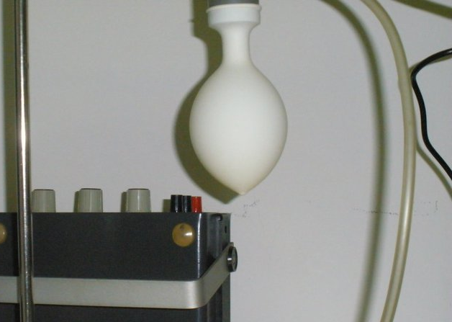
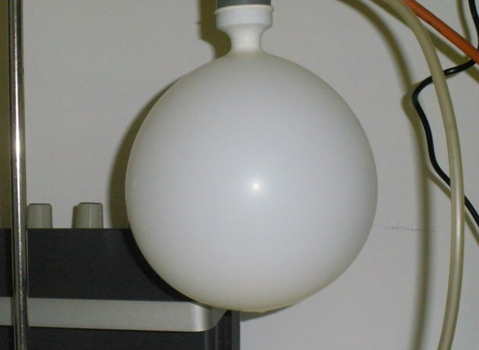
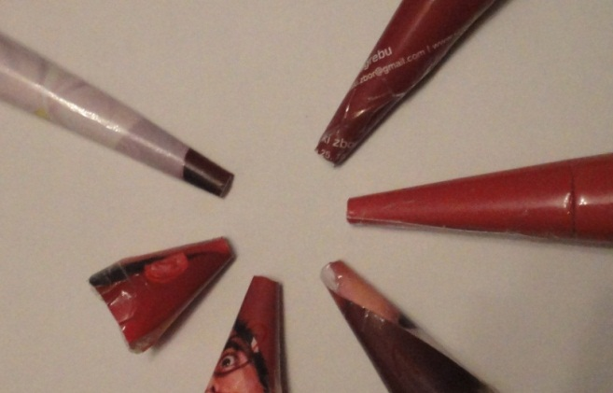
Parameters
initial volume
total input energy
rubber stretching losses
jet diameter
volumetric flow of air Q
Reynolds number 10⁵
tubulent flow
exit velocity
deflation time
nozzle
directs the flow

Slide 23
Initial volume
initial volume! – pressure
total input energy and deflation energy
critical sizes
min
needed to overcome static friction - start car movement
max
radius ~ car height
the balloon must not touch the floor
range ~ 0.15 dm³ - 4.5 dm³
deflated balloon ~ 0.075 dm³
air drag friction force

Slide 24
Initial volume Results
travelled distance:
$s=s0+s1$
maximisation largest balloon
efficiency:
output/input energy
small
losses on the air kinetic energy
maximisation smallest balloon
$$η=\frac{mvmax2}{2Ei}$$

Slide 25
Jets - circular tube openings
different diameters d
jet diameter changes
how well the air is directed
time needed for deflation
air drag duration
amount of resistance the air endures in mutual collisions
Reynolds number $Re=\frac{vd}{ν}$, $ν$ kynematic viscosity
turbulent flow Re>4000, 10₅
d₁
d₂
deflation time $t(d)>>t(D)$

Slide 26
RESULTS (V~4dm3)
different v_{max} for a certain diameter
both travelled distance and efficiency depend on v_{max}²
max distance 47.3 m
max efficiency 2.7%
best jet diameter 1.2cm-1.4cm

Slide 27
NOZZLES – CONE SHAPED
different nozzles change
angle – how well the air is directed
tube lenght – amount of losses due to friction
6 cones – different angles  and thus lenghts (7.5°- 30°)
effective velocity – horizontal component of rapid molecule movements

$$β$$
l
l

Slide 28
RESULTS (V~3dm³) d=1cm
different v_{max} for a certain diameter
both travelled distance and efficiency depend on v_{max}²
max distance 20.5 m
max efficiency 1.5%
best cone angle 15°-20°

Slide 29
Conclusion
piston inflation/deflation model – energy evaluation
stretching losses – theoretical and experimental curve
basic working priciple explained
found maximum conditions for jets and noozles
travelled distance
efficiency
initial V =4.5dm³ max
optimal:
jet diameter1.2cm
nozzle angle 20°
DISTANCE 70m
initial V=1.5dm³ min
optimal:
jet diameter 1.2cm
nozzle angle 20°
EFFICIENCY 6,4%

Slide 30
Thank You!

Slide 32
PISTON MODEL ~ energy
V_{1f}
V₂₀ = V_{piston}
V_{2f} = 0
V₁₀
p₀ = p_{atm}
p_{f}
$${p_{0}(V}_{10}+V_{20})=nRT=const$$
$${p_{f}V}_{1f}=nRT$$
$${p(V}_{1}+V_{2})=nRT$$
$$−dW=\left(p−p_{0}\right)dV_{2}$$
$$W=\int_{p_{0}}^{p_{f}}{pdV_{1}}+p_{f}V_{f}(\ln{\frac{p_{f}}{p_{0}}−1)+p_{0}V_{10}}$$
$\int_{p_{0}}^{p_{f}}{pdV_{1}}$varies for inflation/deflation – determined from the graph

Slide 33
PISTON MODEL ~ energy
V_{1f}
V₂₀ = V_{piston}
V_{2f} = 0
V₁₀
p₀ = p_{atm}
p_{f}
$${p_{0}(V}_{10}+V_{20})=nRT=const$$
$${p_{f}V}_{1f}=nRT$$
$${p(V}_{1}+V_{2})=p_{f}V_{1f}$$
$$dV_{1}+dV_{2}=−\frac{p_{f}V_{1f}}{p^{2}}dp$$
$dV_{2}\text{=}−dV_{1}−$ $\frac{p_{f}V_{1f}}{p^{2}}dp$
$$−dW=\left(p−p_{0}\right)dV_{2}$$
$$−dW=p\left(−dV_{1}−\frac{p_{f}V_{1f}}{p^{2}}dp\right)−p_{0}dV_{2} \int_{p_{0}}^{p_{f}}{ }$$

Slide 34
PISTON MODEL ~ energy
$$−dW=p\left(−dV_{1}−\frac{p_{f}V_{1f}}{p^{2}}dp\right)−p_{0}dV_{2}$$
$$−dW=−pdV_{1}−\frac{p_{f}V_{1f}}{p}dp−p_{0}dV_{2} \int_{p_{0}}^{p_{f}}{ }$$
$$W=\int_{p_{0}}^{p_{f}}{pdV_{1}}+p_{f}V_{f}\ln{\frac{p_{f}}{p_{0}}+}p_{0}(0−V_{20})$$
$${p_{0}(V}_{10}+V_{20})=p_{f}V_{f}$$
$$V_{20}=\frac{p_{f}V_{f}}{p_{0}}−V_{10}$$
$W=\int_{p_{0}}^{p_{f}}{pdV_{1}}+p_{f}V_{f}\ln{\frac{p_{f}}{p_{0}}−}p_{0}(\frac{p_{f}V_{f}}{p_{0}}−V_{10}$)
$$W=\int_{p_{0}}^{p_{f}}{pdV_{1}}+p_{f}V_{f}(\ln{\frac{p_{f}}{p_{0}}−1)+p_{0}V_{10}}$$
$\int_{p_{0}}^{p_{f}}{pdV_{1}}$varies for inflation/deflation – determined from the graph

Slide 36
Baloon stretching – theoretical curve
elastic energy
$U=4π{r0}_{}^{2}κRT\left(2λ^{2}+\frac{1}{λ^{4}}−3\right)$
$λ=\frac{r}{r0}$ $relative strain$
$κ−rubber property$
work needed to increase radius from $r$ to r+dr under pressure difference $∆P (being overpressure)$
$$dW=∆PdV=∆P4πr_{}^{2}dr=\left(\frac{dU}{dr}\right)dr$$
$dV=\frac{d(\frac{4}{3}r3π) }{dr}=4πr_{}^{2}dr$
initial volume

Slide 37
Baloon stretching – theoretical curve
$$elastic energy U=4π{r0}_{}^{2}κRT\left(2λ^{2}+\frac{1}{λ^{4}}−3\right)$$
$$dW=∆P4πr_{}^{2}dr=\left(\frac{dU}{dr}\right)dr=16πκRT\left(r−\frac{r06}{r5}\right)dr$$
$∆P=4κRT\left(\frac{1}{r}−\frac{r06}{r7}\right)=\frac{4κRT}{r0}\left(\frac{r0}{r}−\frac{r07}{r7}\right)$
$$∆P=\frac{4κRT}{r0}(\frac{1}{λ}−\frac{1}{λ^{7}})$$
final expression
$∆P=α(\frac{1}{λ}−\frac{1}{λ^{7}})$

Slide 39
Friction
F₂
$$F1=Fg\frac{s1}{l}$$
F_{g}
F₁
$$μ=\frac{h}{s}=4.5∙{10}^{−3}$$
l
$$s=s1+s2$$
s₁
s₂
$$mgh=F1μl+Fgμs2$$
$$mgh=mgμ\frac{s1}{l}l+mgμs2$$
$$h=μ(s1+s2)$$
h - car-surface distance
s - horizontal travelled distance

