Slide 2
Experimental problem 23 Tea bag

Slide 3
Tea bag
Produce a standing vertical cylinder from an empty tea bag and ignite it from the top. Observe and explain the flight. Estimate the quantitative parameters. What happens if four tea bags standing close to each other are ignited at once?
3

Slide 4
Plan of work
Qualitative explanation
Conclusions
Investigation of the flight
?
!
4

Slide 5
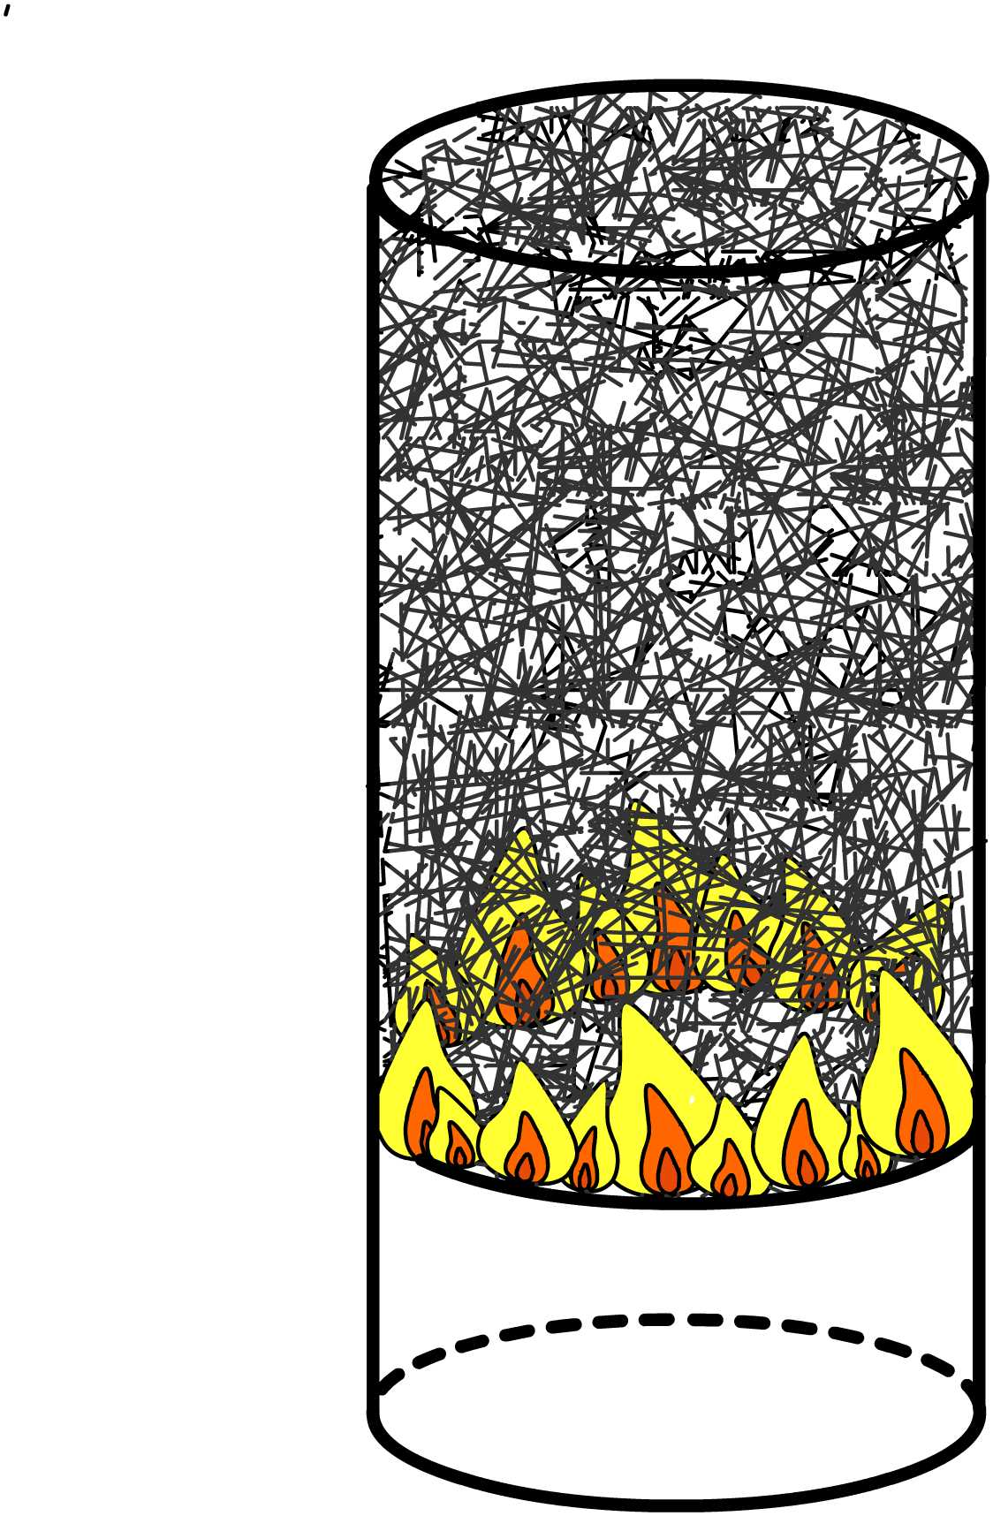
Explanation of the phenomenon
5

Slide 6
Explanation of the phenomenon
Convective streams
Heating

Slide 7
Relative parameters
Material
Method of burning
Air humidity
Air temperature
Size of tea bag
Surface

Slide 8
Method of burning
Should be burnt from the top

Slide 9
Air conditions
Influence of external airflows should be minimized
Humidity of the air should be as less as possible

Slide 10
Size of the tea bag
Tea bag should be long enough

Slide 11
Conclusions
The tea bag should be burnt from the top
Influence of the external airflows should be minimal
Surface does not influence
Influence of external airflows should be minimized
Humidity of the air should be as less as possible
11

Slide 12
Thank you for attention!

