Slide 1
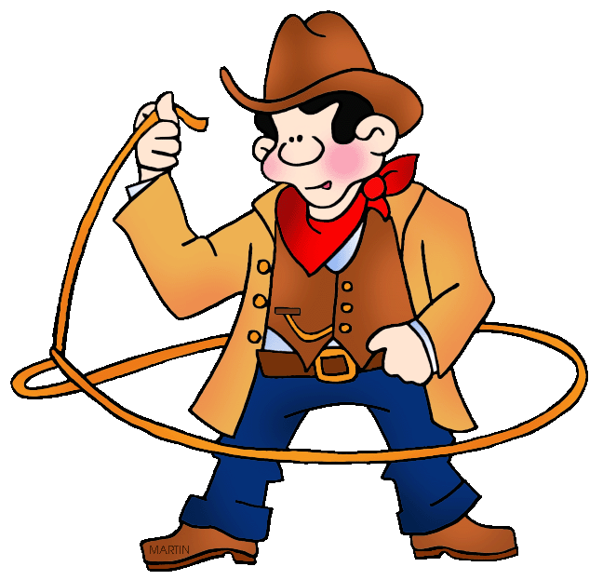
The Land Lease Contract
Team “Dream”

Slide 2
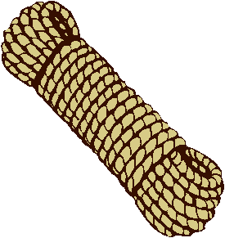
Task The chief of the tribe Chingachgook is settling a bargain with a cowboy Joe. The chief is about to turn over some of the Indian land to the cowboy, but only the land which Joe will be able to fence around with the help of four stakes and the same number of ropes tighten between each pair of stakes.

Slide 3
The chief also has put forward the demand according to which the lengths of the ropes are to come to the quantities of (1 - 7t); (14t + 5); (7 - 6t) and ( 5 -3 t), where t is a certain number. What is the value of t at which Joe will be able to fence the largest area and what is the size of that area?

Slide 4
Assumptions:
The ropes will be stretched tight.
Joe must use all 4 ropes and all 4 posts.
All the lengths have
to exist (be positive)

Slide 5
The Enclosed Land
1-7t
5-3t
14t+5
7-6t

Slide 6
Cyclic Quadrilaterals
c
b
a
d

Slide 7
b
a
c
d

Slide 8
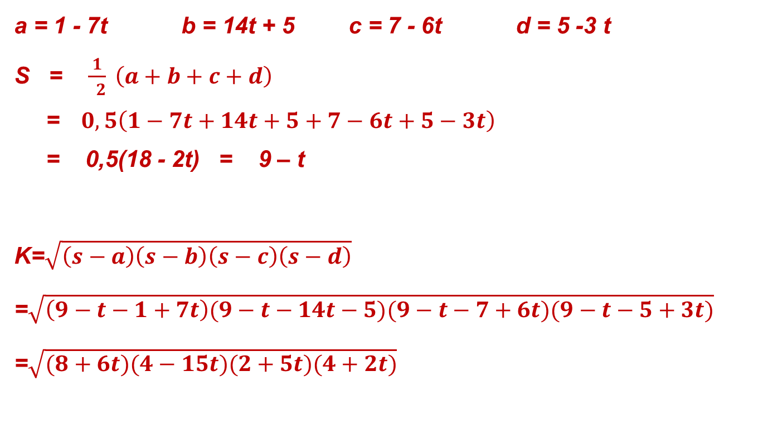
Using Brahmagupta’s Formula
S = 9 - t

Slide 9
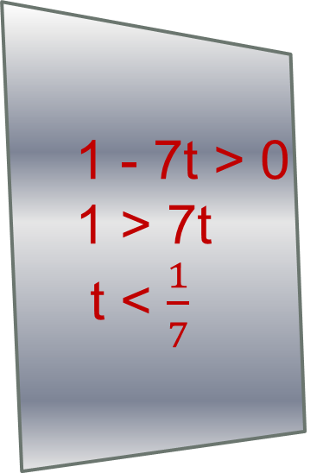
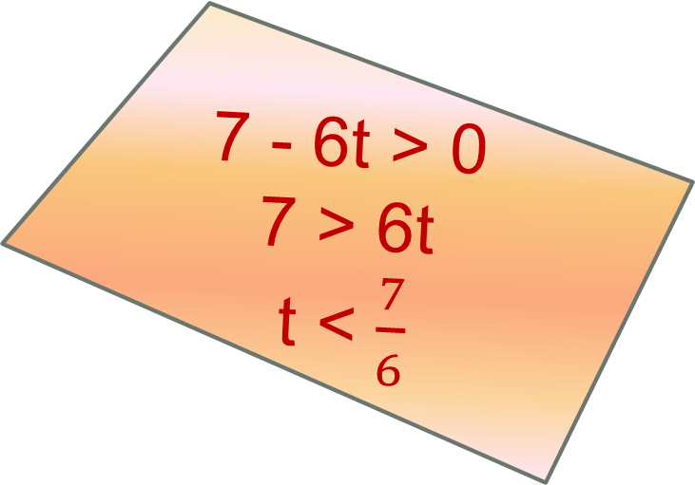
Possible Values of t
5 - 3t > 0 5 > 3t t < ⁵/₃
14t+5 > 0
14t > -5
t > -⁵/₁₄

Slide 10
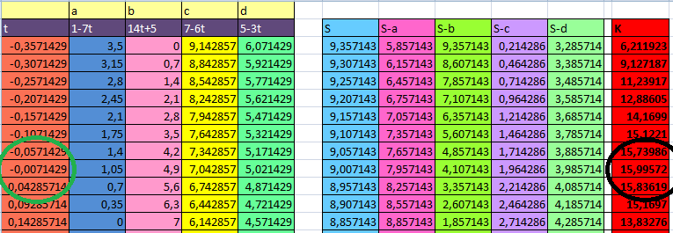
Possible values of t and K

Slide 11
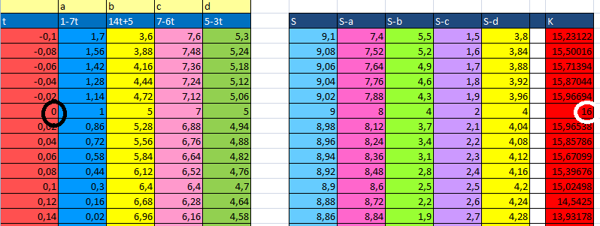
Looking more closely …

Slide 12
These are formulas used to find K

Slide 13
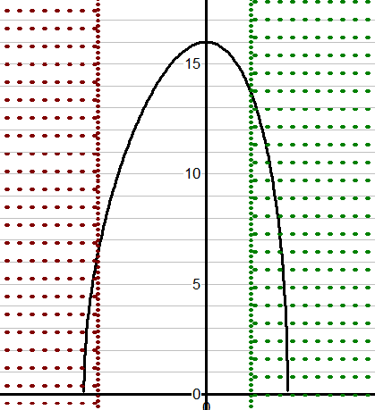
Graph of values
Maximum point at (0,16)
x < -⁵/₁₄
x < -⁵/₁₄

Slide 14
Conclusion
I proved that if cowboy Joe says that t = 0, he will be able to fence the largest area.
Using Brahmagupta’s formula I have shown that this area will be sixteen square units.
1
5
16
5
7

Slide 15
Thank you for attention!

Slide 16
References:
http://math.tutorvista.com/geometry/cyclic-quadrilateral.html
http://en.wikipedia.org/wiki/Cyclic_quadrilateral
Omnigraph; Microsoft Excel;
Programs used:

