Slide 1
FRESH and SALTED WATER
Deniz Akyıldız
Pro Evolution Science
Team of Turkey
1

Slide 2
Problem
Electroconductivity of natural water depends on concentration of dissolved salts.
What might be the source of water with 13.2 μS/сm conductivity?
At the tournament you will be provided by a sample of water. Measure the electroconductivity of the new sample. Decide whether it is distilled water, tap water or mineral water.
2

Slide 3
The Work Plan
Give an explanation of conductivity
Find the relation between the conductivity and dissolved concentration.
Explain these relations
3

Slide 4
Conductivity
Is a measure of ability to conduct electricity.
The unit is Siemens per meter (S/m) in SI unit system.
It is related to the ions dissolved in liquid.
σ is conductivity
ρ is resistivity
4

Slide 5
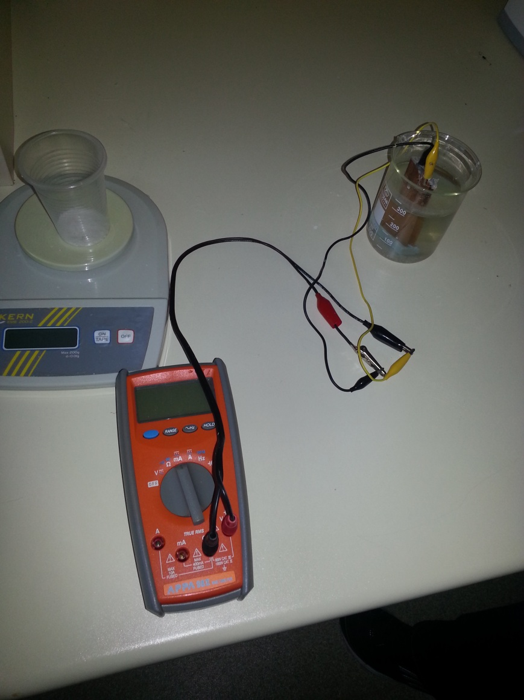
Scheme of Experimental Setup
R
V
A
Multimeter
5

Slide 6
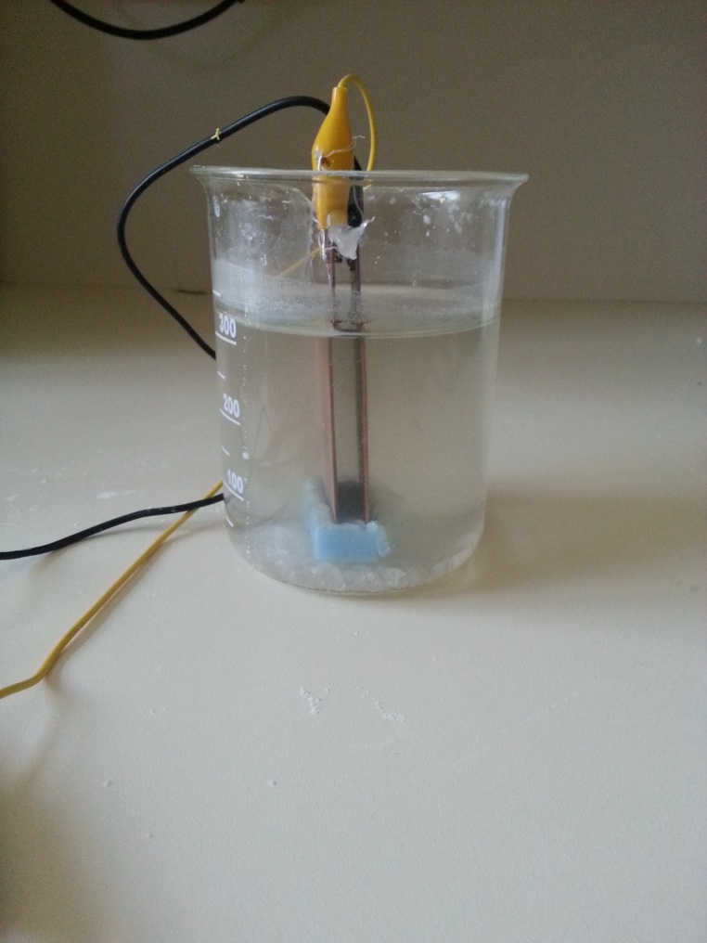
A Closer View
Solution
Copper plates
6

Slide 7
The Motion of the Ions
-
+
Cl
Na
+
-
Na
Cl
-
+
Cl
Na
7

Slide 8
THEORITICAL MODEL
Ohm’s Law
Potential Difference
Current
Conductivity
8

Slide 9
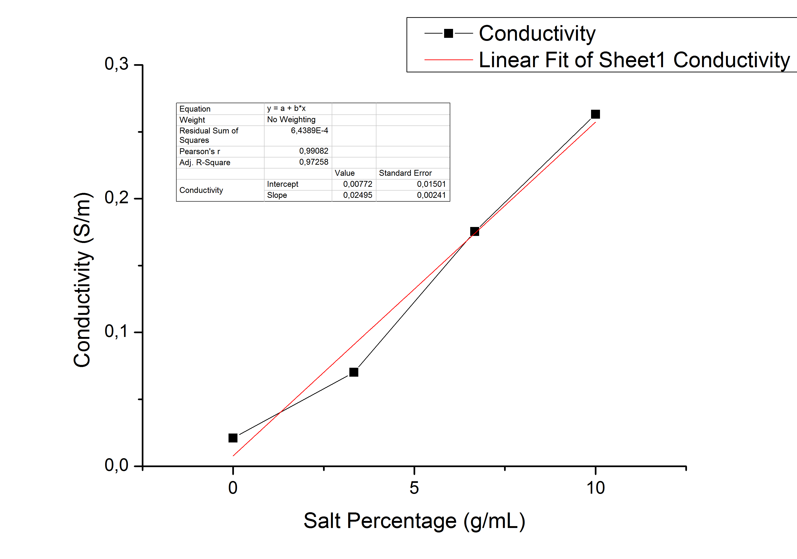
Plot (Graph)
9

Slide 10
THEORITICAL MODEL
Here n is concentration
b , α and ν are constants related to solution.
And this ratio is equal to slope of our salinity-conductivity graph
10

Slide 11
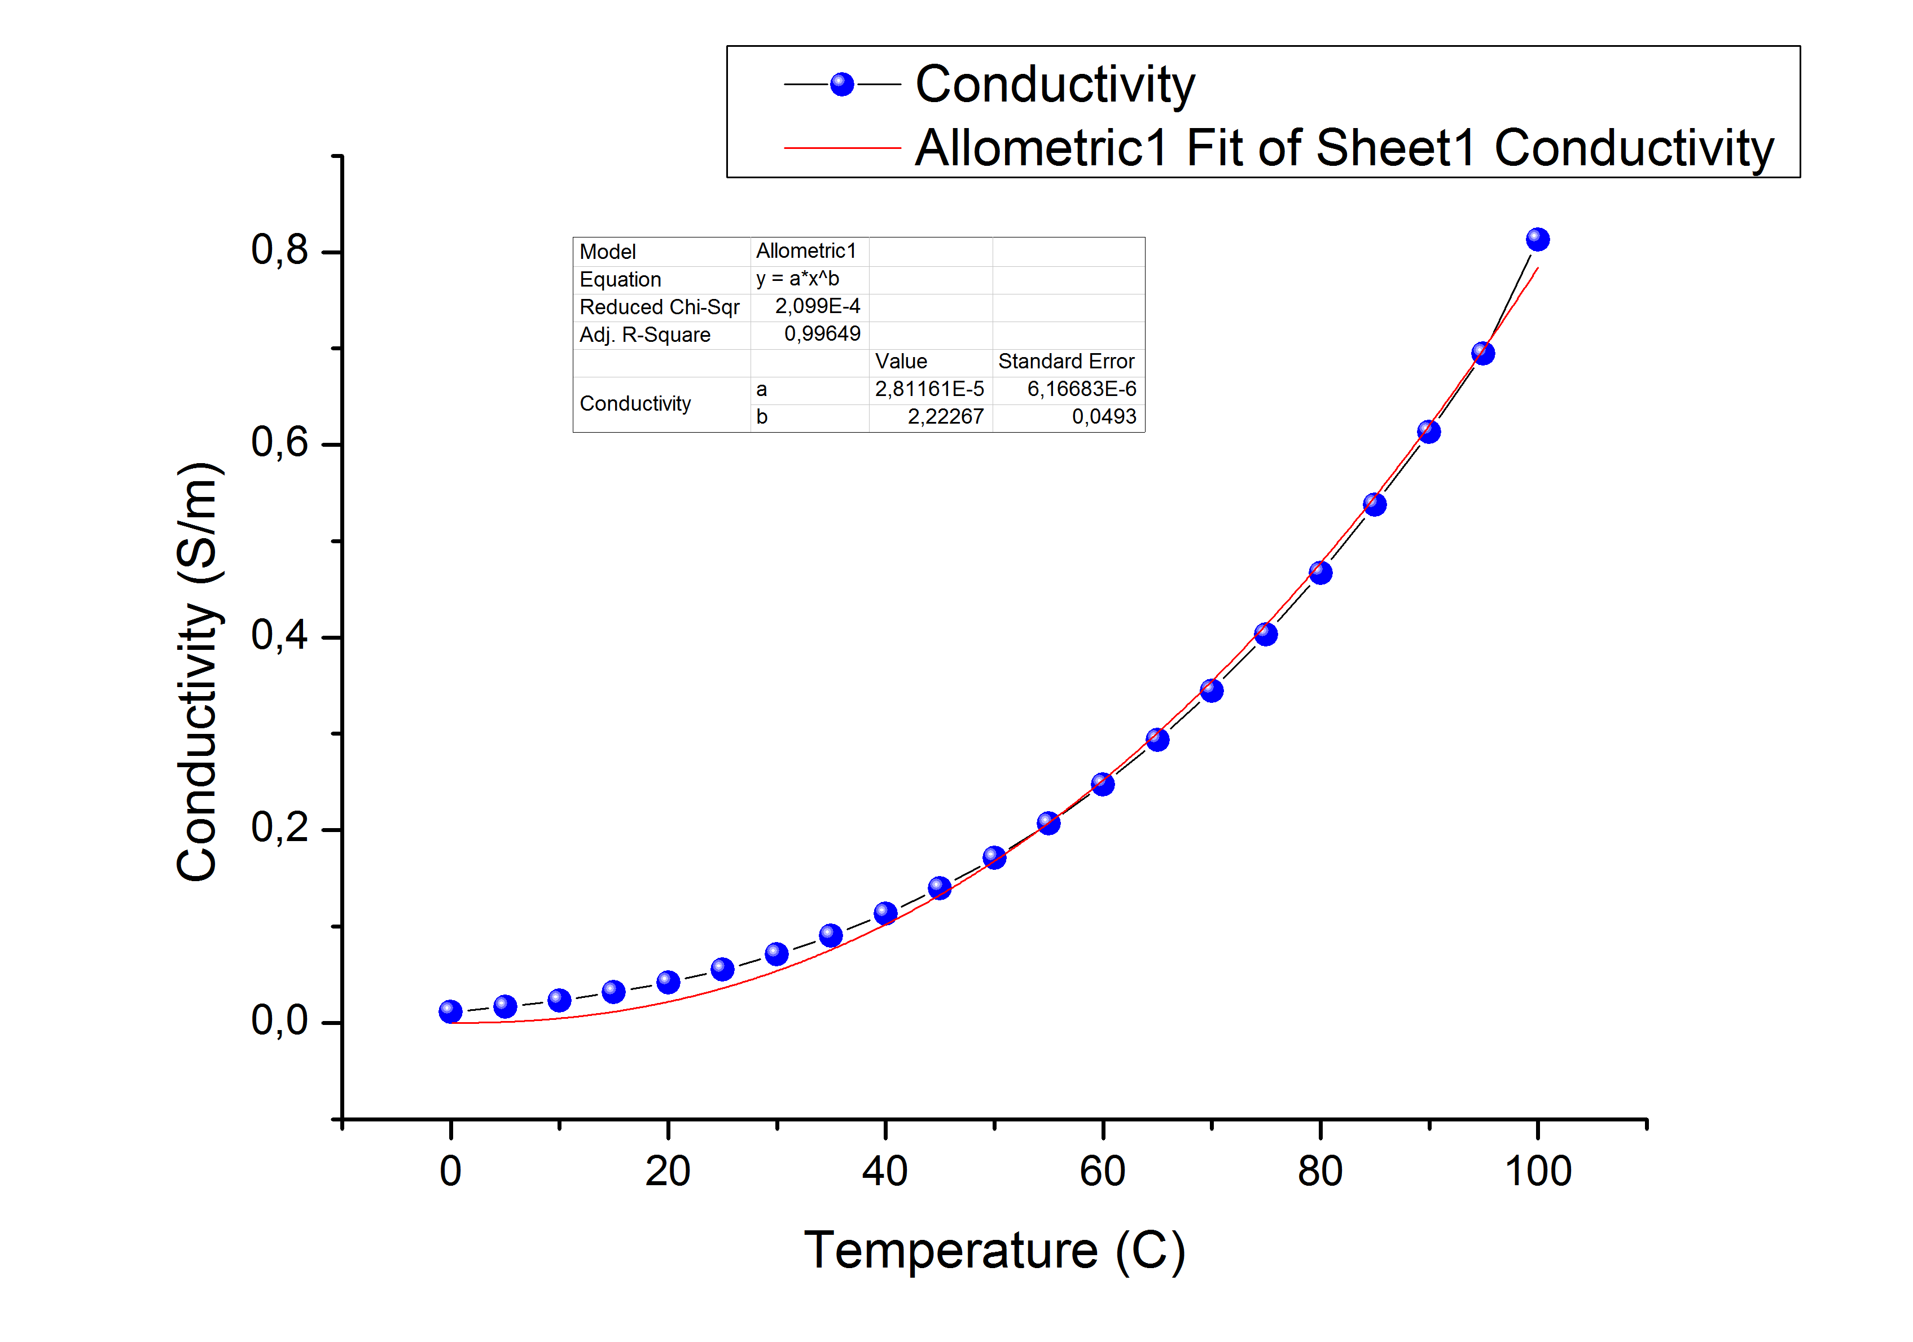
Temperature
Temperature is a factor which also effects the conductivity but in our problem we do not need to consider it.
11

Slide 12
Table
Black Sea
Dead Sea
Baltic Sea at Neva estuary
Lake Baikal
Moscow-river, upstream of Moscow City (in winter)
Peat bog lake
Moscow-river, downstream of Moscow City (in winter)
Possible values of the electroconductivity, μS/сm: 10; 125; 420; 580; 4580; 45600; 228000.
12

Slide 13
Sources | Possible Conductivity Values (μS/cm) | Salinity (%)
Dead Sea | 228000 | 33-34
Black Sea | 45600 | 18-18.5
Baltic Sea | 4580 | 6-8
Moscow-River (downstream) | 580 | -
Moscow-River (upstream) | 420 | -
Peat Bog Lake | 125
Lake Baikal | 10 | 0.12
13.2 μS/сm = ?
13

Slide 14
Conclusions
Conductivity is linearly related to salinity.
Conductivity is related to temperature exponentially.
The type of ions’ determine the conductivity.
14

Slide 15
References
http://www.lehigh.edu/~amb4/wbi/kwardlow/conductivity.htm
http://en.wikipedia.org/wiki/Electrical_resistivity_and_conductivity
http://en.wikipedia.org/wiki/Conductivity_(electrolytic)
http://www.lenntech.com/applications/ultrapure/conductivity/water-conductivity.htm
http://www.mbhes.com/conductivity_measurement.htm
http://en.wikipedia.org/wiki/Salinity
http://www.fao.org/docrep/field/003/AC183E/AC183E03.htm
http://www.ehow.com/about_6582701_conductivity-vs_-salinity.html

Slide 16
Thank you for your attention!
15

