Slide 1
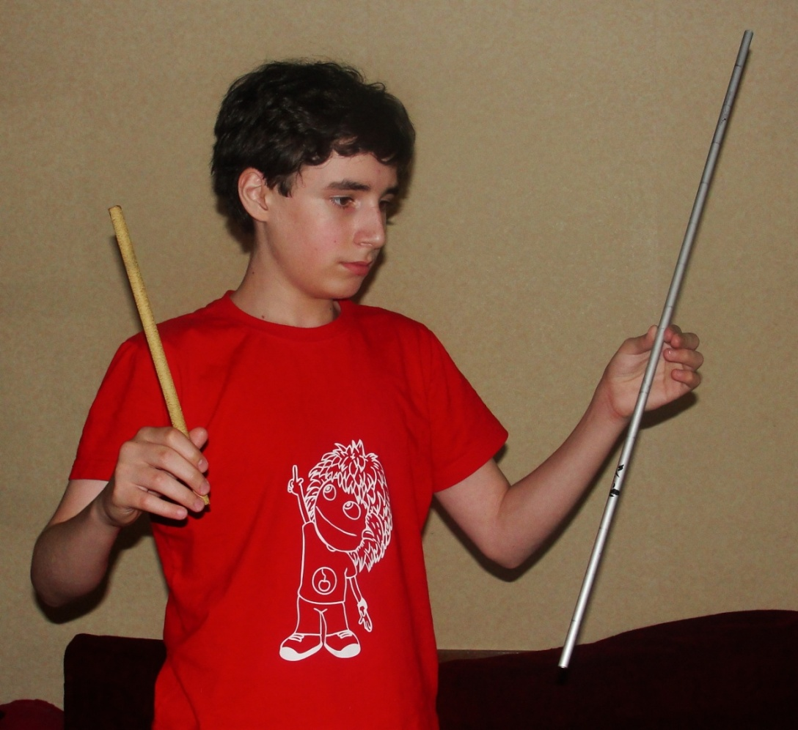
IYPT 2010
№13 Shrieking Rod
GEORGIAN Team
Sandro Barnaveli
A metal rod is held between two fingers and hit. Investigate how the sound produced depends on the position of holding and hitting the rod?

Slide 2
Presentation Plan
Wave types in rod
Longitudinal Waves
Bending Waves
Torsion waves
b) Longitudinal waves
Wave equation
Solution of Wave equation
Frequency modes ; Node positions
c) Experiments with Longitudinal waves
d) Bending waves
Wave equation
Solution of Wave equation
Frequency modes ; Node positions
e) Experiments with Bending waves
f) Conclusion

Slide 3


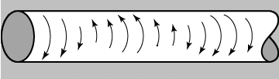
Wave types in rod
(A) Quasi-longitudinal Compression waves in a thin rod
Quasi longitudinal due to transverse strains– as rod stretches, it grows thinner
(B) Bending waves in a thin rod
Bending waves involve both compression and share strains.
Their velocity depends on frequency - they are DISPERSIVE
(C) Transverse Torsion waves in a thin rod
A lateral displacement χ which varies with x gives rise to a shear strain.
In a thin rod torsion shear waves travel at a speed which is always little less then longitudinal wave speed.
(A) – type Compression waves (in ideal case)
Also if sliding fingers along the rod
(C) – type Torsion waves
(B) – type Bending waves
(A) – type Compression waves
(B) – type Bending waves
(A) – type Compression waves

Slide 4
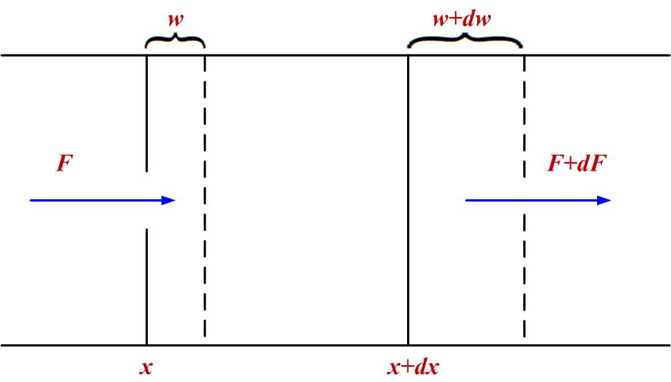





Longitudinal Waves
Wave equation
Short segment of length dx
Cross-section area S
Force F(x)
The plane at x moves a distance w to the right
The Stress F/S
The Strain (change in length per unit of original length) ∂w/ ∂x
The Young’s module E
The Hooke’s law: (1)
The net force:
The Newton’s second law:
or (2)
- one-dimensional wave equation for waves with a velocity
(3)

Slide 5









Solution of Wave equation
Let us search the harmonic standing wave modes in the form:
Substituting in (2) gives:
This yields:
Where the wave number . (4)
Boundary conditions for both (x=0 ; x=l ) ends free:
This gives : ; .
i.e.
Frequency modes: (5)
Wave lengths: (6)
Wave solution: ; ;

Slide 6
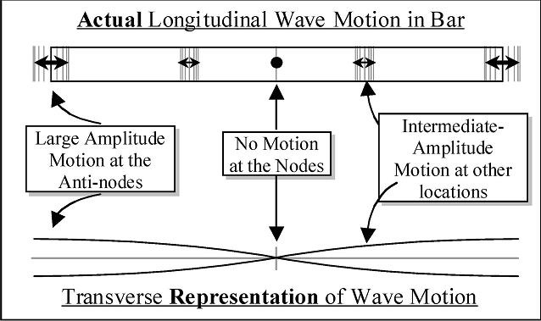



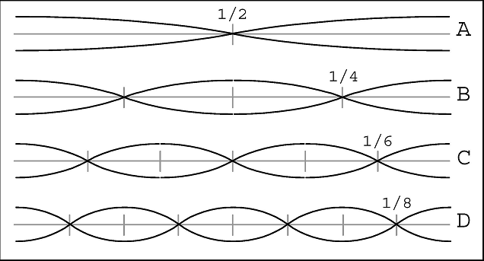





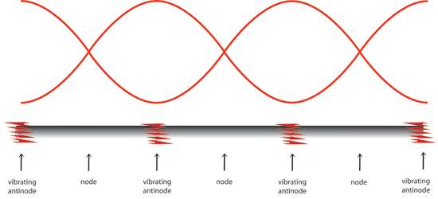



Standing wave modes
The First Harmonic:
Wave length:
Frequency:
Nod positions:
The Second Harmonic:
Wave length:
Frequency: = 2ν₁
Nod positions: ;
The Third Harmonic:
Wave length:
Frequency: = 3ν₁
Nod positions: ; ;

Slide 7
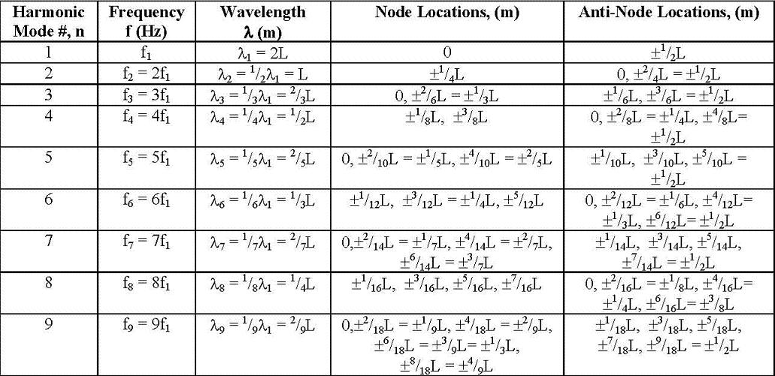
The modal frequencies, wavelengths, and the locations of nodes and anti-nodes
for the first nine harmonics associated with a vibrating rod of length, L
All modes (n = 0, 1, 2, 3, 4, 5, … ) of vibration of the rod all have the same longitudinal speed of propagation of sound in the rod = ν_{i} λ_{i}

Slide 8

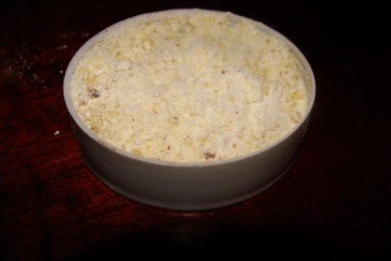
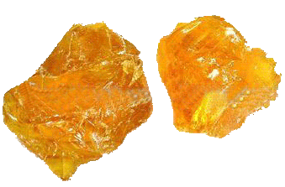
Experiments with Longitudinal Waves
To make rod sound clearer and louder, we shall:
Hit the rod as fast as possible
Hit it not very hard, because harmonicity of waves will be violated.
Hit the rod with thing, that doesn't produce good sound (e.g. Ebonite Rod), not to interrupt Main one.
Try to hit it vertically or horizontally, and not intermediate.
Also sliding of hand down the length of the rod.
Addition of Rosin makes fingers more sticky.
The pitch of the sound can be varied by changing holding places of the Rod or by changing the length of the rod itself.

Slide 9
Ringing The Rod
Experiment

Slide 10



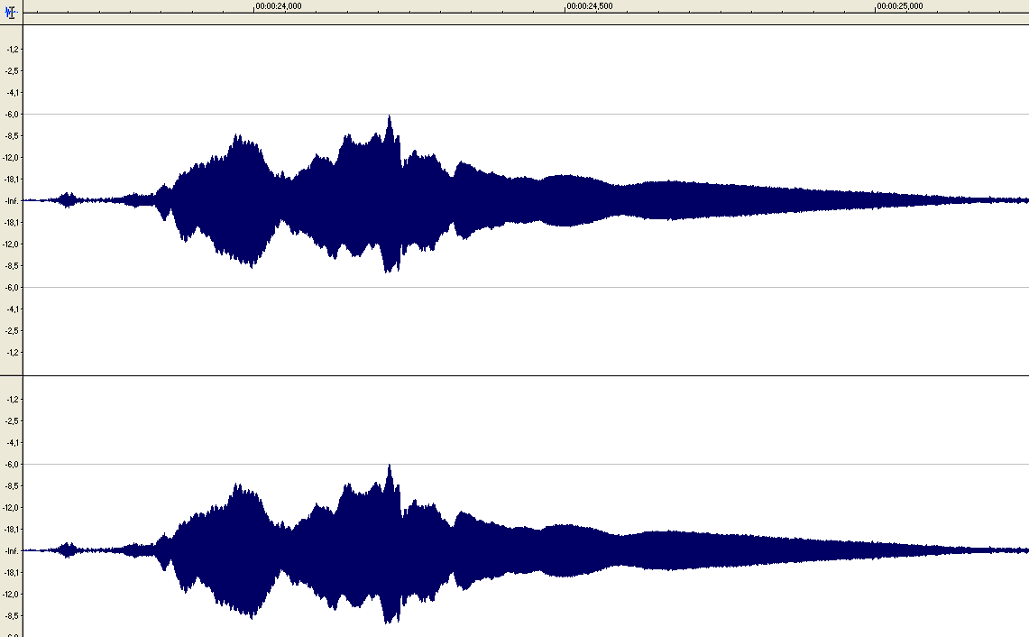
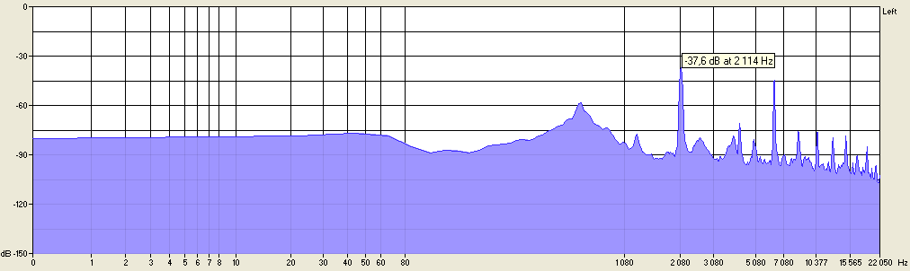
Experiments with Longitudinal Waves
1. Aluminium rod ( ρ_{AL} =2,7·10³ kg/m³ ; E_{AL} =70×10⁹ N/m² ; C_{L(Al)} = 5082.4 m/s )
Length of the rod 1: l= 1,2m
The first harmonic: λ₁=2.4m ; ν₁=2117 Hz ; nodes: 0.6m
The second harmonic: λ₂=1.2m ; ν₂=4234 Hz ; nodes: 0.3m , 0.9m
The third harmonic: λ₃=0.8m ; ν₃=6351 Hz ; nodes: 0.2m , 0.6m , 1.0 m
If hold the rod in the place where nods of several modes are placed all these modes will occur.
Touching the rod at the ends will stop the sound . holding in center
ν₁
ν₃
ხმები ფოლდერშია

Slide 11
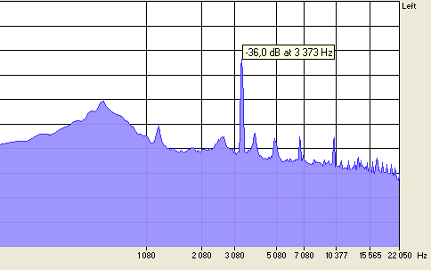
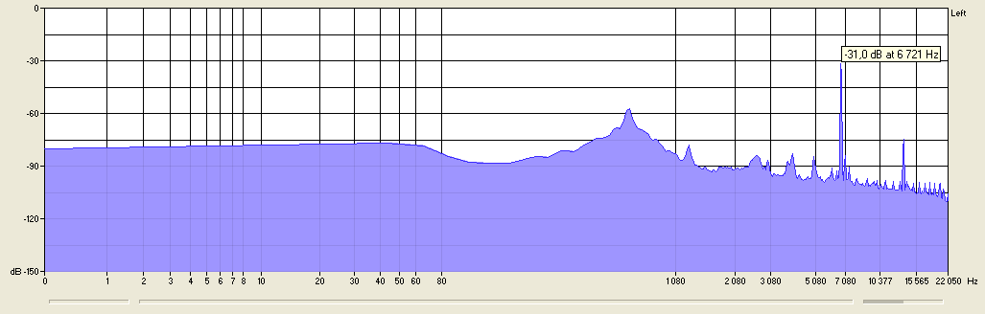
Experiments with Longitudinal Waves
2. Aluminium rod ( ρ_{AL} =2,7·10³ kg/m³ ; E_{AL} =70×10⁹ N/m² ; C_{L(Al)} = 5082.4 m/s )
Length of the rod 2: l= 0.75m
The first harmonic: λ₁=1.5m ; ν₁=3388 Hz ; nodes: 0.37m
The second harmonic: λ₂=0.75m ; ν₂=6776 Hz ; nodes: 0.19m , 0.56m
The third harmonic: λ₃=0.5m ; ν₃=10 164 Hz ; nodes: 0.12m , 0.37m , 0.63 m
If hold the rod in the place where nods of several modes are placed all these modes will occur.
Touching the rod at the ends will stop the sound .
holding in center
ν₁
ν₃
ν₂
holding at l/4

Slide 12
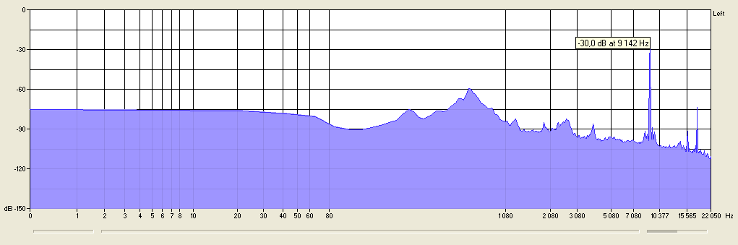
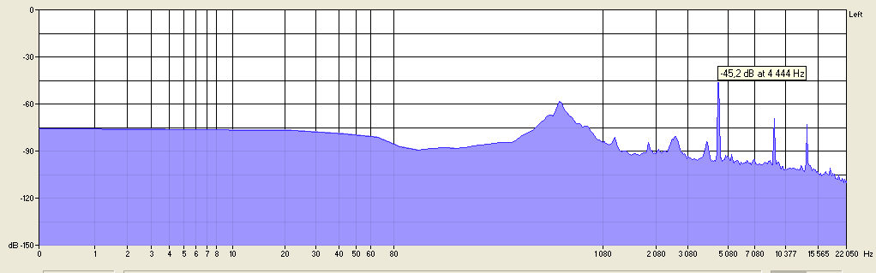
Experiments with Longitudinal Waves
3. BRASS rod ( ρ_{Br} =8,5·10³ kg/m³ ; E_{Br} =95×10⁹ N/m² ; C_{L(Br)} = 3480 m/s )
Length of the rod 3: l= 0.4m
The first harmonic: λ₁=0.8m ; ν₁=4350 Hz ; nodes: 0.2m
The second harmonic: λ₂=0.4m ; ν₂=8700 Hz ; nodes: 0.1m , 0.3m
The third harmonic: λ₃=0.27m ; ν₃=13 050 Hz ; nodes: 0.07m , 0.2m , 0.33 m
If hold the rod in the place where nods of several modes are placed all these modes will occur.
Touching the rod at the ends will stop the sound .
holding at 1/4
ν₂
holding in center
ν₁

Slide 13
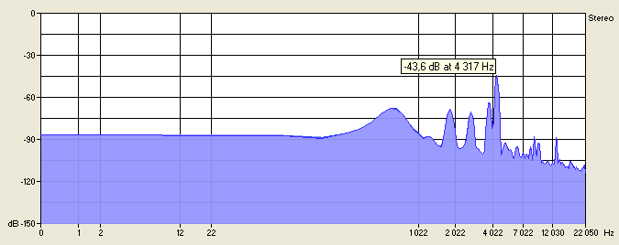
Experiments with Longitudinal Waves
4. STEEL rod ( ρ_{St} =7,8·10³ kg/m³ ; E_{St} =200×10⁹ N/m² ; C_{L(St)} = 5150 m/s )
Length of the rod 4: l= 0.6m
The first harmonic: λ₁=1.2m ; ν₁=4291 Hz ; nodes: 0.3m
The second harmonic: λ₂=0.6m ; ν₂=8582 Hz ; nodes: 0.15m , 0.45m
The third harmonic: λ₃=0.4m ; ν₃=12 873 Hz ; nodes: 0.1m , 0.3m , 0.5 m
If hold the rod in the place where nods of several modes are placed all these modes will occur.
Touching the rod at the ends will stop the sound .
holding in center
ν₁
ν₃

Slide 14
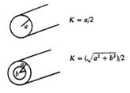






BENDING Waves
Wave equation
Eyler-Bernoulli beam theory equation of motion
Where y is displacement normal to rod axis.
"Radius of Gyration":
z is distance from central axis of rod.
Here shear deformations and rotary inertia are neglected.
Harmonic solutions are of the following form:
is the wave (propagation) number.
Velocity is dependent on frequency. So here is dispersion.
Rossing, Fletcher “Physics of Musical Instruments”

Slide 15




Frequency Modes of Standing Bending Waves
Frequency modes depend on the end conditions
For our task we consider FREE end - no torque and no shearing force
They give restrictions on standing wave frequencies:
And wave lengths:
,

Slide 16

To obtain actual frequencies multiply by
Note: Frequencies for bending waves are sufficiently lower than for the the longitudinal waves
due to extra coefficient .
Higher modes are vanishing very rapidly.
Waves are damped for supported or clamped ends

Slide 17







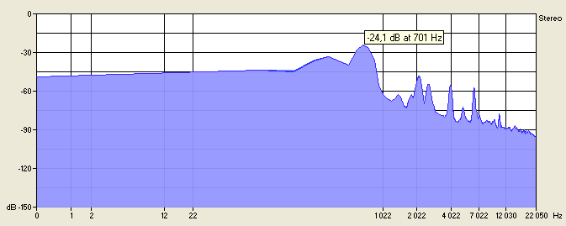

Experiments with BENDING Waves
1. Aluminium rod ( ρ_{AL} =2,7·10³ kg/m³ ; E_{AL} =70×10⁹ N/m² ; C_{L(Al)} = 5082.4 m/s )
FREE Ends
; ;
Length of the rod 1: l= 1,2m ; Radii: a=0.005m, b=0.004m ; K=0.0032m
The first harmonic: λ_{B1}= 1,596m ; ν₁= 40 Hz ; nodes: 0.27m , 0,93m
The second harmonic: λ_{B2}= 0,96m ; ν₂=110 Hz ; nodes: 0.16m , 0.6m , 1.04m
The third harmonic: λ_{B3}= 0.69m ; ν₃=215 Hz; nodes: 0.11m, 0.43m, 0.77m, 1.09m
holding in center

Slide 18

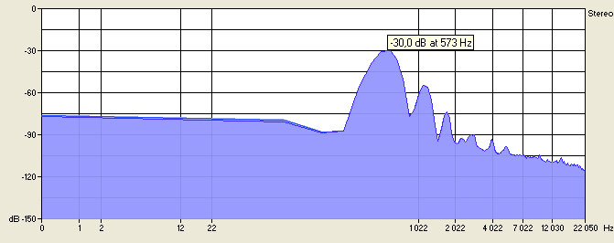
Experiments with BENDING Waves
4. STEEL rod ( ρ_{St} =7,8·10³ kg/m³ ; E_{St} =200×10⁹ N/m² ; C_{L(St)} = 5150 m/s )
FREE Ends
; ;
Length of the rod 4: l= 0.6m ; Radius a= 0.007m ; K=0.0035m
The first harmonic: λ_{B1}= 0.8m ; ν₁= 190 Hz ; nodes: 0.13m , 0.47m
The second harmonic: λ_{B2}=0.48m ; ν₂= 525Hz ; nodes: 0.08m , 0.3m , 0.52m
The third harmonic: λ_{B3}=0.34m; ν₃= 1029Hz; nodes: 0.056m, 0.21m, 0.39m, 0.544m
If hold the rod in the place where nods of several modes are placed all these modes will occur.
Touching the rod at the ends will stop the sound .
ν₂
holding at 0.3m

Slide 19
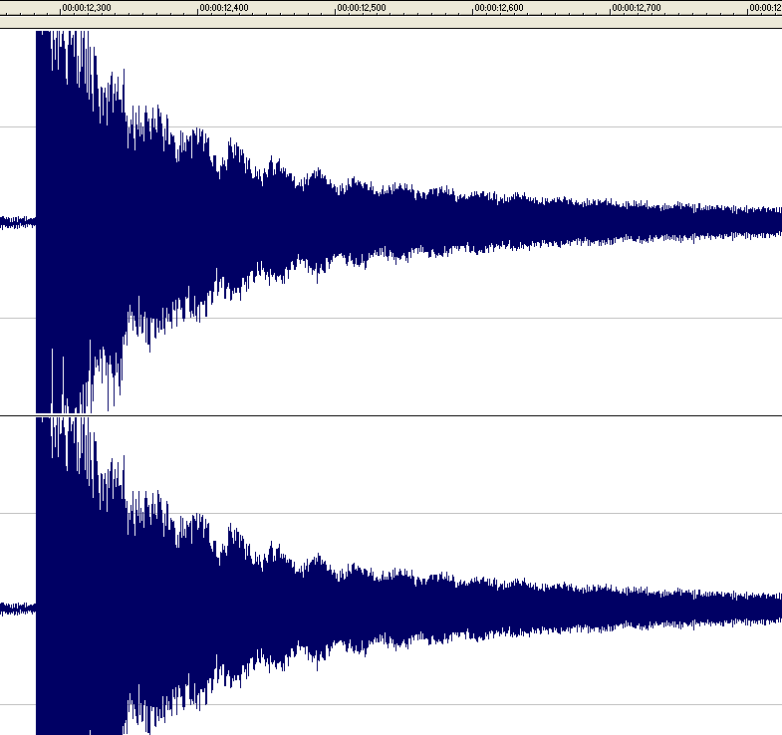
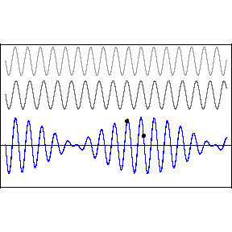
Beats
Sound in Experiments sometimes became stornger, sometimes weaker.
This was because of Beats.
A beat is an interference between two sounds of slightly different frequencies.
Our experimental Beats

Slide 20
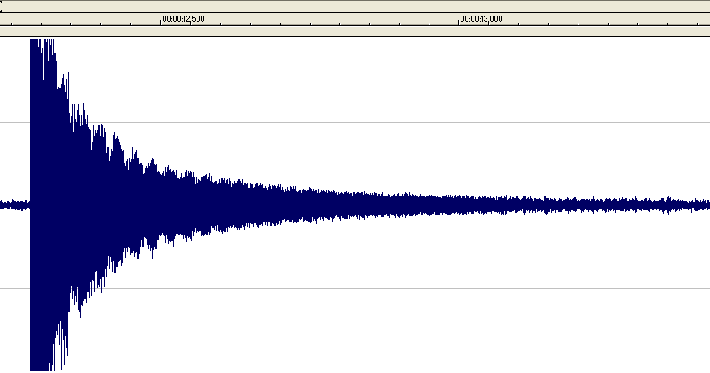




Sound Damping
Sound damps exponentially
Damping is higher for higher frequencies.
We saw it comparing damping for transverse and longitudinal waves.
- Internal Damping The "decay time"
- Air damping. The "decay time"
- Transfer of energy to other systems (e.g. supports) (G- "energy conductance")
Rossing, Fletcher “Physics of Musical Instruments”

Slide 21
Conclusion
There are different types of waves in the rod
The type of wave depends on how do we hit the rod.
The frequency of standing wave depends on where we hold the rod.
The frequencies of bending waves are lower than of compression waves
Damping of the waves depends on frequency

Slide 22
Thank you for your attention!

