Slide 1
NUMBER 1 INVENT YOURSELF
TEAM “RUEN”
Vasilka Krasteva - supervisor
Ivailo Nikolov - captain
Bozhidar Popov
David Stanislavov
Mila Yordanova

Slide 2
1. Invent yourself
Formulate an open problem on your own and solve it. Topic: experiments using a microscope. Allowed magnification: from 10X to 40X.

Slide 3
FORMULATE A PROBLEM
In a hot summer day two children bathe in the river to cool off. On the next day they come out in a rash on the skin. When biologist analyzing the riverbed they found contamination. What will be observed on the microscope slide?

Slide 4
RESOLVE A PROBLEM
With toothbrush and a plastic cup /closed cup/ we taken of material stones to the river bottom.

Slide 5
OBSERVATION

Slide 6
MOTIVATION
№ | Category water | Characteristics
1 | Receiving water 1 st category | Drinking water (for drinking, household needs and more).
2 | Receiving water 2 nd category | Clean rivers (water animal ,bathing, watering).
3 | Receiving water 3 rd category | Polluted rivers (water is not suitable for bathing, watering and watering).
4 | Receiving water 4 th category | Sewage (heavily polluted water).

Slide 7
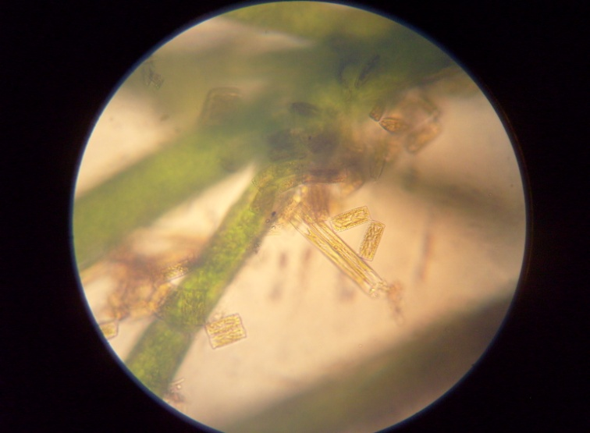
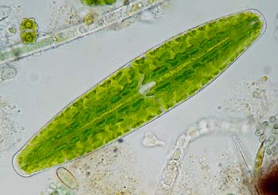
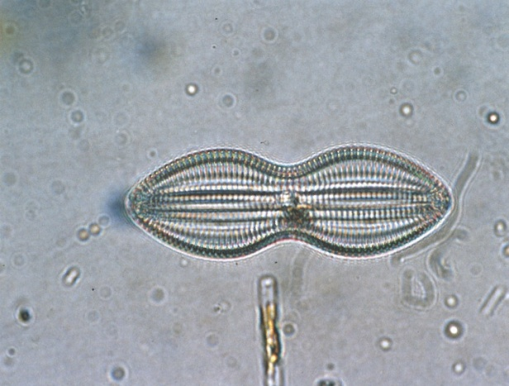
POLLUTED RIVERS
They observed larvae of invertebrates, unicellular animals (Amoeba, Pantoufle and eugleni and another)
Unicellular green and diatom
Bacteria
Decomposed waste plastic

Slide 8
CONCLUSIONS
The presence of large numbers of single-celled algae, unicellular animals, larvae of invertebrates and waste is an indicator of river pollution
Water source is likely III category, which is why children get a rash.
Receiving water 3 rd category is not fit for bathing.

Slide 9
THANK YOU FOR ATTENTION!

