Slide 1


Colorful bouquet
1
Problem 11
Report
Volkova Anastasya
Team «Vinegret»

Slide 2
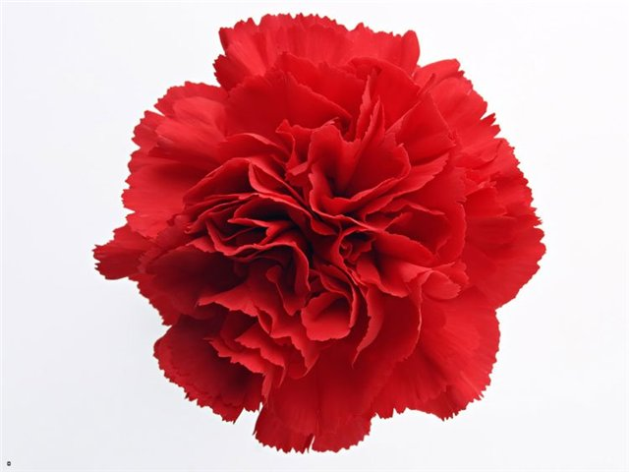
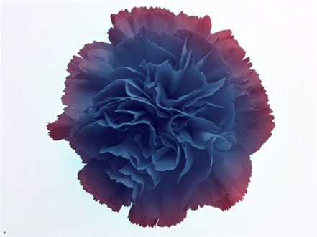
Problem
2
It is known that the color of a carnation flower can be changed if the plant is watered with an ink solution. Can the color of the flowers be changed by other methods? Explain the principle of your method. To what flowers is it applicable?

Slide 3

Purposes
3
Set the experiment
Theoretically explain the phenomenon
Find different ways to change the color
Identify the most effective way
Purposes
Theory
Purposes
Theory
Conclusions
Practice
Optimization

Slide 4
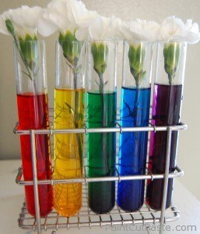
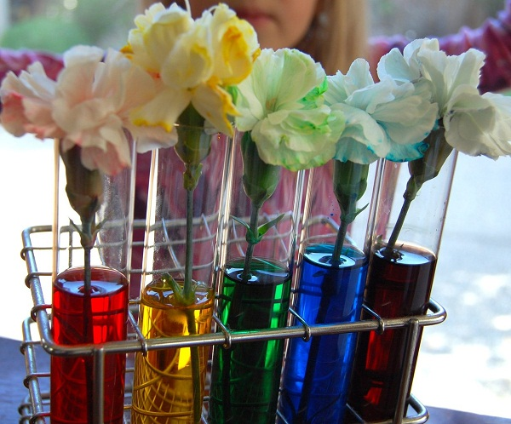
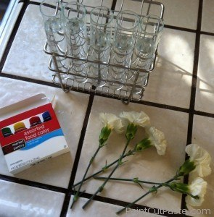
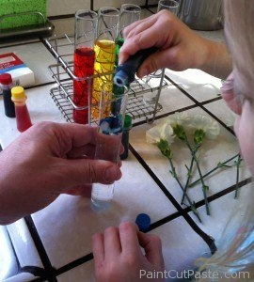
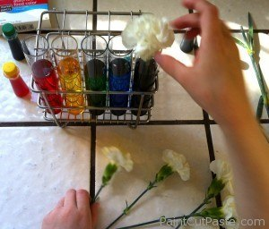
Experiment
4
Purposes
Theory
Conclusions
Practice
Optimization

Slide 5
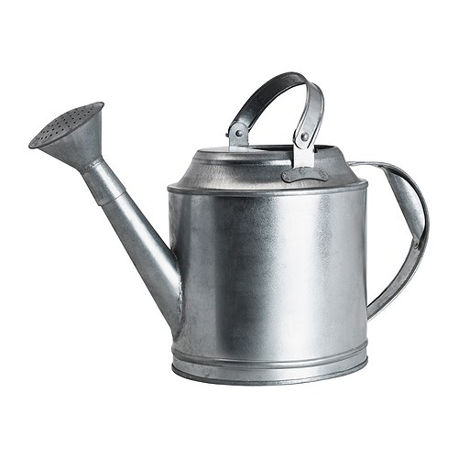
Explanation
5
Purposes
Theory
Conclusions
Practice
Optimization

Slide 6
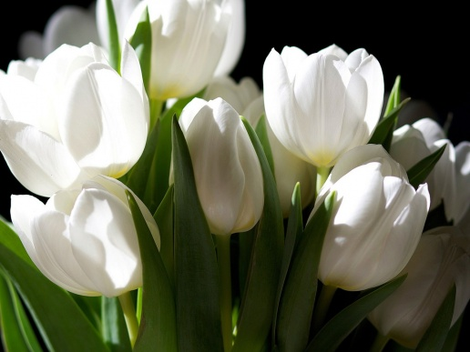
Structure of the flower
6
No pigment
Flowers look white
Sensitive to external influence
Easily colored
Purposes
Theory
Conclusions
Practice
Optimization

Slide 7
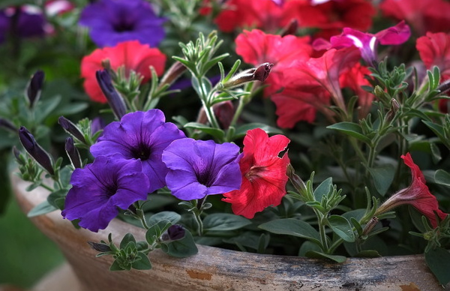
Structure of the flower
7
Anthocyanin
Gives flowers red or violet color
Can be used as pH indicator
Easily soluble in water and chemical polar solutions
Purposes
Theory
Conclusions
Practice
Optimization

Slide 8
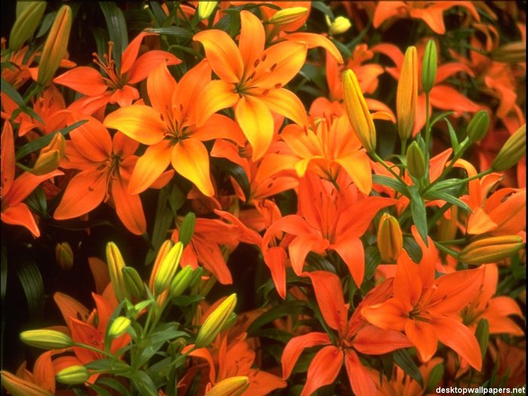
Structure of the flower
8
Flavone
Gives flowers yellow and orange color
Protect flowers from UV
Poorly soluble in water
Easily soluble in organic solvent
Purposes
Theory
Conclusions
Practice
Optimization

Slide 9
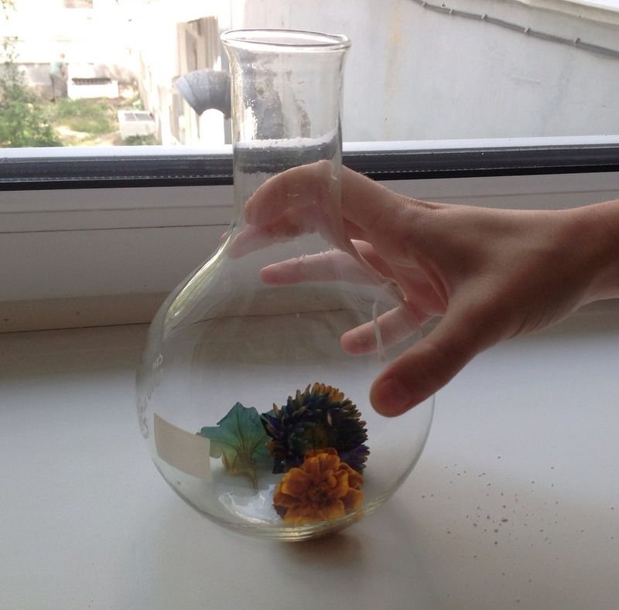
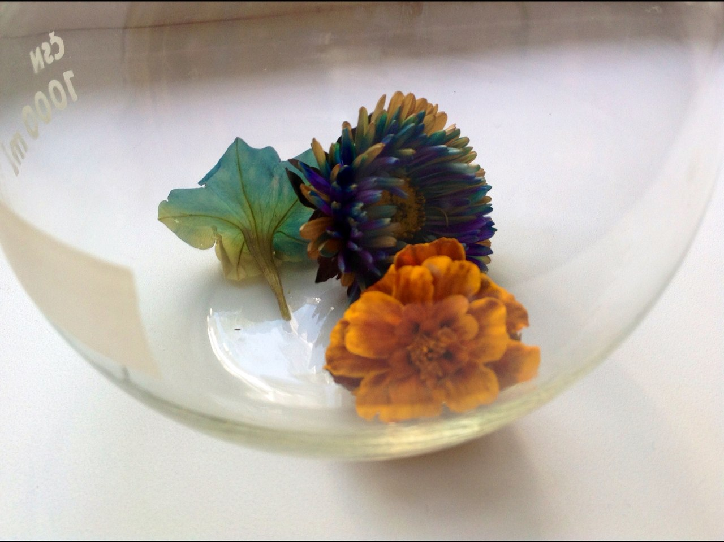
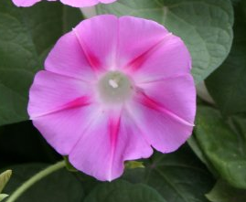
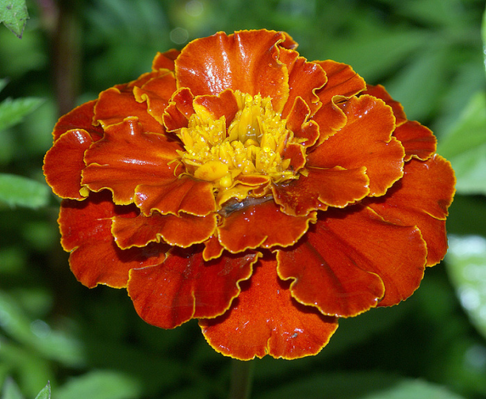
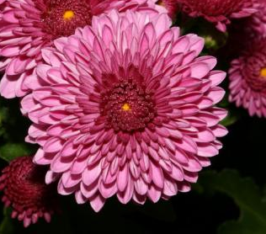
Different way
9
Ammonia vapor creates an alkaline environment in the petals and change the color
Purposes
Theory
Conclusions
Practice
Optimization

Slide 10
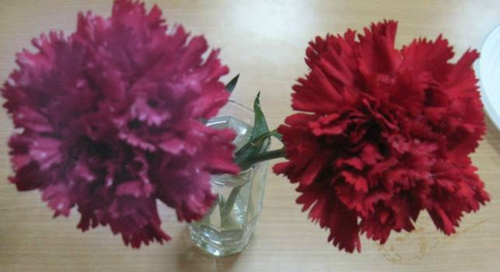
Different way
10
Sulphurous acid discolor flowers because of high pH
Purposes
Theory
Conclusions
Practice
Optimization

Slide 11
Different way
11
Purposes
Theory
Conclusions
Practice
Optimization

Slide 12
Conclusions
12
Pigment gives the flower color
Brightness depends on concentration of pigment
Conductive texture of stem allows water lift to the petal
Anthocyanin is degraded at higher pH
Flavones are degraded at alkaline
The most effective change of color gives ammonium
Purposes
Theory
Conclusions
Practice
Optimization

Slide 13

Thanks for your attention

