Slide 1
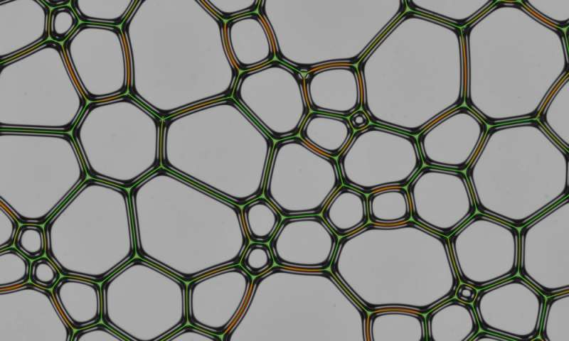
1. 2D FOAM
TEAM KAZAKHSTAN

Slide 2
THE TASK
Soap foam enclosed between two glass sheets appears as a network of polygons. Such foams evolve with time, as individual bubbles move and coalesce, and the liquid drains out. Investigate the structure and evolution of 2D foams.

Slide 3
PLUSES & MINUSES OF THE REPORTER
+
-
Speech
Quality of theory
Quality of experiment
Comparison theory with experiment
Time
Speech
Quality of theory
Quality of experiment
Comparison theory with experiment

Slide 4
CONCLUSION (REPORTER)
EXPLANATION THEORY EXPERIMENT COMPARISION ANSWERING
NEED SOME CORECTIONS
GOOD
TECHNICAL LEVEL OF PRESENTATION
DISCUSSION SPEAKING
EXCELLENT

Slide 5
THANK YOU FOR ATTENTION!!!

