Slide 1
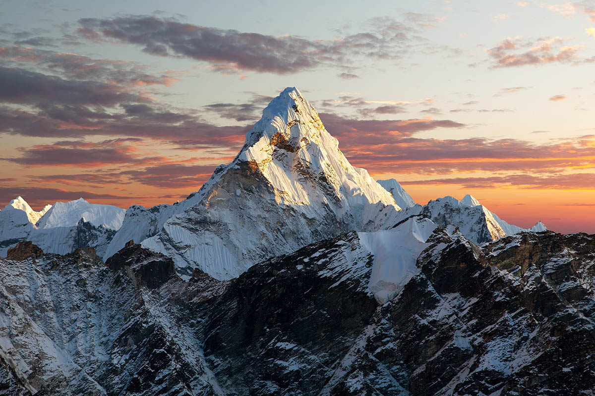
2.MOUNTAINS
TEAM KAZAKHSTAN

Slide 2
THE TASK What are the tallest mountains in the Solar system? Propose and analyse the theoretical models that can allow predicting the maximum attitudes of mountains on various celestial bodies

Slide 3
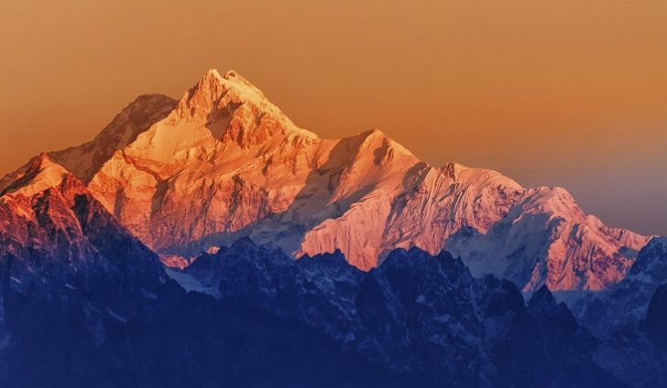
INTRODUCTION:WHAT IS THE MOUNTAIN?

Slide 4
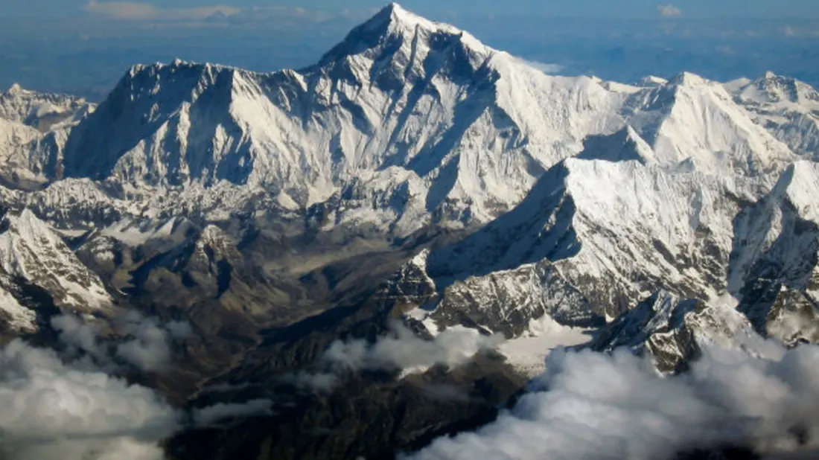
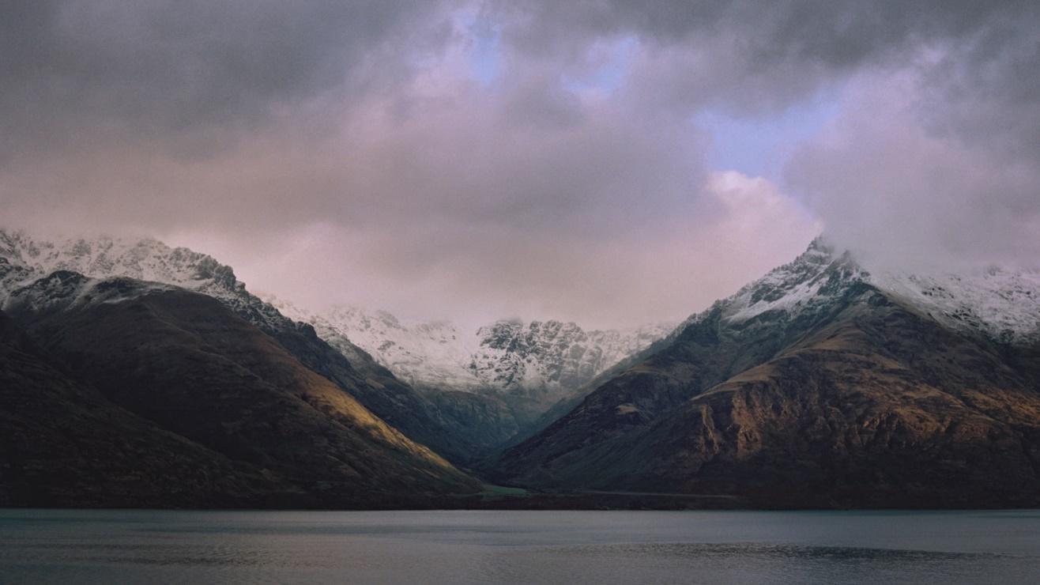
1.Erosion
2.The strength of the crust and mantle supporting the mountain
3.The composition of the mountain
4.Gravity

Slide 5
THE TALLEST MOUNTAINS IN THE SOLAR SYSTEM
Celestial body | Highest peak (s) | Height,km | Origin | Notes
Mars | Olympus Mons | 26 | volcanic | Rises 26 km above northern plains. 1000 km away. Summit calderas are 60 x 80 km wide, up to 3.2 km deep; scarp around margin is up to 8 km high.
Vesta | Rheasilvia Mons | 22 | impact | Almost 200 km (120 mi) wide.
Saturn’s Moon Iapetus | Equatorial Ridge | 20 | uncertain | Individual peaks have not been measured
Jupiter’s moon Io | Boösaule Montes | 18.2 | tectonic | Has a 15 km (9 mi) high scarp on its SE margin
Mars | Ascraeus Mons | 14.5 | volcanic | Tallest of the three Tharsis Montes

Slide 6
DETERMINIG THE MAXIMUM HEIGHT:FIRST METHOD
$$A_{mg}=E_{mel}$$
$ρ$gh$∆$h= $ρ$g $\text{λ} ∆$h
$$\text{h}\text{=}\text{λ}\text{/}\text{g}$$
h-the maximum height of the mountain
𝛌-heat of fusion of rocks
g- gravitational acceleration

Slide 7
COMPARISON(1)
THE NAME OF THE MOUNTAIN | ACTUAL HEIGHT | MEASURED HEIGHT
Olympus Mons
Rheasilvia Mons
Equatorial Ridge
Boösaule Montes
Ascraeus Mons

Slide 8
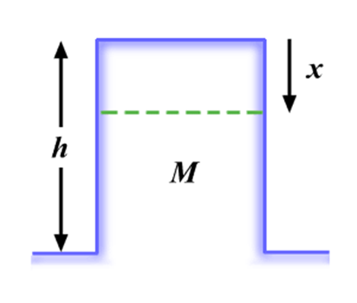
THE SECOND METHOD
MgX=$E_{mel}$XS or Mg=$E_{mel}$nS
M < $E_{mel}$nS/g
M=hSnm=hSnAm*_{p}
h < $E_{mel}$/(А m**_{p}g).
*$m_{p}≈m_{n}$
** m of SiO₂ =A$m_{p}$
h- the max height;
M- the mass;
g- gravitational acceleration;
$E_{mel}$- melting energy;
X-the mountain sinks by this height;
N-the number of moleculs;
S-area

Slide 9
COMPARISON(2)
THE NAME OF THE MOUNTAIN | ACTUAL HEIGHT | MEASURED HEIGHT
Olympus Mons
Rheasilvia Mons
Equatorial Ridge
Boösaule Montes
Ascraeus Mons

Slide 10
THE THIRD METHOD
V ≈ r² h
W≈ ρgr²h
A≈ r²
σ ≈ W/A ≈ (ρ g r²h)/r² ≈
ρgh
ρgh_{m ax} = σ_{C}.
h_{max} ≈ σ_{C}/(ρg)
h
r
V – volume;
W – weight;
A – area;
R- radius;
g- gravitational acceleration;
σ- tensile strength

Slide 11
COMPARISON(3)
THE NAME OF THE MOUNTAIN | ACTUAL HEIGHT | MEASURED HEIGHT
Olympus Mons
Rheasilvia Mons
Equatorial Ridge
Boösaule Montes
Ascraeus Mons

Slide 12
THE FORTH METHOD
P-
h-the max height;
g-gravitational acceleration;
P=$ρ$gh
hg=P/$ρ$
$h_{1}g_{1}=h_{2}g_{2}$
$$h_{everest}g_{everest}=h_{olympus}g_{mars}$$
$$5/2h_{everest}=h_{olympus mons}$$

Slide 13
COMPARISON(4)
THE NAME OF THE MOUNTAIN | ACTUAL HEIGHT | MEASURED HEIGHT
Olympus Mons
Rheasilvia Mons
Equatorial Ridge
Boösaule Montes
Ascraeus Mons

Slide 14
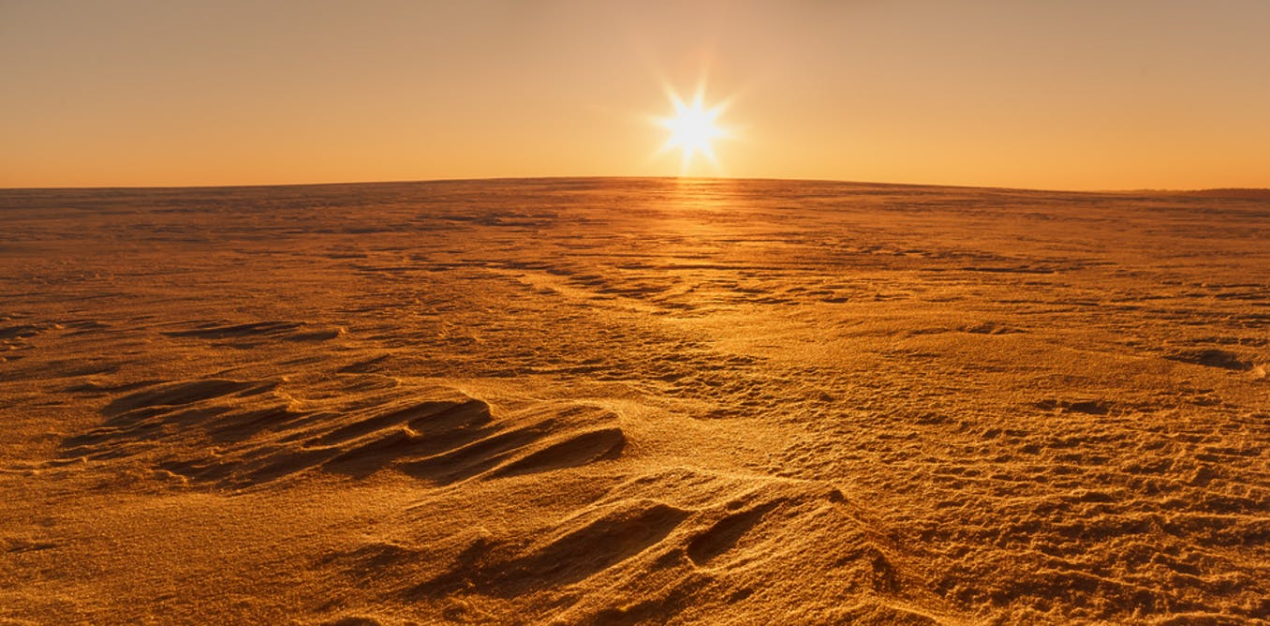
SOLVING
For all problems: $g_{mars}=3.7m/{s^{2}}$
For 1st problem:
𝛌≈250𝑘𝐽/kg
For 2nd problem:
$m_{p}$=1.67${×10}^{−27}$ kg for Si$O_{2}$
$E_{mel}$=0.3eV;e= $1.6×{10}^{−19}$
the mass number of silicon atom is 28, that of oxygen is 16, so A = 28 + 216 = 60
For3rd problem:
σ$≈2.5×{10}^{8} pa\left(basalt\right)$
$$ρ≈2900+3900{kg}/{m^{3}}$$

Slide 15
G = 1,796 м/с²(io)
3,53 г/см³
Bazalt
G- 0,223 м/с²(Iapetus)
1,09 г/см³

Slide 16
CONCLUSION
The maximum height of mountain depends on the composition of the mountain & the gravity

Slide 17
THANK YOU FOR ATTENTION!

Slide 18
USED LINKS
https://www.khanacademy.org/science/how-tall-can-mountains-get
https://talkingphysics.wordpress.com/2011/09/08/how-high-can-mountains-be/
http://www.hk-phy.org/articles/mount_high/mount_high_e.html

