Slide 1
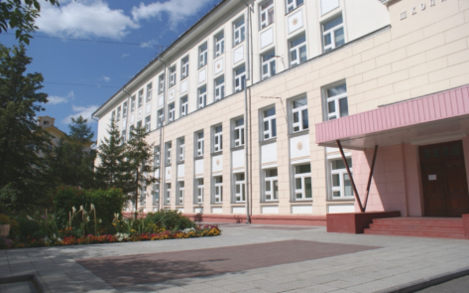
The 7th International Young Naturalists' Tournament
Problem № 2 «Mountains»
Daria Metel
Team «Element»
Russia, Novosibirsk
chnmk@mail.ru

Slide 2
The task
What are the tallest mountains in the Solar System? Propose and analyze the theoretical models that can allow predicting the maximum altitudes of mountains on various celestial bodies.

Slide 3
Hypothesis
If you calculate the scale of the image and the size of a real space object, you can determine the size of the mountain by the length of the shadow.
Aim of the study
Find a way to determine the altitude of the mountains of the astronomical object from satellite photographs with acceptable accuracy.

Slide 4
Objectives
To study the theory of the research topic, which contains data on how to determine the heights of mountains. Carry out theoretical research on known data.
Output a formula for calculating the height of the relief elements of an astronomical object.
Experimentally check the correctness of the formulas using a layout.
On the basis of formulas to write a program for convenient calculation of elevation of relief elements.
Calculate the height of the lunar mountain.

Slide 5
Theory
Mountain – shaped relief, isolated sharp rise of terrain with pronounced slopes and foot or peak in a mountainous country.
The relative height of the peak is a characteristic of a mountain peak, often used to decide whether it should be considered an independent mountain. It is used and calculated mainly by mountain lovers. Relative height is the excess of one point on the earth's surface over another
Absolute height – the height of any point on the Earth's surface above sea level. It is positive (terrain above sea level) and negative (terrain below sea level).

Slide 6
Theory
Terminator – a light separation line separating the illuminated (light) part of the body (e.g. the cosmic body) from the unlit dark part.
Diameter – a segment connecting two points on a circle and passing through the center of the circle, as well as the length of this segment. The diameter is equal to two radii.
Inkscape – is a high-quality professional vector graphics tool for Windows, Mac OS X and Linux.

Slide 7
Theory
To measure the height of the lunar mountain, we need to derive a formula for finding the height of any mountain on the photo, in the initial data we have an image of the moon, which shows the shadow of the mountain and the known diameter of the moon.
tgα= H / S (1),
H = S×tg α,
S - length of the shadow; α - angle of incidence of sunlight
α

Slide 8
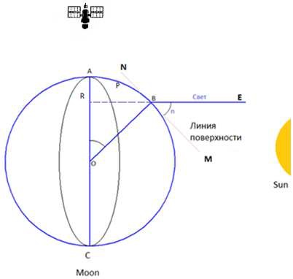
Theory
α = 180×P/π×r (from the arc length formula P=π×r×n/180), which is easily proved by considering the ODS triangle with the outer angle of the OBE.
Where P is the length of the arc in pixels, the boundaries of which are A- some point on the terminator
And point B is the center of the base of the mountain;
π ≈ 3,14;
r - moon radius,
α is the desired angle.
α
Light
Surface line

Slide 9
Theory
D/Dpix - ratio of the Moon diameter in km to the Moon diameter in the image in pixels, or, in other words, the scale of the image.
It is important to note that α=180×P/π×r is a slightly simplified formula for calculating the angle.
It gives an accurate result under two conditions:
The angle of incidence should be small;
The terminator should be near the center of the Moon's disk.

Slide 10
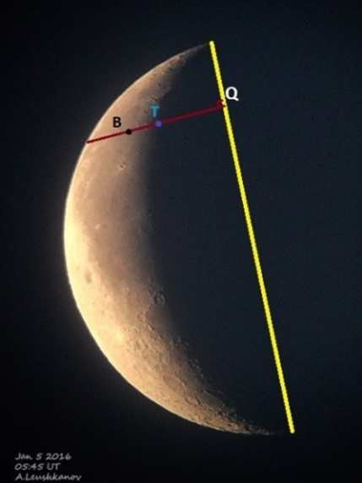
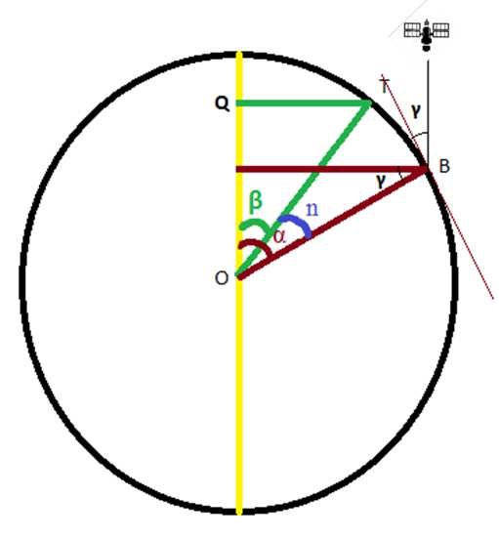
Theory
In a more general case, when the terminator lies far from the center of the moon's disk, P (the distance from the object to the terminator) will look smaller in the photo due to the fact that it will be observed at an angle (as well as the shadow).
𝞪
𝞭

Slide 11
Theory
The yellow line in the figure shows the diameter connecting the terminator end points. If the mountain lies at a considerable distance from this line, its shadow is visible at some angle γ, and because of this it seems to be smaller than it actually is. In order to find the true length of the shadow, the visible length of the shadow S is divided by sin γ.
𝞭

Slide 12
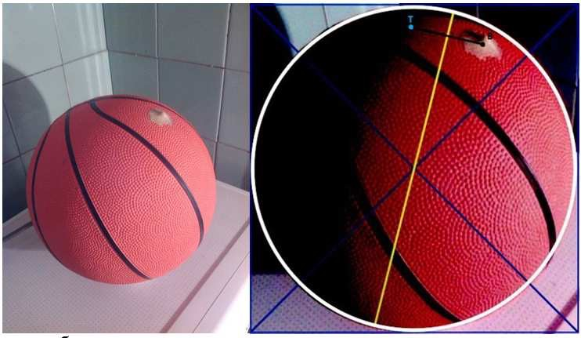
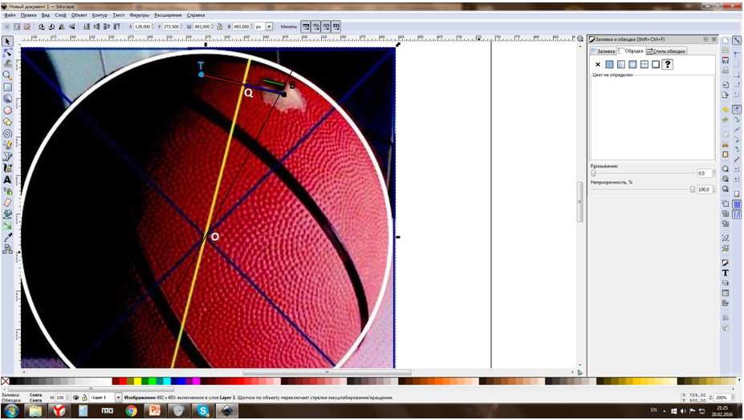
Experiment 1.
Let's check the truthfulness of the formula (2), reproduce the conditions in the form of a layout. On a regular basketball ball we will put a plasticine "mountain" and take a picture of it in a dark room, illuminating one of the sides so that our "mountain" cast a shadow. We'll edit the photo and calculate it in the inkscape editor.

Slide 13
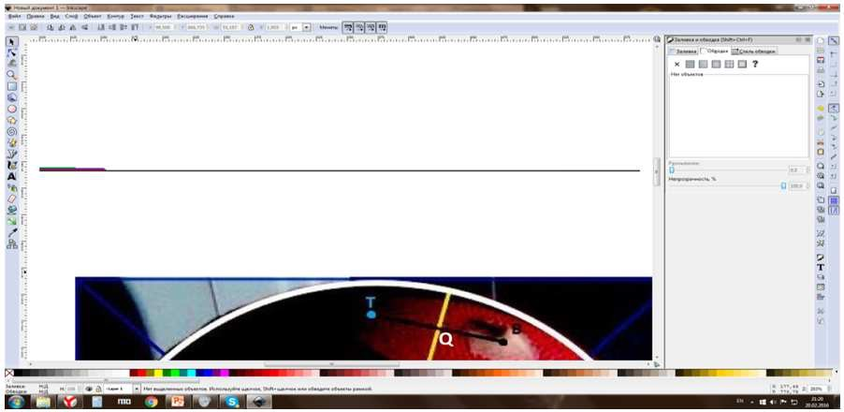
Experiment 1.
Make the necessary measurements by drawing straight lines and applying them to the pixel ruler.
Conclusion: By substituting the values of the variables into formula (2) and calculating the height of our plasticine "mountain" we get the value of 0.7002 cm ± 0.05 cm. Having measured our «mountain» with a caliper, we got the value of 0,6 cm, therefore the accuracy of calculation=83,3%

Slide 14
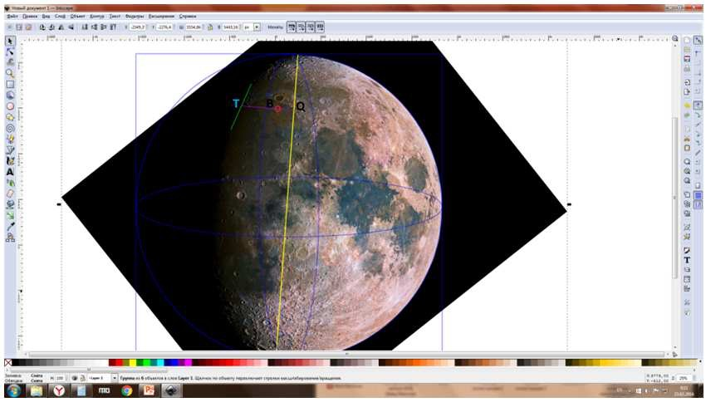
Experiment 2.
Having checked the formula on the layout, we can try to calculate the height of some real element of the lunar surface relief. For example, Mount Pico, located in the northern part of the Rain Sea.

Slide 15
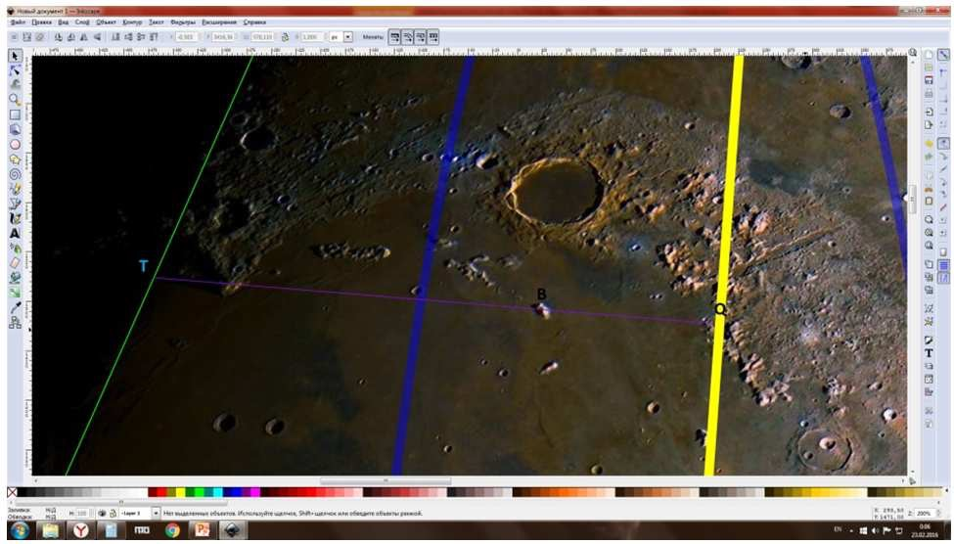
Experiment 2.
Let's calculate the snapshot in the Inkscape editor, measure the necessary parameters with a pixel ruler, substitute their values in the program.
S 9,96
BQ 180,68
TQ 577,11
R 1686,165
D moon (pix) 3372,33
D moon (constant) 3474
Outcome H: 2,5469

Slide 16
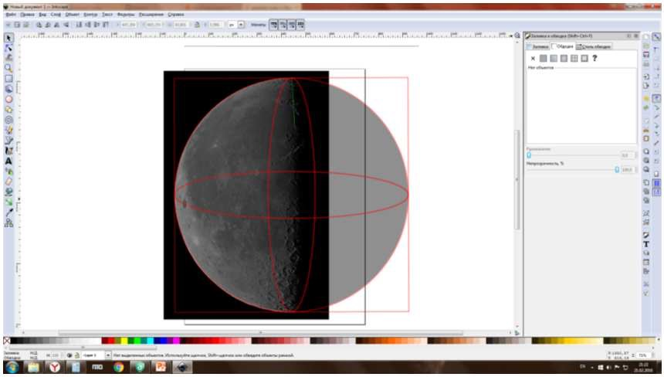
Experiment 3.
To make sure we calculate the exact altitude of Mount Pico, we'll run it again, but this time we'll take another picture of the moon in another phase of it.

Slide 17
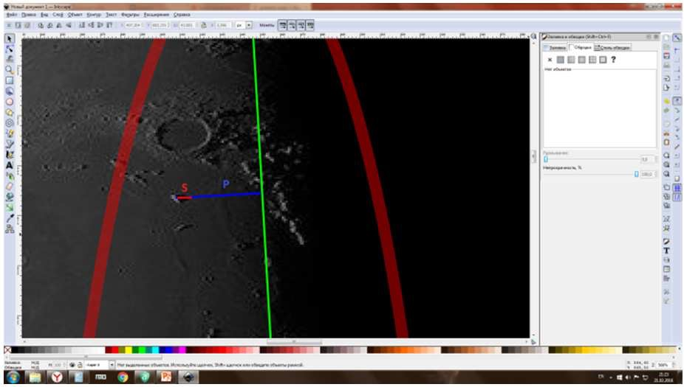
Experiment 3.
In this case, we will use formula (1), as all the necessary conditions for an accurate calculation are met. The calculation will take place in Microsoft Excel.
Initial data
S 7,5
P 42,87
r 483,8
D moon (pix) 967,6
D moon (constant) 3474
Outcome H: 2,3936

Slide 18
Experiment 3.
By measuring the same object twice, we can calculate the measurement error using this formula:
Conclusion: The height of Mount Pico H = 2470.25m ± 76.65m. The lunar surface atlas height of this mountain is 2420m, so the accuracy of our calculations is ≈ 98%.

Slide 19
Conclusions
Having completed the tasks in turn, we have found a reasonably accurate way to determine the altitudes of the Moon's relief elements from satellite images.
In the course of our work we have calculated formulas that can be used to determine the heights of mountains. The initial data used are the diameter of the space body and the length of the shadows measured from the image.
In the practical part of the work we applied the obtained formulas for the experimental model, as well as calculated the heights of a number of mountains on the surface of the moon. The calculation was carried out in the Visual Basic programming environment using formulas derived during the work and tested experimentally.
Our approach allows us to calculate the elevation of the relief elements not only of the Moon, but also of any other space bodies.

Slide 20
The 7th International Young Naturalists' Tournament
Problem № 2 «Mountains»
Daria Metel
Team «Element»
Russia, Novosibirsk
chnmk@mail.ru

Slide 21
Theoretical part of the research
Heavenly body | mountain | Absolute height, km | Relative height, km
Mars | Olympus | 21,2 | 26
Vesta | Reyasylvia | 9 | 22
Yapet | Stan Yapet | 13 | 20
Io | South Boosavel | 17,5 | 18,2
Mars | Mountain of Askria | 18 | 14,9
Io | Mount Ionian |  | 12,7
Mars | Elisii | 16 | 12,6
Mars | Arsia | 19 | 11,7
Io | Euboea | 10,5 | 10,3-10,4
Land | Mauna-Kea | 4,2 | 10,2
Land | Teide | 3,7 | 7,5
Land | Jomolungma | 8,8 | 3,55

