Slide 1
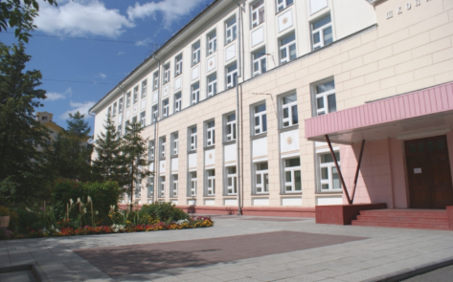
The 7th International Young Naturalists' Tournament
Problem № 7 «Burning glass»
Alina Nedikova
Team «Element»
Russia, Novosibirsk
chnmk@mail.ru

Slide 2
The task
Propose and test various methods to start a fire with a magnifying glass.
Hypothesis
If you change the characteristics of the collecting lens, you can influence the time of fire.

Slide 3
Aim of the study
Get the fire by using the collecting lens in the shortest time.
Objectives
Study the theoretical material on the research topic.
Consider how to make fire with a magnifying glass.
Experimentally obtain conditions under which the time of firing of the tinder will be minimal.
Identify the most suitable tinder for effective fire with a magnifying glass.
Do conclusions on the results of work.

Slide 4
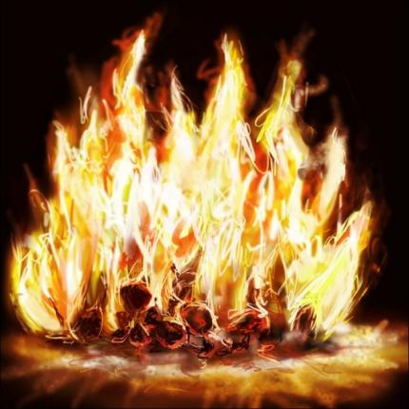
Theory
Fire – is an intensive oxidation process, accompanied by radiation in the visible range and the release of thermal energy.
This process is only possible with arbitrary (involuntary):
heating the combustible material to a certain point in the presence of oxygen;
during a chemical reaction;
the flow of electric current in the environment.

Slide 5
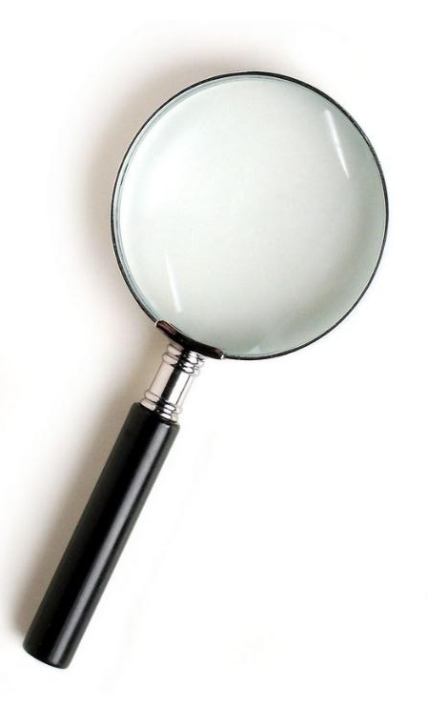
A magnifier – is an optical system consisting of a lens or several lenses designed to enlarge and observe small objects at a finite distance.
Theory
Types of lenses: Collecting: 1 – 3
Scattering: 4 – 6

Slide 6
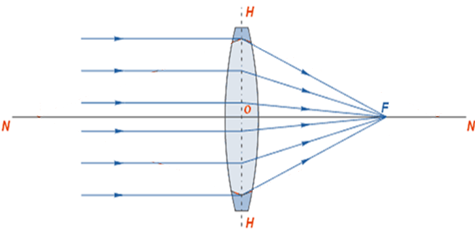
Theory
The focus of a lens – is the point at which the rays are collected after refraction.
The focal length – is the distance from the optical center of the lens to the focus.
Optical power – is a physical quantity that characterizes the refractive power of a lens.
D =
F – focal length of lens, [m]
D – optical power of the lens, [dptr]

Slide 7
Experiment 1.
Purpose: measure the time of occurrence of fire from the lens material.
Equipment: lens fixing device, lens (d=60mm, D=4 diopter), matches, thermometer.
Conclusion: a magnifier with a glass lens can be faster to get a fire, than a magnifier with a lens made of acrylic plastic.

Slide 8
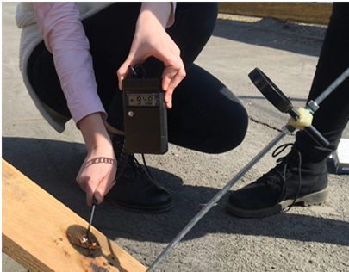
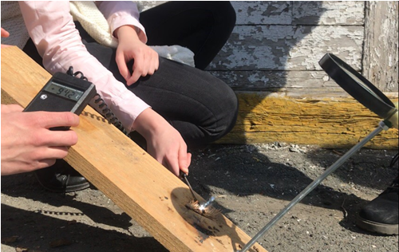
Experiment 2.
Purpose: establish the dependence of the time of fire from the optical power of the lenses.
Equipment: lens fixing device, lens (d=60mm; D=4, 6, 8, 12 diopter), matches, thermometer.

Slide 9
Experiment 2.
Conclusion: that the greater the optical power of the lens, the less time it takes to get the fire.

Slide 10
Experiment 3.
Purpose: to establish the dependence of the time of fire from the diameter of the lens.
Equipment: lens fixing device, lens (d=40mm, 60mm, 100mm; D=12 diopter), matches, thermometer.
d=40mm
d=60mm
d=100mm

Slide 11
Experiment 3.
Magnifier diameter | The average ignition temperature, °С | Radiation power, W | The average ignition time, s
40 mm | 94,8 ± 0,1 | 25,6 | 20,9 ± 1
60 mm | 94,9 ± 0,1 | 57,5 | 14,5 ± 1
100 mm | 94,8 ± 0,1 | 159,8 | 12,1 ± 1
Conclusion: if you use a magnifying glass of a larger diameter, then the time to receive fire will decrease.

Slide 12
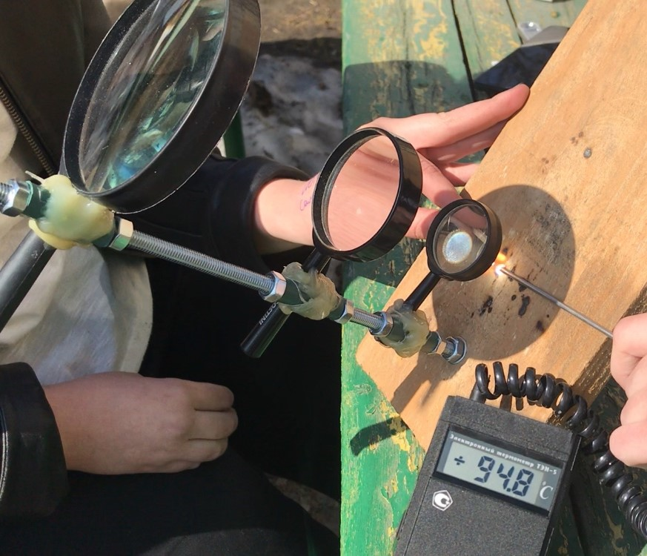
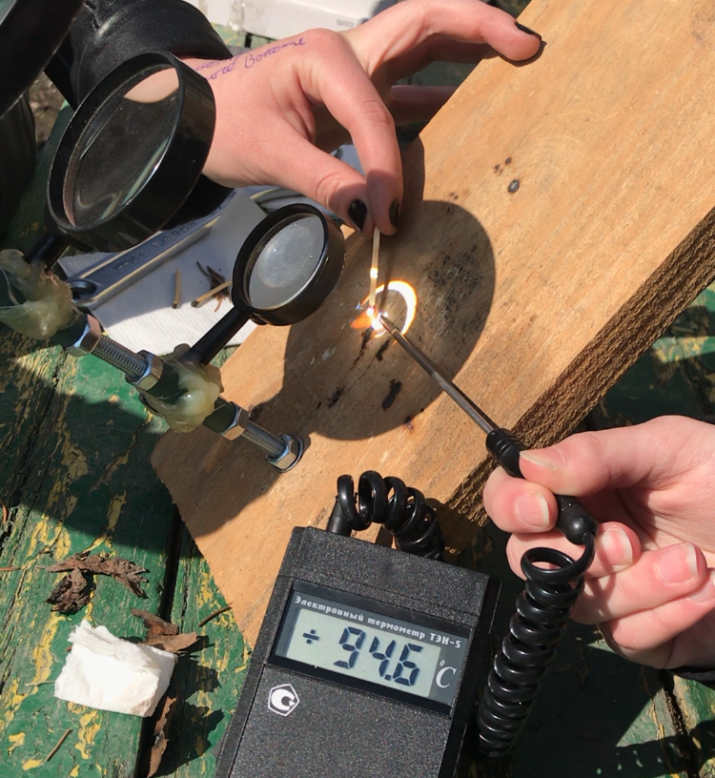
Experiment 4.
Purpose: to make a system of lenses of different diameters.
Equipment: installation of lenses (d=100mm, 60mm, 40mm; D=4 diopter), matches, thermometer.
D = D₁+D₂+D₃ = 4dptr +4dptr +4dptr =12dptr

Slide 13
Experiment 4.
Conclusion: if you use a lens system, the time of fire is reduced .

Slide 14
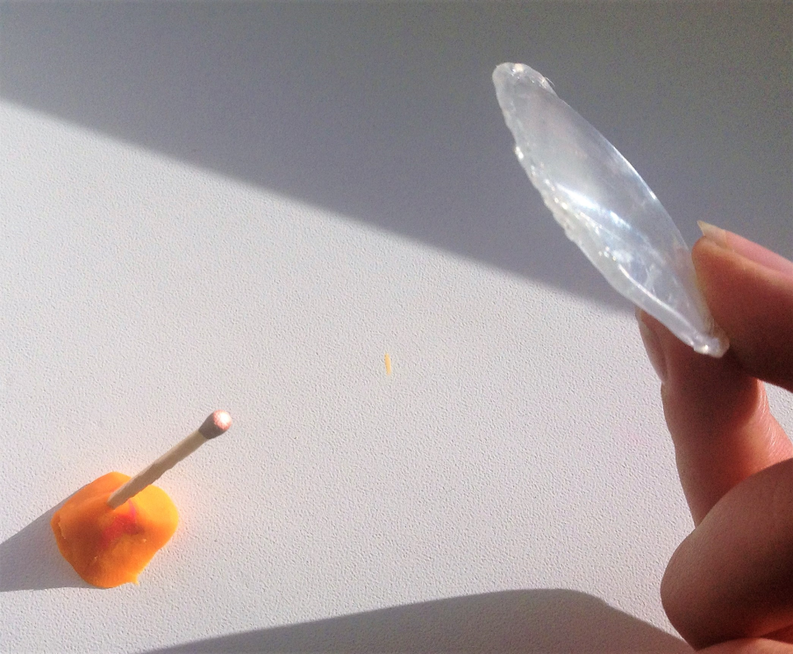
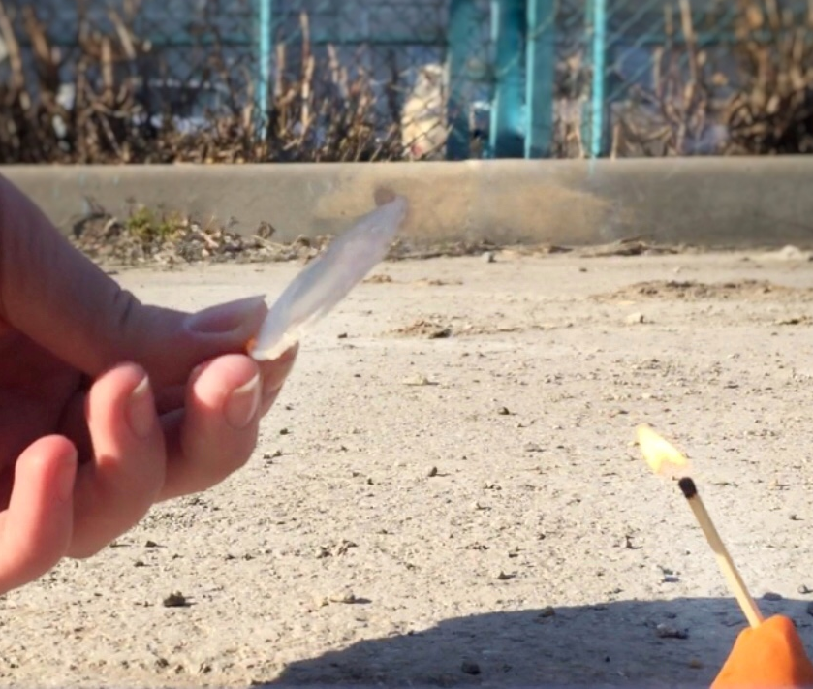
Experiment 5.
Purpose: make a collecting lens, and compare with the performance of previous experiments.
8 sm

Slide 15
Experiment 5.
Conclusion: using a homemade lens, you can light a fire, but for a longer period of time.

Slide 16
Experiment 6.
Purpose: measure the time of fire from a different tinder.
Sample | Theoretical value of the temperature °С | Experimental value of the temperature, °С | Time, s
Dry leaves | 75 | 76,6 ± 0,1 | 5,1 ±0,1
Birch bark | 90 | 90,1± 0,1 | 6,3 ±0,1
Napkin | 133 | 132,1 ± 0,1 | 23,3 ±0,1
Match | 95 | 94,9 ± 0,1 | 12,1 ±0,1
Fir needles | 113 | 113,4 ± 0,1 | 16,9 ±0,1
Conclusion: the most flammable tinder - dry leaves, as they have the minimal density and almost do not contain moisture.

Slide 17
Conclusions
In the course of the experimental part of the study, the properties of the lens that affect the time of receiving the fire were studied.
After conducting experiments, we found out that the tinder should be placed at the focal point of the lens. The time of appearance of fire depends on the material from which the lens is made, its optical power, as well as its diameter.
The minimum ignition time of a match will be when using a system of lenses - 7.8 s.

Slide 18
References
The textbook "Physics-8", M. Peryshkin. Enlightenment, 2017
Lens Brief - Copyright © 2005-2019 Cambridge in Color
Lens focal length - A. Shapoval
https://www.betaenergy.ru/insolation/novosibirsk/
http://optikarf.ru/lenses/
http://optica100.ru/sovety/kak_podobrat_lupu
http://glazzdorov.ru/ochki/kakie-vybrat-stekla-dlya-ochkov-plastik-ili-steklo.html
https://brodude.ru/9-sposobov-razzhech-ogon-bez-spichek/
http://chem21.info/

Slide 19
The 7th International Young Naturalists' Tournament
Problem № 7 «Burning glass»
Alina Nedikova
Team «Element»
Russia, Novosibirsk
chnmk@mail.ru

Slide 20
Marking | Focal length, sm | Optical power, dptr
2× | 25 | 4
2.5× | 16,67 | 6
3× | 12,5 | 8
4× | 8,33 | 12
5× | 6,25 | 16
7× | 4,17 | 24
7.5× | 3,85 | 26
10× | 2,78 | 36
12× | 2,27 | 44

