Slide 1
8. SMELLS
Team Croatia
Reporter: Marko Drozdek

Slide 2
8. SMELLS
Smells spread through the air, however it would take some time before a human nose is able to detect the smell. Study different aspects of odor diffusion and sensation of odor by humans.

Slide 3
Outline
Theoretical introduction
Experiment
Results
Sense of smell
Methods and measurements
Depandence of temperature
Depandence of distance

Slide 4
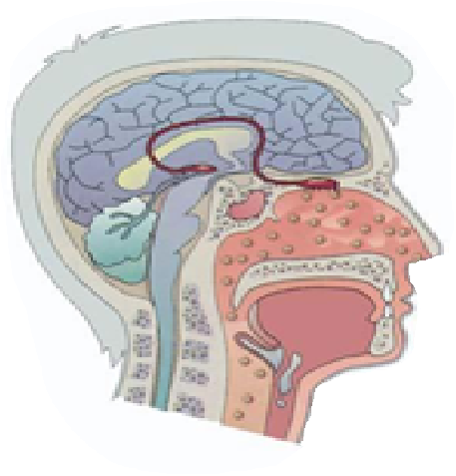
SENSE OF SMELL
SENSATION
SMELL PARTICLES
DIFFUSION
MUCUS
SATURATION

Slide 5
HYPOTHESIS
Longer distance more time for sensation
Higher temperature shorter sensation time

Slide 6
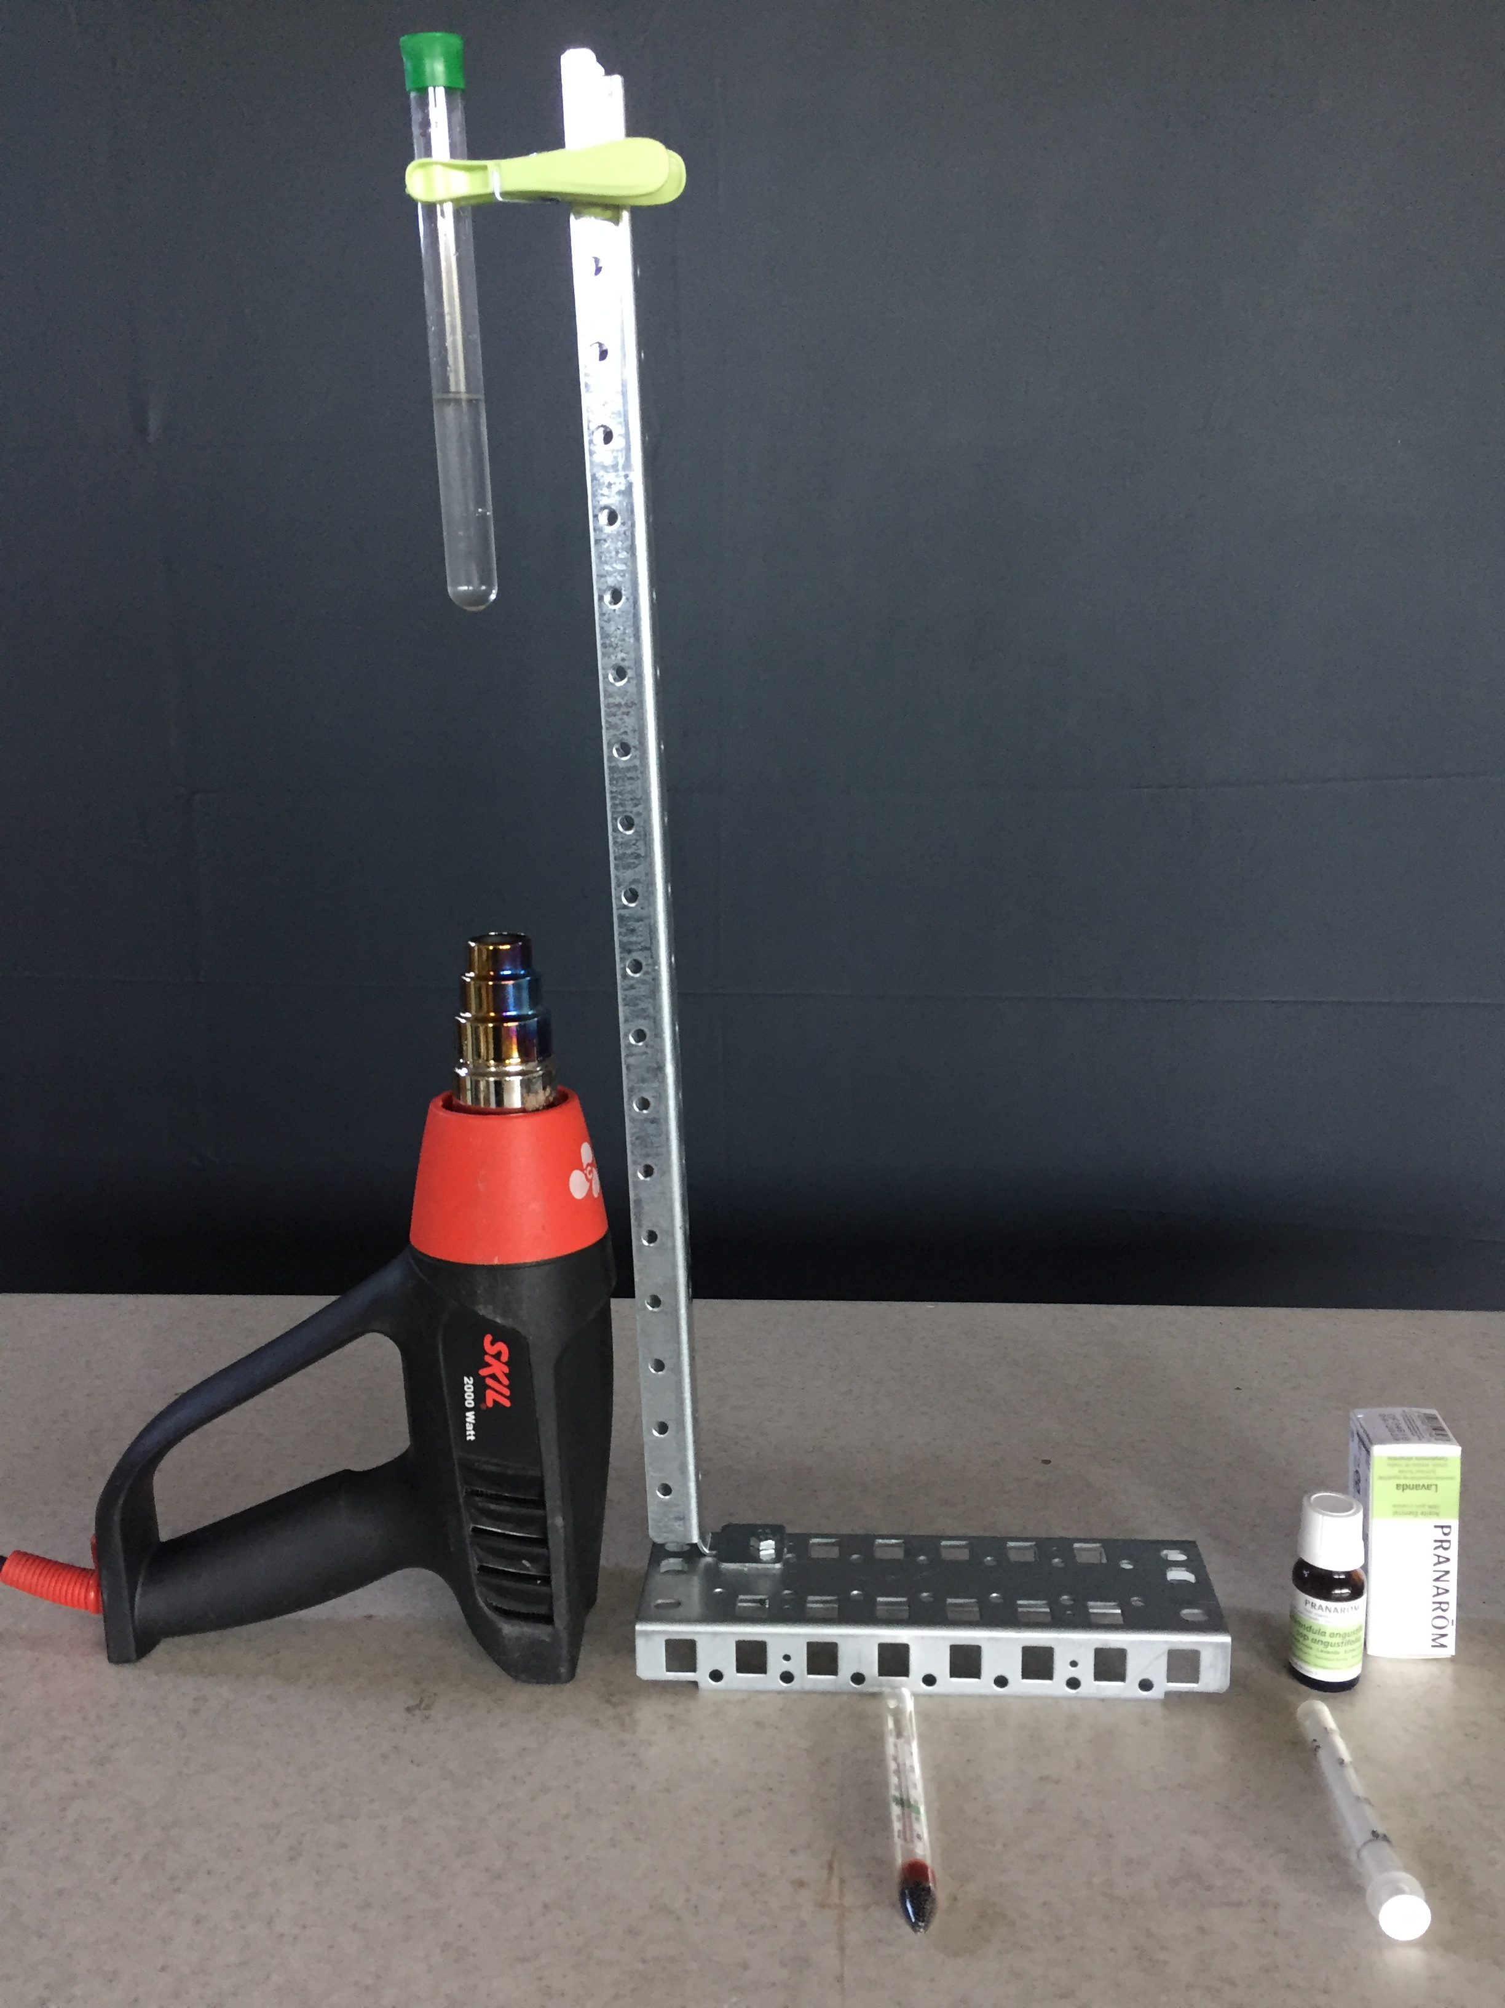
METHODS AND MESUREMENTS
8 respondents
Distance smell source and respondents
Solution temperature
Time stopwatches
Smell source
Respondents

Slide 7
RESULTS- DIFFERENT DISTANCES
Longer distance more time for sensation

Slide 8
RESULTS- DIFFERENT SOLUTION TEMPERTURES
Higher temperature shorter sensation time

Slide 9
CONCLUSIONS
Longer distance more time for sensation
Higher temperature shorter sensation time

Slide 10
Literature
[1.] Jurčić, Metzger, Vujaklija, Batinica : Čovjek, Mozaik knjiga, 2004.
[2.] Wilson : Čovječje tijelo, Školska knjiga, 1973.
[3.] Parsons : Ljudsko tijelo, Grafica Veneta, 2009.
[4.] Bastić, Begić, Novoselić, Popović : Biologija 8, Alfa, 2014.
[5.] http://www.enciklopedija.hr
[6.] http://tip.ba/2015/12/21/znanstvenici-presudili-u-vjecnoj-borbi-medu-spolovima-istina-je-muskarci-bolje-voze-ali-i-zene-imaju-svojih-jakih-aduta/
[7.] https://journals.plos.org/plosone/article?id=10.1371/journal.pone.0111733

Slide 11
Thank you!
Team Croatia
Reporter: Marko Drozdek

