Slide 1
No.10
Problem review
Chicken bones kept in acidic conditions for a few days become elastic. Perform such an experiment in controlled conditions and investigate what components of bones are responsible for their mechanical properties.

Slide 2
Advantages
1. Clear logic
2. Discussed the effects of different components of bones on the results.
3. The conclusions are clearly classified, and the experimental results tend to be in line with theoretical predictions.
4. Qualitative error analysis

Slide 3
Disadvantages
Theory :
1. Neglect the changes of the proteins in the acid.
Experiment:
1. Insufficient variable (acid concentration)
2. No quantitative comparison between theory and experiment
3. No quantitative error analysis
4. Part of the parameter change method is unknown
5. The precision of the measurement can be improved.
6. Device diagram without experimental facilities
7. No specific measurement method is given.

Slide 4
Discussion
1.About the choice of bone types. Why choose only one type of the bone?
2.About the control of experimental variables.
3. How do you understand the mechanical properties of bone? Stiffness, strength?
Notes:
1.Actually, different types of bones are different in composition, such as long bones and flat bones. You can enrich your theory by using different types of bones.
(The bone is divided into cancellous bone and dense bone.)
2. About the control of experimental variables.
Bone strength depends not only on composition, but also the internal structure of the bone. In our preliminary experiments, we can find that the bones in the acidic environment completely lost the original internal structure. How do you ensure that the measurements in the experiment are due to changes in bone composition rather than structural changes? You have no control variables and prove that other factors such as bone structure have not changed.

Slide 5
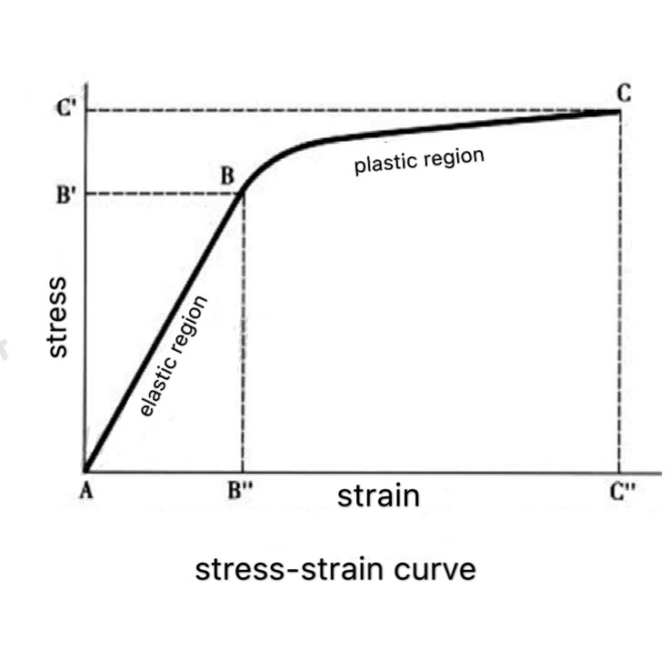
According to the definition of modulus and Hooke's law
The stiffness is estimated by calculating the Regression linear equation.
The slope can indicates the resistance to deformation.
Strength is estimated by calculating the area under the curve, which represents the amount of absorbed energy.

