Slide 1
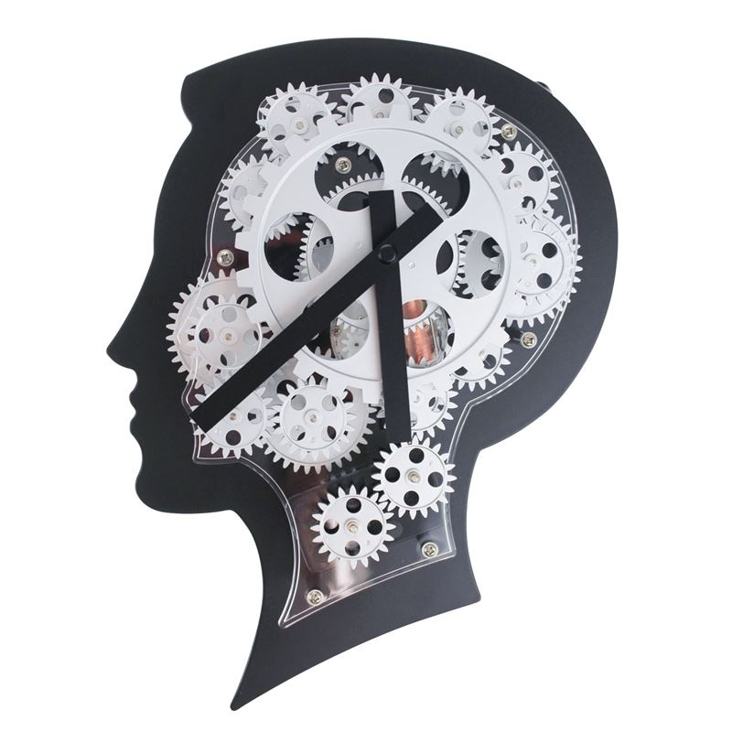
Problem №16 «Short-term memory»
ТЮЕ 2019
Speaker: Laletina Evgenia;
Team: 13 element
Voronezh

Slide 2
The task:
Our task condition:
What is the capacity and duration of a human’s short-term memory? Suggest an experimental study to evaluate short-term memory and factors that may have important influence.
To conduct a study on the size and duration of short-term memory and by conducting short-term tests on groups of participants of different age and gender.

Slide 3
Goal: Identify how short-term memory depends on various factors. Tasks:
Describe what memory is.
Find out what short-term memory is.
Identify the difference between short-term and long-term memory.
Find out what Miller’s number is.
Describe the duration of short-term memory.
Evaluate factors which influence on short-term memory by conducting short-term tests on groups of participants of different age and gender.

Slide 4
Theoretical part:

Slide 5
Memory:

Slide 6
Short-term memory:

Slide 7
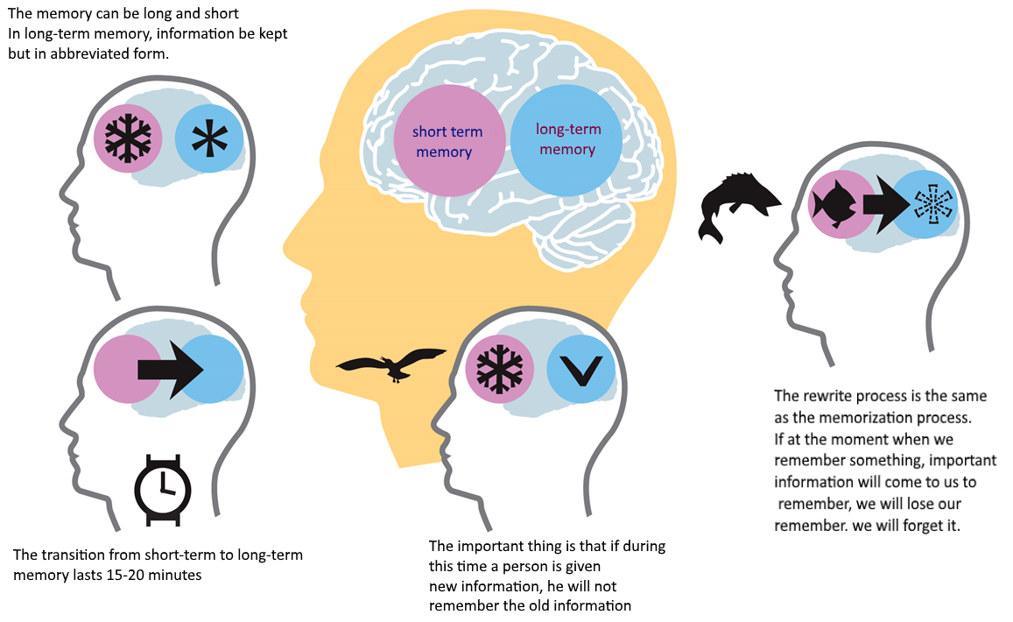
The difference between short-term memory and long-term memory:

Slide 8
Duration short-term memory:

Slide 9
Millers number

Slide 10
Practical part:

Slide 11
Testing the amount of short-term memory:
After studying the research of scientists, we learned that both the capacity of short-term memory and the time of memorization are very different.
The test contains 10 levels, representing a set of pictures, the number of which is gradually increasing and a checklist by which we can draw a conclusion about the capacity of short-term memory.

Slide 12
Examples of pictures for testing:
1 level
3 level
5 level
10 level

Slide 13
Checklist:

Slide 14
Answer Forms:

Slide 15
Research methodology:
Subject groups were asked to undergo testing.
Participants of the experiment were asked to look at the pictures during some period of time, and then at the checklists
After each level, the participants noted the number of memorized figures in the special checklist and called them.

Slide 16
The investigated parameters:
Time of exposure to pictures on participants (15, 30, 45 and 60 sec.)
Age of participants (10-11, 13-14, 16-17, 22-23, 45-50 years)
Gender of participants (to build statistics, both participants of the same age and all participants of different ages who were tested for 30 seconds were taken)

Slide 17
Results:

Slide 18
Investigation of the dependence of short-term memory volumes on exposure time by pictures.
Age: 13-14 years old

Slide 19
Influence of exposure time on Short-term memory, 15 sec, 20 people

Slide 20
Effect of exposure time on Short-term memory, 30 sec, 20 people

Slide 21
The influence of exposure time on short-term memory, 45 sec, 20 people

Slide 22
The influence of exposure time on KVP, 60 seconds, 20 people

Slide 23
Research results
Time/ Level completed | 0 | 1 | 2 | 3 | 4
15 sec | 45% | 30% | 20% | 5% | 0%
30 sec | 5% | 20% | 40% | 30% | 5%
45 sec | 25% | 55% | 15% | 5% | 0%
60 sec | 25% | 65% | 10% | 0% | 0%
With an increase in exposure time, the efficiency of short term memory decreases
Time shorter than 30 seconds is not enough to record memorized objects.

Slide 24
Study of the dependence of the capacity of short-term memory on age
Exposure Time: 30 sec

Slide 25
Dependence on age, 10-11 years, 60 people

Slide 26
Dependence on age, 13-14 years, 80 people

Slide 27
Dependence on age, 16-17 years, 90 people

Slide 28
Dependence on age, 22-23 years, 47 people

Slide 29
Dependence on age, 45-50 years, 28 people

Slide 30
Research results
Age / Level Completed | 0 | 1 | 2 | 3 | 4
10-11 | 18,33% | 11,67% | 66,67% | 0,33% | 0%
13-14 | 16,25% | 13,75% | 66,25% | 3,75% | 0%
16-17 | 10% | 22,5% | 72,5% | 6,25% | 1,25%
22-23 | 17,02% | 10,64% | 68,08% | 4,26% | 0%
40-45 | 17,86% | 10,71% | 67,86% | 3,57% | 0%
Our statistics show that in mixed by sex groups and at the same time allotted for memorizing pictures, the differences in the volume of short-term memory for subjects of different ages are insignificant.
A slight increase in KVP is observed in the group of 16-17 years. We believe that this is due to increased loads at school, since the number of memorized objects is directly related to the "training" of memory.

Slide 31
The study of the dependence of the volume of Short-term memory on the floor
Time: 30 sec

Slide 32
Influence of gender on KVP, 30 sec, 20 people, 16-17 years female

Slide 33
Influence of gender on 30 sec, 20 people, 16-17 years male

Slide 34
Influence of gender on KVP, 30 sec, 156 people, female

Slide 35
Influence of gender on STM , 30 sec, 149 people, male

Slide 36
Results of the study
Gender / Level completed | 0 | 1 | 2 | 3 | 4
F, the same age | 10% | 15% | 60% | 10% | 5%
М, the same age | 15% | 10% | 70% | 5% | 0%
F, mixed | 13,46% | 14,1% | 64,75% | 7,05% | 0,64%
М, mixed | 14,09% | 12,75% | 64,43% | 8,73% | 0%
According to this experiment we can conclude that gender doesn’t influence on capacity of short-term memory.
Достаточно большая погрешность в 4ом столбце связана с влиянием единичного случая на небольшое количество испытуемых

Slide 37
Выводы
We found out what memory is and what short-term memory is.
Found out the difference between short-term and long-term memory
found out what the Miller number is
Conducted the practical part

Slide 38
Thanks for attention!

