Slide 1
17. Atmospheric Electricity
REPORT
Greece-Pinewood
Boris Katafygiotis
Hellenic Physical Society
I.Y.N.T. - Minsk 2019

Slide 2
Topic
A method of detecting atmospheric electricity was investigated.

Slide 3
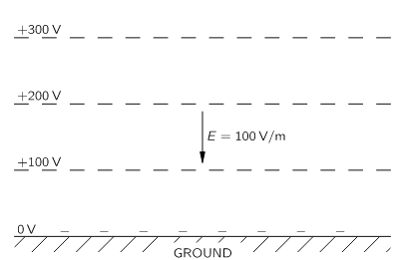
Atmospheric Electricity
In fair weather there is a voltage between the ground and ~50 km up of around 400kV¹.
The rate of change in voltage is not uniform with increasing height, but near the ground the voltage increases by around 100V/m.
A vertical electric field E = 100V/m exists in the air.
Equipotential line
The potential distribution above the earth¹.

Slide 4
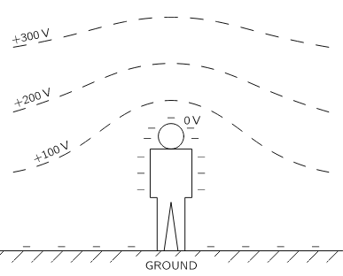
Atmospheric Electricity
The human body is a relatively good conductor².
Conductive enough to be at ground potential (when in contact with the ground)
The equipotential lines curve around them
Equipotential line
The potential distribution near a man in an open flat place¹.

Slide 5
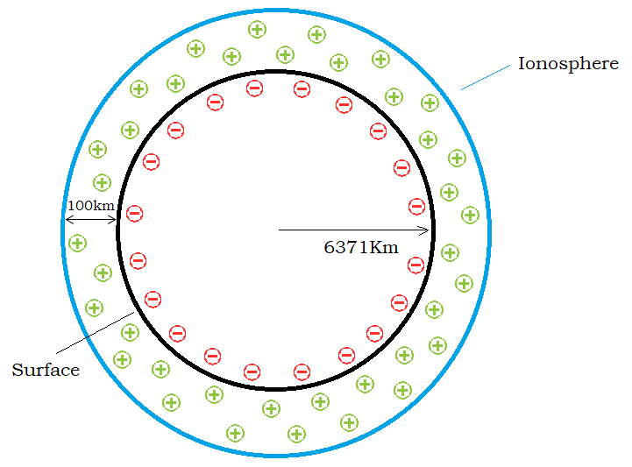
Atmospheric Electricity
In the ionosphere there is enough ionization of air (mainly by UV radiation) to make the atmosphere an electrically conducting layer.
The ground is normally negatively charged during fair weather.
Positive charge is found in the air between the ground and the ionosphere³.
The Earth's surface and the ionosphere resemble a charged spherical capacitor.

Slide 6
Experiment
Research question:
How can we measure the atmospheric electric field in fair weather?
Hypothesis:
If a copper wire that is in contact with an electrometer is lifted at a certain altitude, then electrons from the electrometer’s leaves will be transferred to the copper wire and the leaves will become positive – repelling each other.
1. Positive ions will draw e⁻ from the wire – becoming neutral
2. Electrons will move up the wire due to voltage difference
Electrometer
Ground
3. Electrons from the leaves will move up the wire, making the leaves positive
4. The leaves will repel each other

Slide 7
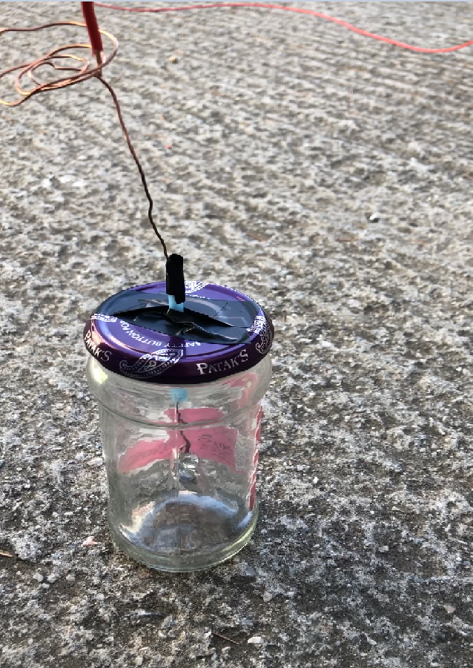
Method
An electrometer was constructed
a hole was screwed off a jar lid (width of a straw)
two leaves were cut from a tin foil sheet
a 30cm copper wire was cut
the two leaves were attached to one end of the copper wire
a circular spiral at the other end of the wire was made
the wire was put through the jar lid, leaving the leaf side inside the jar
2)One end of a 30m copper wire was attached to a drone.
3)The other end of the wire was in contact with an electrometer.
4)The drone took off straight up from the rooftop of our school 20m above ground
5)The electrometer was observed constantly

Slide 8
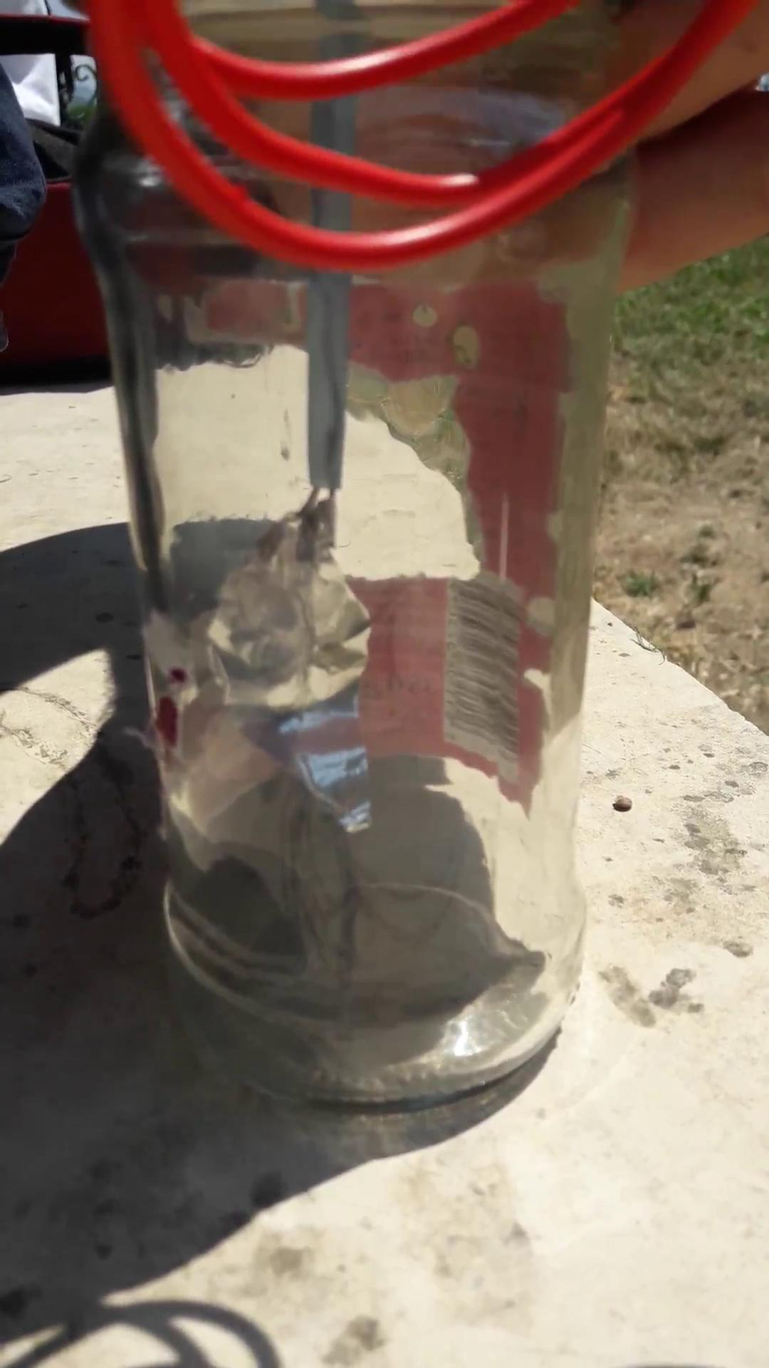
Results
-The electromagnet is shown to work
-Reason for this is that the leaves are shown
to repel each other as it should corresponding
with the theory
-Allowing us to detect the positive ions
in the atmospheric electric field during fair weather

Slide 9
Conclusion
In conclusion we were able to detect the atmospheric electricity in fair weather using the electrometer that we created in conjunction with the drone

Slide 10
Bibliography
J.A Chalmers. Richard Feynman's Lecture on Physics, volume 2, section 9, Pergamon Press, London (1957).
M Fish, Raymond & A Geddes, Leslie. Conduction of Electrical Current to and Through the Human Body: A Review. Eplasty. 9. e44. (2009).
http://www.atmo.arizona.edu/students/courselinks/spring13/atmo589/ATMO489_online/lecture_1/lect1_global_elec_circuit.html

