Slide 1
25.AIRPLANES
REPORT
Greece | AFS
Konstantinos Markopoulos
Hellenic Physical Society
IYNT - Minsk 2019
<αριθμός>

Slide 2
Introduction of the problem:
Construct a paper airplane usinf an A4 paper sheet. Investigate te conditions ensuring the longest distance of its fligt

Slide 3
Forces on an paper airplane
Lift
Air Drag
Weight

Slide 4
How an airplane flights
Lift=Weight
Thrust=Drag
But since the paper airplane has no thrust, it consequently will fall

Slide 5
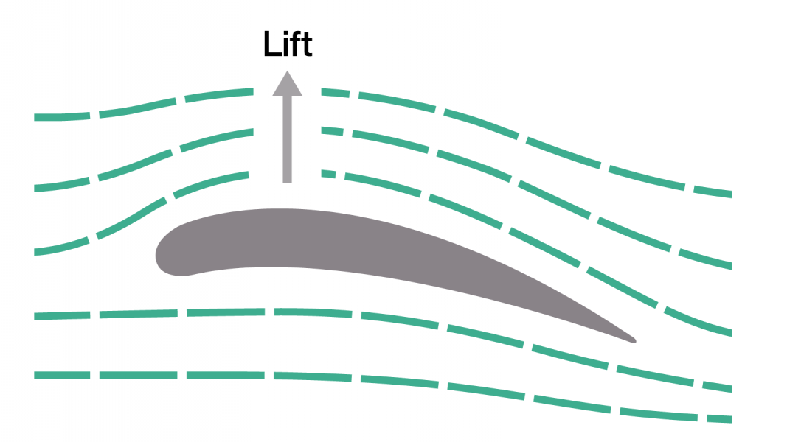
How lift is created through the airfoils

Slide 6
Experiment
We used a basic type of a paper airplane and we tried to optimize its design step by step to help improve aerodynamics

Slide 7
Results
Basic Airplane | ~10m
Airfoil | ~14m
Airtips | ~13m

Slide 8
Thank You For Your Attention!

