Slide 1
Problem №1 Adhesive tape
Made by:
Sapegin Vitaliy
Team of Russia
Notes:
─

Slide 2
Terms of the problem
Determine the force necessary to remove a piece of adhesive tape from a horizontal surface. Investigate the influence of relevant parameters.

Slide 3
Plan
Nature of cohesive forces
Parameters
Investigate the dependence on initial pressure
Investigate dependence on square of area
Investigate the dependence on applied force angle
Conclusion

Slide 4
Parameters
1) surface square
2) angle of force application
3) initial pressure

Slide 5
Setup
Body which is removed from tape
Basket with the weight
Adhesive tape. sticky side up

Slide 6
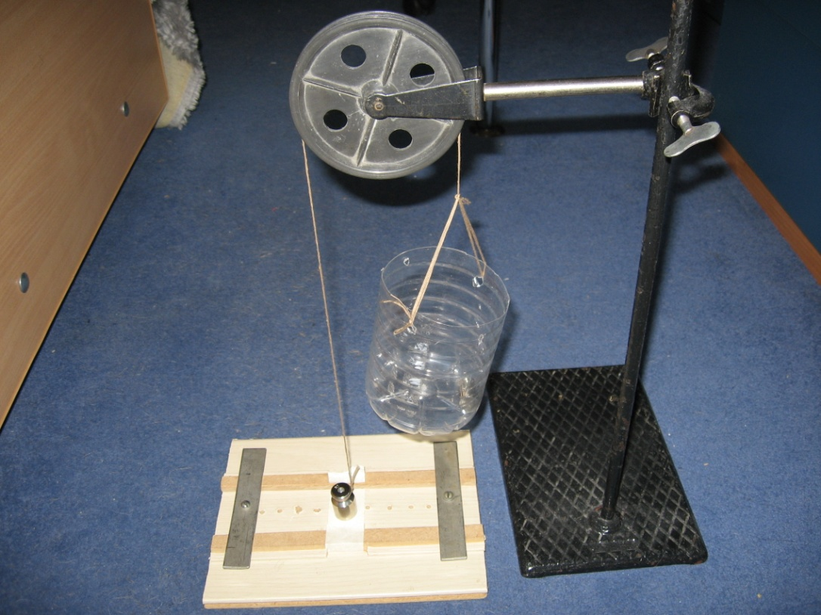
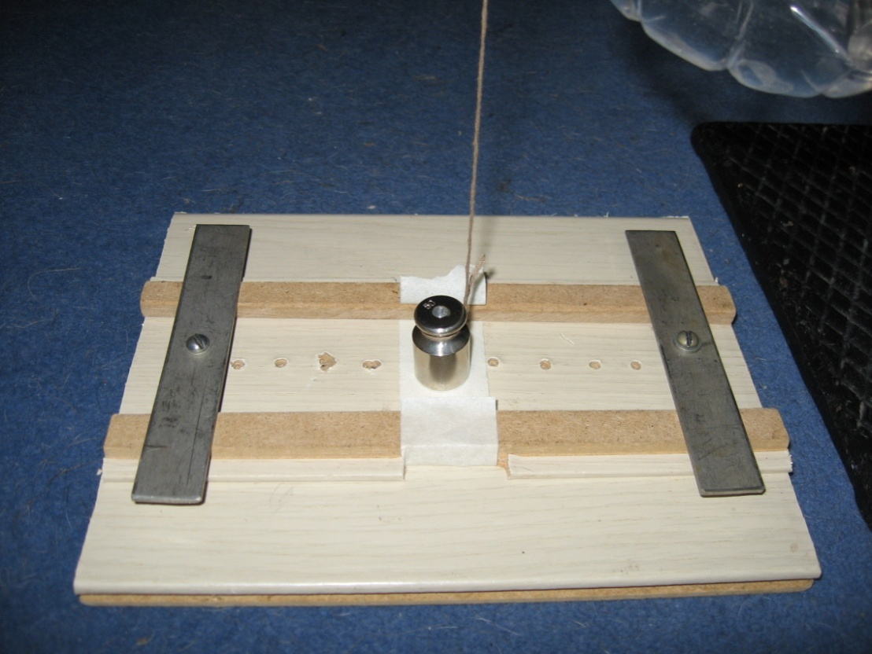
Dependence on pressure
Pressing bars
Adhesive tape. sticky side up

Slide 7
Dependence the removing force on the initial pressure

Slide 8
Explanation

Slide 9
Dependence the removing force on the area of surface

Slide 10
Force necessary to remove 1mm² area.
Force necessary to remove 1mm² area of tape

Slide 11
Dependence on removal angle

Slide 12
Dependence the removing force on the application angle

Slide 14
Dependence the vertical part of removing force on the application angle

Slide 15
Derivation of the formula working area tape
Notes:
Обозначить S F

Slide 16
Maximal distance

Slide 17
Dependence the working area on the cotangent of application angle

Slide 18
Scheme
Adhesive tape
Working glue

Slide 21
Results and conclusion:
The force increases while the initial pressure rises until the force becomes saturated. In this case, it will remain constant
The force increases linearly while the area increases
The force required to remove the tape increases while the angle decreases
Tape has the working area
Maximal distance between tape and surface found

Slide 22
References
«Nature: a weekly journal of science»
academic journal “Science “

Slide 23
задачи
Допол рисунок
Вставка формул индексы
Четко объснения дополнительного иследование
Убрать «в» в графиках
Буквы вместо слов
Рисунок с раб площадью

Slide 26
№ | F , Н | Δm отр. г | S предм. мм 2
1 | 2,27 | 2.3 | 91,56
2 | 2,09 | 0.3 | 91,56
3 | 2,13 | 2.7 | 91,56
1 | 4,75 | 0 | 153.86
2 | 5,20 | 15 | 153.86
3 | 5,55 | 15 | 153.86
1 | 7,43 | 8.4 | 277,45
2 | 7,04 | 6.6 | 277,45
3 | 6,95 | 1.6 | 277,45

Slide 27
Зависимость от угла
№ | Угол в градусах | Сила F, Н
1 | 90 | 3,94
2 | 90 | 3,92
3 | 90 | 3,95
1 | 60 | 6,15
2 | 60 | 6,84
3 | 60 | 7,01
1 | 45 | 9,30
2 | 45 | 9,68
3 | 45 | 9,84

Slide 28
№ | m отр. гр | Δm отр. Гр | S предм. Мм 2
1 | 100 | 3,3 | 28,26
2 | 110 | 7,7 | 28,26
3 | 105 | 2,7 | 28,26
1 | 153 | 1,3 | 63.585
2 | 150 | 4,3 | 63.585
3 | 160 | 7,7 | 63.585
1 | 210 | 13,3 | 94.985
2 | 240 | 17,7 | 94.985
3 | 220 | 3,3 | 94.985
1 | 310 | 5 | 153.86
2 | 320 | 5 | 153.86
3 | 315 | 0 | 153.86
1 | 860 | 11.6 | 660.185
2 | 875 | 3.4 | 660.185
3 | 880 | 9.4 | 660.185

Slide 29
Расчеты

Slide 30
Расчеты

Slide 31
№ | P, КПа | F, Н
1 | 358,64 | 3,94
2 | 358,64 | 3,92
3 | 358,64 | 3,95
1 | 191,34 | 3,97
2 | 191,34 | 3,89
3 | 191,34 | 3,90
1 | 44,27 | 3,10
2 | 44,27 | 3,01
3 | 44,27 | 3,27

