Slide 1
Problem №16 two shovels
Reporter: Tekle Dolidze
Team: Georgia

Slide 2
Introducing Problem
Sink two metal shovels deep into the soil outdoors, e.g. in a garden or in a field. Determine the dependence of the resistance between the two shovels on the distance between them in a sufficiently wide range, e.g. 0 to 25 meters.

Slide 3
Plan
Theoretical Model
L << A
L < A or L ≥ A
Experiments
Electric Circuit
Experimental Graphic
Determining L_{cri}
Comparing Experiments and Theory
Comparing Expected and Experimental Graphics
Experimental L_{cri}
Conclusion

Slide 4
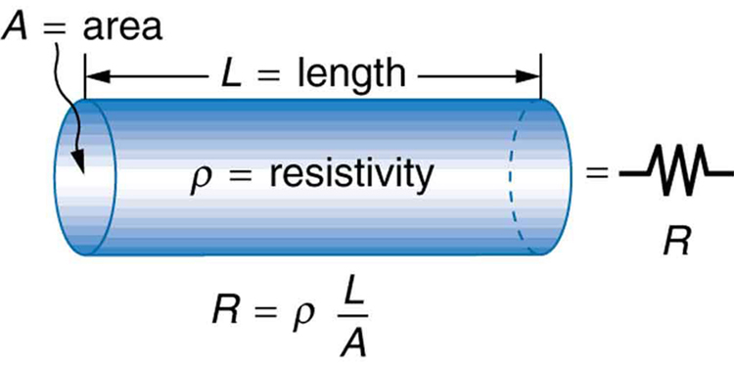
Theoretical Model If L << A
L
L_{cri} – Distance between two shovels when any L>L_{cri} gives less and less resistivity with increasing L
L(cri)
RR

Slide 5
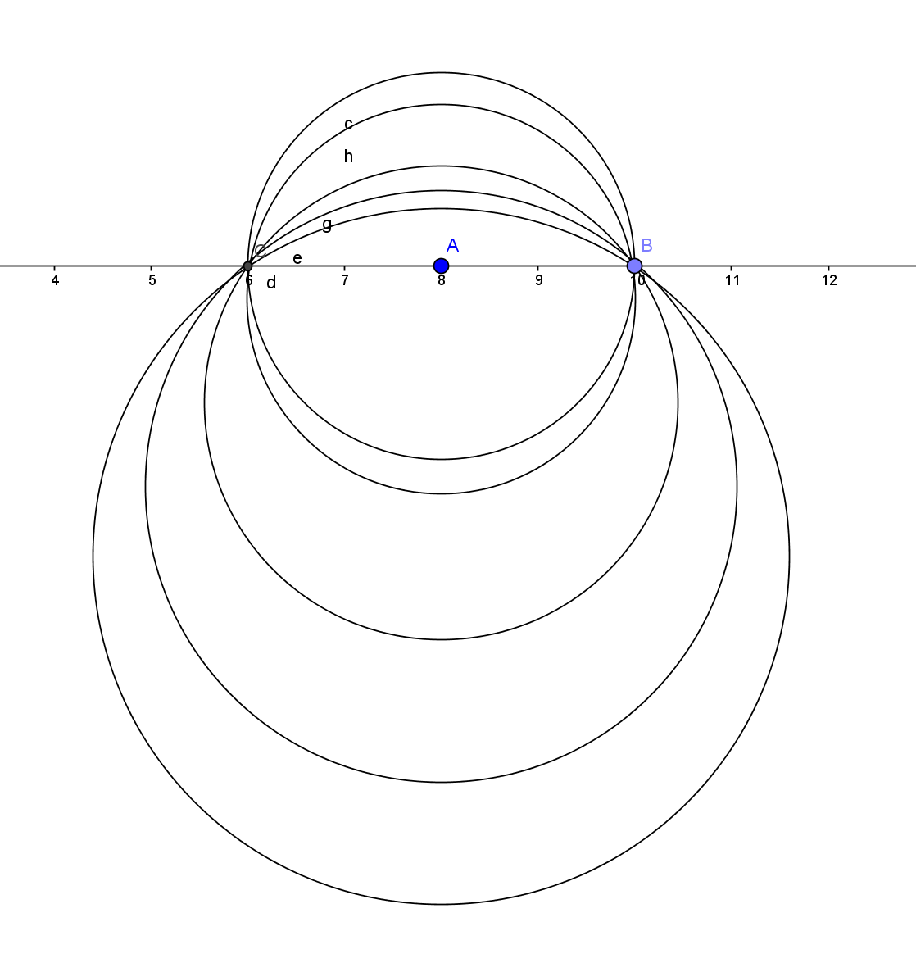
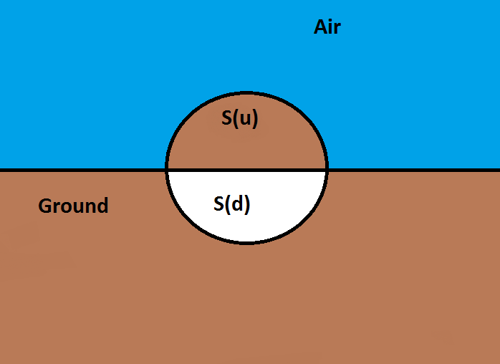
Theoretical Model if L < A or L ≥ A

Slide 6
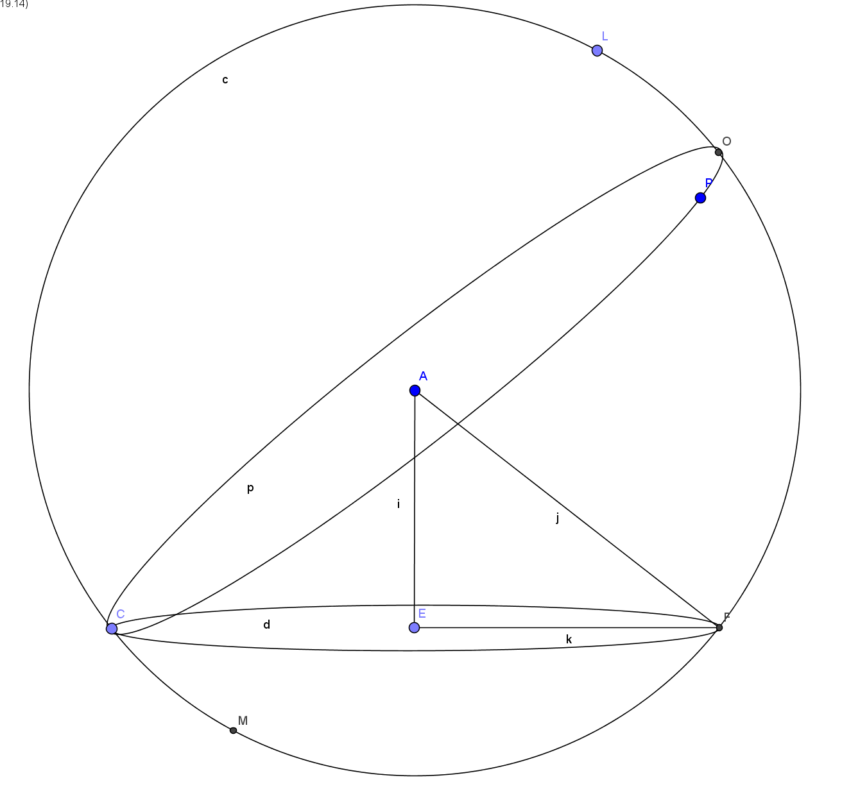
Theoretical Model if L < A or L ≥ A

Slide 7
Theoretical Model

Slide 8
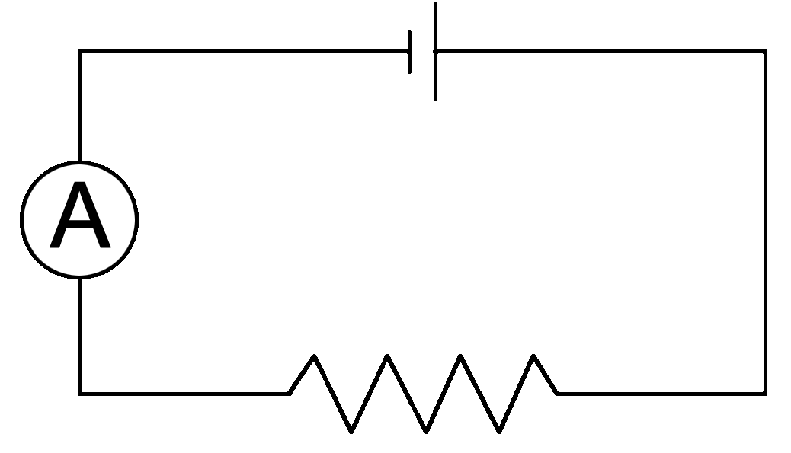
Experiments Electric Circuit

Slide 9
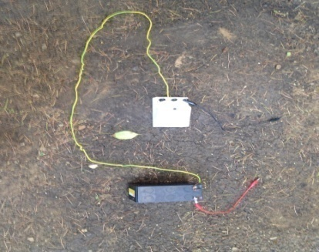
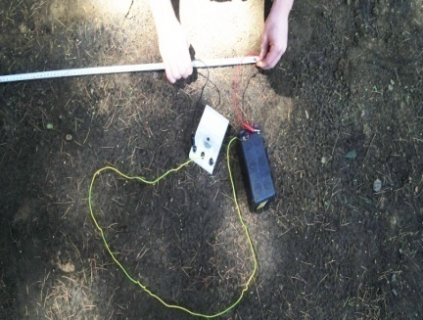
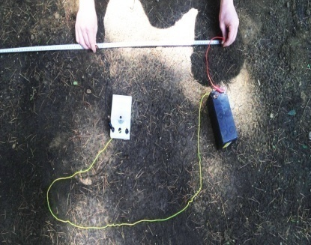
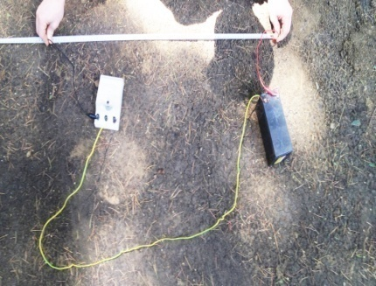
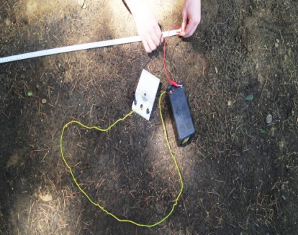
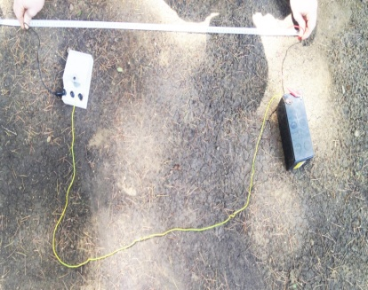
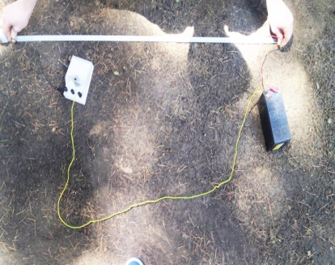
Experiments Results For Points

Slide 10
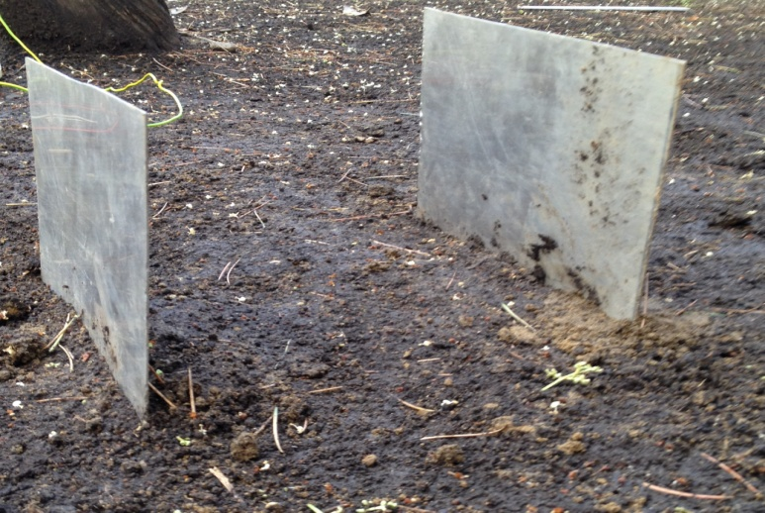
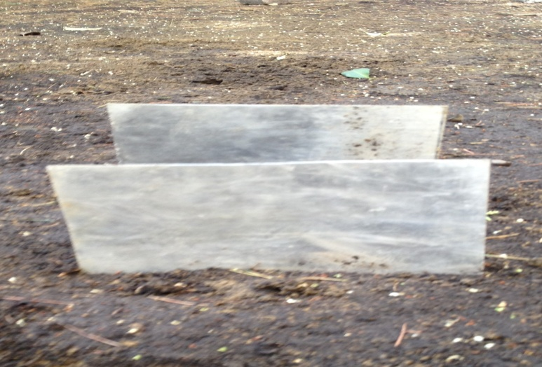
Experiments Dependence On The Buried Surface

Slide 11
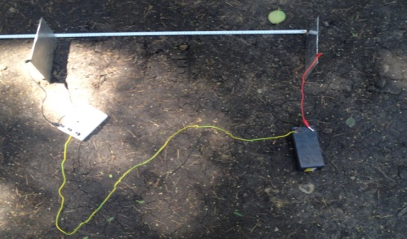
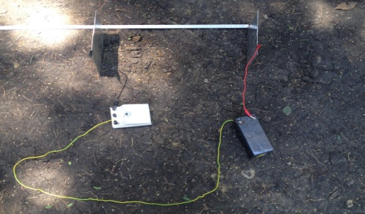
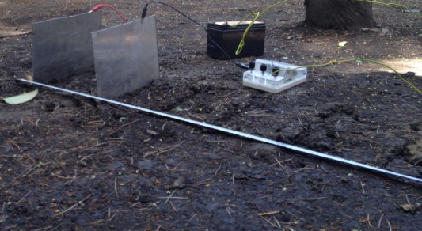
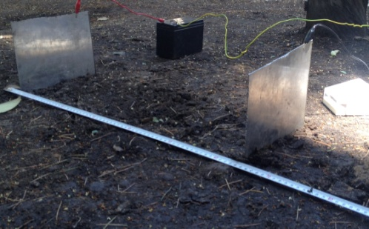
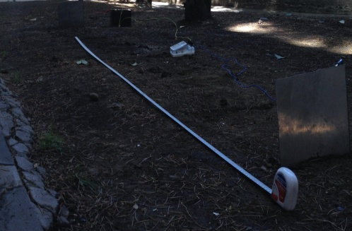
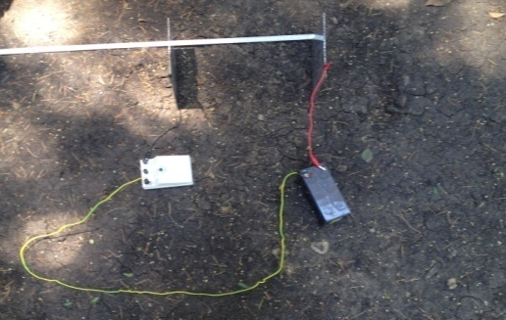
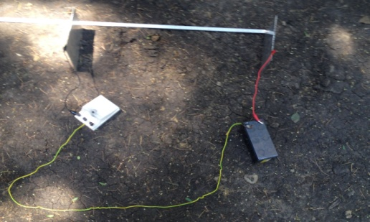
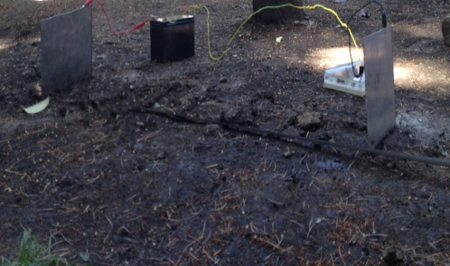
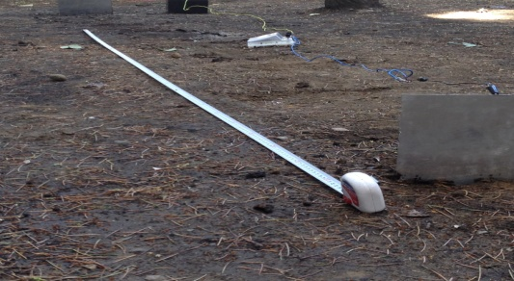
Experiments Results For Shovels

Slide 12
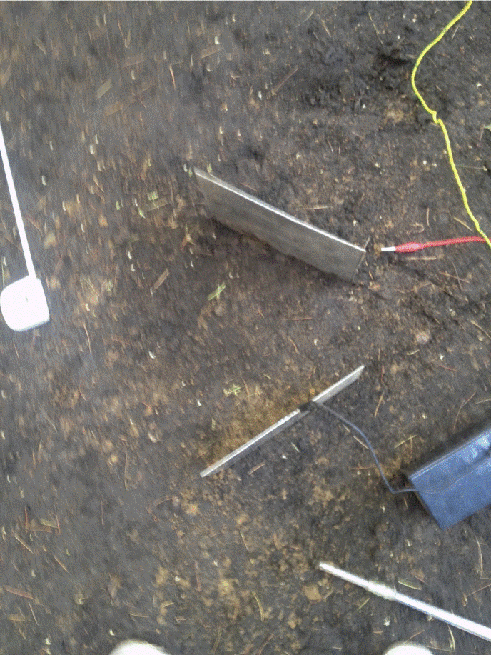
Experiments Results For Turning Shovels

Slide 13
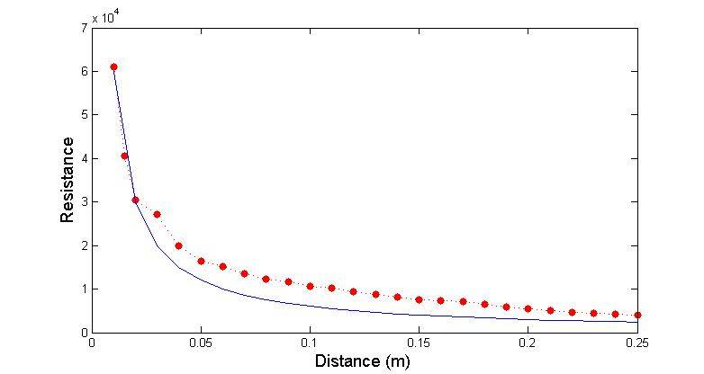
Comparing Experiments and Theory For Points

Slide 14
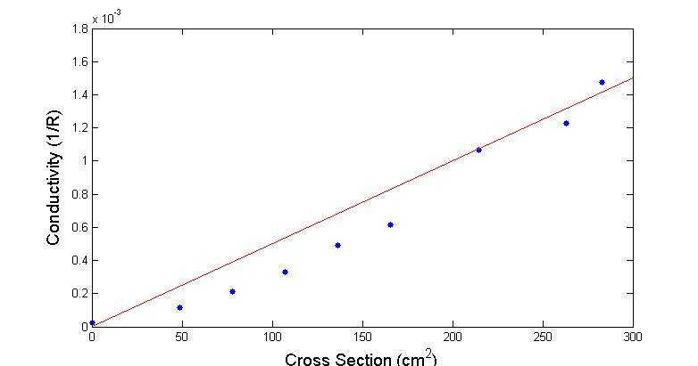
Comparing Experiments and Theory Dependence On The Buried Surface
L=0,45m
b=0.195m

Slide 15
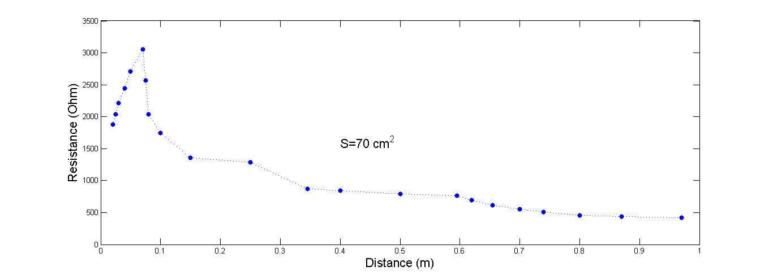
Experiments For Shovels

Slide 16
Conclusion
Theory for Two States of The Shovels
Expected Graphic Was Written
Electric Circuit Was Created
Resistances Were Measured The Various Conditions
Experimental Graphic Was Drawn
Expected and Experimental Graphics Were Compared To Each Other
Arrived At A Conclusion

Slide 18
Bibliography
http://www.weschler.com/_upload/sitepdfs/techref/gettingdowntoearth.pdf
https://en.wikipedia.org/wiki/Soil_resistivity
http://electrical-engineering-portal.com/download-center/books-and-guides/power-substations/earth-resistance-testing
https://support.fluke.com/find-sales/Download/Asset/2633834_6115_ENG_A_W.PDF
http://www.chauvin-arnoux.com/sites/default/files/documents/dc_earth-ground_measurement_ed1.pdf

Slide 19
Experiments Dependence On The Buried Surface
S (Buried Surface m^2 )*10^(-4) | R ( Resistance O) * 10^(-3)
0 | 0,61
58,5 | 0,762500
126,75 | 1,220000
175,5 | 2,440000
234 | 6,100000
292,5 | 15,250000
341,25 | 61,000000

Slide 20
Experiments Results For Shovels
L (Length m)*10^(-2) | R (Resistance R)*10^(-3)
5,50 | 4,066667
7,00 | 2,033330
2,50 | 2,030000
4,00 | 2,440000
25,00 | 1,355550
34,50 | 0,871400
59,50 | 0,762500
62,00 | 0,697140
65,50 | 0,610000
70,40 | 0,554545
74,00 | 0,508333
80,00 | 0,451851
87,00 | 4,357140
97,00 | 0,420689
135,00 | 0,400000
219,00 | 0,381250
389,00 | 0,373088
515,00 | 0,366366

Slide 21
Experiments Results For Points
L (Length m) *10^(-2) | R (Resistance O ) *10^(-3)
1 | 61,000000
2 | 30,500000
3 | 27,111110
4 | 20,000000
5 | 16,486487
6 | 15,250000
7 | 13,555555
8 | 12,200000
9 | 11,619047
10 | 10,608697
11 | 10,166666
12 | 9,384610
13 | 8,714280
14 | 8,133333
15 | 7,625000
16 | 7,393939
17 | 7,176400
18 | 6,421052
19 | 5,980390
20 | 5,545454
21 | 5,083330
22 | 4,638783
23 | 4,518518
24 | 4,206896
25 | 3,485714

