Slide 1
Problem No.23 colors of the Rainbow
Besat 2
Alireza Hamidian

Slide 2
Problem:
You are given aqueous solutions of potassium dichromate (K₂Cr₂O₇) and copper (ll) sulfate (CuSO₄). By mixing these two solutions in any combination with colorless solutions of your choice, obtain as many test tubes showing distinctly different colors as possible.

Slide 3
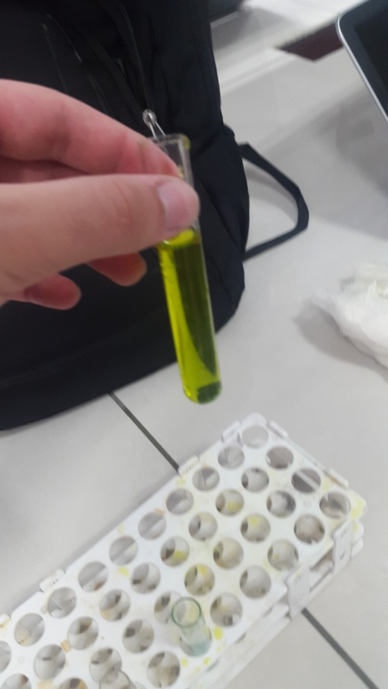
Initial:
K₂Cr₂O₇ + CuSO₄ = Yellow
Blue + orange = light purple
K₂Cr₂O₇ +CuSo₄ = K₂SO₄ + CuCr₂O₇
????
Yellow
Colorless

Slide 4
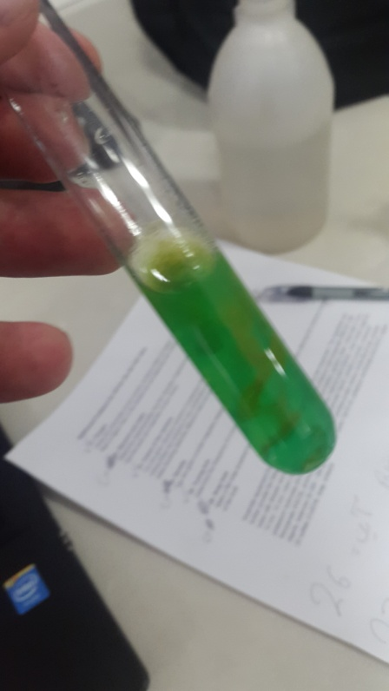
Then:
KOH + solution = Green not dissolved salt(Green)
2KOH + CuSO₄ = Cu(OH)₂ + K₂SO₄
And it happened again with NaOH.
Green

Slide 5
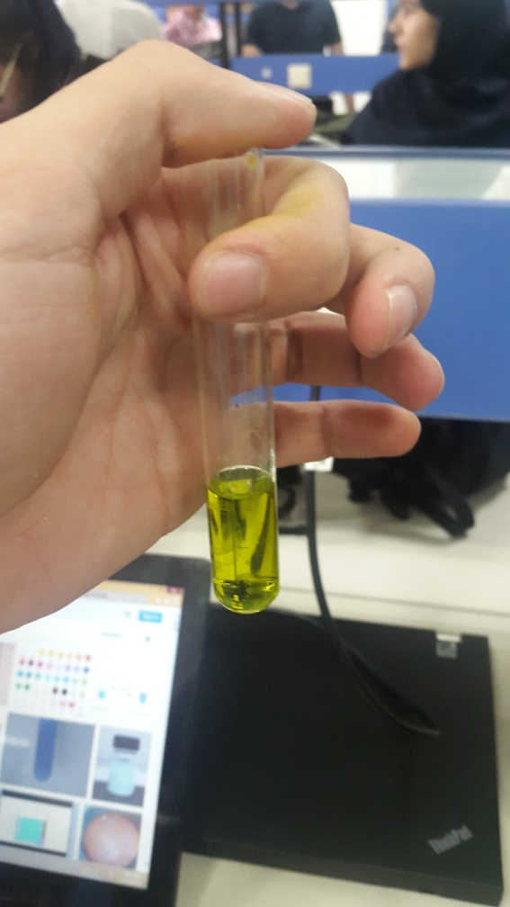
We also used NH₄OH
But nothing happened;
So we conclude that no reaction
will happen.

Slide 6
Thanks for your attention!

