Slide 1
Problem 1. Air traffic
Reporter: Matytcin Vadim
Team: Russia - Voronezh

Slide 2
Statement of the problem
Flightradar24 is a web-service which aggregate and provide data on positions, altitudes, speeds, and other parameters of almost any commercial flight in the world. Using it, determine and investigate the density of air traffic at a certain flight level. Investigate and confirm thаt it follows the rules for the air traffic.

Slide 3
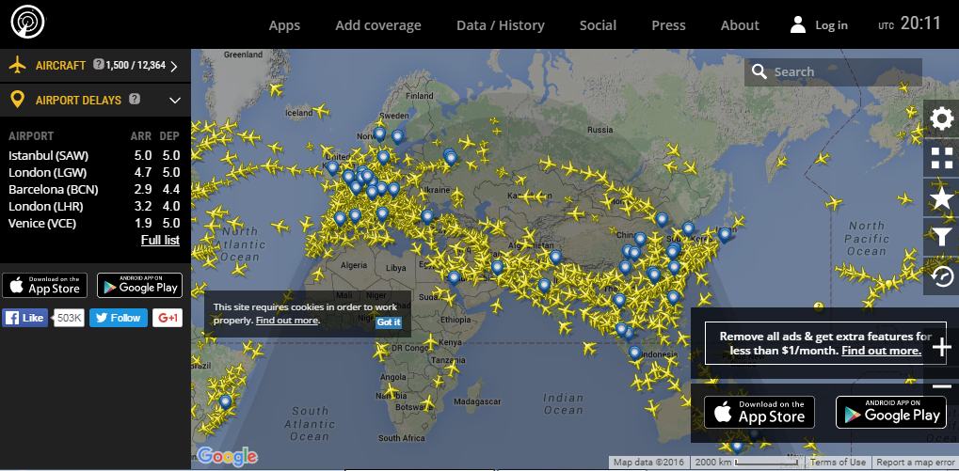
Goals
Explore aspects of the air traffic using the information from the service Flightradar24:
Air traffic density.
Absence of violations of air traffic rules.

Slide 4
The theoretical part
One of quantities characteristics of air traffic :
Air traffic density.
Absence of violations of air traffic rules. (qualitative)

Slide 5
Why air traffic density is important?
Too high air traffic density leads to:
Flight delays.
Difficulties with flight.
The extra cost of fuel.

Slide 6
Air traffic density
is given by the formula
Here
P: traffic density.
N: number of aircrafts.
V: volume of airspace.

Slide 7
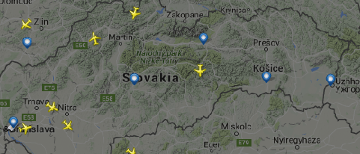
The traffic density in Slovakia

Slide 8
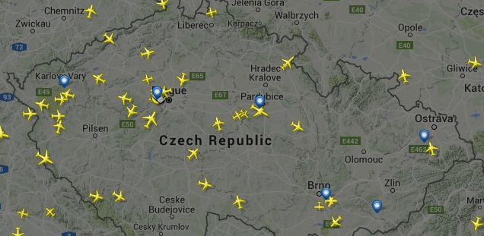
The traffic density in Czech Republic

Slide 9
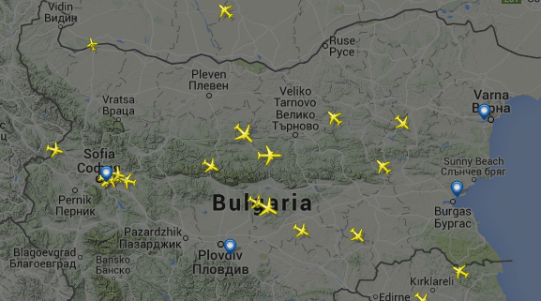
The traffic density in Bulgaria

Slide 10
The density of air traffic on the territory of three countries
Slovakia | Czech Republic | Bulgaria
0,0001 | 0,0003 | 0,00009

Slide 11
Height rules
Aircrafts, flying to the East, South-East and North-East must move at height at 9,000 and 11,000 meters.
Aircrafts, flying to the West, North-West and South-West must move at height at 10,000 and 12,000 meters.

Slide 12
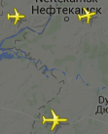
Aircraft’s height
The height at which aircraft are, m
10 300 | 11 300 | 11 100
11 000 | 11 500 | 11 800
11 100 | 10 500 | 10 500

Slide 13
Conclusion
We studied one of the main aspects of air traffic:
number of aircraft at the same flight level,
absence of violations of air traffic rules concerning maximum and minimum height.
Practical part of my work was performed using the Flightradar24 servers.

Slide 14
Thank you for your attention!

