Slide 1
Mountain Peaks

Slide 2
Task
What methods are used to determine the elevation of the World’s highest mountains? Suggest your own experimental method and determine the height of a mountain or a hill of your choice.

Slide 3
Goals and objectives
1) List the different ways to determine the height of the mountain peaks
2) Learn how the height of peaks changes in time
3) Suggest method of measuring height of mountains
4) Measure the height of a mountain or a substitute

Slide 4
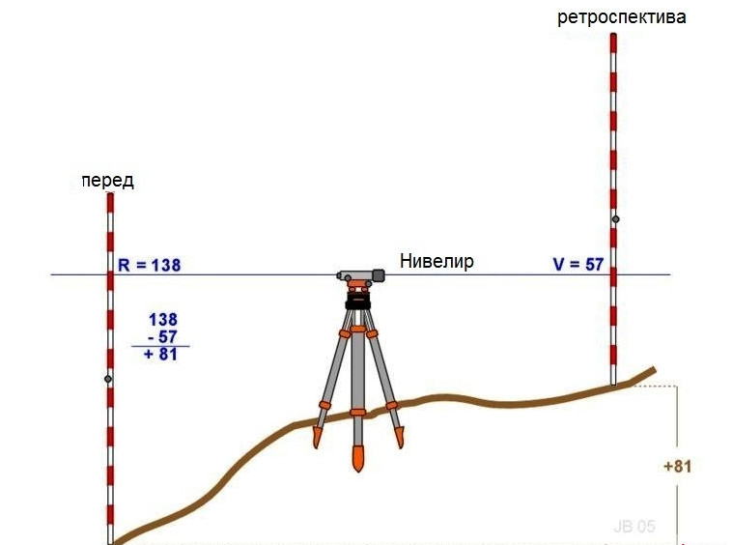
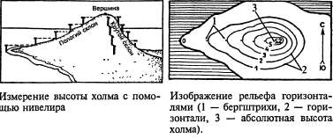
Leveling instrument

Slide 5
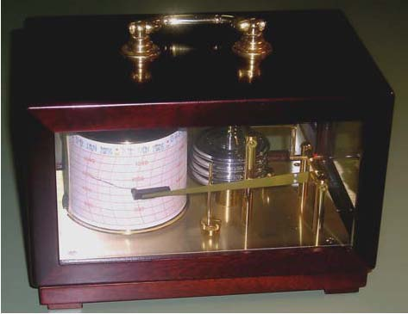
Barometer

Slide 6
Is the height of the mountains change in time?
YES!

Slide 7
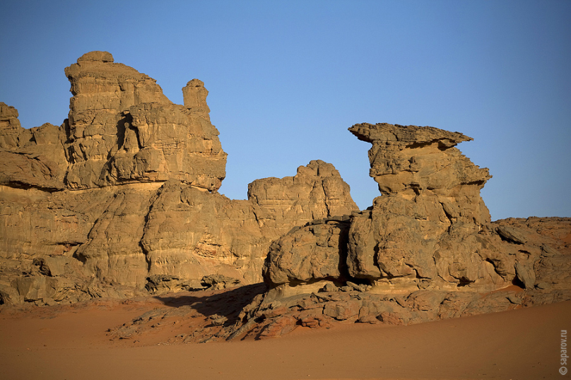
1) Tectonic processes
2) Erosion
3) Human intervention
wind
water
sun
human
temperature
plants

Slide 8
Measuring the height of the mountains with the pole
Equipment:
1. Pole size with your growth
2. Tape-measure
3. Map

Slide 9
Схема1
1. Determine the point at eye level
13

Slide 10
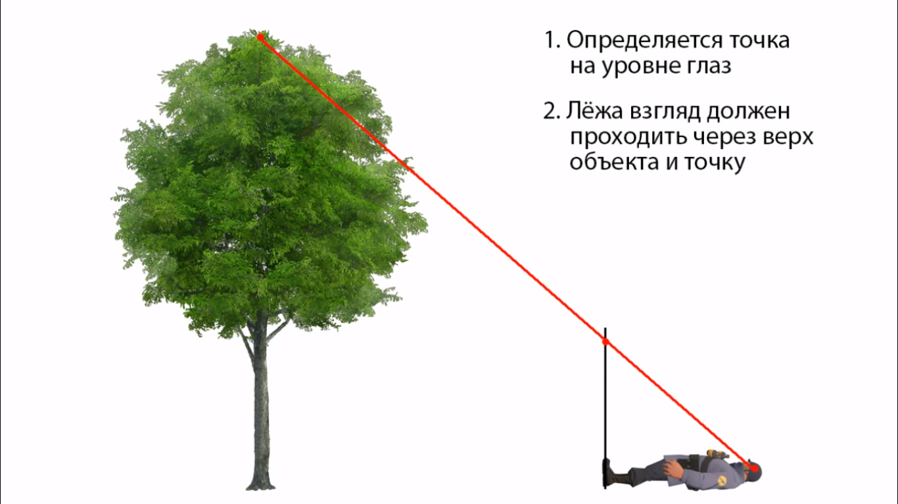
Схема2
In the supine position should look to pass through the top of the object and the point.
1. Determine the point at eye level
А
2. In the supine position look should pass through the top of the object and the point, which you determine on the pole
E
В
C
D
14

Slide 11
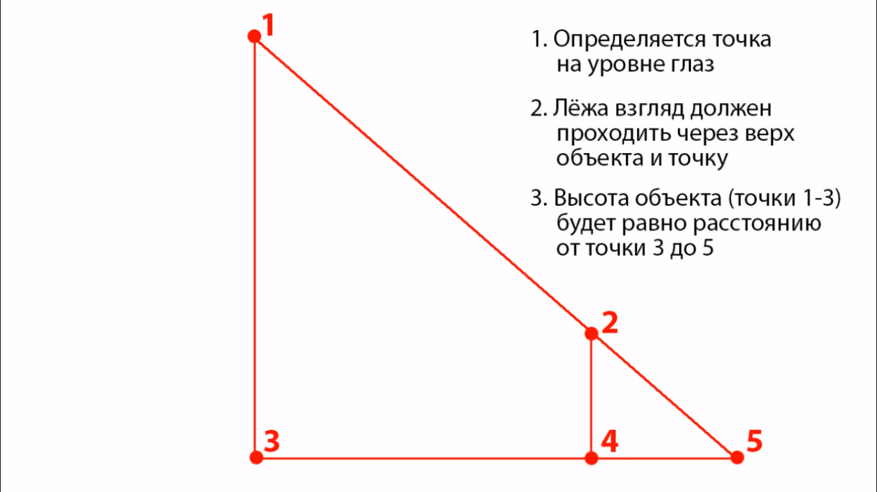
1. Determine the point at eye level
2. In the supine position look should pass through the top of the object and the point, which you determine on the pole
3. The height of the object (the distance from point 1 to 3) is equal to the distance from point 3 to 5 (according to similarity of triangles)

Slide 12
Measuring error ≈ + 0.2-0.4
Measurement results | The actual height
31,6 meters | 32 meters
17,7meters | 18 meters
40,2 meters | 40 meters

Slide 13
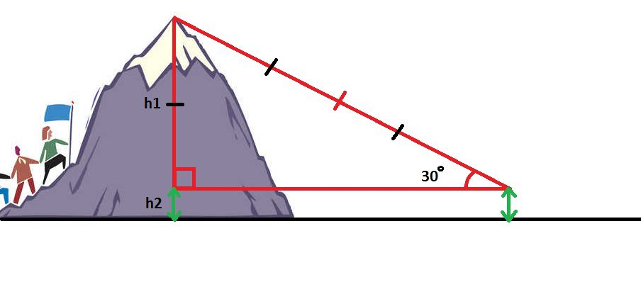
Method with the laser measure tape

Slide 14
Conclusion
We covered some ways of measuring heights. With the help of our method we have measured the height of the hills. We have learned that height is changing it time due to several factors.

