Slide 1
PROBLEM 2. SLOW MATCH
Team Croatia
Reporter: Ivona Halas

Slide 2
STATEMENT
A cord in which the flame front propagates with a constant low speed has been important to ignite cannons. Produce such cords and investigate their burn rates and other properties.

Slide 3
OUTLINE
Theoretical introduction
Potassium nitrate and sugar
Experiment
Hypothesis
Results
Dependence of sugar mass
Dependence of KNO₃ mass
Methods and measurements
Dependence of cord thickness
Burning

Slide 4
BURNING
burning substance + oxidizer + $E_{a }$ products + $E_{r }$
E required for burning to start
E released with burning
Theoretical introduction
Experiment
Results

Slide 5
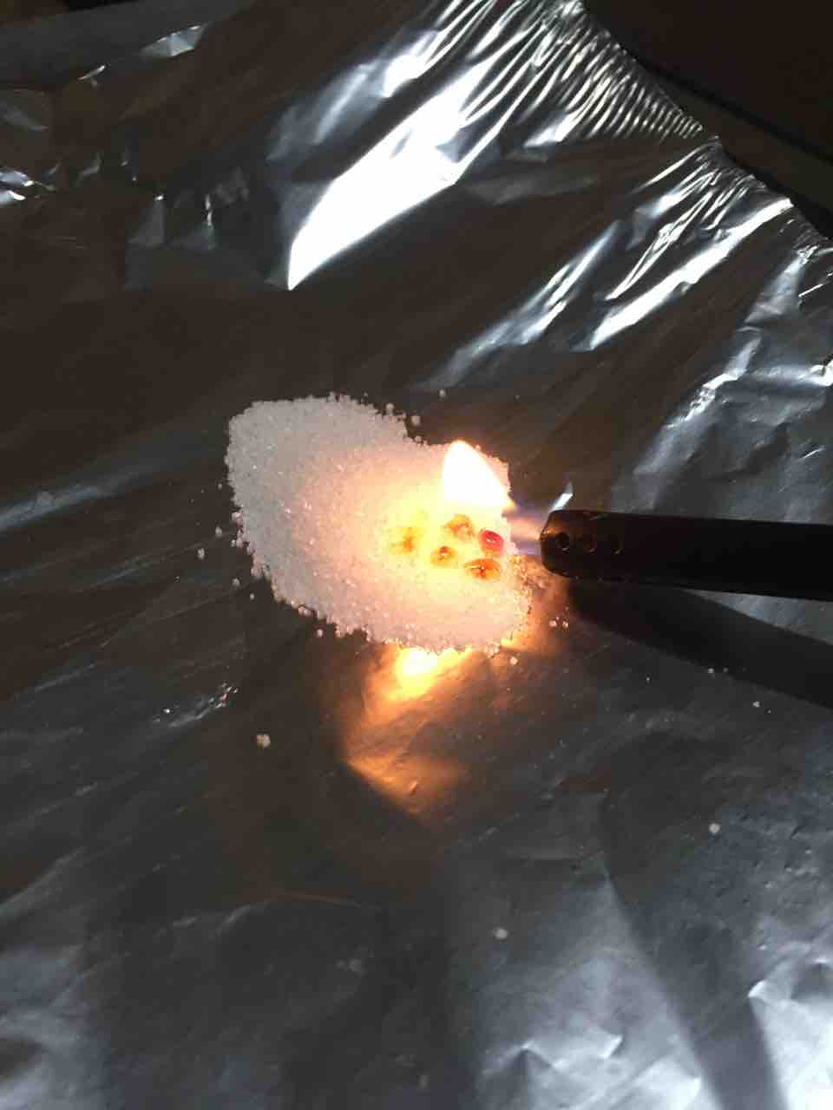
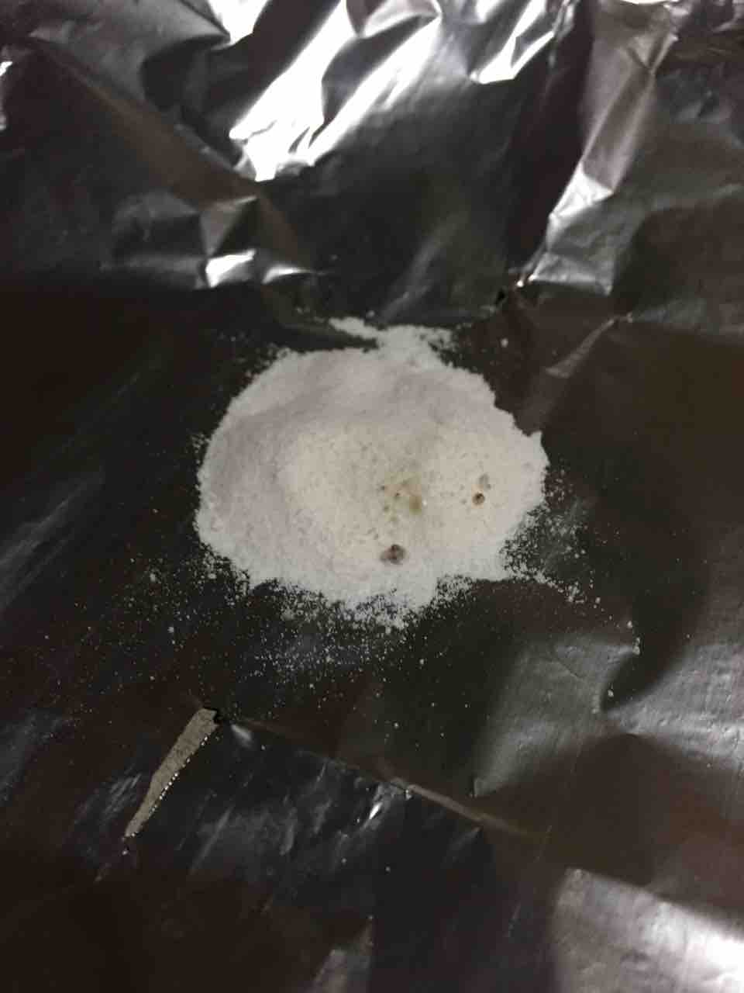
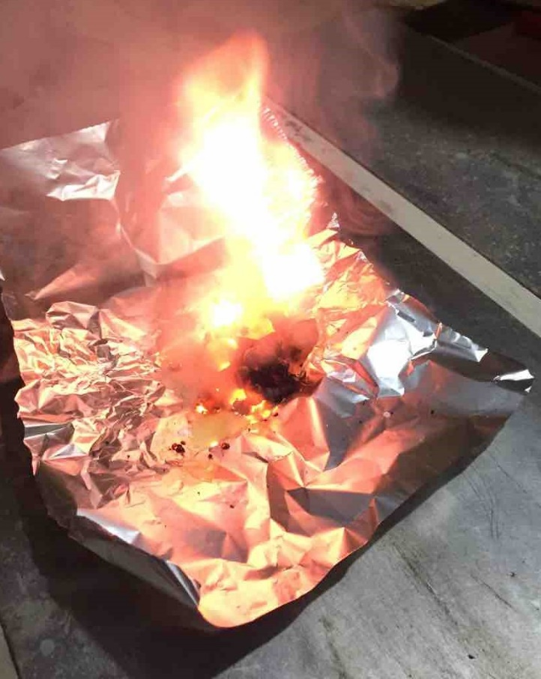
POTASSIUM NITRATE AND SUGAR
C₆H₁₂O₆ + 6O₂ 6H₂O + 6CO₂ + energy
2KNO₃ 2KNO₂ + O₂
KNO₃ + C₆H₁₂O₆ in 3:2 ratio
Theoretical introduction
Experiment
Results

Slide 6
HYPOTHESIS
Thicker cord faster burning
Changing sugar amount slower burning
Changing KNO₃ amount faster burning (to a certain extent)
Highest starting temperature the fastest burning
Theoretical introduction
Experiment
Results

Slide 7
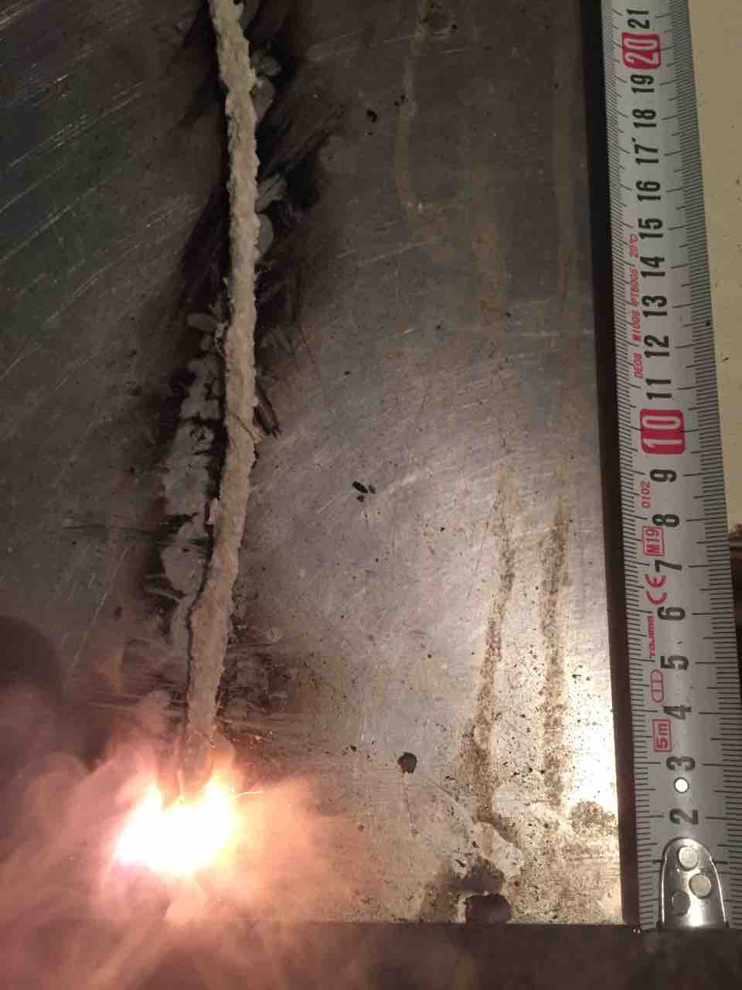
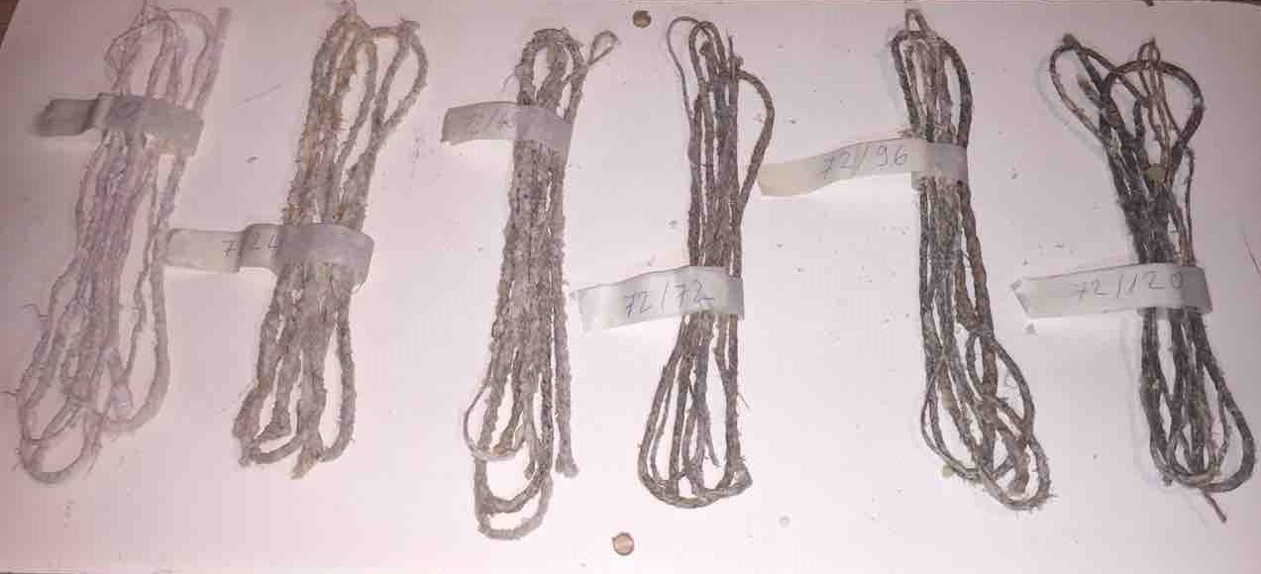
METHODS AND MEASUREMENTS
Cord thickness: 2mm, 3mm, 5mm
Sugar amount (72g KNO₃): 0g, 24g, 48g, 72g, 96g, 120g
KNO₃ amount (48g sugar): 0g, 24g, 48g, 72g, 96g, 120g
Fuse temperature: oven, freezer - 8 temperatures
Time: stopwatch - every 10cm (measuring tape)
Theoretical introduction
Experiment
Results

Slide 8
H2: CHANGING SUGAR AMOUNT WILL RESULT IN SLOWER BURNING
72g of KNO₃
Changing sugar amount
x
x
x
x
x
x
x
x
x
x
Slower burning
Theoretical introduction
Experiment
Results

Slide 9
H1: FLAME FRONT WILL PROPAGATE THE FASTEST ON THE THICKEST CORD H3: CHANGING AMOUNT OF KNO₃ WILL RESULT IN FASTER BURNING
48g of sugar
Changing KNO₃ amount
Thicker cord
x
x
x
x
x
Faster burning (until certain amount)
Faster burning
Theoretical introduction
Experiment
Results

Slide 10
H4: FUSE WITH HIGHER STARTING TEMPERATURE WILL BURN FASTER
Highest starting temperature
the fastest burning
Theoretical introduction
Experiment
Results

Slide 11
PERFECT INGRIDIENT RATIO
Changing amount of KNO₃
Changing amount of sugar
48 g of sugar (constant) 72 g KNO₃
72 g of KNO₃ (constant) 48 g sugar
Theoretical introduction
Experiment
Results

Slide 12
CONCLUSION
Thicker cord faster burning
Changing sugar amount slower burning
Changing KNO₃ amount faster burning (to a certain extent)
Highest starting temperature the fastest burning
Theoretical introduction
Experiment
Results

Slide 13
LTERATURE
http://people.bu.edu/straub/courses/demomaster/no3periodic.html
http://www.auburn.edu/academic/forestry_wildlife/fire/heat_transfer.htm
https://www.thoughtco.com/why-is-fire-hot-607320
https://www.thoughtco.com/definition-of-combustion-605841
http://www.qrg.northwestern.edu/projects/vss/docs/propulsion/2-how-do-things-burn.html
https://sciencing.com/mix-ammonia-glycerine-7904965.html
https://www.thoughtco.com/combustion-reactions-604030
https://sciencing.com/burn-potassium-nitrate-7708552.html
Sikirica, M., Zbirka kemijskih pokusa za osnovnu i srednju školu, Školska Knjiga, Zagreb, 2011.
Smer Pavelić, Đ., Gorenje i sredstva za gašenje, Mi Star, Zagreb, veljača 1996.
Ester, Z., Miniranje I. Eksplozivne tvari, svojstva i metode ispitivanja, Tiskara Zelina d.d., Zagreb. 2005.
Karlović, V., Procesi gorenja i gašenja, Tiskara Zelina d.d., Zagreb, 2010.

Slide 14
THANK YOU!
Team Croatia
Reporter: Ivona Halas

Slide 15
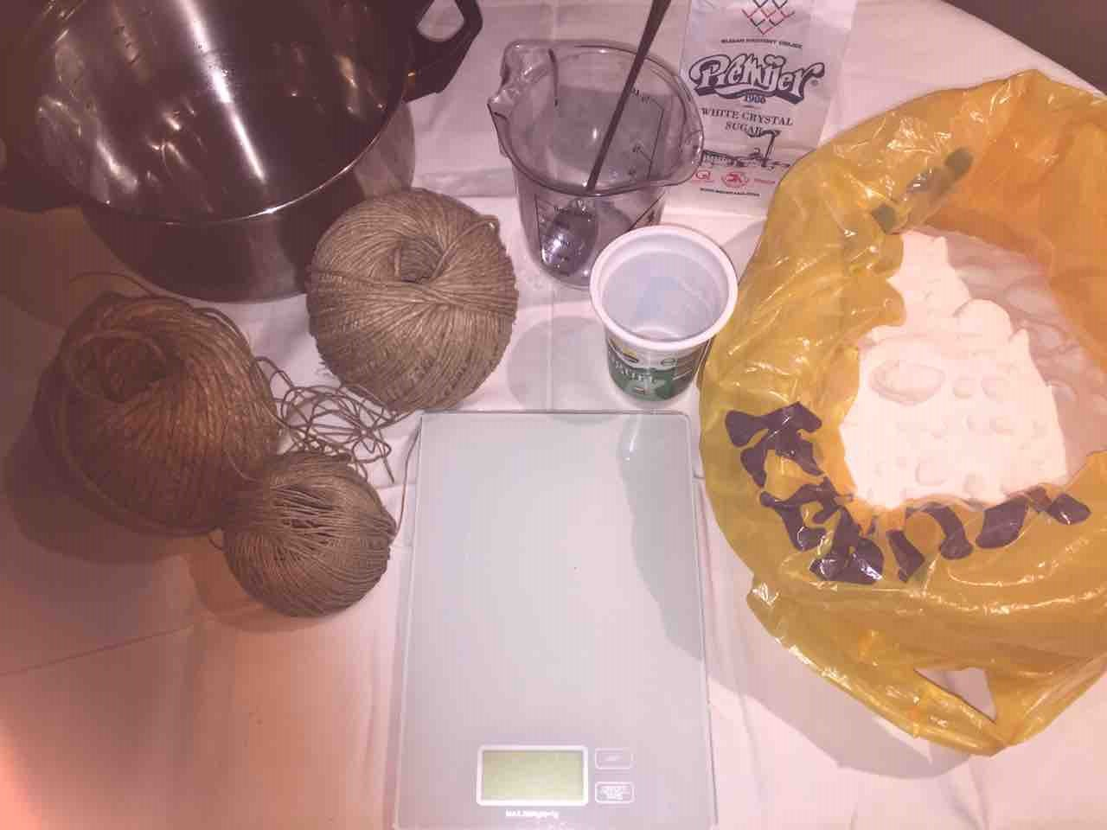
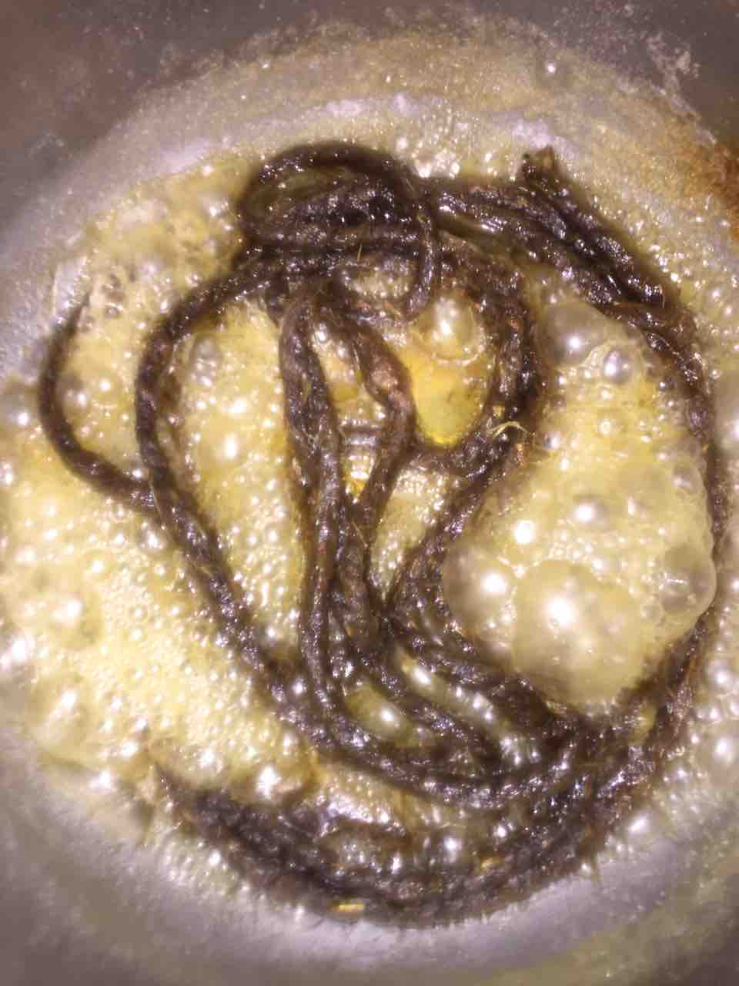
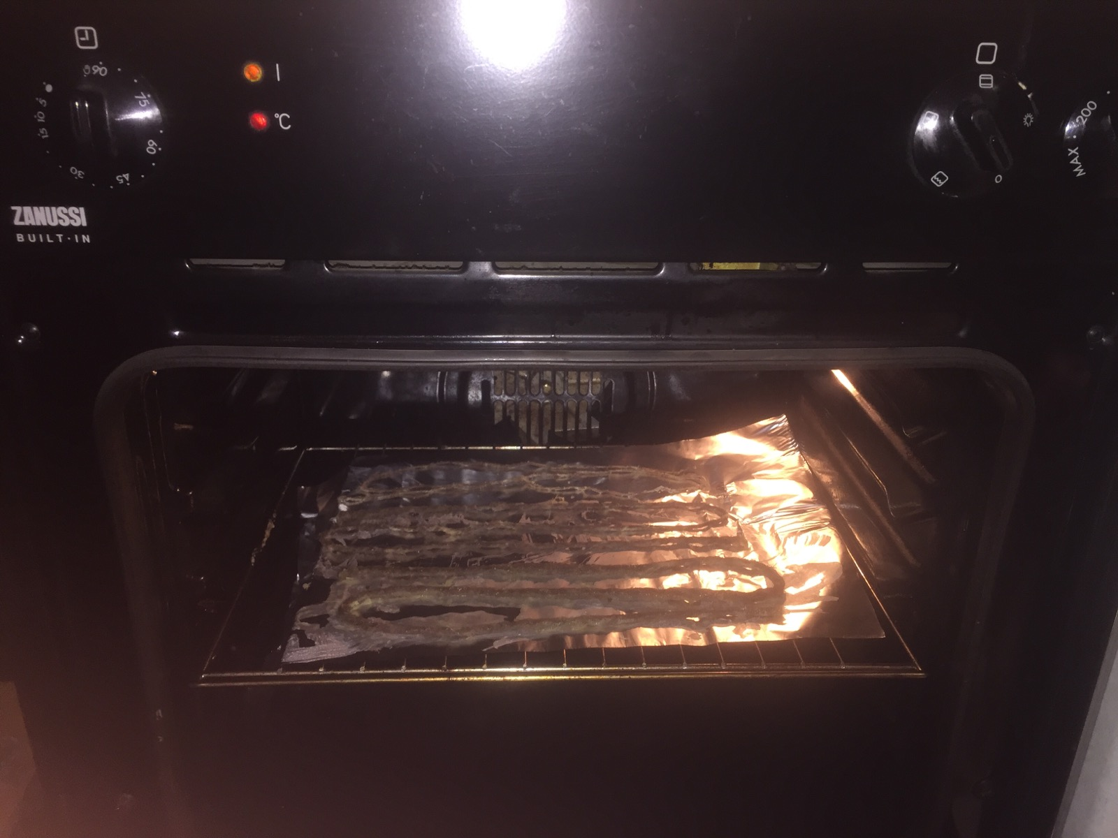
ADDITIONAL SLIDES: PROCESS OF FUSE MAKING
1. Choosing the rope
2. Soaking the rope
3. Putting rope in the oven
Theoretical introduction
Experiment
Results
Additional slides

Slide 16
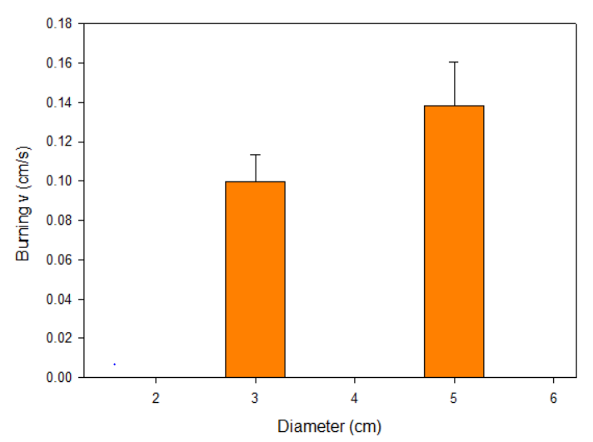
ADDITIONAL SLIDES: MOLAR RATIO
x
Theoretical introduction
Experiment
Results
Additional slides

Slide 17
ADDITIONAL SLIDES: AMOUNT OF KNO₃ MOLAR RATIO (0,27 MOL SUGAR)
Theoretical introduction
Experiment
Results
Additional slides

Slide 18
ADDITIONAL SLIDES: AMOUNT OF SUGAR MOLAR RATIO (0,71 MOL KNO₃)
Theoretical introduction
Experiment
Results
Additional slides

Slide 19
ADDITIONAL SLIDES: POSSIBLE IMPROVEMENTS
Different material cords
Other burning substances and oxidizers
Power and direction of wind
Air temperature and moisture
Temperature of flame front
Colour and amount of smoke
Time of ignition
Additional ingredients
Theoretical introduction
Experiment
Results
Additional slides

Slide 20
ADDITIONAL SLIDES: FUSE BURNING
Theoretical introduction
Experiment
Results
Additional slides

Slide 21
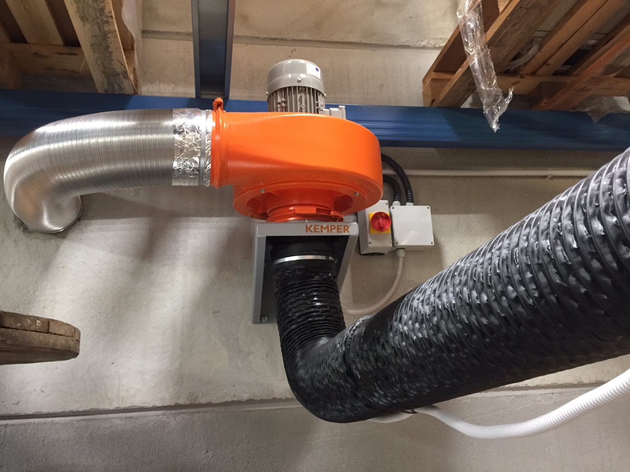
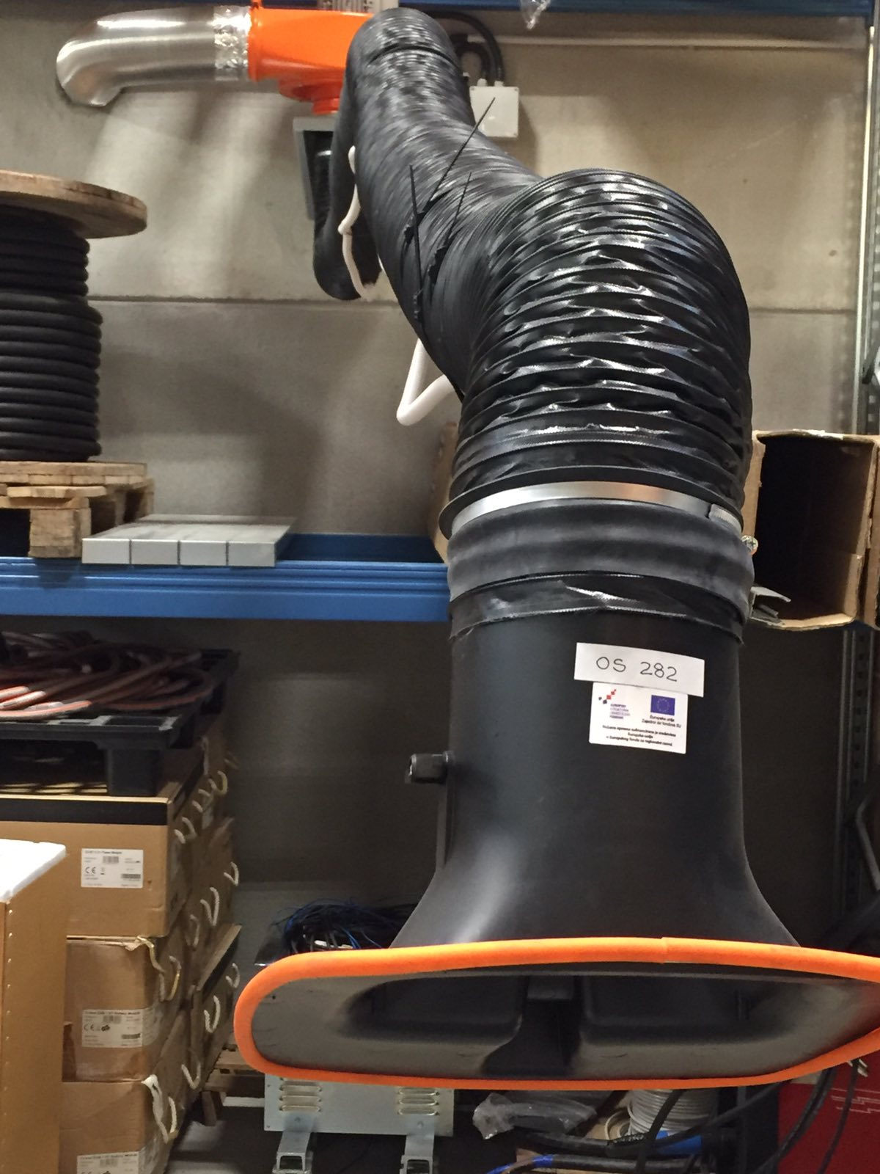
ADDITIONAL SLIDES: EXHAUST FAN
Theoretical introduction
Experiment
Results
Additional slides

Slide 22
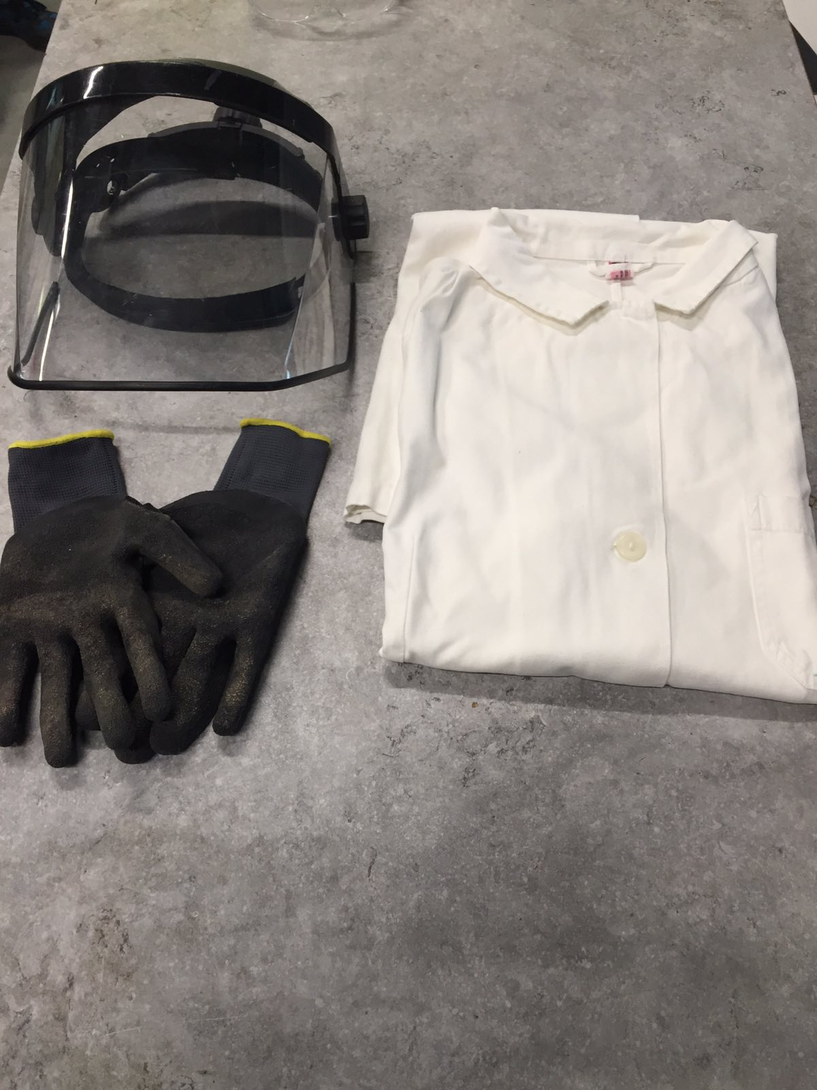
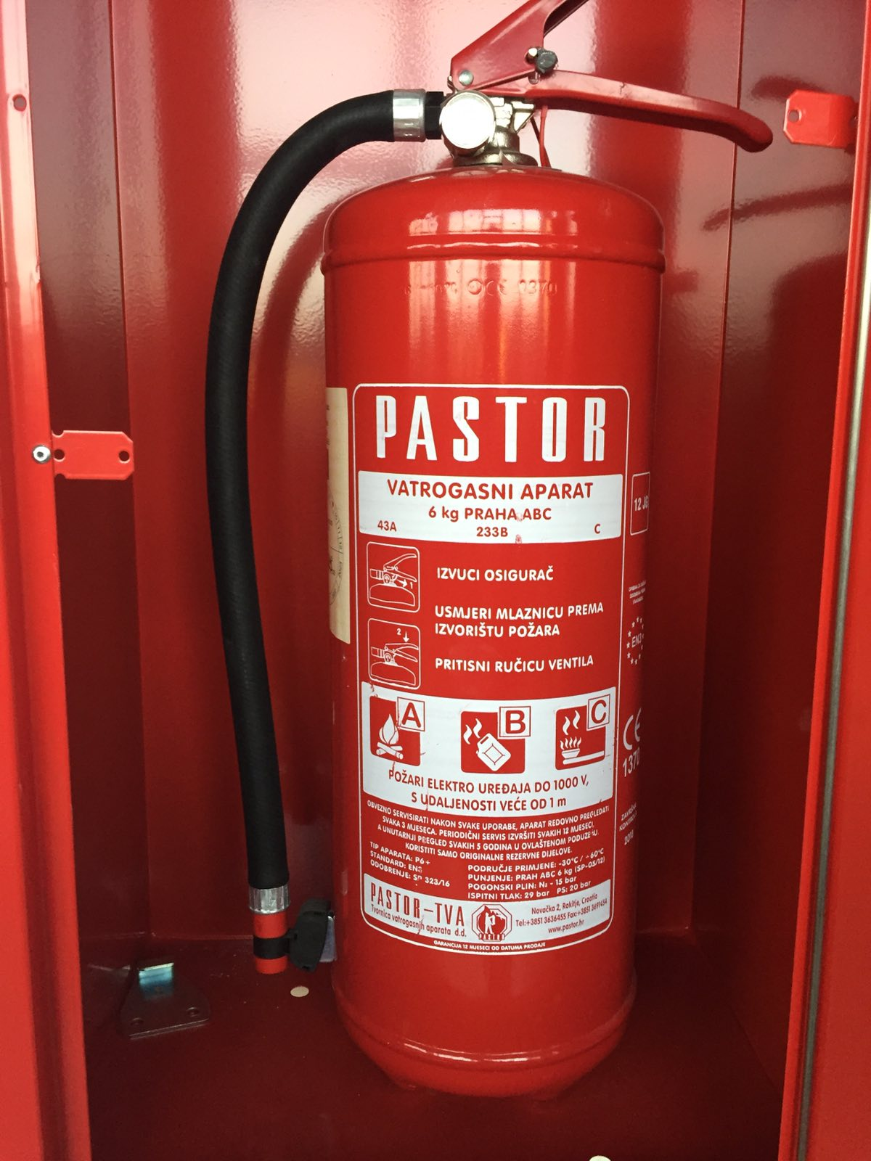
ADDITIONAL SLIDES: SAFETY EQUIPMENT
Theoretical introduction
Experiment
Results
Additional slides

Slide 23
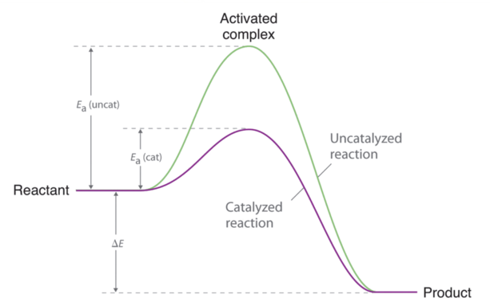
ADDITIONAL SLIDES: ACTIVATION ENERGY
https://chem.libretexts.org/Bookshelves/Physical_and_Theoretical_Chemistry_Textbook_Maps/Supplemental_Modules_(Physical_and_Theoretical_Chemistry)/Kinetics/06%3A_Modeling_Reaction_Kinetics/6.02%3A_Temperature_Dependence_of_Reaction_Rates/6.2.03%3A_The_Arrhenius_Law/6.2.3.03%3A_The_Arrhenius_Law-_Activation_Energies
Theoretical introduction
Experiment
Results
Additional slides

