Slide 1
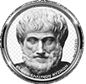
2. Slow Match
REPORT
Greece - Athanasios Tzikas
Hellenic Physical Society
I.Y.N.T. Thessaloniki 2020

Slide 2
Problem to be investigated
A cord in which the flame front propagates with a constant low speed has been important to ignite cannons. Produce such cords and investigate their burn rates and other properties.

Slide 3
Contents
HISTORY AND THEORY
HYPOTHESIS
EXPERIMENT
RESULTS
CONCLUSION
REFERENCES

Slide 4
HISTORY
The slow match was used by musketeers in the past and for a small period of time, this was the only way of firing a cannon or a gun. However, nowadays it has been replaced by quick match and punk, which are commonly used for igniting fireworks. The firing of a gun isn’t triggered by such a mechanism anymore.

Slide 5
THEORY
What is a slow match?
A slow match is a cord that, after chemical treatment, is burning slowly but with a standard desired speed. It mustn’t be affected by weather conditions, either these are wind, rain, snow etc.

Slide 6
HYPOTHESIS
From my experience I think that the variables that affect the burn rate of the slow match will be:
1.the time letting the cordon to absorb the chemical solution
2.the density of the solution
3.the way we dry the cordon (vertically-horizontally)

Slide 7
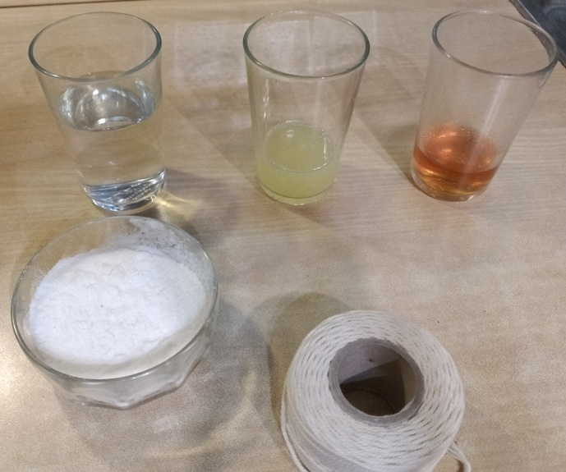
EXPERIMENT
In the experiment I used the following materials:
Cotton cord
Lemon
Vinegar
Water
Potassium nitrate (I used this material, though it is possible to make a slow match with other materials too, like sodium nitrate and lead acetate)
Lighter

Slide 8
EXPERIMENT
Variables
Constants
Time of drying
Time of absorbing the solution
Density of solution
Type of solvent in the solution
Way of drying the cordon
Material of the cord
Length of the cord
Place
Temperature
Weather

Slide 9
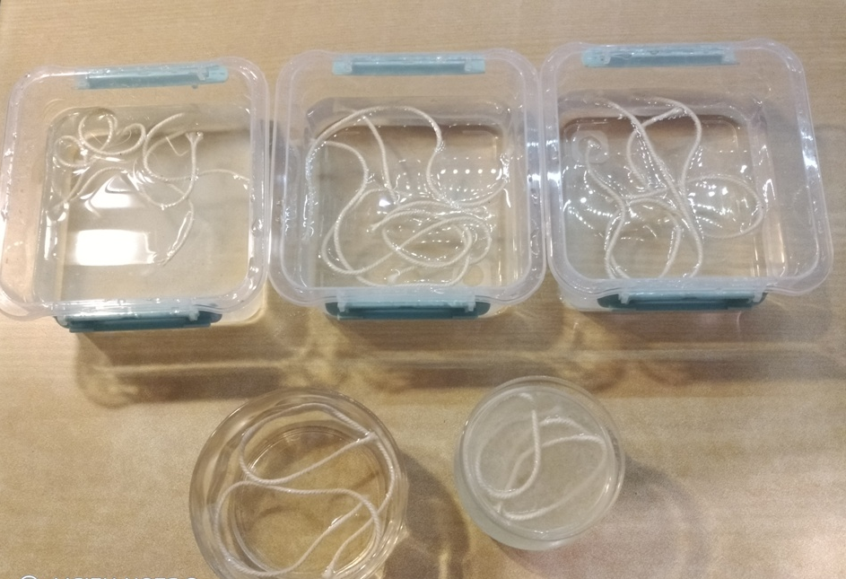
EXPERIMENT

Slide 10
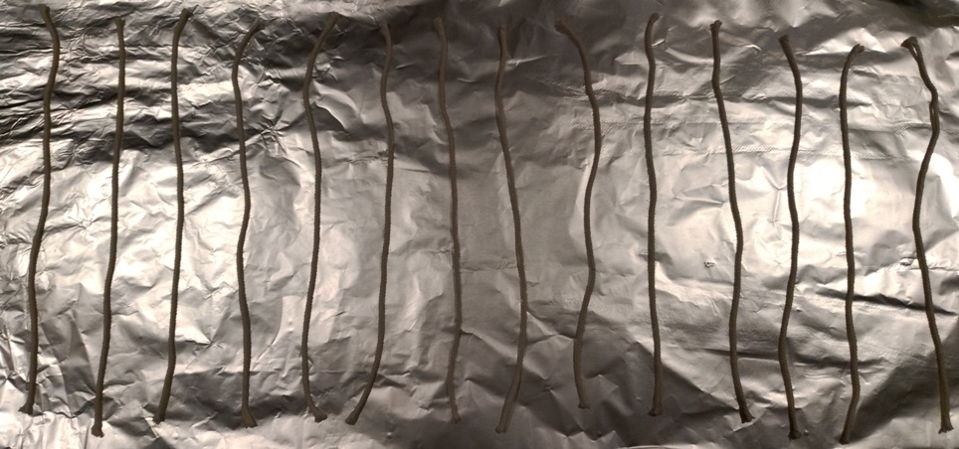
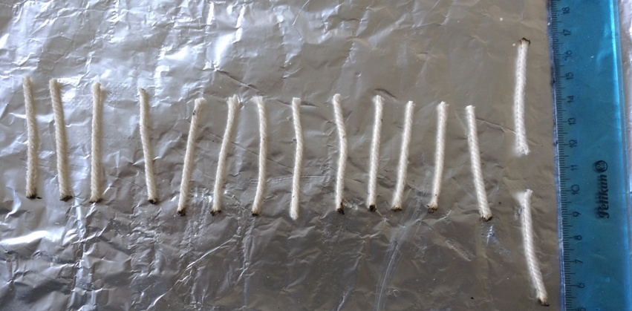
EXPERIMENT

Slide 11
RESULTS
1st Experiment (2 days) | 5 cm slow match
 | 12h | 24h | 36h
100ml/500ml | 4:30 | 3:35 | 3:26
50ml/500ml | 3:51 | 3:23 | 3:09
20ml/500ml | 3:41 | 3:09 | 3:05
50ml/450ml+50ml vinegar |  | 3:34 | 3:19
50ml/450ml+50ml lemon |  | 3:31 | 3:23
50ml/500ml vertical/upper |  | 3:20
50ml/500ml vertical/lower |  | 3:07
2nd Experiment (7 days) | 5 cm slow match
 | 12h | 24h | 36h
100ml/500ml | 4:22 | 3:28 | 3:19
50ml/500ml | 3:44 | 3:20 | 3:02
20ml/500ml | 3:00 | 2:55 | 2:42
50ml/450ml+50ml vinegar |  | 3:22 | 2:50
50ml/450ml+50ml lemon |  | 3:33 | 2:58
50ml/500ml vertical/upper |  | 3:15
50ml/500ml vertical/lower |  | 2:45

Slide 12
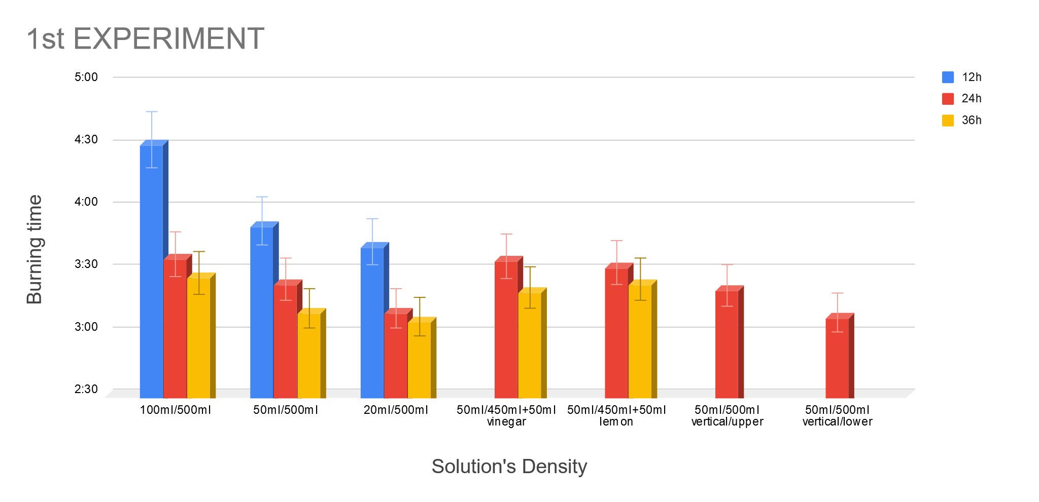
RESULTS

Slide 13
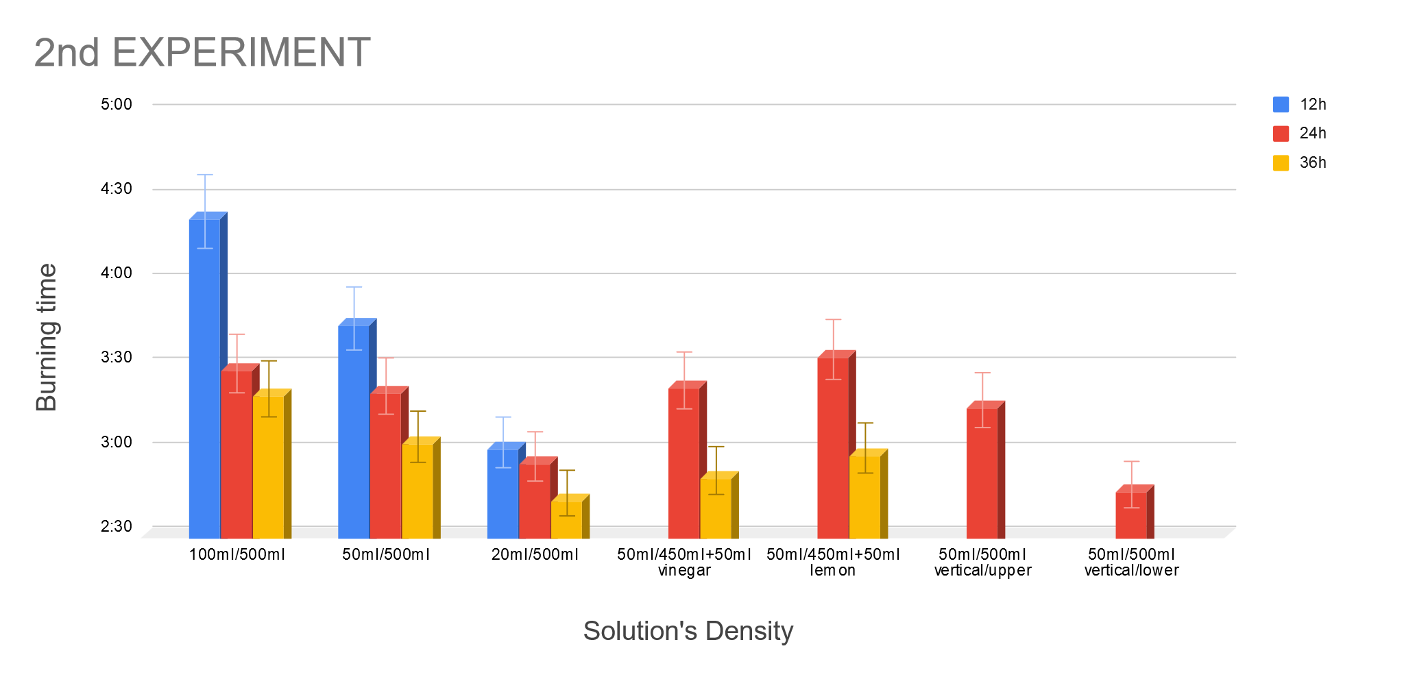
RESULTS

Slide 14
CONCLUSION
What I have concluded from my experiment is:
The type of solvent affects just a little the result
The more potassium the slower the burn rate will be
The more time the cordon absorbs the solution the faster it is burned
Drying the cordon vertically results at unstable burn rate
The more time the slow match is left to dry the faster it is burned
Although in both of these experiments it was a bit windy the matches kept burning.

Slide 15
REFERENCES
http://www.metamuseum.com/us/slowmatch/Index.cfm?F=E43
https://www.youtube.com/watch?v=xOjtlIxYYbs
https://sciencenotes.org/make-ammonium-nitrate/
https://pyrodata.com/PyroGuide/index.php%5Etitle=Slow_match.htm
https://en.wikipedia.org/wiki/Potassium_nitrate
https://el.wikipedia.org/wiki/%CE%91%CE%B9%CE%B8%CE%B1%CE%BD%CE%B9%CE%BA%CF%8C_%CE%BF%CE%BE%CF%8D
https://el.wikipedia.org/wiki/%CE%9A%CE%B9%CF%84%CF%81%CE%B9%CE%BA%CF%8C_%CE%BF%CE%BE%CF%8D
https://en.wikipedia.org/wiki/Slow_match

Slide 16
THANK YOU FOR YOUR ATTENTION!
Hellenic Physical Society
I.Y.N.T. Thessaloniki 2020

