Slide 1
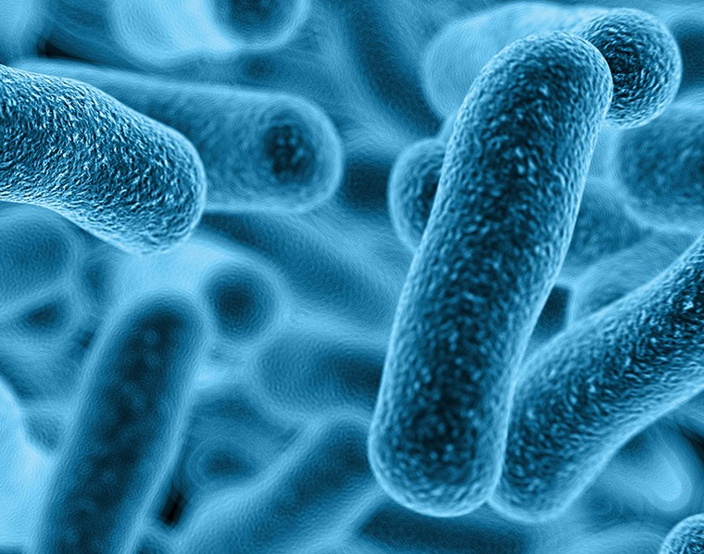
Problem N5
Prepare sterile culture dishes and investigate the growth of door handle bacteria and other common microorganisms.
Investigate how various disinfectants, such as antibacterial soap, affect the bacteria

Slide 2
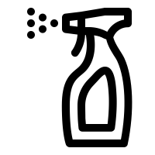
Problem N5
Presentation Plan
Theory
Experiments/statistics
What is bacteria?
Statistics about most used disinfectants
what’s a disinfectant and what does it mean to disinfect?
Experiment about 4 main disinfectant groups
The most frequent bacteria on human hands and door handles
Our mathematical model : bacteria mass difference dependent on time
Experiment about concentration : does a higher concentration mean a better result?

Slide 3
Problem N5: Hypothesis
Hypothesis
Most bacteria on the door handles will match the bacteria on human skin (especially hand area).

Slide 4
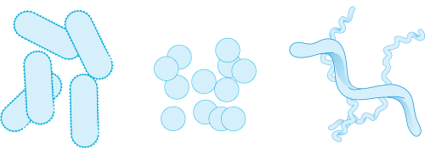
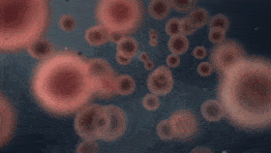
What is bacteria?
Rod (bacilli)
Bacteria found on human hands
Spherical (cocci)
Spiral (spirilla)
Pseudomas Putida
Staphylococcus warneri
Klebseilla pheumoniae
Binary fission
S. aureus
Enterobacter cloacae
Disinfection – Process of eliminating many or all pathogenic microorganisms

Slide 5
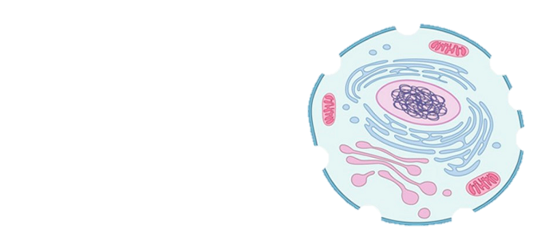
Most frequently used disinfectant groups
disinfectants
denaturants
reactants
oxidants

Slide 6
Mathematical model : Bacteria mass change
dependent on time
$$\frac{dM_{x}}{dt}=q_{x}M_{x}⇒\frac{dM_{x}}{M_{x}}=q_{x}dt⇒$$
$$⇒\int_{M_{x}(0)}^{M_{x}}{\frac{dM_{x}}{M_{x}}}=\int_{0}^{t}{q_{x}dt}⇒ln⁡|M_{x}|−ln⁡|M_{x }\left(0\right)|=q_{x }t⇒$$
$$⇒ln\frac{M_{x}}{M_{x}\left(0\right)}=q_{x}t⇒$$
$${⇒M}_{x}=M_{x}\left(0\right)e^{q_{x}t}⇒$$
$$⇒v_{x}=M_{x}(0)q_{x}e^{q_{x}t}$$

Slide 7
Problem N5 : Disinfectant groups
Alcohol - The most feasible explanation for the antimicrobial action of alcohol is denaturation of proteins. This mechanism is supported by the observation that absolute ethyl alcohol, a dehydrating agent, is less bactericidal than mixtures of alcohol and water because proteins are denatured more quickly in the presence of water.
Inactivation by chlorine can result from a number of factors: oxidation of sulfhydryl enzymes and amino acids; ring chlorination of amino acids; loss of intracellular contents; decreased uptake of nutrients; inhibition of protein synthesis; decreased oxygen uptake; oxidation of respiratory components; decreased adenosine triphosphate production; breaks in DNA; and depressed DNA synthesis.
Hydrogen peroxide works by producing destructive hydroxyl free radicals that can attack membrane lipids, DNA, and other essential cell components.
Ammonium - The bactericidal action of the quaternaries has been attributed to the inactivation of energy-producing enzymes, denaturation of essential cell proteins, and disruption of the cell membrane

Slide 8
Gram negativity/positivity
Gram negative
Gram Positive
Lipopotysaccharide and proteins
Cell wall

Slide 9
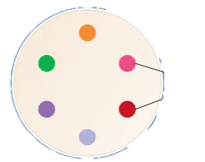
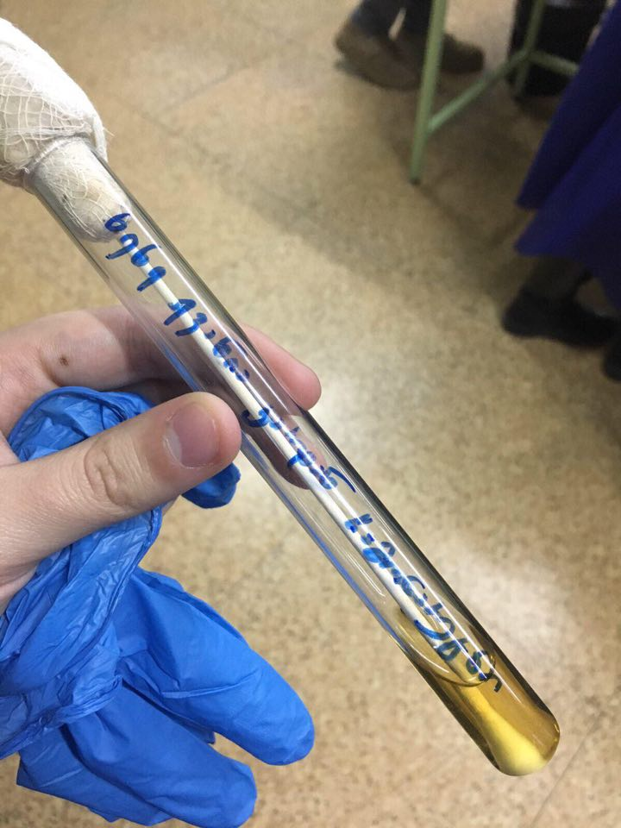
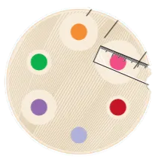
Problem N5 : Experiment
The structure of the experiment
Sterile discs soaked with disinfectants
Inhibited areal
Material used during the
experiment
Petri dishes
Sterile discs
Sterile cotton
Alcohol heater
Incubator
ruler
Liquid cell-culture
Sample from the door

Slide 10
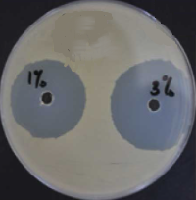
Problem N5: experiment – different disinfectant groups
incubation: 20 hours in a $37℃$ environment.
Our experiment on hydrogen peroxide
The graph shows the inhibited areal in mm-s.
Pseudomas Putida
Staphylococcus warneri
Klebseilla pheumoniae
S. aureus
Enterobacter cloacae

Slide 11
Problem N5: Experiment - Concentrations
Concentrations 50%-100%
incubation: 20 hours in a $37℃$ environment.
The graph shows the inhibited areal in mm-s.
Max disinfection was shown on 70%
Minimal disinfection was at 100%

Slide 12
Problem N5: Experiment - Fungus
incubation: 20 hours in a $37℃$ environment.

Slide 13
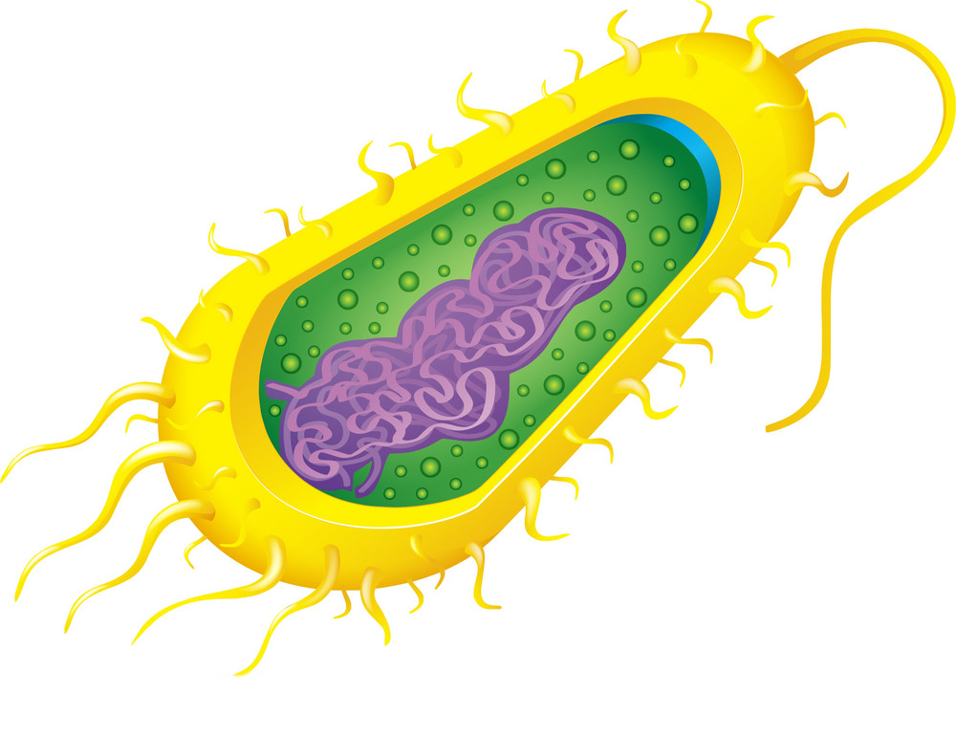
Problem N5: Conclusion
Bacteria are prokaryote cells and their wall build-up is dependant on gram posivity/negativity.
Different disinfectants work differently on bacteria and their outside wall.
The bacteria on door handles is almost identical to the one found on a human hand.
The strongest disinfectant from our experiment turned out to be rubbing alcohol.
From the experiment about alcohol concentrations, we concluded that higher concentration doesn’t always mean a better disinfection.
The best result for fungus was also 70% alcohol.

Slide 14
Problem N5
Thanks for the attention

Slide 15
https://sciencing.com/alcohol-kill-bacteria-5462404.html
https://bio.libretexts.org/Bookshelves/Microbiology/Book%3A_Microbiology_(Boundless)/6%3A_Culturing_Microorganisms/6._15%3A_Chemical_Antimicrobial_Control/6.15C%3A_Types_of_Disinfectants
https://www.ncbi.nlm.nih.gov/pmc/articles/PMC2062569/
https://bio.libretexts.org/Bookshelves/Microbiology/Book%3A_Microbiology_(OpenStax)/04%3A_Prokaryotic_Diversity/4.3%3A_Nonproteobacteria_Gram-negative_Bacteria_and_Phototrophic_Bacteria
https://bio.libretexts.org/Bookshelves/Microbiology/Book%3A_Microbiology_(Boundless)/6%3A_Culturing_Microorganisms/6.7%3A_Bacterial_Population_Growth/6.7A%3A_Microbial_Growth_Cycle
https://bio.libretexts.org/Bookshelves/Microbiology/Book%3A_Microbiology_(Boundless)/6%3A_Culturing_Microorganisms/6._15%3A_Chemical_Antimicrobial_Control/6.15A%3A_Effective_Disinfection
https://en.wikipedia.org/wiki/Skin_disinfection
https://en.wikipedia.org/wiki/Door_handle_bacteria
https://microbiomejournal.biomedcentral.com/articles/10.1186/s40168-015-0135-0
https://en.wikipedia.org/wiki/Proteobacteria
https://www.realclearscience.com/journal_club/2012/10/16/hospital_door_handles_106387.html
https://www.kemi.se/en/statistics/statistics-in-brief/products-and-sectors/disinfectants
https://www.sciencedirect.com/topics/chemistry/hypochlorite
https://bio.libretexts.org/Bookshelves/Microbiology/Book%3A_Microbiology_(OpenStax)/13%3A_Control_of_Microbial_Growth/13.4%3A_Testing_the_Effectiveness_of_Antiseptics_and_Disinfectants
https://en.wikipedia.org/wiki/Thymol

Slide 16
Problem N5: Extra slides

