Slide 1
Problem №6 «Piezo ignition»
Sennikova Arina
Team «Uranium-239»
International Young Naturalists’ Tournament 2020

Slide 2
Problem statement
problem
intro
G&T
voltage vs mass
discharge
p. module
voltage vs area
another piezoid
results
resources
A common lighter uses piezoelectric crystals.
Investigate the quantitative parameters describing the response of such crystals to pressure.

Slide 3
Goals and tasks
problem
intro
G&T
voltage vs mass
discharge
p. module
voltage vs area
another piezoid
results
resources
Goals
To study some piezoelectric material, particularly the response to pressure.
Tasks
To find the functional connection between output voltage and force, applied to the piezoid.
Piezoid$=$capacitor?

Slide 4
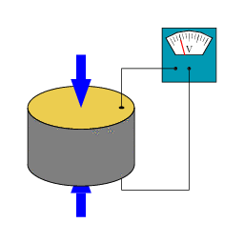
Piezoelectricity
problem
intro
G&T
voltage vs mass
discharge
p. module
voltage vs area
another piezoid
results
resources
Piezoelectric effect is an effect of the occurrence of an electric voltage between the faces of piezoid under an influence of mechanical action.

Slide 5
What is a piezoid?
problem
intro
G&T
voltage vs mass
discharge
p. module
voltage vs area
another piezoid
results
resources
Piezoid is a crystal that polarizes under a physical impact
A charge on a piezoid can be found by the formula:
$q=d∙F$
$d$ - piezoelectric module

Slide 6
Hypotheses
problem
intro
G&T
voltage vs mass
discharge
p. module
voltage vs area
another piezoid
results
resources
The voltage on the piezoid depends on:
Applied force – linearly
Area, to which the force is applied
A piezoid is similar to the capacitor in properties, so can a piezoid be a flat capacitor?

Slide 7
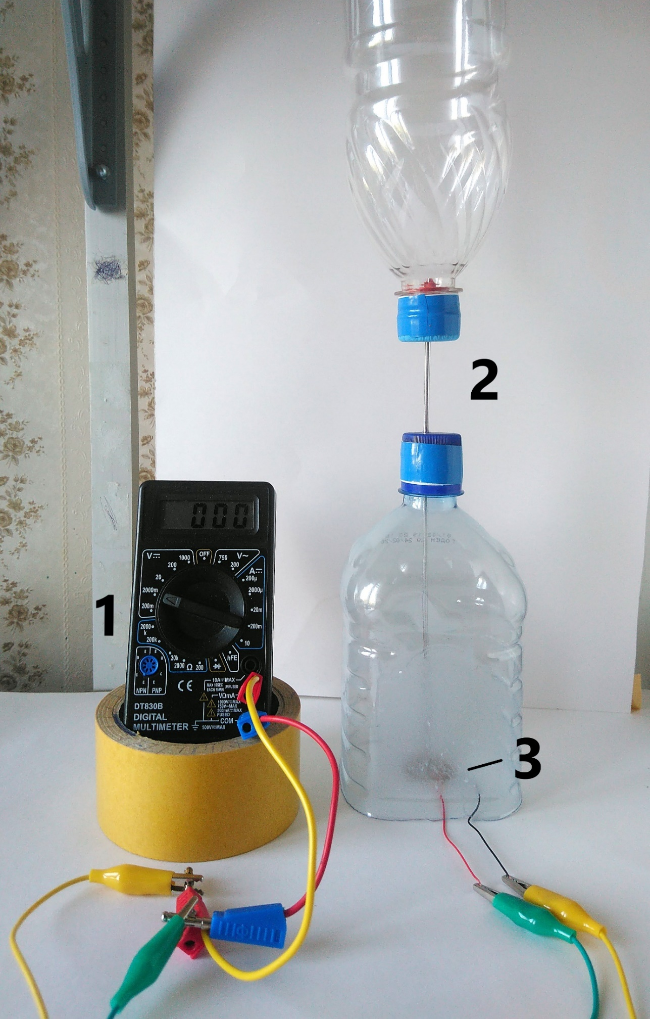
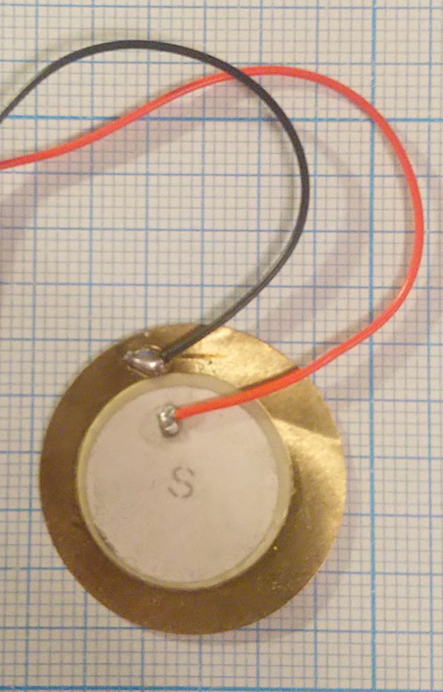
Equipment
problem
intro
G&T
voltage vs mass
discharge
p. module
voltage vs area
another piezoid
results
resources
Multimeter
Experimental setup, made of plastic bottles and needle
Piezoid

Slide 8
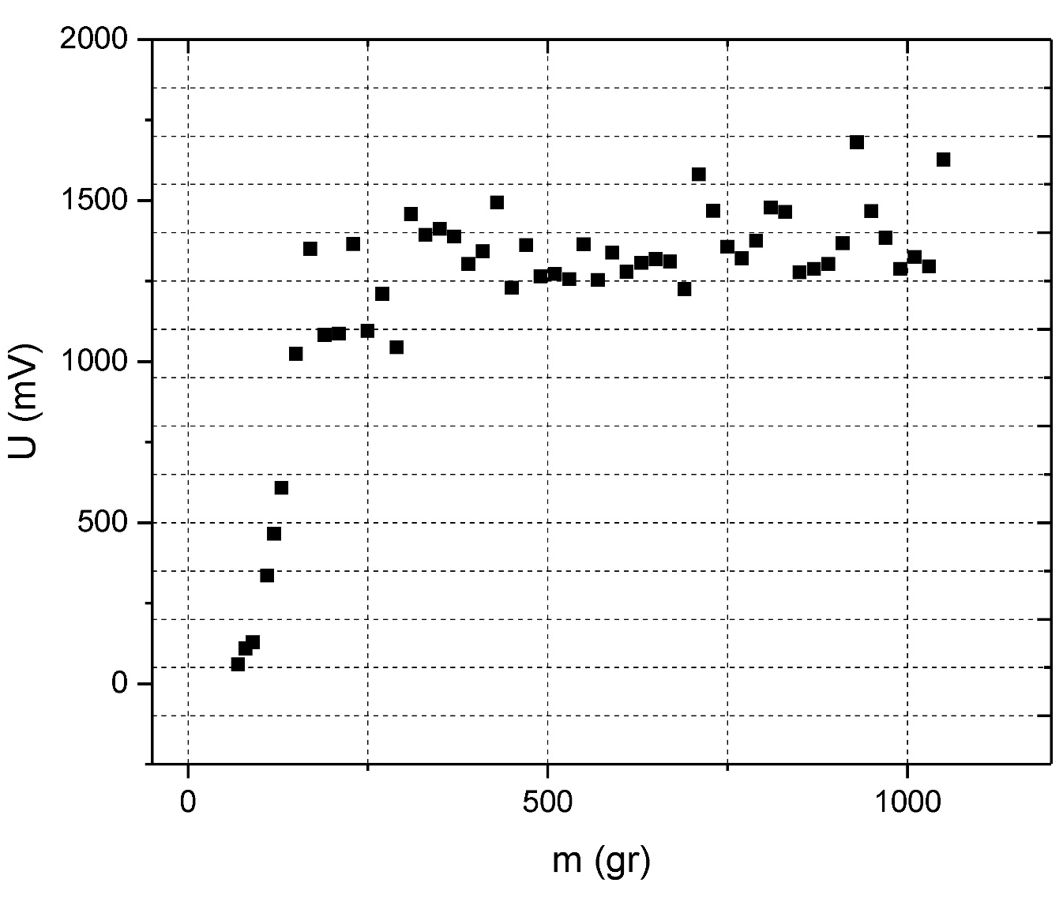
problem
intro
G&T
voltage vs mass
discharge
p. module
voltage vs area
another piezoid
results
resources
Experiment №1
Case №1. Maximum output voltage
$U_{max}=2100$ mV

Slide 9
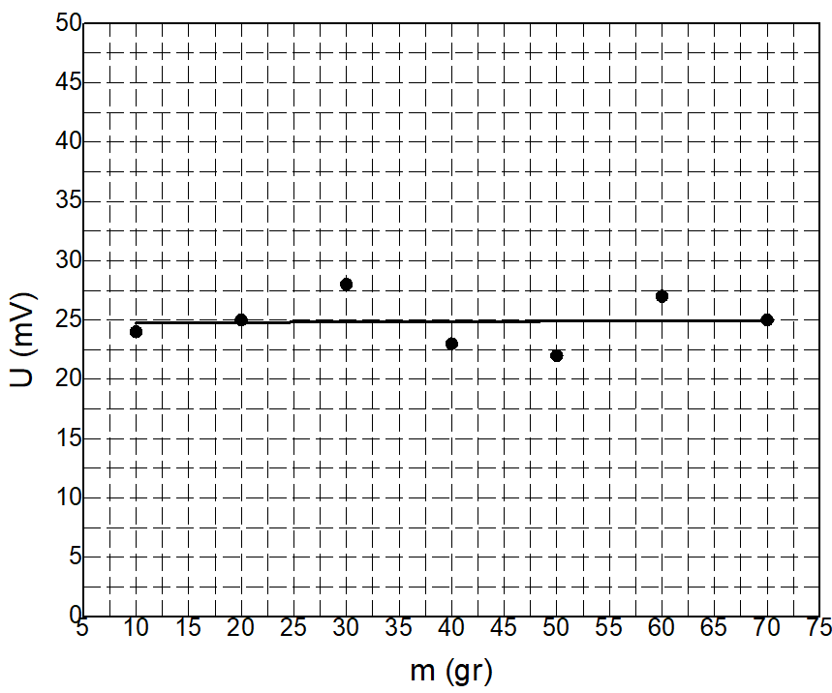
Experiment №1 Case №2
problem
intro
G&T
voltage vs mass
discharge
p. module
voltage vs area
another piezoid
results
resources
m (gr) | U (mV)
10 | 24
20 | 25
30 | 28
40 | 23
50 | 22
60 | 27
70 | 25
$σ≈$1.957 mV (table on the plot)

Slide 10
Experiment №2 Piezoid’s discharge through the multimeter (1)
problem
intro
G&T
voltage vs mass
discharge
p. module
voltage vs area
another piezoid
results
resources

Slide 11
Linearization
problem
intro
G&T
voltage vs mass
discharge
p. module
voltage vs area
another piezoid
results
resources
$$U=U_{0}∙e^{−\frac{t}{RC}}$$
$U_{0}$-maximum gained output voltage
$U$- output voltage
$\ln\left(\frac{U_{0}}{U}\right)=\frac{t}{RC}$
so we can make a linear plot:

Slide 12
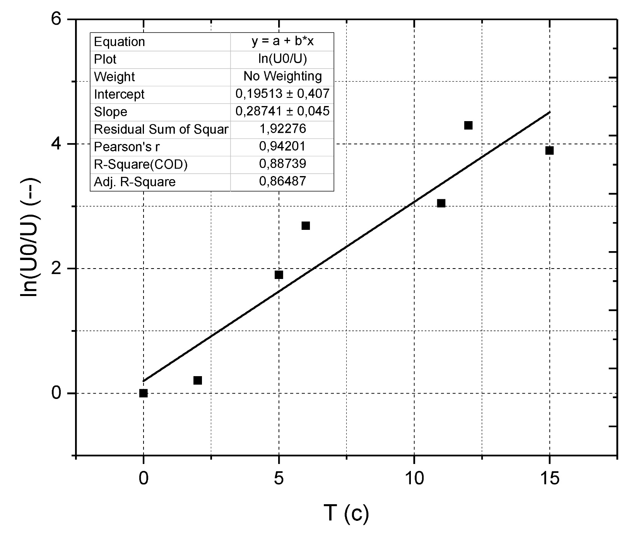
Linearization
problem
intro
G&T
voltage vs mass
discharge
p. module
voltage vs area
another piezoid
results
resources

Slide 13
Piezoelectric module (method 1)
problem
intro
G&T
voltage vs mass
discharge
p. module
voltage vs area
another piezoid
results
resources
After linearizing we get
$k=\frac{1}{RC}$
$$С=\frac{1}{k∙R}≈4.9705∙{10}^{−9} F$$
$q=d∙F⇒$ $d=\frac{q}{F}$
Also $q=CU$
$d_{1}=\frac{CU}{F} ≈6.54761{∙10}^{−10}$ С/N
(looks like PZT-4 ?)

Slide 14
Piezoelectric module 1 (method 2)
problem
intro
G&T
voltage vs mass
discharge
p. module
voltage vs area
another piezoid
results
resources
For a flat capacitor we have:
$$C=\frac{{εε}_{0}S}{d}≈\text{19.5267 }\text{nF}$$
$$d_{2}=\frac{CU}{F}≈2.68492∙{10}^{−9} C\text{/}\text{N}$$
Piezoid = capacitor (hypothesis)
$$d_{1}≠d_{2}$$
Conclusion: piezoid $≠$ flat capacitor (hypothesis is partly confirmed).

Slide 15
Experiment №3. Dependence on the area
problem
intro
G&T
voltage vs mass
discharge
p. module
voltage vs area
another piezoid
results
resources

Slide 16
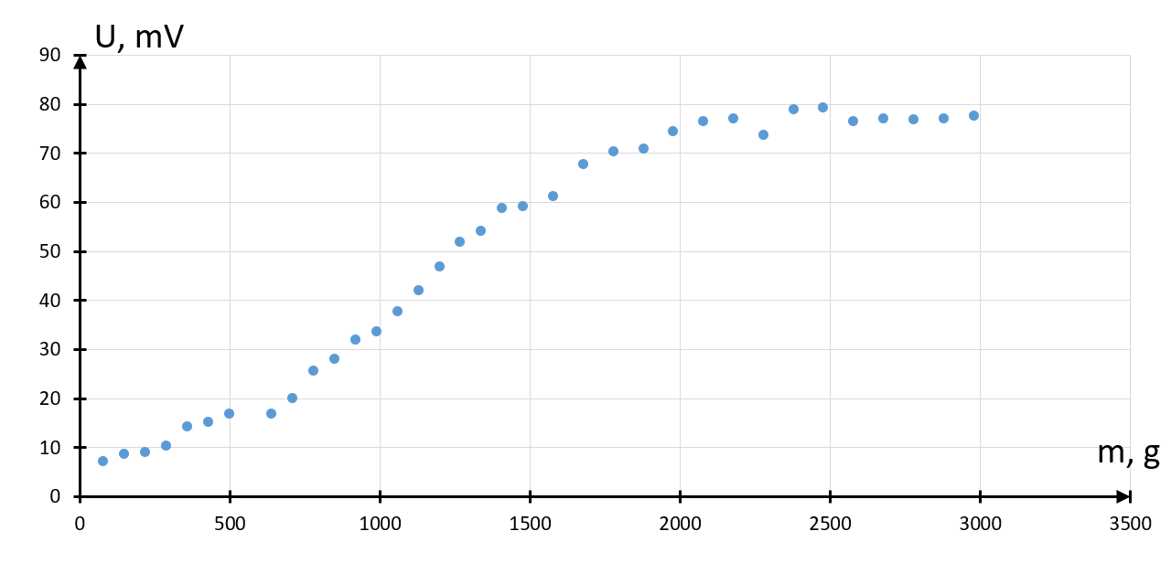
Maximum output voltage 2
problem
intro
G&T
voltage vs mass
discharge
p. module
voltage vs area
another piezoid
results
resources
15

Slide 17
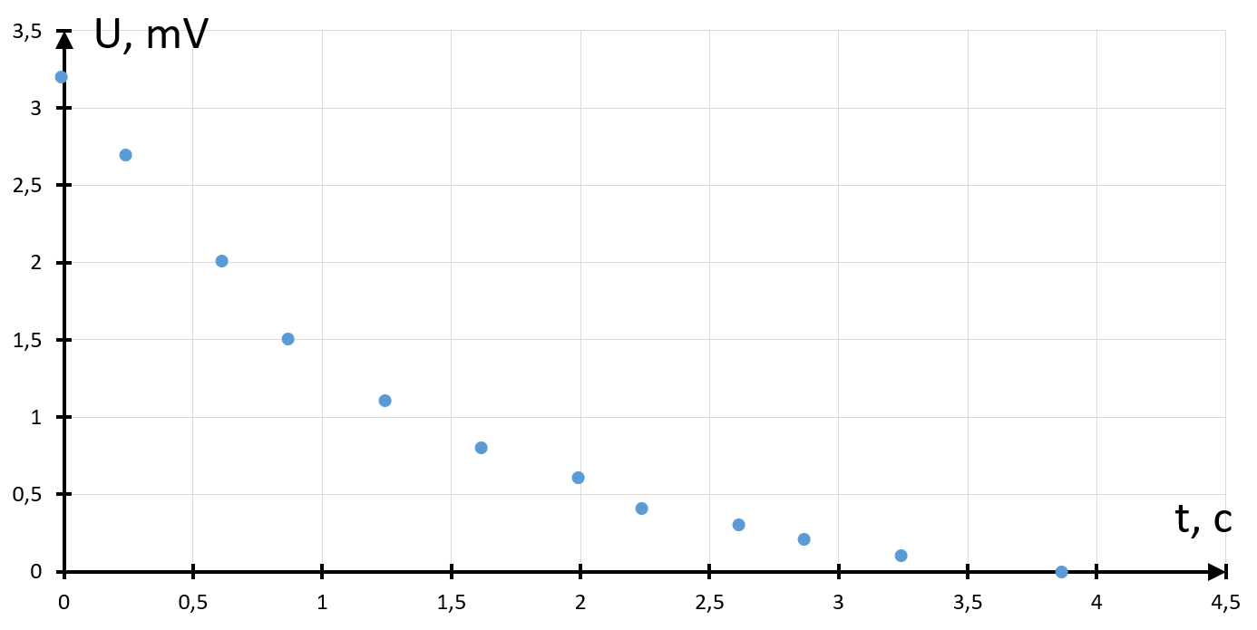
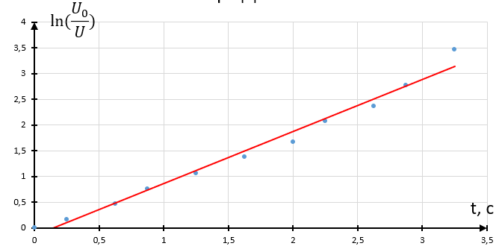
Piezoid’s discharge through the multimeter (2)
problem
intro
G&T
voltage vs mass
discharge
p. module
voltage vs area
another piezoid
results
resources
Let’s get the similar plot for the other piezoid
Linearized plot

Slide 18
Piezoelectric module 2 (method 1)
problem
intro
G&T
voltage vs mass
discharge
p. module
voltage vs area
another piezoid
results
resources
$$k= \frac{1}{RC}=0,853 \frac{1}{ohm∙F}$$
$\text{R}\text{ = 63,2}$ Mohm (according to the experiment statement)
$$C= \frac{1}{R∙k}=1,85∙{10}^{−8}=18,5 nF$$
$$q=CU= \left(5,18 ÷18,5\right)∙{10}^{−11} C$$
It’s clear that:
$d_{1}= \frac{q}{F}=\left(74 ÷264\right)∙ {10}^{−12} C$ $⇒$ looks like PZT-23

Slide 19
Piezoelectric module 2 (method 2)
problem
intro
G&T
voltage vs mass
discharge
p. module
voltage vs area
another piezoid
results
resources
$$C= \frac{εε_{0}S}{d}=4,37∙{10}^{−9}f=4,37 nf$$
$q=CU=\left(1,224 ÷ 4,37\right)∙{10}^{−11} C$
$d_{2}= \frac{q}{F}=1,749∙{10}^{−11}C ÷ 6,24∙{10}^{−11}C$
Piezoid = capacitor (hypothesis)
$$d_{1}≠d_{2}$$
Conclusion: piezoid $≠$ flat capacitor (hypothesis is partly confirmed)

Slide 20
Results
problem
intro
G&T
voltage vs mass
discharge
p. module
voltage vs area
another piezoid
results
resources
The flat capacitor model is not applicable to a piezoid.
Output voltage grows if the force grows.
Output voltage decreases if the area is growing.
Piezoelectric modules for two different piezoids were found.

Slide 21
Resources
problem
intro
G&T
voltage vs mass
discharge
p. module
voltage vs area
another piezoid
results
resources
[1] "Physical encyclopedic dictionary" A. M. Prokhorov
[2] "Handbook of elementary physics” N. I. Koshkin, M. G. Shirkevich
[3] «Piezoelectric Roads: Energy Harvesting Method Using Piezoelectric Technology» Ravjeet Kour, Ahmad Charif, ONCampus Coventry University, UK
[4] «A preliminary study on the highway piezoelectric power supply system» Hailu Yang, Linbing Wang, Bin Zhou, Ya Wei, Qian Zhao

Slide 22
Thank you for your attention!

Slide 23
Problem №6 «Piezo ignition»
Sennikova Arina
Team «Uranium-239»
International Young Naturalists’ Tournament 2020

Slide 24
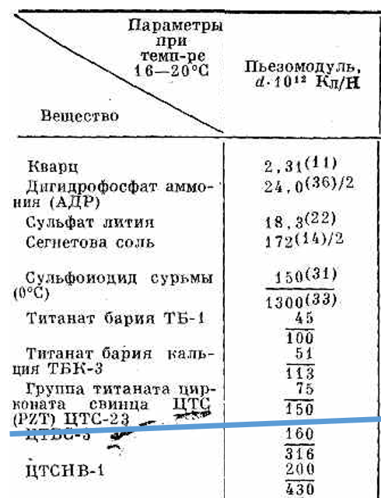

Slide 25
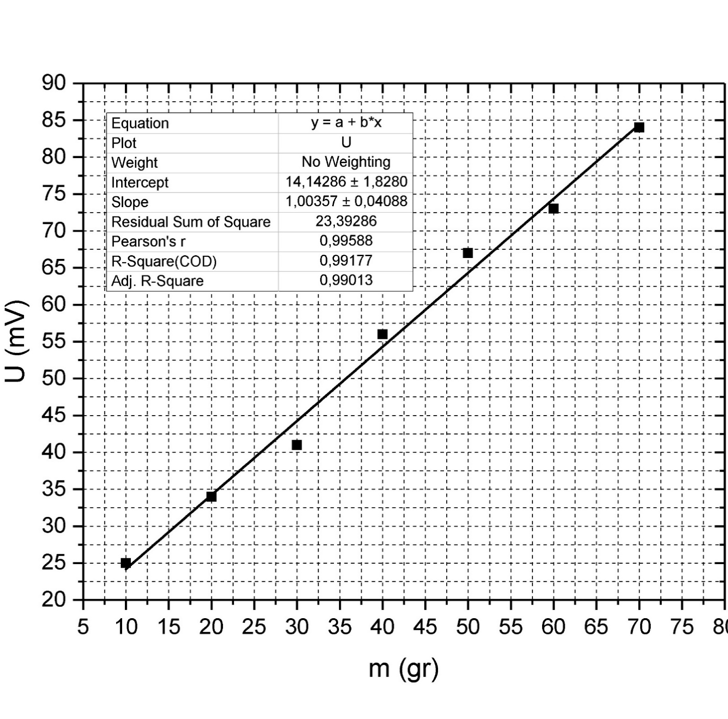
Case №1

Slide 26
