Slide 1
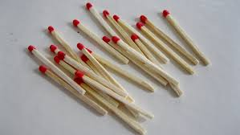
Opposition - Problem No.8
Magnet and matchstick
Menelaos Raptis - Team Fryganiotis
I.Y.N.T.

Slide 2
Reporter’s Theory - Pros & Cons
Theory wasn't relevant to the phenomenon and insisted way too much on it
Irrelevant equations
Chaotic presentation, lacks of structure & couldn't be fully understood and it was confusing
Missed important variables like the type of the magnets, humidity
Not sufficient theoretical support to justify the results.
parameters weren’t included
too much theory
Lack of the reference to the Possible Errors.
Excellent definition of the phenomenon.
Sufficient theoretical support of the results.
Included relevant parameters.
Presence of visual aid (video/photos)
Well defined almost all of the parameters

Slide 3
Experiment - Pros & Cons
Hypothesis didn’t exist
No graphs
Not enough parameters tested.
Experiments conducted in a non-controlled environment
Results not presented
Unclear method
No errors explained.
Not enough data presented.
Used only one type of magnet
Well conducted experiments.
Interesting Results.
visual aid

Slide 4
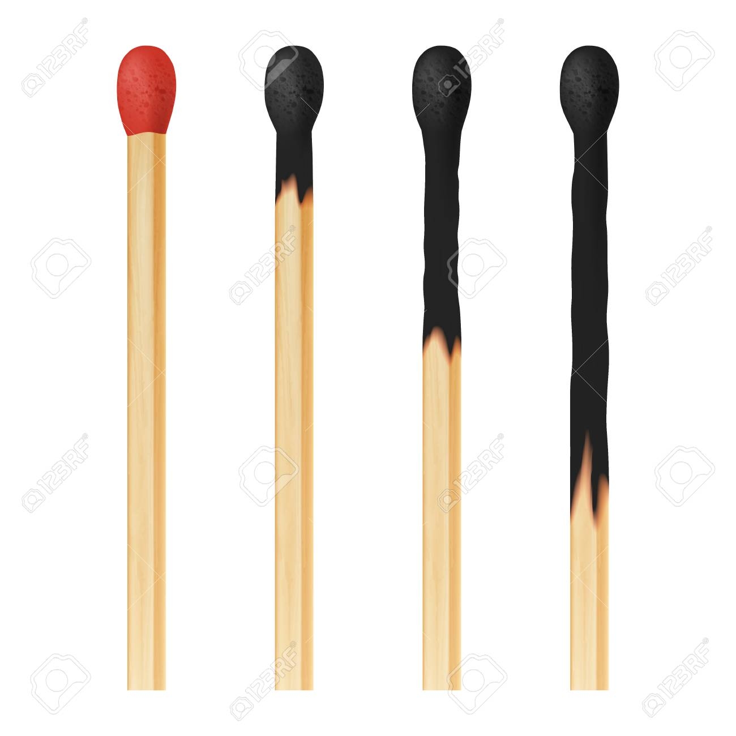
Theory vs Experiment - Pros & Cons
Not enough data presented and as a result he didn’t support any conclusions/results
No hypotheses included
.
Well conducted experiment

Slide 5
Conclusions
Well-defined almost all of the relevant theory.
Didn't mention the importance of the iron concentration
Experiments were properly conducted and shown.
Atmospheric conditions were not tested.
Causes of errors & errors themselves in the measurements have not been explained.
Not clear how conclusions are justified by the experimentals results.
No hypotheses were included
More experiments needed for revealing the dependence of air humidity to the burning of the match.

Slide 6
Suggestions for further improvement
Add hypotheses
Test more parameters
Less time on irrelevant theory
Explain the reasons behind your errors in your measurements.
Perform more experiments in order to make your experiment even more valid.
Add graphs
Take more measurements per experiment so you can see the points of interest that appear in the graphs.
Include more magnets to test more parameters

Slide 7
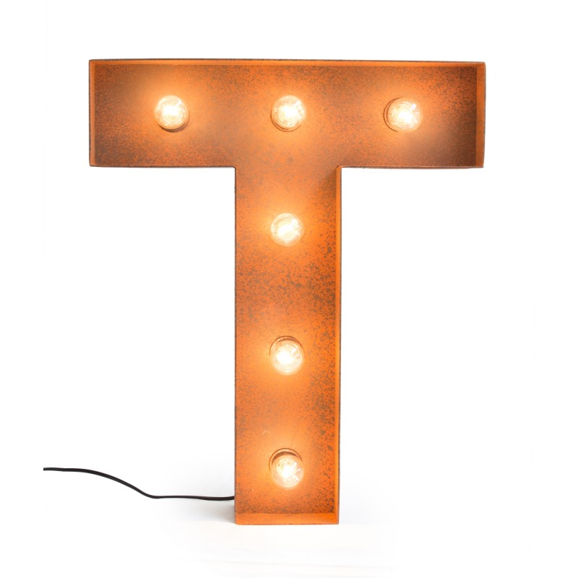
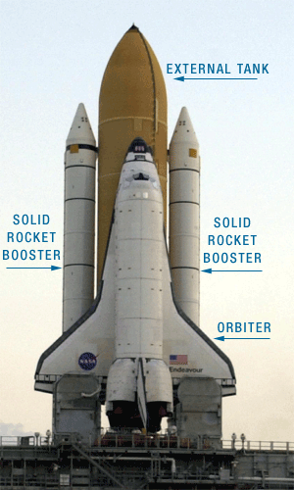
YOU
FOR
YOUR ATTENTION
ALL
ALL

