Slide 1
Review - Problem No.11
Hydrogen Release
Myrto Terpsiadou - Team Fryganiotis
I.Y.N.T.

Slide 2
Reporter - Pros & Cons
Unclear definitions.
Cluttered slides
No theory and graphs.
Lack of hypotheses.
Experiments conducted in a non-controlled environment.
Unclear method
No errors and reasons behind them explained.
Lack of significant parameters such as salt concentration, temperature, pH, kinds of salt.
1st experiment irrelevant to the problem statement.
the balloon is not suitable to count hydrogen
Aluminium wire is not pure Al
Presence of visual aid & demonstrations.

Slide 3
Opponent - Pros & Cons
He noticed there was no measurement of the surface area of the aluminum.
Structured presentation
Noticed missing formulas for H2 volume
Noticed that the reporter didn’t use more salts
Noticed missing graphs
He didn't notice that the addition was of alloys instead of pure aluminium.
Missed huge error in 1st experiment.
He didn't insist on the reasons behind the errors in the experiments.
He didn’t mention the missing parameters, such as the concentration of salts.
Insist too much on parameters that were not tested.

Slide 4
REPORTER VS OPPONENT - POINTS DISCUSSED
Asked if the reporter calculated the surface area of aluminium
Asked what are the different types of salts the reporter could use
Did not answer
Did not answer

Slide 5
----> Opponent is Right
We think that all of the aforementioned parameters are something really important to be calculated.

Slide 6
Conclusions
Reporter :
Not justified assumption about the reaction
Clear definition
Uncontrolled parameter of temperature
No possible errors, low accuracy
Irrelevant experiment
didn’t answer the question proposed in the problem
Opponent :
Understood the experimental procedure
Asked relevant and significant questions about the types of salts.
Good time management
Didn’t insist on parameters that were tested

Slide 7
Suggestions for further improvement
Examine the phenomenon in more detail in order to observe the reaction
It is not possible for the reaction from the problem statement to be observed because the reporter did not add pure aluminium, so we suggest her to make her experiment happen with pure aluminum.

Slide 8
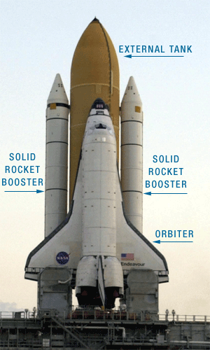
YOU
FOR
YOUR ATTENTION
ALL
ALL

