Slide 1
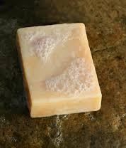
Review - Problem No.16
Soap Production
Nafsika Koutava - Team Fryganiotis
I.Y.N.T.

Slide 2
Reporter - Pros & Cons
Lack of hypothesis.
Didn’t explain the experimental setup.
Could test and other additives like butter.
Experiments conducted in a non-controlled environment.
Results not presented.
No possible errors and reasons behind them explained.
Unclear method(cold/hot)
Not enough data presented.
No error bars in the graphs
Missed some parameters like pH, lather, during time
Excellent definition of the phenomenon.
Structured and persuasive presentation.
Presence of visual aid & demonstrations.
Well-conducted experiments.
Interesting results.
Understanding graphs.

Slide 3
Opponent - Pros & Cons
He mentioned the lack of hypotheses
Opponent highlighted the lack of parameters considered.
He noticed there were no errors bars considered in the graphs.
He didn't notice or mentioned to if the soap was made with the hot or cold process .
He insisted too much on the volume and density of the soap and spent too much time on it.
He didn't insist on the reasons behind the errors in the experiments.
Aggressive and ironic

Slide 4
REPORTER VS OPPONENT- POINTS DISCUSSED
Asked how the reporter measured the volume of the soap
Said that salt soap is not antibacterial
asked how the reporter measured the foam production
Did not answer to the question
Disagreed
Didn’t fully answer the question

Slide 5
Our opinion is that the volume of the soap could be measured with a simple volumetric container.
We also believe that the soaps are antibacterial, proof for that is the recent researches about the coronavirus.

Slide 6
Suggestions for further improvement
Repeat the experiment in order for the results to be more valid.
Reporter should explain the experiments better
Test more parameters
Include error bars

Slide 7
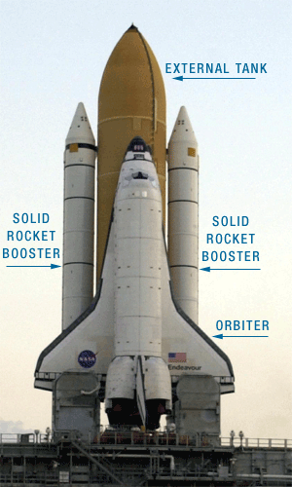
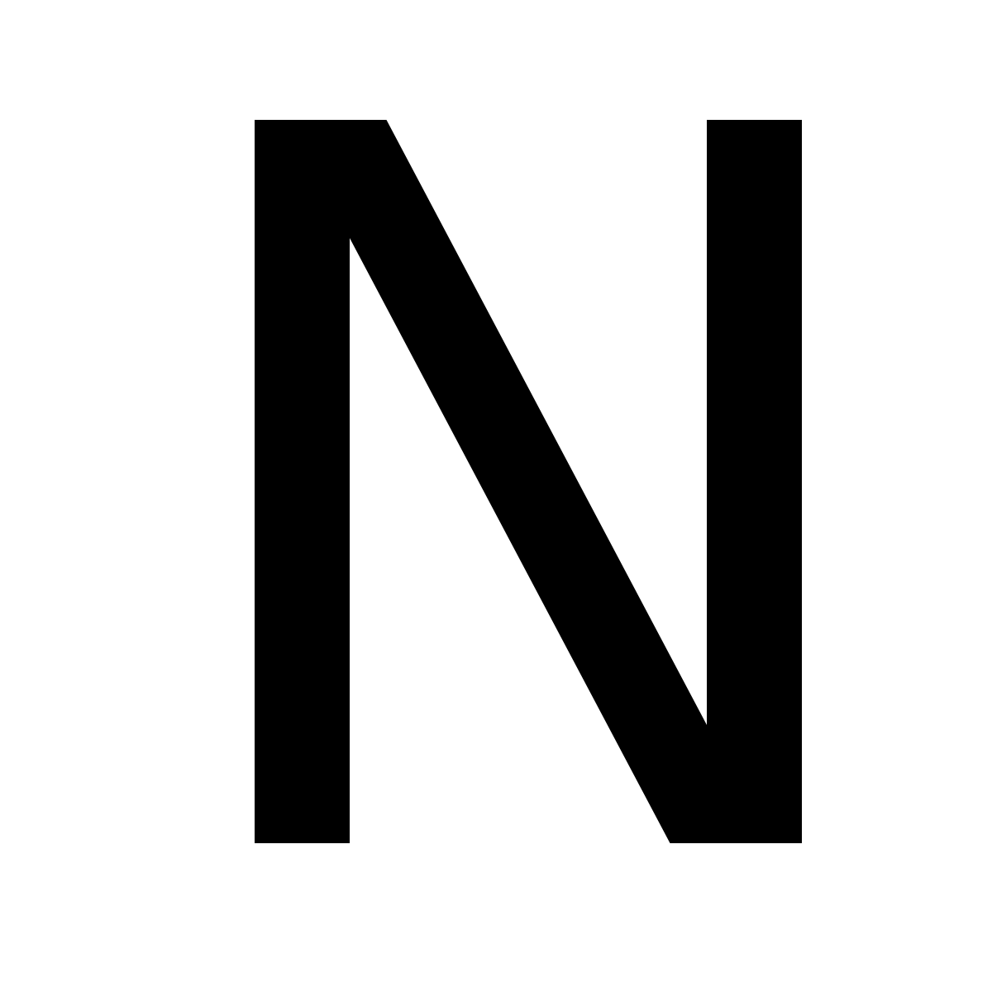
YOU
FOR
YOUR ATTENTION
ALL
ALL

