Slide 1
Pahonia:)
The problem №16
“Granular materials”
Reporter: Maria Zhuiko
Team of Belarus

Slide 2
Statement:
Explore the phenomenon of adsorption for the substances purification using the granular materials.

Slide 3
What is the phenomena of adsorption?
No adsorption surface
Notes:
Lets talk about the adsobtion. A sorbent is a material used to absorb or adsorb liquids or gases.
Adsorption differs from absorption. Adsorption is a surface phenomenon, while absorption involves the whole volume of the material.

Slide 4
What is the phenomena of adsorption?
Adsorption surface

Slide 5
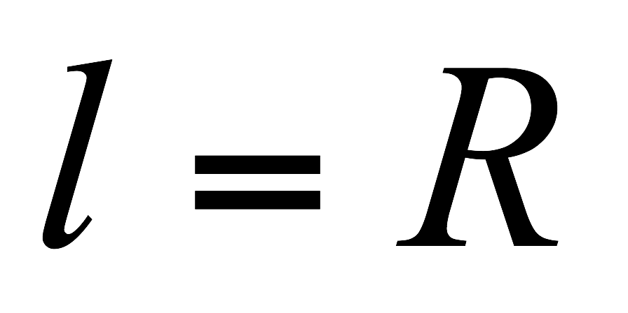
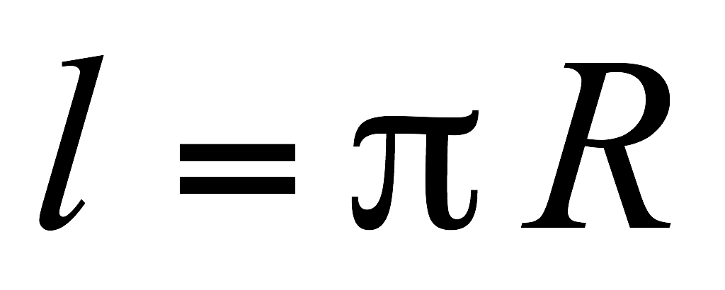
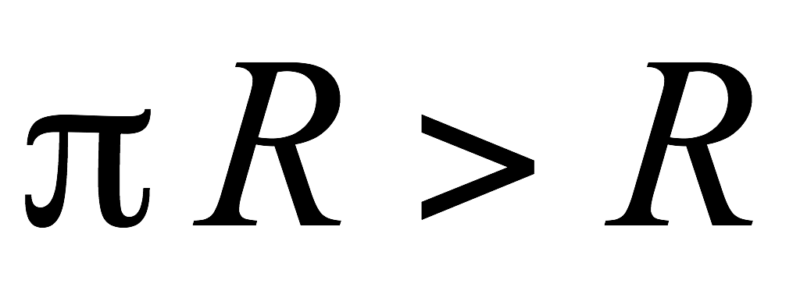
Why we use the granular materials to make a sorbents?
Flat surface
Granular surface
R
R

Slide 6
How we take a surface from a granular materials?
Buffer
Just granules
Granules after buffer adding

Slide 7
Setup
Input substance
Buffer
Filters
Substance of sorbents
Output substance
Notes:
Здесь обязательно текст по том зачем нам буфер и фильтры!!!!!!! Роль геля

Slide 8
Setup
Input substance
Sorbents
Notes:
Не забудьте сказать, что ваши вещества движуться под дейтсвием силы тяжести

Slide 9
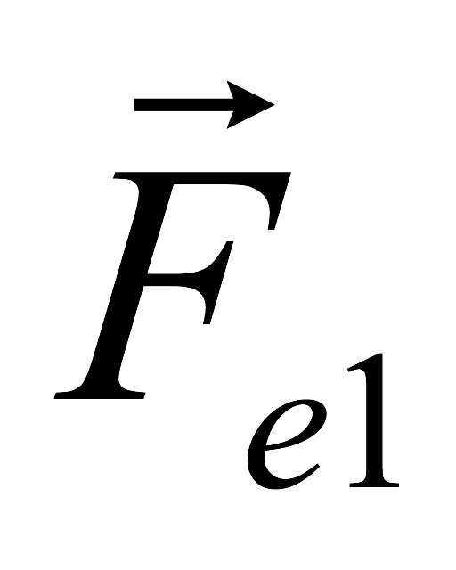
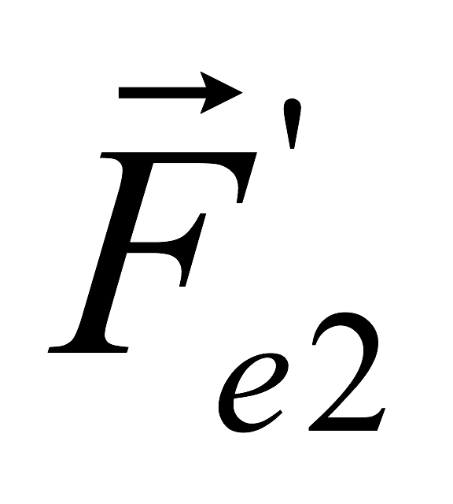
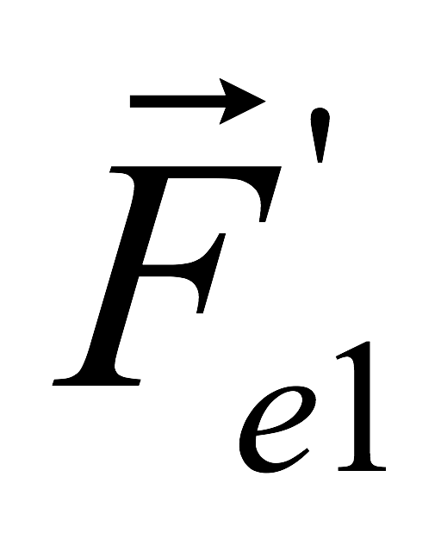
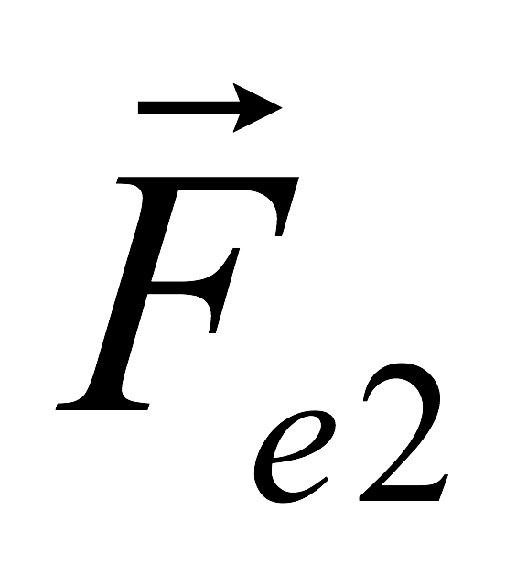
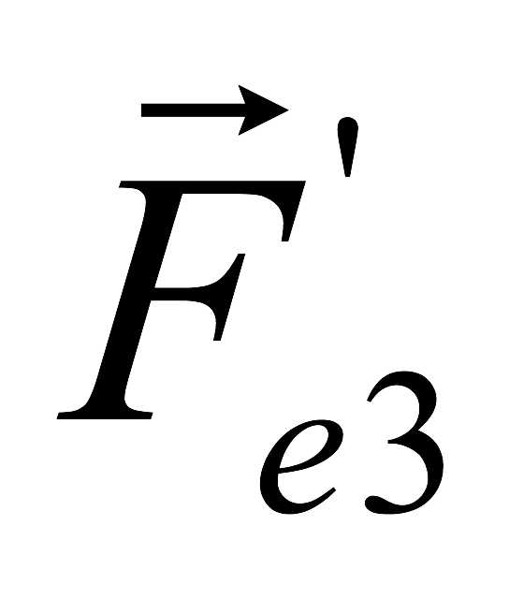
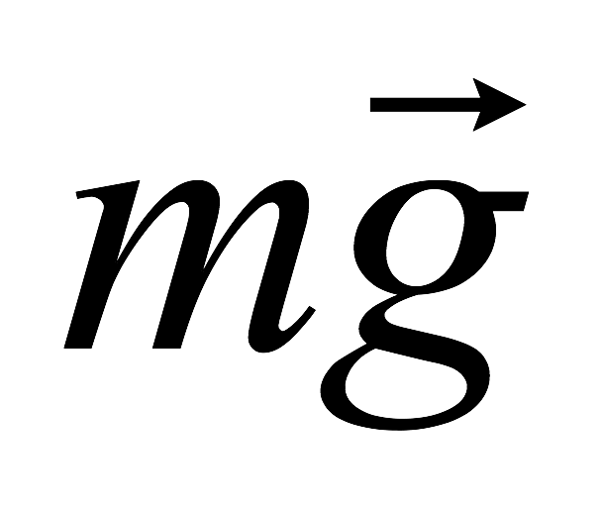
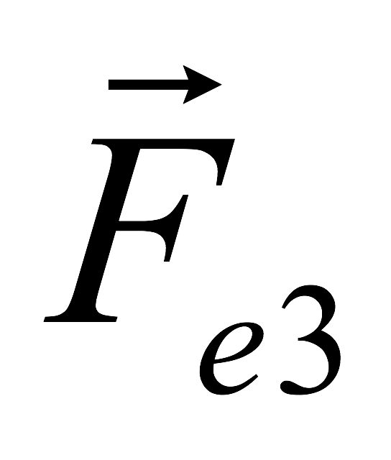
A process of moving

Slide 10
Pahonia:)
Experimental part

Slide 11
Features of granules
Pore
It’s a number of pores per unit of area
Notes:
Адсорбирующие сва-ва достигаются благодаря пористости материала

Slide 12
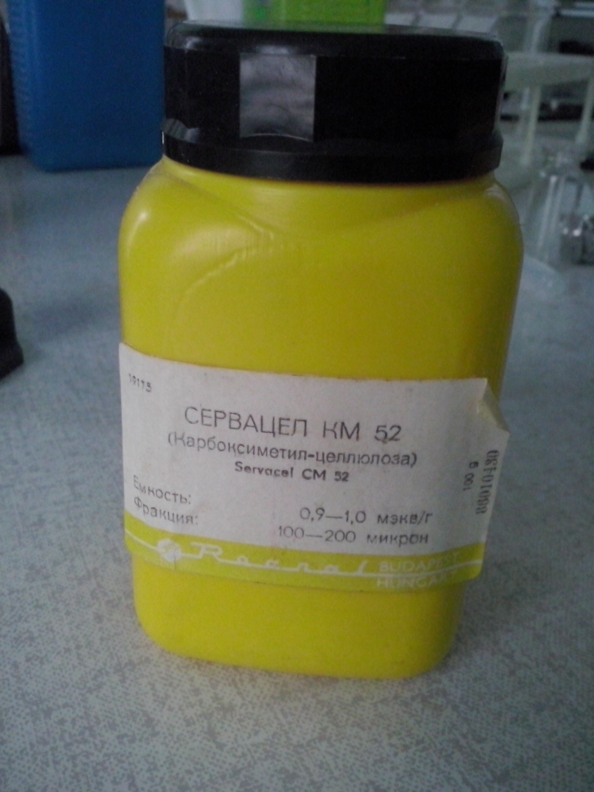
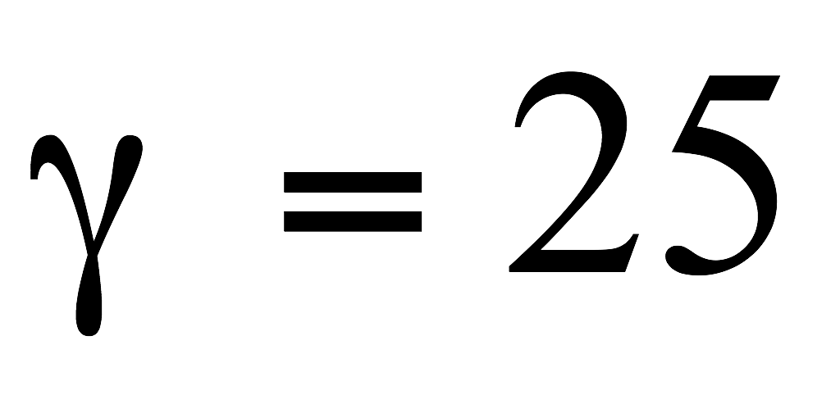
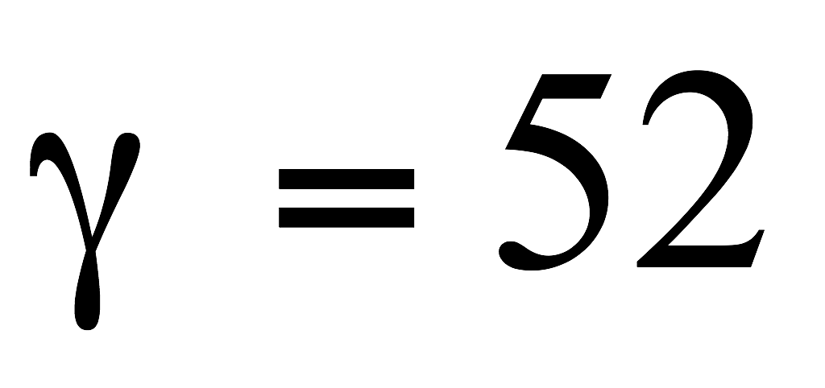
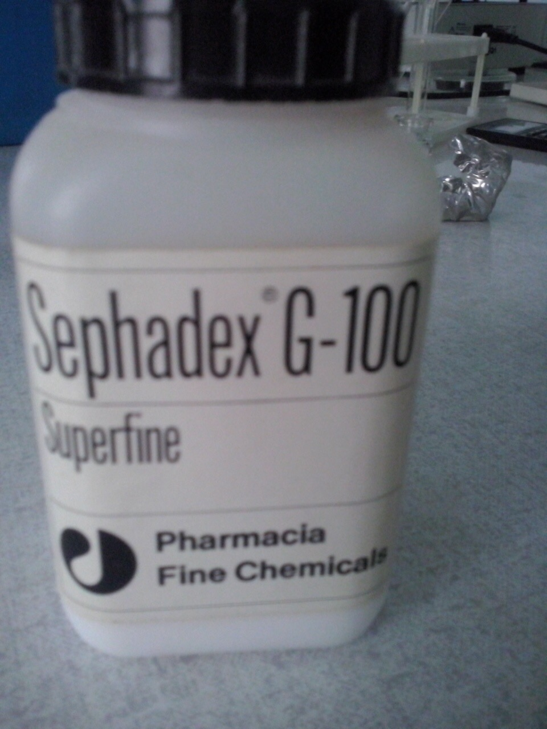
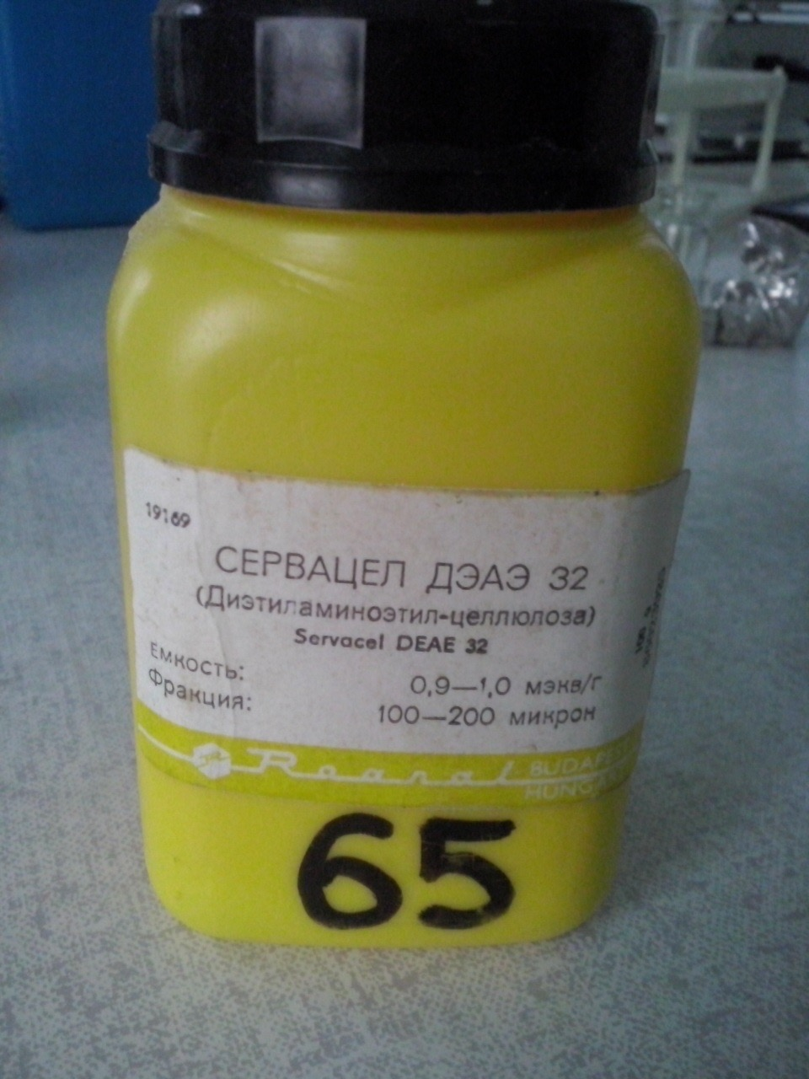
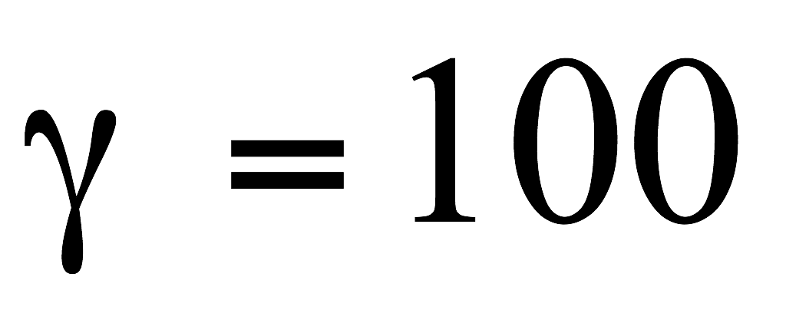
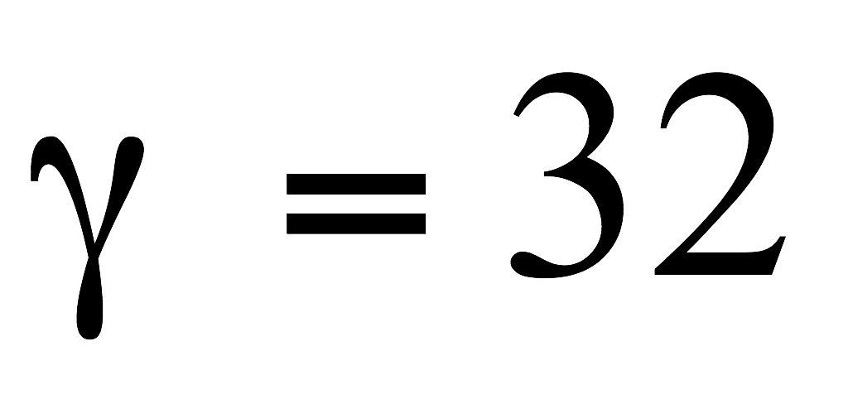
Granular materials which we want to explore
Sephadex
Servacel SM
Servacel DEAE
Sephadex
Notes:
About bacterial polimer

Slide 13
What is the features of the substances?
Sephadex
Servacel
+ charge in SM
- charge in DEAD
0 charge
Notes:
прокоменьтете почему положительный у см и отрицательный у деад, иначе вы всосете, рельно

Slide 14
Input substance
Setup

Slide 15
Parameters of input substance
1. Molecular mass
2. Color
The color
Casein
Vitamin B12
Notes:
Color for easy detecting
It doesn’t matter what substance you use, but it have to be different in two parameters…

Slide 16
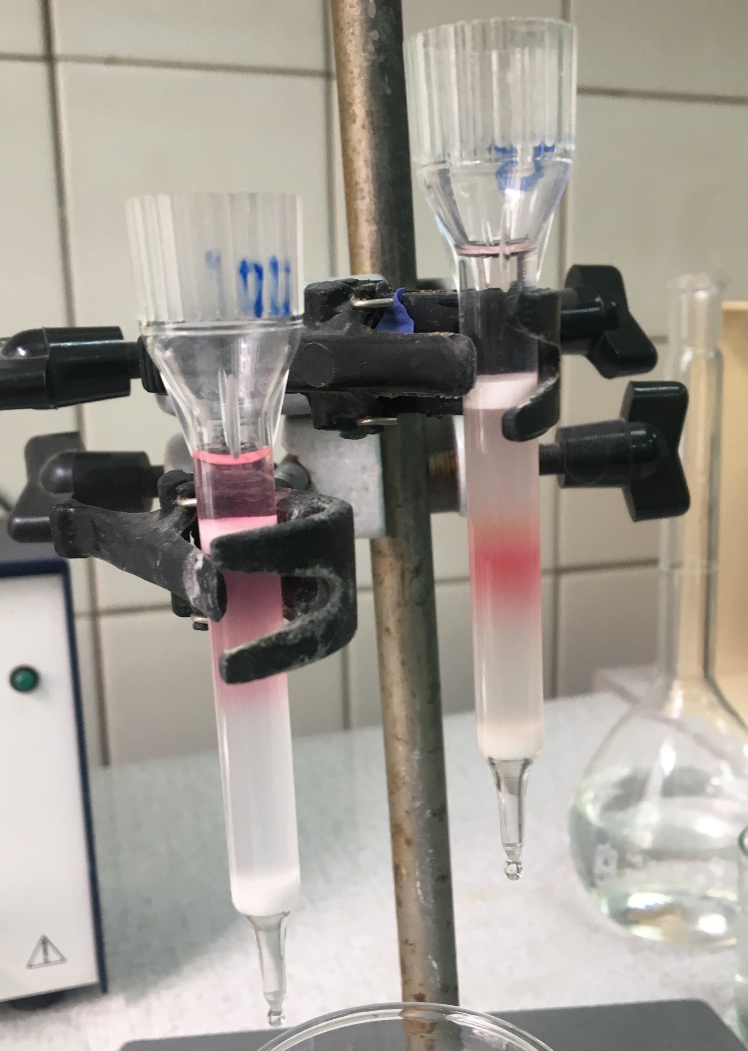
Experiments
Casein
Vitamin B12

Slide 17
Qualitative reaction to protein
B12
Reaction with protein
Blue solution

Slide 18
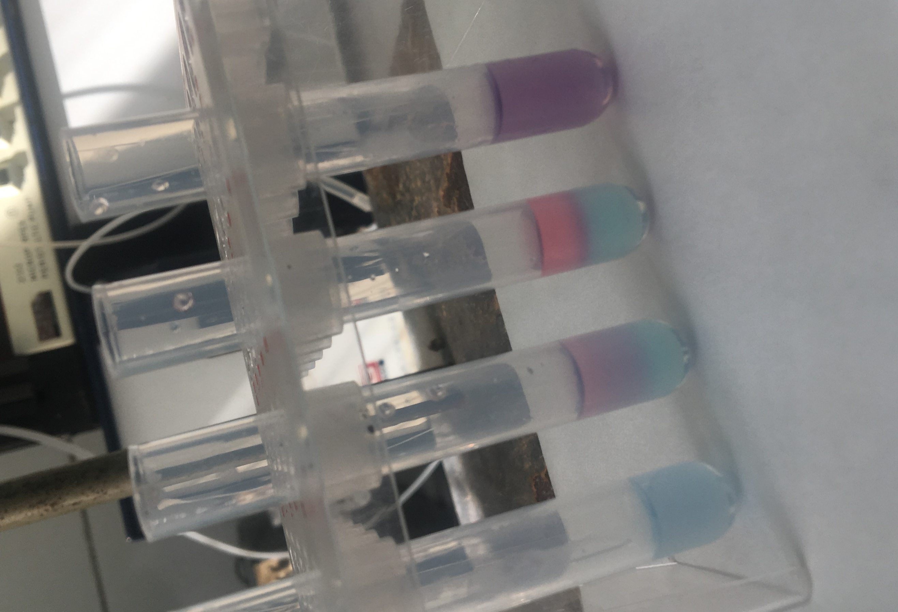
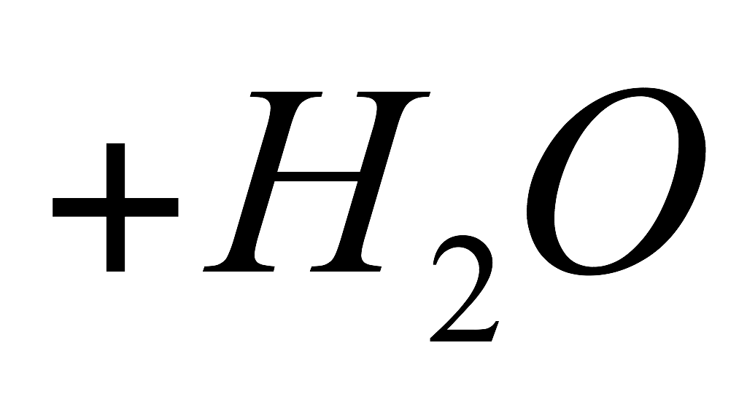
Identification with help of Biuret’s reaction
Blue solution:
0,15 g of
0,6 g of
30 ml 10%
0,1 g of

Slide 19
Results of experiments with sephadex

Slide 20
Results of experiments with Servacel
Notes:
Therefore we can conclude

Slide 21
Why casein don’t absorb substance?
Servacel SM
Servacel DEAE
+
-
+
-
0
0
+
-

Slide 22
Conclusions
Charge of the molecule influences the adsorption
Porosity of the granules influences the adsorption
Small molecules come down much faster than big ones, because big ones just stuck in that pours in the structure of the sorbent
Sephadex separates substances not by charge, but by different molecular masses
Servacel separates substances by charge
Notes:
Сорбенты могут абсорбировать за счет своего заряда и пористости
Чем больше пор, тем круче без пор вообще плохо если нет заряда

Slide 23
Pahonia:)
Thank you for your attention!

Slide 24
Parameters of input substance
1. Molecular mass
2. Color
3. Charge
The color
Interferon His
Vitamin B12
Notes:
So you need to add additional parameters talking about hist end

