Slide 1
Lora Lukmanova, Team Bulgaria B
Review: Wave optics
BULGARIA
Notes:
1

Slide 2
14. Invent yourself: Wave optics
Invent yourself task:
Formulate an open, thought-provoking problem that concerns a phenomenon of wave optics.
Statement:
Use some wave optical phenomenon to measure the refractive index of a transparent material.
Task was fully fulfilled.

Slide 3
Overview
Theory
Experiment
Results
Agreement between theory and experiment
Conclusions
Green = very good
Yellow = average
Red = needs improvement

Slide 4
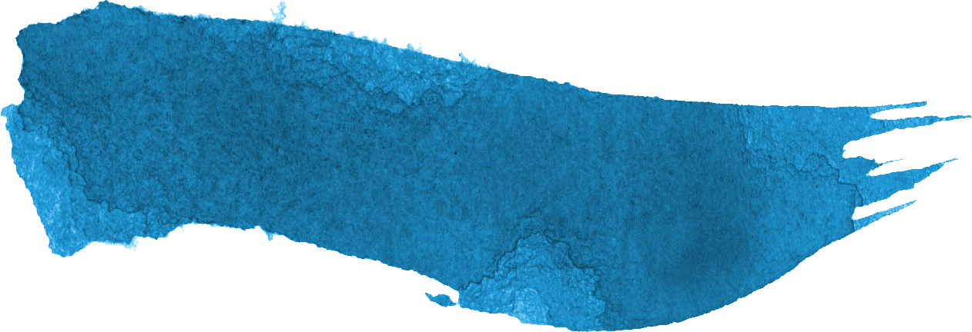
Reporter
Not perfect collection of data, the fringes are not absolutely clear
Doesn’t take into account the inhomogeneities of the glass plate
Small vibrations and particles in the air could have large effects on the experiment
Didn’t make clear why she changed the coefficient $b$
No exact explanation of the difference between geometrical and optical path
Improvement suggestion: varying the wavelength and refractive index
Proper and deep theory, starting from basic explanation and deriving the equations needed
Accurate experimental setup and procedure, taking a lot of measurements
Showed correlation between theory and experiment
Derives error, gets pretty accurate results
Includes graphs and images

Slide 5
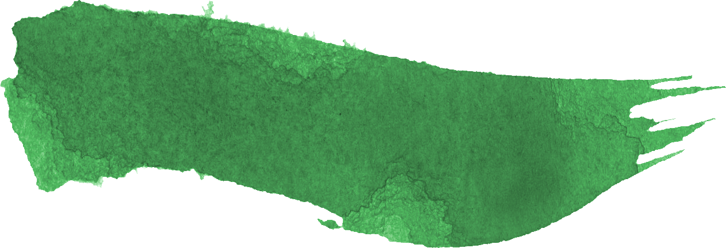
Opponent
Mentions and asks interesting questions about varying the parameters
Questions the transparent medium and why was exactly glass used
Doesn’t ask why she changes the theoretical model ($b$)
Doesn’t address possible issues with the experiment (small vibrations, air particles)
Targets minor problems irrelevant to the report and problem (both in the statement and the questions)
Doesn’t understand the studied phenomena (study solid

Slide 6
Opponent
Asks appropriate clarifying questions
Points out important missing points in the report
Shows deep understanding of the problem shown
Doesn’t understand the basic theory behind the experiment
Points out minor problems in the experiment

Slide 7
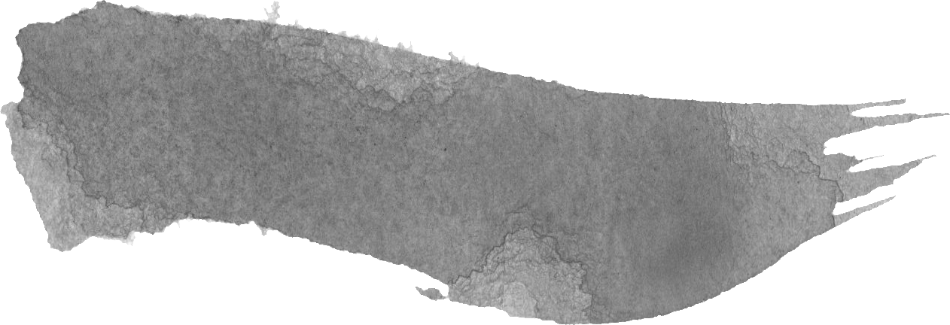
Discussion
Reporter addressed varying parameters and explained why they didn’t vary them (wavelength)
Mentioned the present human errors
Reporter answers all the questions properly and in detail
Opponent asks for using equipment not needed for solving the stated problem and task
Opponent doesn’t show the visuals to the whole room
Asks irrelevant question (white light)
Opponent let the reporter lead the discussion

Slide 8
Discussion
Opponent shows understanding of the phenomenon and the experiment, asking relevant questions
Reporter answers all the questions properly and in detail
Discussion was focused on the report and led to interesting ideas for improvement
Opponent shows no understanding of the essence of the report, asking irrelevant questions (things mentioned in the report/not connected to the report)
Opponent let the reporter lead the discussion

Slide 9
Clashes
Q: Why not handheld refractometer
Opp: Would be easier to measure
Rep: Would simplify the problem too much and won’t be thought provoking
Rev: Agree with reporter

Slide 10
Clashes
Q: Why not use white light
Opp: Would make the problem more interesting
Rep: Would not create a proper interference pattern
Rev: Agree with reporter
Thank you for your Attention

Slide 11
Clashes
Q:
Opp:
Rep:
Rev:
Q:
Opp:
Rep:
Rev:
Thank you for your Attention

Slide 12
Missed points
Oppone
Thank you for your Attention

