Slide 1
1.Chocolate and the speed of light
Reporter: Team Romania Starry Night
Opponent: Team Romania Starry Night

Slide 2
Problem’s task
A visual method to measure the speed of light is to place a chocolate bar in a microwave oven until chocolate starts to melt and measure the distance between hotspots. Study this effect and investigate the accuracy of the method.

Slide 3
Problem’s task
Well done
Good
Introduction
Needs improvement
Theoretical explanation
Setup
Experiments
Correlation
Conclusions

Slide 4
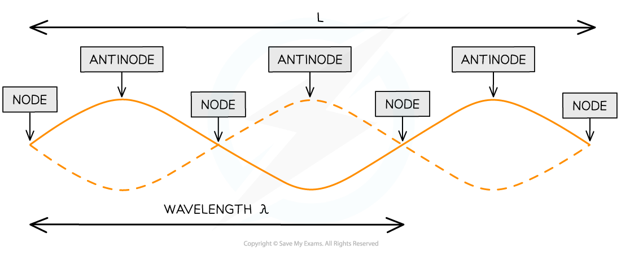
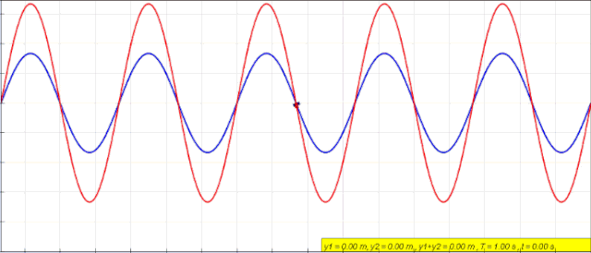
Theoretical Part
Strong points
Weak points
Did not explain how microwaves cook food
Did not explain how the hot spots form
Did not mention standing waves, and how they form
Did not mention Nodes and Antinodes
Did not illustrate the effect
Good explanation of the physics formulas
Good definition of terms (eg. crystallization)
Well chosen relevant parameters
Notes:
Strong points:
Good definition of terms (eg. crystallization)
Clear physical explanation of the phenomenon
Good visualization of the chemical reaction
Clear and relevant visual aids were used
Well chosen relevant parameters (diameter, mass, density)
Weak points:
Unclear organization – theory between the experiments
Some more text on the slides could have helped / Too many content (text) on the slides
The chemical reactions were a little too simplified
Didn’t make any quantitative predictions
Not fully explained the predictions of the hypotheses
Poor understanding of the theory

Slide 5
Experimental Part
Strong points
Weak points
Used a thermal camera
Great accuracy
Varying the chocolate
Illustrated the results
Low number of experiments(10)
Did not mention how many experiments are required for an accurate result
Did not vary the time
Did not accurately measure hotspots
Notes:
Strong points:
The experiment was done in a properly controlled manner.
The experiment reached clear results.
Use of multiple materials.
Had a well working setup.
Had great visual aids for the experiment.
Had some trial and error for her recipe.
Extreme control of the external factors allowed the team to obtain accurate results.
Weak points:
No hypotheses were drawn.
Lacking parameter: temperature (it influences results).
More quantitative data could have been used and mentioned.
Unlabeled graphs - points, labelled axis, connection to theory.
No errors mentioned.
Not explained why these materials were chosen.
Didn’t control many of the parameters (example).
Task of the problem was not fully fulfilled (explain why).
No quantitative parameters.
No picture of their own experimental setup was presented.

Slide 6
Discussion
topics
Antinodes form hotspots
The microwaves cooks food using water molecules.
Did you perform experiments one right after another? Microwave could be heated from previous trials.
How could you measure the hotspots more precisely?
Do you think it’s possible to also vary the frequency of the microwave (hypothetically)? Idea of building your own microwave
Notes:
Clarifying questions:

Slide 7
Thank you for your attention!

Slide 8
Clarifying questions:
Daca nu explica deloc standing waves - Why is the antinode fixed? Fixed nodes exist only for standing waves
Why do microwaves cook food? The electric field oscillates continuously, keeping the water molecules oscillating and causing friction between them, and thus heating the food.
Position of chocolate in the microwave - does it matter or not? NOT matter
Different forms of chocolate (variables such as size, the type of the chocolate and its weight) - do they matter? Heating points of different types of chocolate may vary, requiring different exposure times, but producing in the end the same result (same wave)

