Slide 1
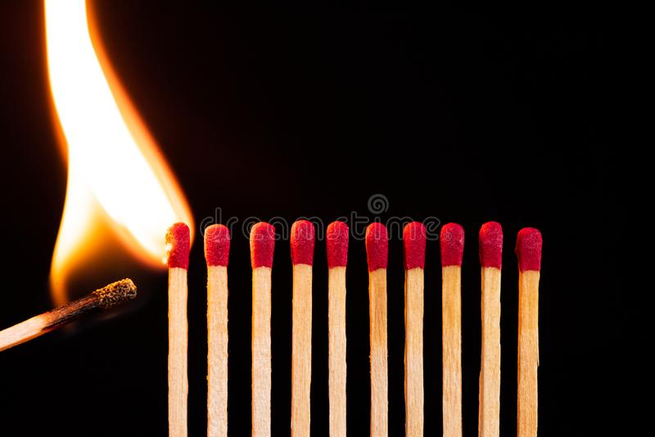
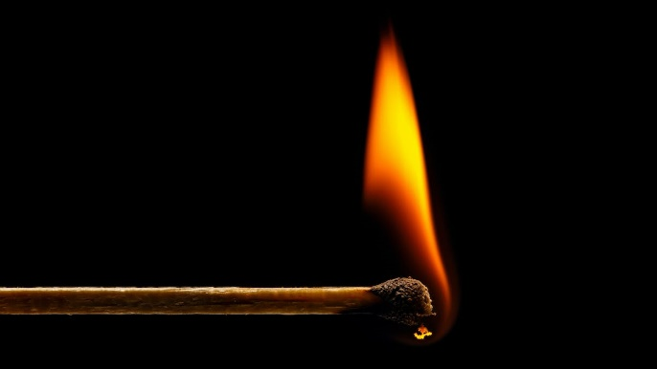
Opposition
Problem №3
“Matches on fire”
Important factors:
Controlled environment
Match Type
Distance between matches
Heat loss
Problem statement:
When the outermost match in a regular array of matches is lit, the following matches ignite one by one. Investigate the parameters that determine the speed for such a fire wave.

Slide 2
General evaluation of Report:
Theoretical model
Experimental Setup
Phenomenon
Compare results
Conclusion
Experiments
Good
Normal
Needs Improvement

Slide 3
8/20/2022
Reporter:
Strengths
Weaknesses
Phenomenon:
good explanation
simulations
Theoretical model:
many and important formulas
Experiments:
He has done many experiments:
Changed distance between matches
Changed type of matches
Calculated velocity changing
Calculated errors
Comparison:
He compared experimental results to theory
Other:
He Answered questions well
He knew topic well
Phenomenon:
Didn’t said how rubber bands were fixed.
Theoretical model:
he didn’t explain formulas well.
Experiments:
He didn’t explained how he has calculated errors
He hasn’t calculated errors.
Didn’t explained diagrams well.
Other:
He didn’t answered questions well

Slide 4
Discussion:
Distance between matches (between edges or centers)
Heat loss
Critical distance
Effect then match bends ?
Diagram/Theory explanation

Slide 5
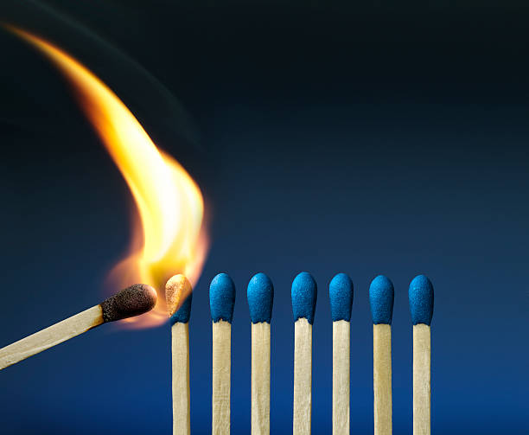
Thank you for your attention!

Slide 6
8/20/2022
Opponent:
Strengths
Weaknesses
Quick Questions:
many and important questions:
Asked about…
Asked about…
s
Theoretical model:
many and important formulas
Experiments:
He
Changed number of rubber bands
Changed light power
He
He
Quick Questions:
few and unimportant questions:
Didn’t Asked about…
Didn’t Asked about…
s
Th
At
Exp
He
g

Slide 7
Discussion:
Discussion topics:
Enter
Enter
Enter
Opponent:
Reporter:
Enter
Enter
Enter
Enter
Enter
Enter
Reviewer:
Enter
Enter
Enter

