Slide 1
5. Frosty Patterns
Reporter: Team Bobek-Almaty
Opponent: Team Romania Starry Night
Reviewer: Team Romania Starry Night

Slide 2
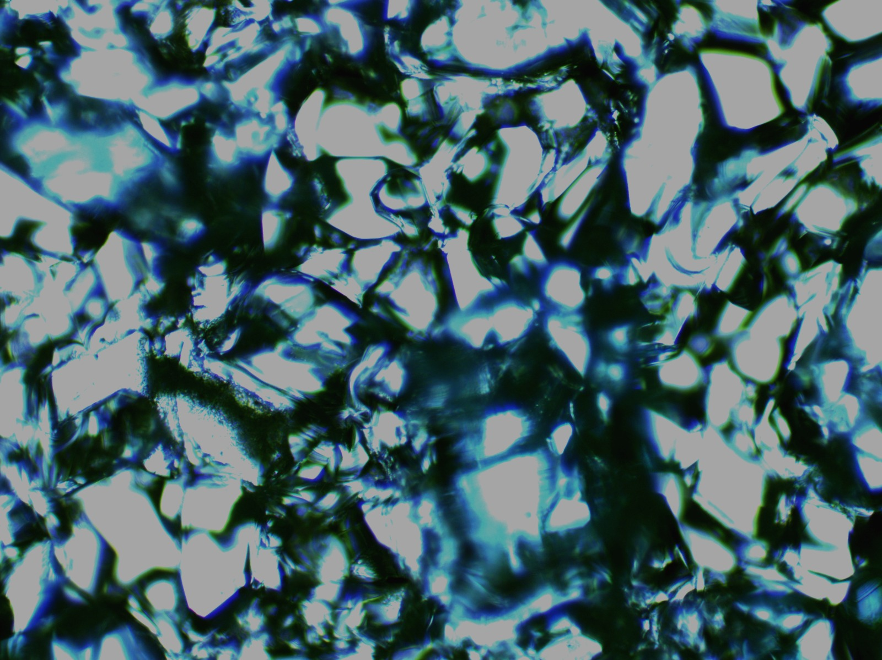
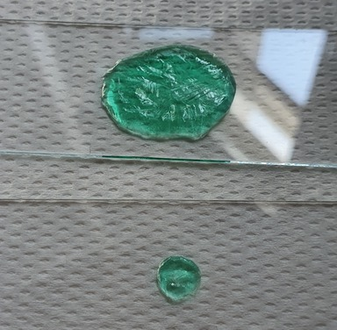
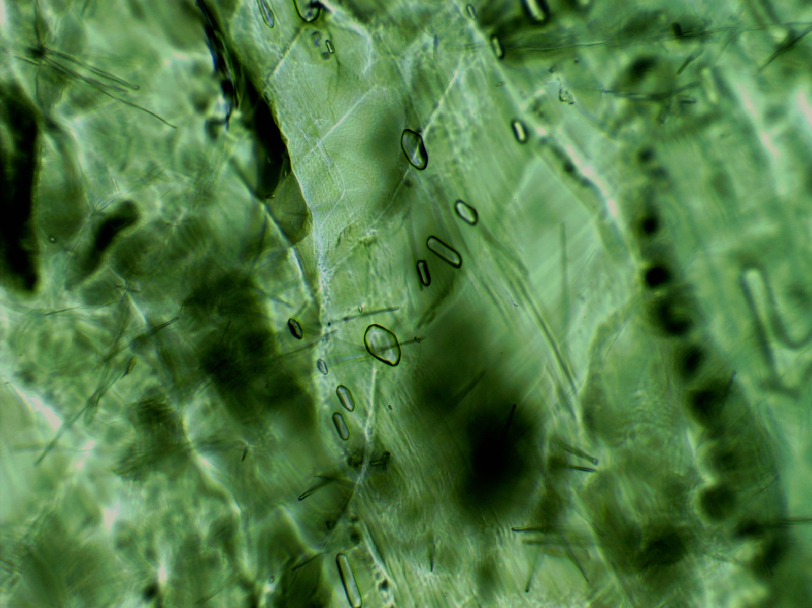
Problem’s task
Patterns similar to frost on a winter window are obtained if magnesium sulphate in solution is deposited on a glass surface. Investigate this effect.

Slide 3
Reporter Summary
Strong points
Weak points
Did not explain the crystallization process entirely
Did not measure the amount of substance that was put on the glass surface
Did not vary the solvent and solute.
Did not change the medium of crystallization
Did not characterize the crystal shape
Did not mention the time of crystallization
Not good time usage
Pictures with the phases of crystallization
A lot of pictures, describing the result
Clarifying the steps of the experiment
Notes:
Strong points:
Understanding of topic
The powerpoint was extremely well done, especially the animations, and was mostly clear.
Reporter drew clear conclusions and drew clear hypothesis-result ties.
Extreme control of the external factors allowed the team to obtain accurate results.
Weak points:
Theoretical part was weak and didn’t go into enough detail.
Unclear organization - theory between experiments.
Results were not elaborated on.
No explanation of set-up or materials.
Key parts of the problem were unexplored
Unexplained formulas

Slide 4
Opponent Summary
Strong points
Weak points
Relevant questions that completed the reporter’s affirmations
Mentioned the lack of explanation on the crystallization process
Broad points
Repetitive observations
Did not mention the lack of characterization of crystals
Did not present their opinion on their unanswered questions
Notes:
Strong points:
The opponent noticed most of the errors and presented them, while also developing on them, providing additional insight.
Good questions and hypothetical scenarios were proposed, showing deep understanding of the material.
Interpretation was good
Good points regarding: time of day, error bars, materials used
Challenged reporter’s solution
Background research on topic
Weak points:
The opponent did not realize the fact that the original task was not met.
Asked questions about facts that we believe were sufficiently explained by the reporter (eg. bla).

Slide 5
Clashes during
the fight
Opp: Super-saturated solutions
Rep:Would not dissolve (50g) Rew: We agree with the opponent
Opp: Using other salts
Rep: No response
Rew: We agree with the opponent
Opp: Why are the crystals on the edge more obvious Rep: No response
Rew: Because of the tension

Slide 6
Thank you for your attention

Slide 7
Clarifying questions for the reporter and opponent
Reporter:
Did you vary the substances used?
What do you think would happen if you would vary the concentration
Why did you use these salts? Why sulphates only?
Do you know other sulphats that crystalize in frosty patterns?
How did you characterize the crystals?
Do you think that the humidity in the air influenced the crystallization? How?
Can you do something in order to increase the speed of crystallization? …. But what would happen if the solutions would be put in the refrigerator?
Opponent:
What’s your position on the crystallization

