Slide 1
Clicking Fingers
Reporter – Hristo Hristov
Team Bulgaria B

Slide 2
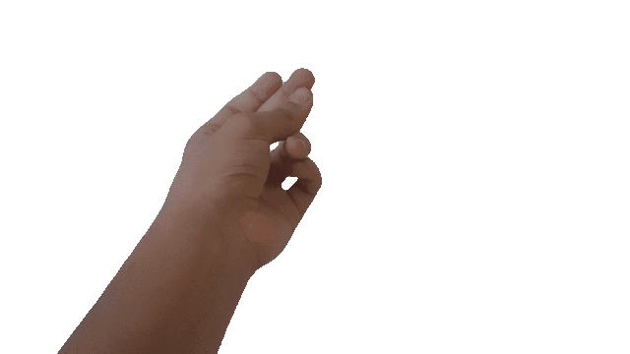
1
7. Clicking Fingers
Snapping one’s fingers results in a loud popping sound. Investigate the nature and properties of the sound.

Slide 3
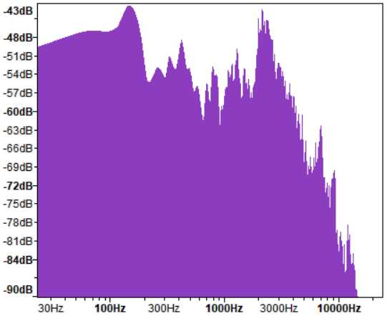
2
Why is this problem interesting?
Science lies in every corner of our daily lives!

Slide 4
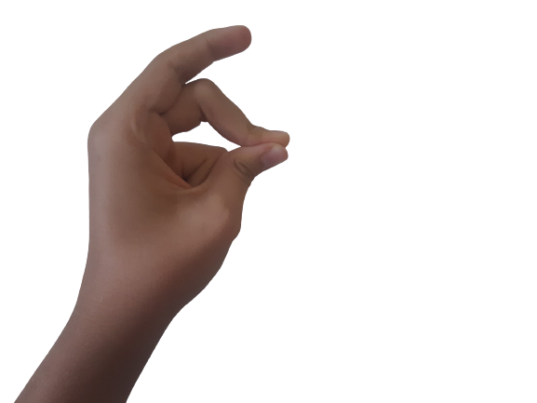
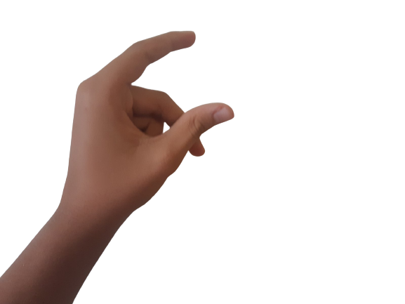
3
The Nature of the sound
How does one snap their fingers?
- Create tension between a thumb and a middle finger
- Release the middle finger
It’s that simple!

Slide 5
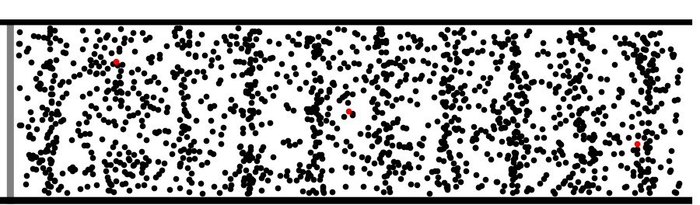
4
The Properties of the sound
Sound has two distinct unrelated properties: Intensity [dB] and Frequency [Hz]
However some factors can influence these properties

Slide 6
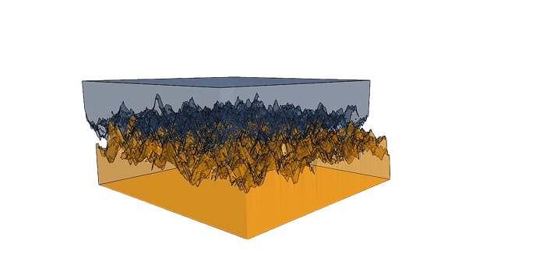
5
Hypothesis #1:
Both increasing and decreasing friction will be ineffective

Slide 7
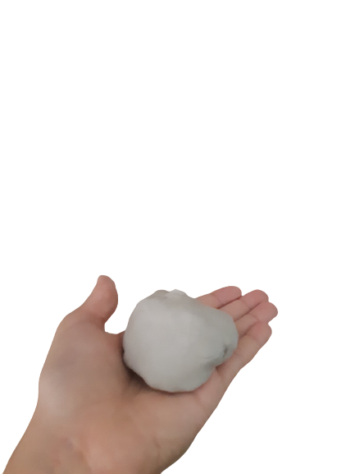
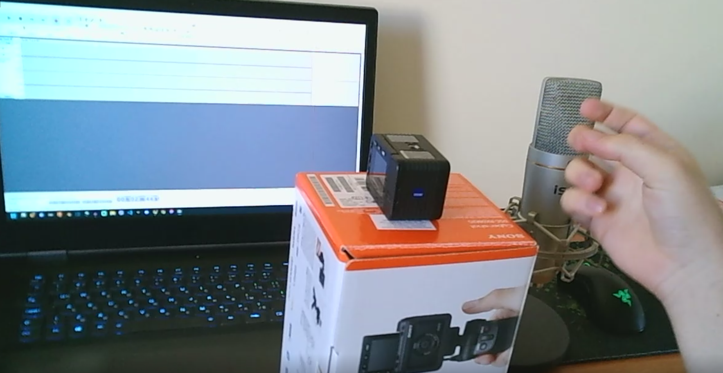
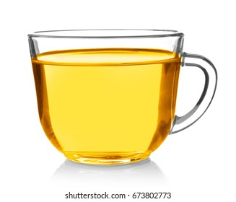
6
Experimental setup
1. Microphone
2. Camera
3. Recording software
(Computer)
4. Oil
5. Clay

Slide 8
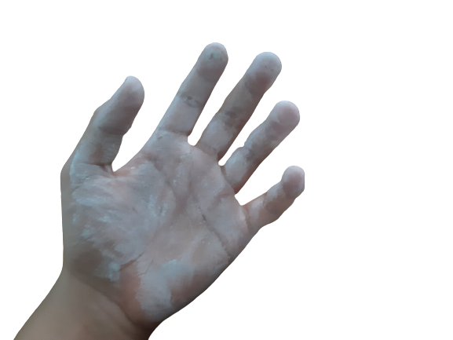
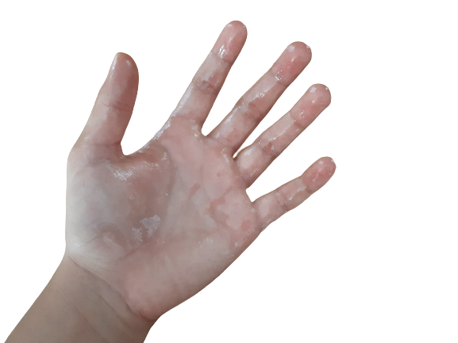
7
Experimental procedure:
Put clay/oil on subjects hand

Slide 9
8
Experimental procedure:
2. Record using Audacity

Slide 10
9
Friction testing results

Slide 11
10
Hypothesis #2 / Mythbuster:
Water will not have a big effect on the amplitude

Slide 12
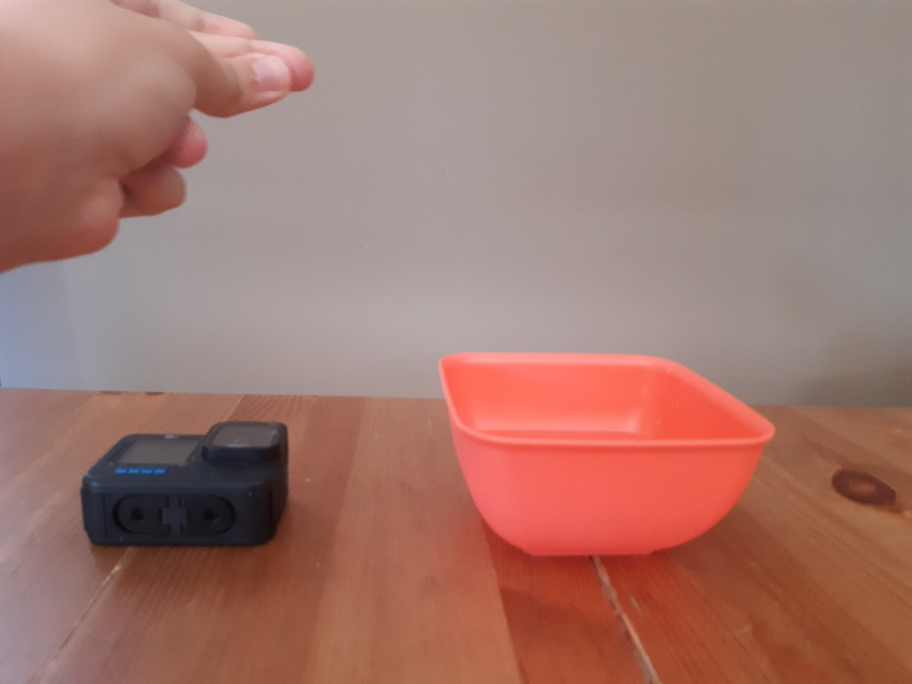
11
Experimental setup
Water
GoPro camera/microphone

Slide 13
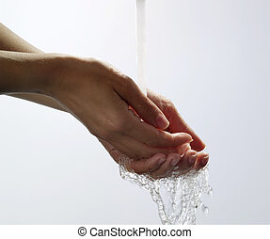
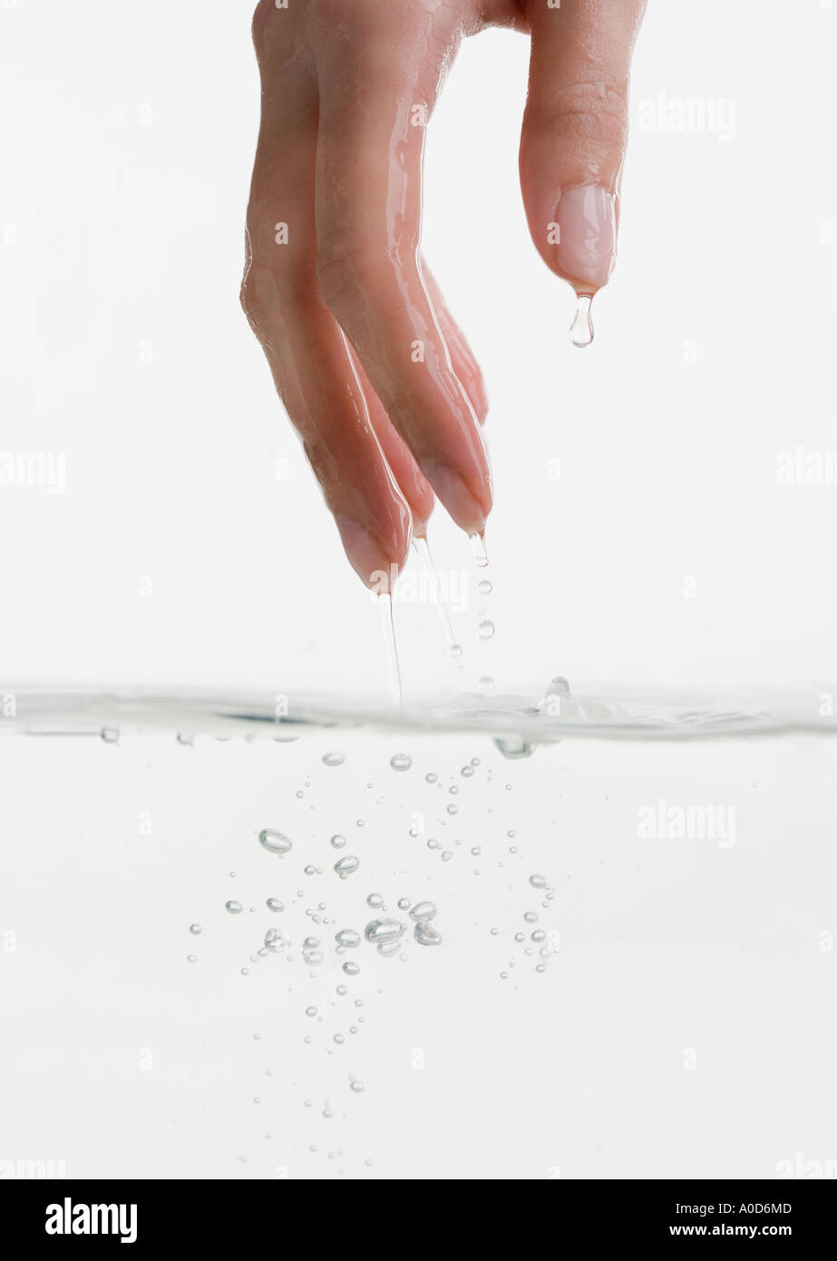
12
Experimental procedure:
Put water on subjects fingers

Slide 14
13
Experimental procedure:
2. Record using Audacity

Slide 15
14
Wet and dry fingers

Slide 16
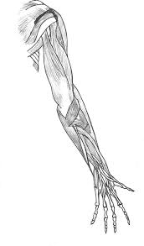
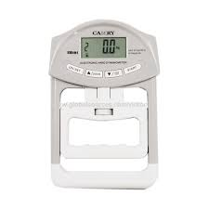
15
Hypothesis #3:
Grip strength has a great influence over the sound

Slide 17
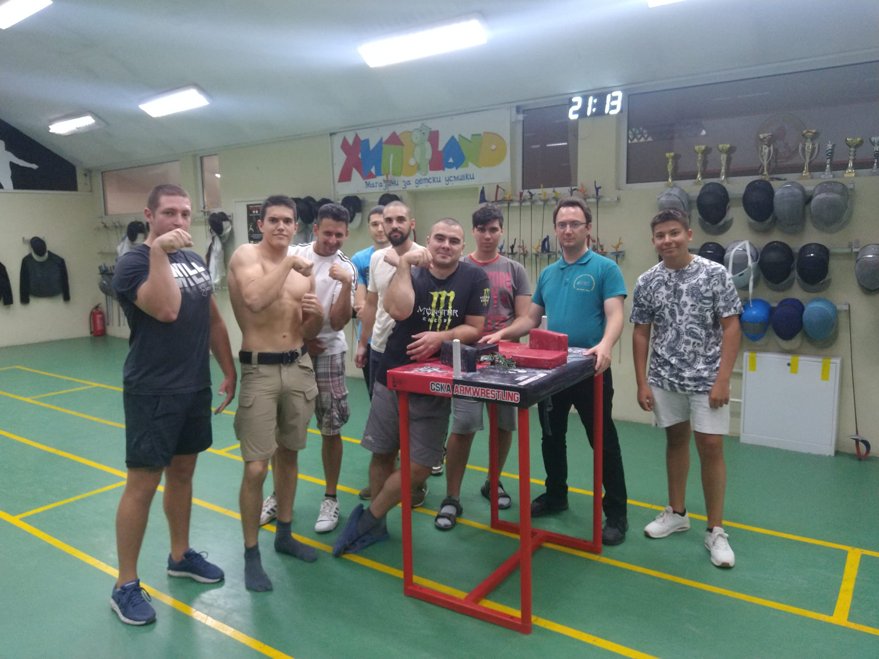
16
Experimental setup
1. Team of professional arm wrestlers

Slide 18
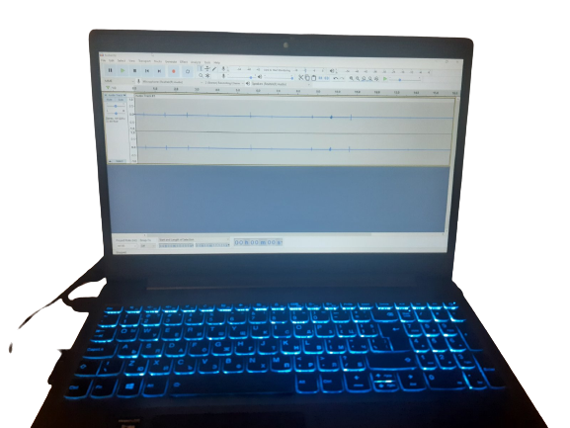
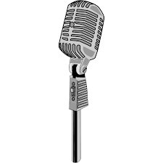
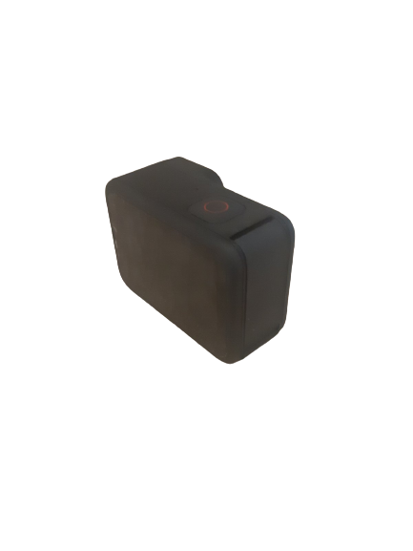
17
Experimental setup
Microphone
Camera
Recording software

Slide 19
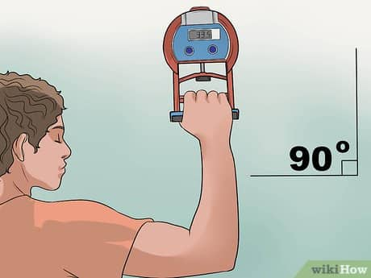
18
Experimental procedure:
Measure grip strength using a dynamometer

Slide 20
19
Experimental procedure:
2. Record using Audacity

Slide 21
Strongest – 71.75 kg of force Weakest – 49.65 kg of force Hristo – 36 kg of force
20
Results:

Slide 22
21
Results:

Slide 23
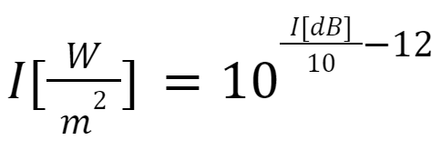
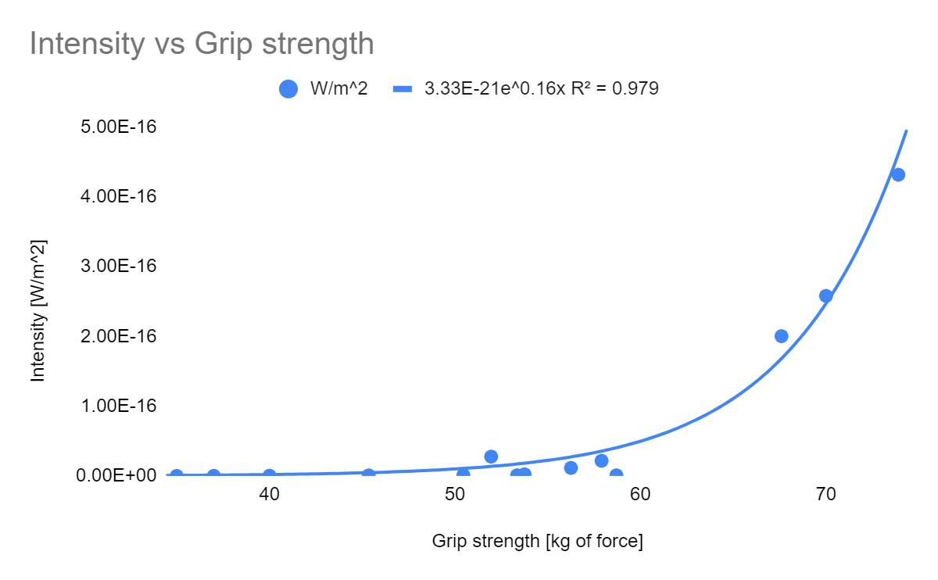
22
Results:
Intensity [W/m²] to Grip strength
Intensity [W/m²]
Grip strength [kg of force]

Slide 24
23
Extra data and correlations we found
Higher grip strength doesn’t mean higher speed

Slide 25
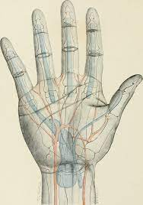
24
Sources of error
Microphone
Software
Hand topography

Slide 26
25
Conclusions
Grip strength has a BIG influence over the intensity
Friction change isn’t effective
Water isn’t effective
Thank you!

Slide 27
Friction change
Option 1#: Less friction
This → but also this →

Slide 28
Friction change
Option 2#: More friction
This → but also this →

Slide 29
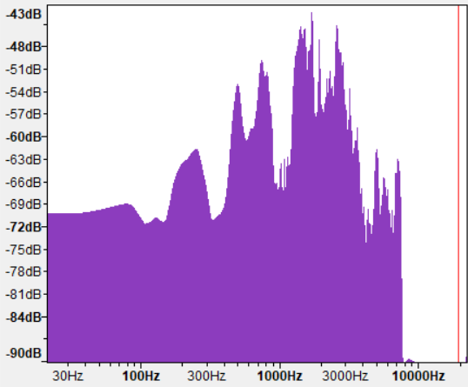
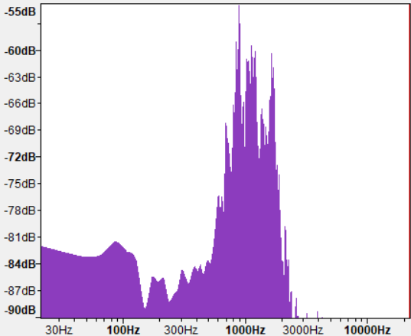
How do we remove the background noise?

Slide 30
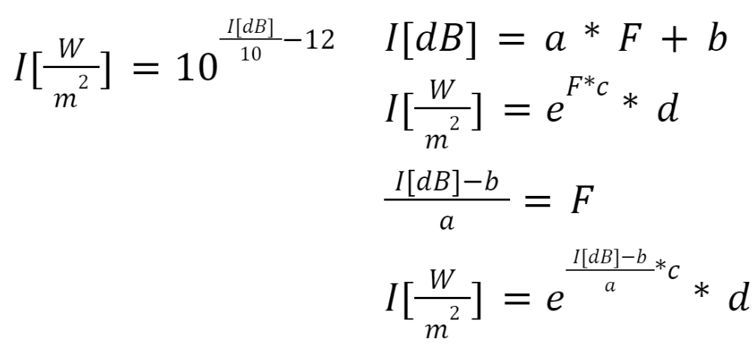
Exponential curve?

Slide 31
26
Resources:
Audio editing software – Audacity
Images – WikiHow
High speed video processing - Tracker

