Slide 1
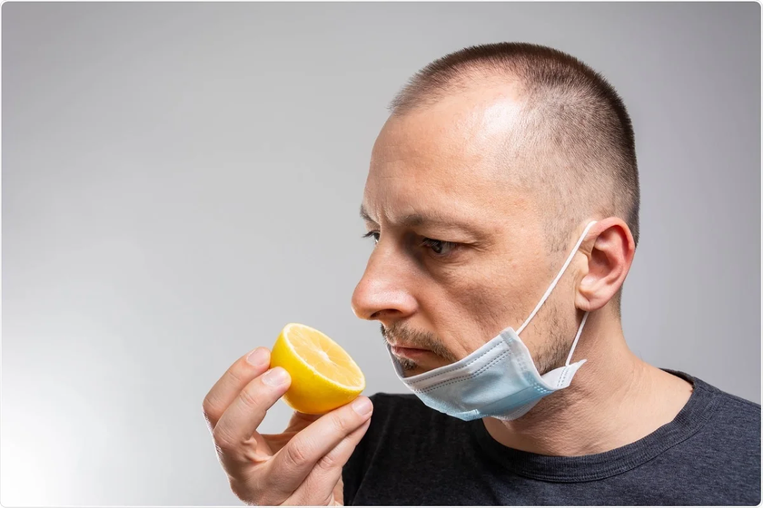
№9. PAROSMIA
Team: RFMS
Reporter: Zhanna Alibekova

Slide 2
TASK
Misperception of existing odors is a common post-COVID side effect that may persist for months. Collect data to study and characterize this dysfunction.

Slide 3
CONTAIN:
Theory
Statistics
Analysis
Conclusion

Slide 4
THEORY
Olfactory - the sense of smell

Slide 5
THEORY
Qualification of olfactory disorders
Qualitative
Quantitive
Phantosmia
Parosmia
Troposmia
Euosmia
Anosmia
Hyposmia

Slide 6
THEORY
Parosmia is distortion of normal sense of smell

Slide 7
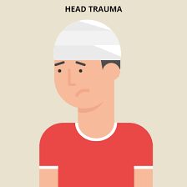
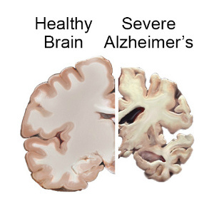
THEORY
CAUSES
Notes:
Postviral (covid-19, influenza)
Head injury
Neurodegenerative conditions such as Alzheimer’s and Parkinson’s diseases
Medications, particularly selective serotonin reuptake inhibitors (SSRIs), serotonin and norepinephrine reuptake inhibitors (SNRIs), benzodiazepines, and non-benzodiazepine sedatives (half of the 100 most prescribed medications have the potential to cause olfactory disturbance3)
Chemical exposure of the nasal mucosa to toxins including ammonia, nickel, solvents, tobacco, and cocaine.

Slide 8
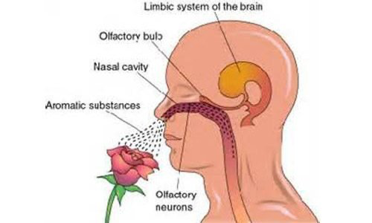
THEORY
Where and how smells are felt?

Slide 9
THEORY

Slide 10
THEORY

Slide 11
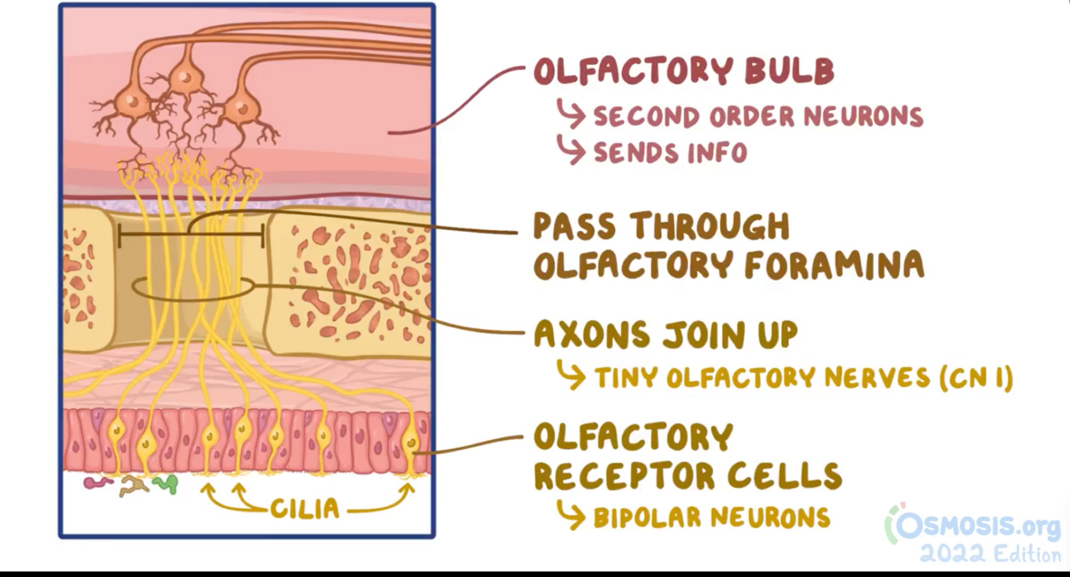
THEORY

Slide 12
THEORY

Slide 13
THEORY
Ways of treatment
Just wait and keep a diet
Smell training
Neuroleptic or Anti-Epileptic medications

Slide 14
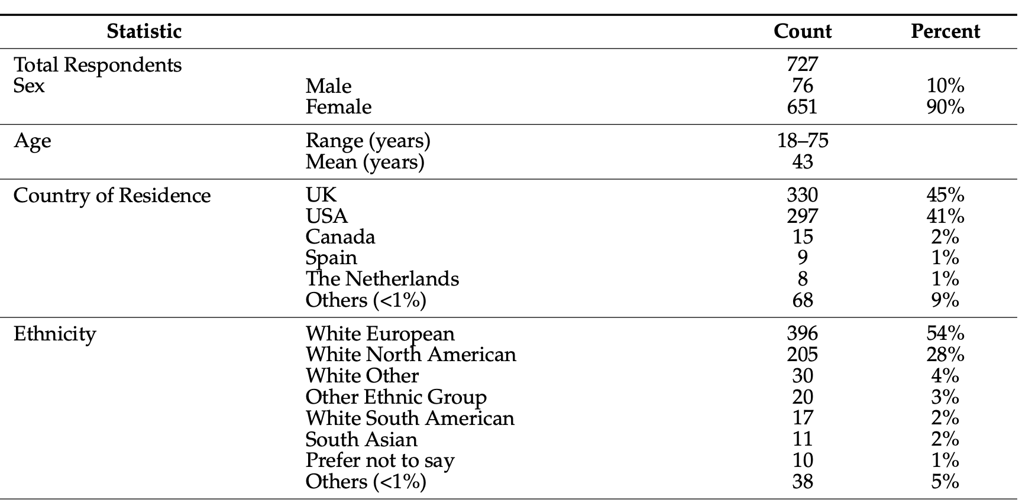
STATISTICS
Link: https://www.ncbi.nlm.nih.gov/pmc/articles/PMC8997629/pdf/foods-11-00967

Slide 15
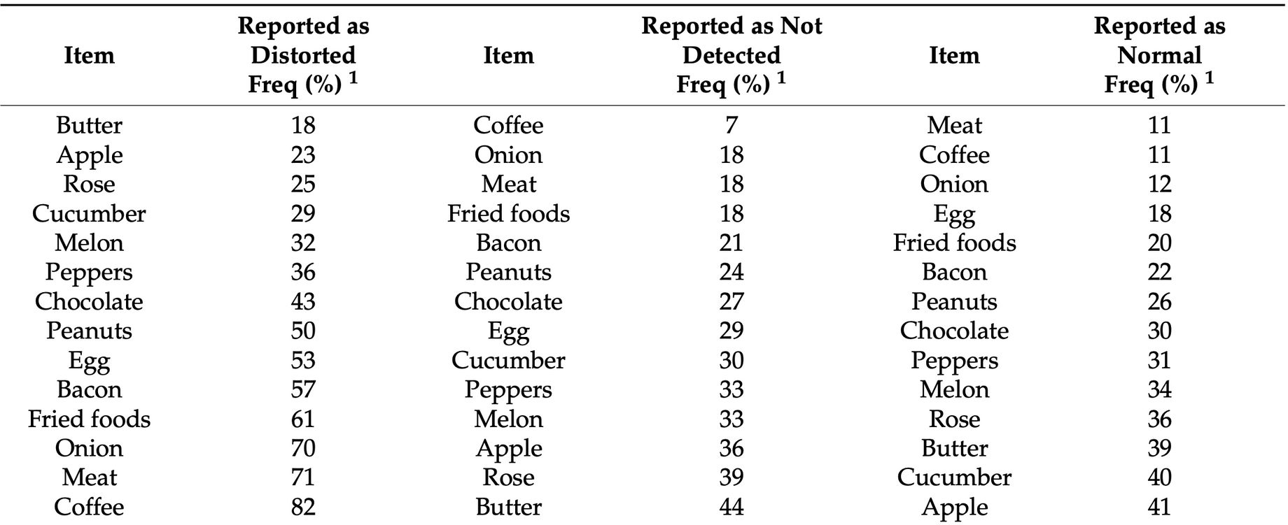
STATISTICS
Link:https://www.ncbi.nlm.nih.gov/pmc/articles/PMC8997629/pdf/foods-11-00967

Slide 16
Statistics | Data | Count
Sex | Male | 4
 | Female | 11
Age | <20 | 3
 | >20 | 12
Country | Russia | 5
 | Iraq | 1
 | USA | 6
 | Kazakhstan | 3
Time from Cov19 | 1-3 weeks | 2
 | 1-6 months | 6
 | 7-11 month | 4
 | 1 year & more | 3
Current research

Slide 17
Current research
Statistics | Data | Count
Duration | 1-3 weeks | 0
 | 1-6 months | 2
 | 7-11 month | 6
 | 1 year & more | 7

Slide 18
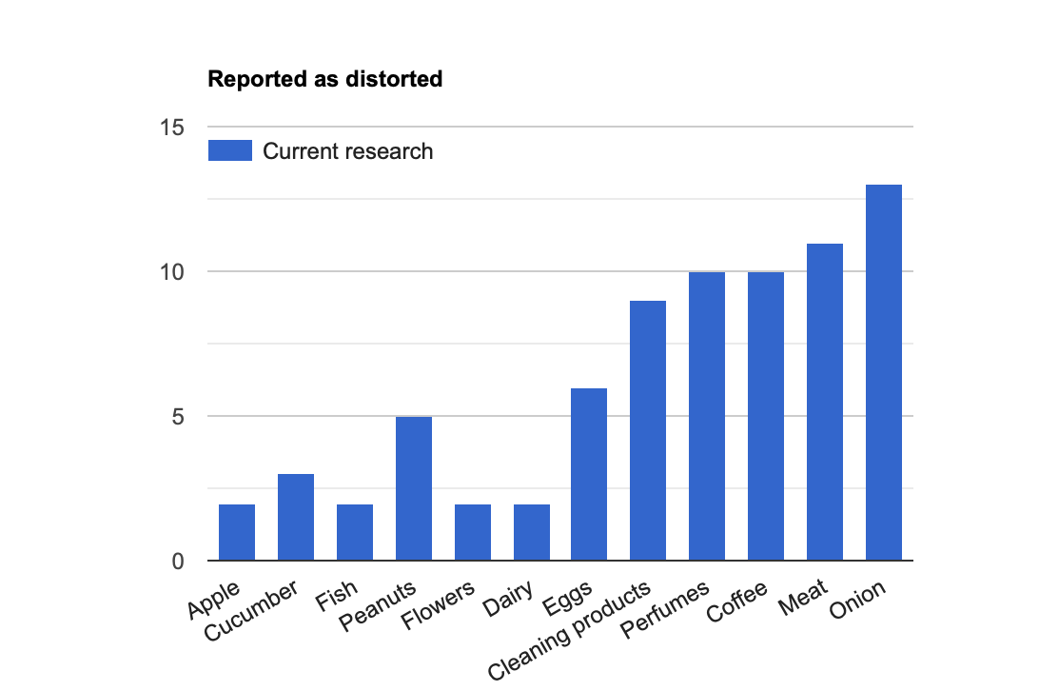
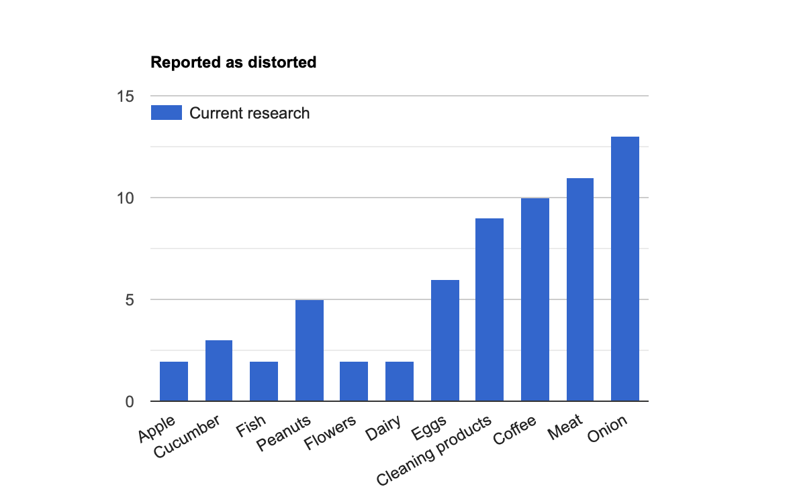
Results of current research

Slide 19
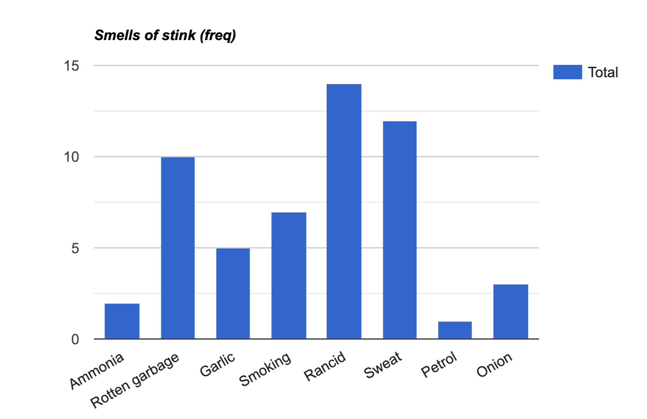
Results of current research

Slide 20
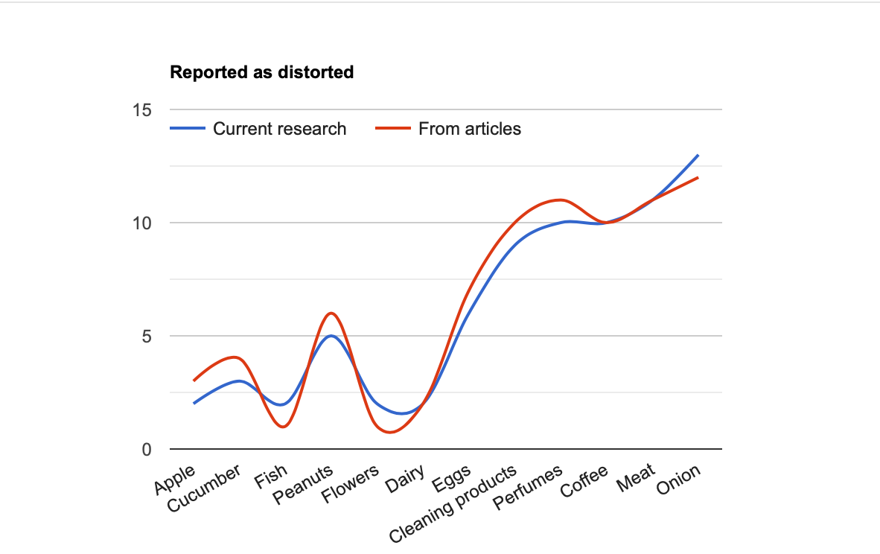
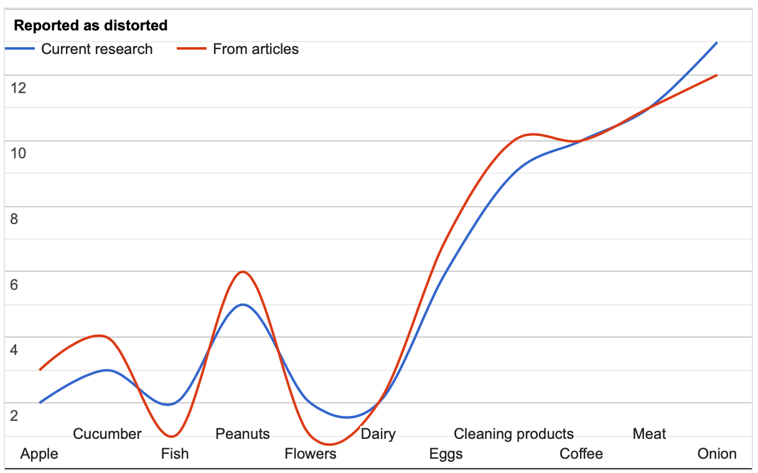
ANALYSIS

Slide 21
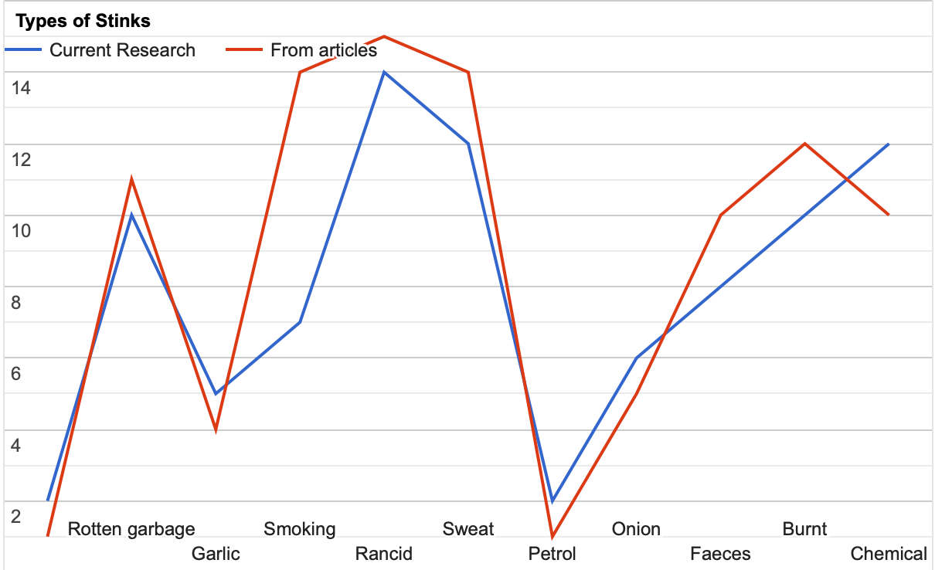
ANALYSIS

Slide 22
CONCLUSION
Age, race and gender absolutely don't matter
May not be for all things, but only for certain and even only for one
Often distorted: perfumes, meat, coffee, cleaning products, onions
Frequent stinky odors: rotten garbage, rancid, burnt, chemical, sweat

Slide 23
RESOURCES:
youtube.com
https://trends.rbc.ru/trends/social/62299bb69a79473bbfdf2f78
https://www.nature.com/articles/s43856-022-00112-9
https://www.frontiersin.org/articles/10.3389/fneur.2020.543275/full
https://www.osmosis.org/answers/parosmia
https://www.ncbi.nlm.nih.gov/pmc/articles/PMC8997629/pdf/foods-11-00967.pdf

Slide 24
THANK YOU FOR YOUR ATYTENTION!

