Slide 1
International Young Naturalists' Tournament (IYNT)
Presentation of Survey Findings
On Parosmia
Theme: Misperception of odor as a post COVID-19 side effect

Slide 2
Structure of Presentation
1. Introduction
2. Background to Parosmia
3. Survey Methodology
4. Survey Findings
Background Characteristics
Characterization of Parosmia
5. Discussion of Survey Findings
6. Conclusions
7. Recommendations

Slide 3
Introduction
Parosmia is a conditionof misperception of odor. It comes from the word anosmia which means loss of smell.
Parosmia can be manifested with having weird smell in the nose

Slide 4
Background to Parosmia
Parosmia is a condition of misperception of odor caused by damaging the cells that support the olfactory neuron called sustentacular which are responsible for transmission of impulses from nose to the brain for interpretation.
Damaging the cells that support the olfactory canal cuts off its supply of nutrients.

Slide 5
Survey methodologies
We use different methods of collecting data which included;
Coming up with questionnaires that were answered by different people in different places
Random interviewing of different people that were students, teachers, doctors.
Visiting different hospitals .
Consultations from medical personnel.

Slide 6
STATISTICAL STUDY RESULTS
A survey carried out in various districts, towns, and villages in UGANDA to find out:
The most affected gender, age, career fields.
Time of recovery
Most affected places

Slide 7
Table of survey finds
Age group | Male | Female | Percentage of male | Percentage of female | Average time of recovery | Respondents | Respondents that didn't suffer the dysfunction
20-30 | 108 | 189 | 33.8 | 59 | 2 weeks | 297 | 7.2
30-40 | 162 | 148 | 50.6 | 46.3 | 2.5 weeks | 310 | 3.1
40-50 | 72 | 60 | 48 | 40 | 3.5 weeks | 132 | 12
50-60 | 55 | 55 | 35 | 55 | 3.5 weeks | 110 | 10
60-70 | 40 | 23 | 44.4 | 25.6 | 4 weeks | 63 | 30
70-80 | 50 | 48 | 50 | 48 | 5 weeks | 98 | 2
80-90 | 32 | 18 | 64 | 36 | 6 weeks | 50 | 0
90-100 | 24 | 22 | 48 | 44 | 6 weeks | 46 | 8

Slide 8
A bar graph showing variation of parosmia amongst different genders with age groups

Slide 9
A line graph of percentages of respondents with age groups

Slide 10
A line graph of time of recovery from the parosmia with age groups

Slide 11
A line graph of respondents against age groups

Slide 12
Discussion of Survey Findings
From the survey finds carried out between 1st August, 2022 and 10th August, 2022 the different data collected could characterize the dysfunction in the following ways:
Mainly common among the age group of 30-40 although most persistent among the elderly of age group of 80-90.
Mainly among the female this is because for the female in the areas of study, majority of the male do manual work such as un mechanized agriculture that involves tilling of land which is a form of physical exercise thus keeping their bodies fit and more tolerant to post COVID-19 side effects including misperception of odor where as majority of women are house wives doing less tiresome work thus their bodies are not physically fit as compared to the men

Slide 13
Examples of manual labour carried out
CULTIVATING OF LAND
construction
Brick laying
Operating of heavy machines in industries
Harvesting of crops

Slide 14
Discussion of survey findings
It was short lived among the teenagers and young adults of age group 20-30.
It was more rampant in urban centers than in villages.
Among the villages because people in villages are more exposed to the local indigenous foods are organic such as lemons, oranges, sweet potatoes, potatoes, cassava, ginger and vegetables like Dodo that are fresh and can boast the immunity thus such people could easily resolve the dysfunction.

Slide 15
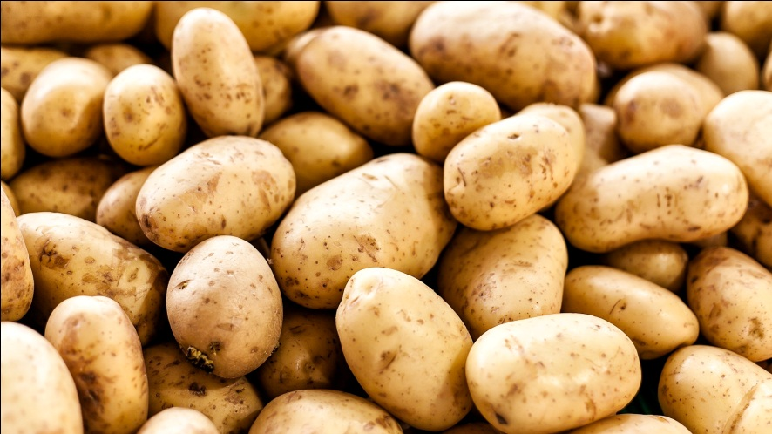
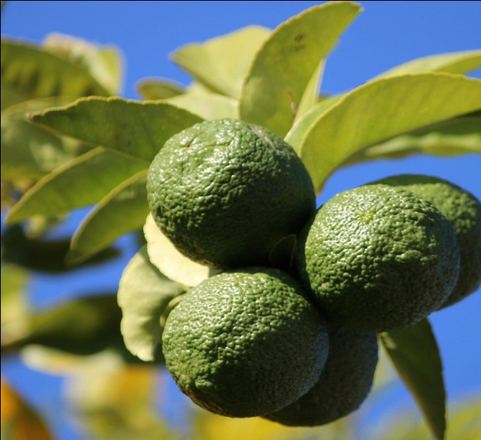
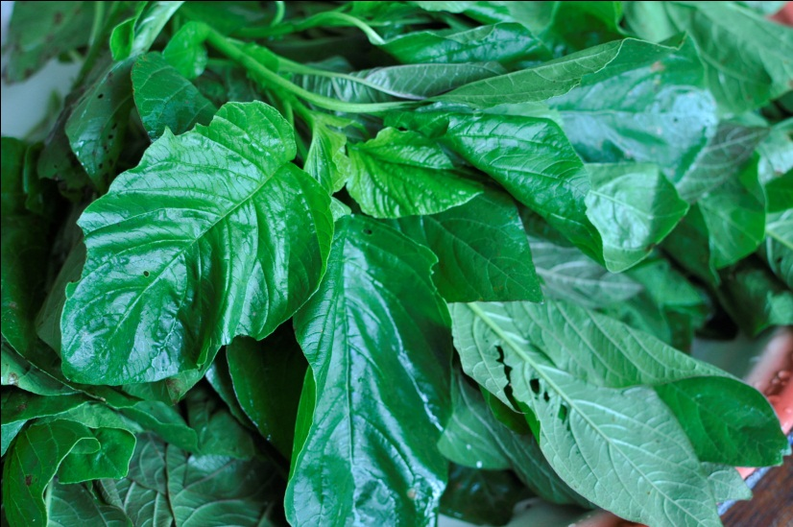
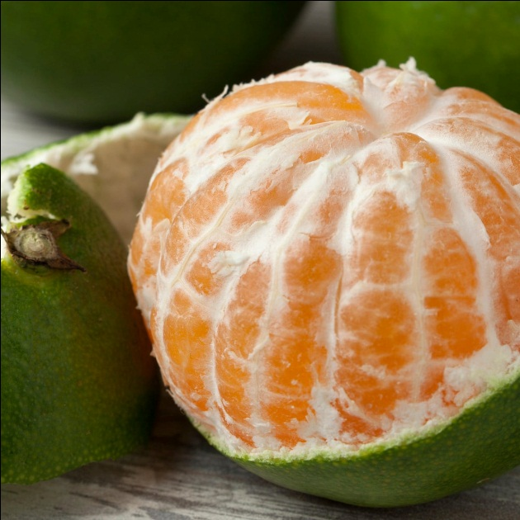
Local indigenous foods
Irish potatoes
Lemons
Dodo
Oranges

Slide 16
Conclusion
The condition of misperception of odor was accompanied with loss of test
Parosmia was short lived among the young 0f age group 20-30
This condition was most persistent among the elderly
Parosmia was most evident among the male but less persistent among them
This condition was long lived among the female

Slide 17
Recommendations
As a team we would recommend people to do the follow so as to easily recover from the kind dysfunction
Eat organic foods
Do regular physical exercises
Go for vaccination against COVID -19

Slide 18
Acknowledgements
Mengo senior school
Mengo hospital
Ministry of health Uganda
Dr.RUWEMBO WILSON (Professor of microbiology
Ministry of health of Uganda
Dr. Olivia Jemba (lecturer of statistics Makerere University)

Slide 19
References
Uganda Ministry of health report @MinofhealthUG Twitter page

Slide 20
Thank You for listening
END

