Slide 1
Ivaylo Kartev, Team Bulgaria B
Review: 13. Naming Colors
BULGARIA
Notes:
1

Slide 2
13. Naming Color
Investigating the factors that affect colour naming in humans
Task partially fulfilled.

Slide 3
Overview
Theory
Experiment
Results
Agreement between theory and experiment
Conclusions
Green = very good
Yellow = average
Red = needs improvement

Slide 4
Reporter
Basic explanation of the Munsell diagram
Mention the effect of colorblindness
Mentioned different factors that influence color perception
No use of the Munsell chart in the experiment
Poor explanation of the experimental procedure
No quantitive results
Lack of proper conclusion
Unnecessary background info
No results shown with visualization
Not enough variation of the parameters in the experiment
No exact results from colorblind people

Slide 5
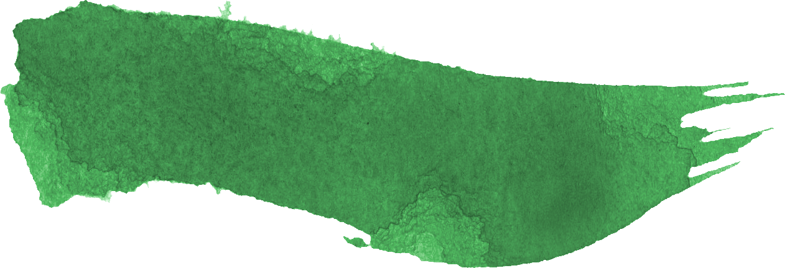
Opponent
Asked proper clarifying questions
Targeting some of the weak points
Stated interesting questions for discussion (age, experimental setup)
No prioritization in the statement
Didn’t point out the most important improvement points
Didn’t point out the flaws in the experiment and how it could be improved

Slide 6
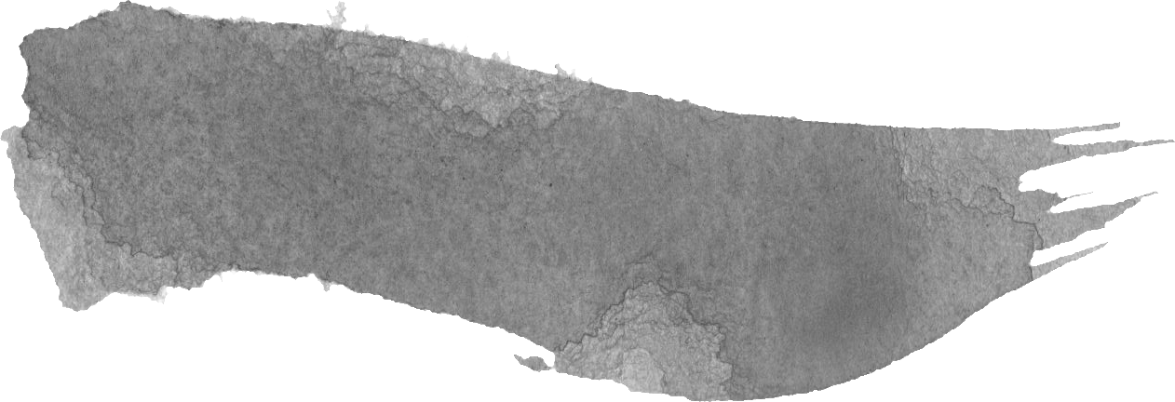
Discussion
Mentioned what could be improved about the experiments
The reporter doesn’t answer the questions clearly and the opponent has to ask for more for clarification (what are hues?)

Slide 7
Clash in Discussion
Opp: Age is not important
Rep: Age has an effect (but not mention what)
Opinion: Age is important – color perception decreases with age
Thank you for your Attention

Slide 8
Missed points
Thank you for your Attention

