Slide 1
21. Sinking paper clips
IYNT 2022 team Greece LaGrands
Reporter: Stratos Artopoios

Slide 2
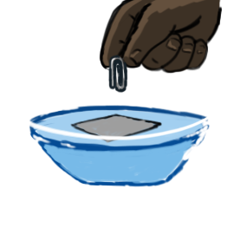
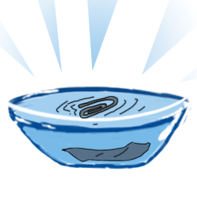
PROBLEM TO BE INVESTIGATED:
Introduction
Theory
Hypotheses/setup
Experiment 1
Experiment 2
Experiment 3
Results
In a well-known physics demonstration, small metal objects (eg paper clips, pins or needles) stay afloat on water. If a small amount of soap is then added to water, some of the floating objects instantaneously sink. Investigate the critical conditions for sinking.

Slide 3
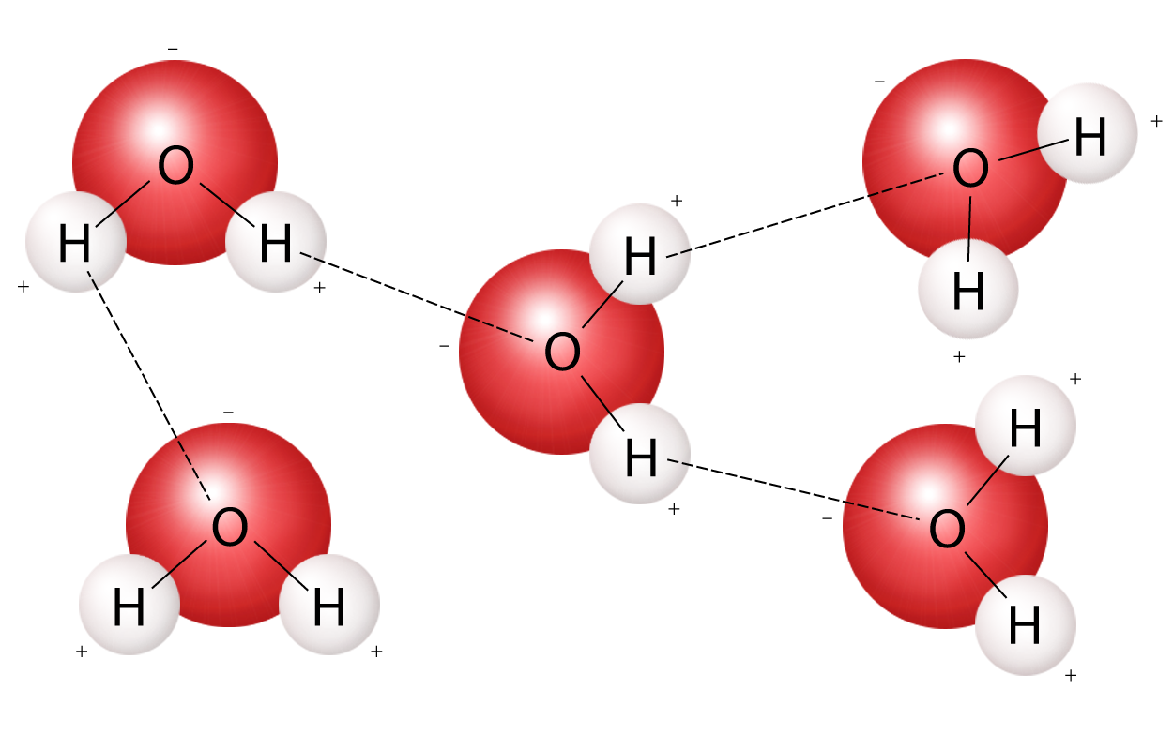
KEY TERMS
Introduction
Theory
Hypotheses/setup
Experiment 1
Experiment 2
Experiment 3
Results
Hydrogen bonds: Water molecules are highly attracted to each other because they are polar molecules. It consists of the partially positive hydrogen atoms and the partially negative (because of the difference in electronegativity) oxygen atom. The negative oxygen creates electrostatic forces with the hydrogen atoms of another water molecule.

Slide 4
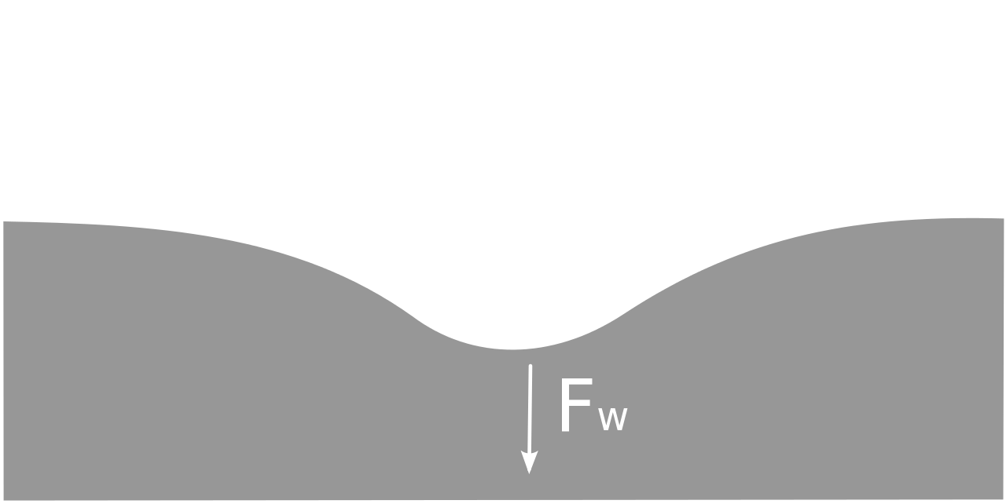
KEY TERMS
Introduction
Theory
Hypotheses/setup
Experiment 1
Experiment 2
Experiment 3
Results
Surface tension: Surface tension is the attraction of like particles to one another on a surface—in our case, a water-air surface. Water molecules on a surface experience cohesion, which is the sticking together of one molecule to another molecule of the same material.

Slide 5
THEORETICAL BACKGROUND
Introduction
Theory
Hypotheses/setup
Experiment 1
Experiment 2
Experiment 3
Results
Why do paper clips float in water ?
Small metals objects can float in water even though they have higher density. The reason why this happens is surface tension. Water molecules have high cohesive forces, which means that they are strongly bonded with each other and is hard to seperate them. Thats why paperclips float in water.
Why soap affects the phenomenon
The soap reduces the force between water molecules to about one-third that of plain water.
Cohesive forces

Slide 6
THEORETICAL BACKGROUND
Introduction
Theory
Hypotheses/setup
Experiment 1
Experiment 2
Experiment 3
Results
Other parameters that affect surface tension:
The surface tension of liquids generally decreases with increase of temperature and becomes zero at critical temperature.
Surface tension versus temperature for water in contact with air.

Slide 7
HYPOTHESES
Introduction
Theory
Hypotheses/setup
Experiment 1
Experiment 2
Experiment 3
Results
1. If we increase the ratio of hand soap in water then the metal object will fall on the bottom faster.
2. The higher the water temperature is, the faster the clip will fall.

Slide 8
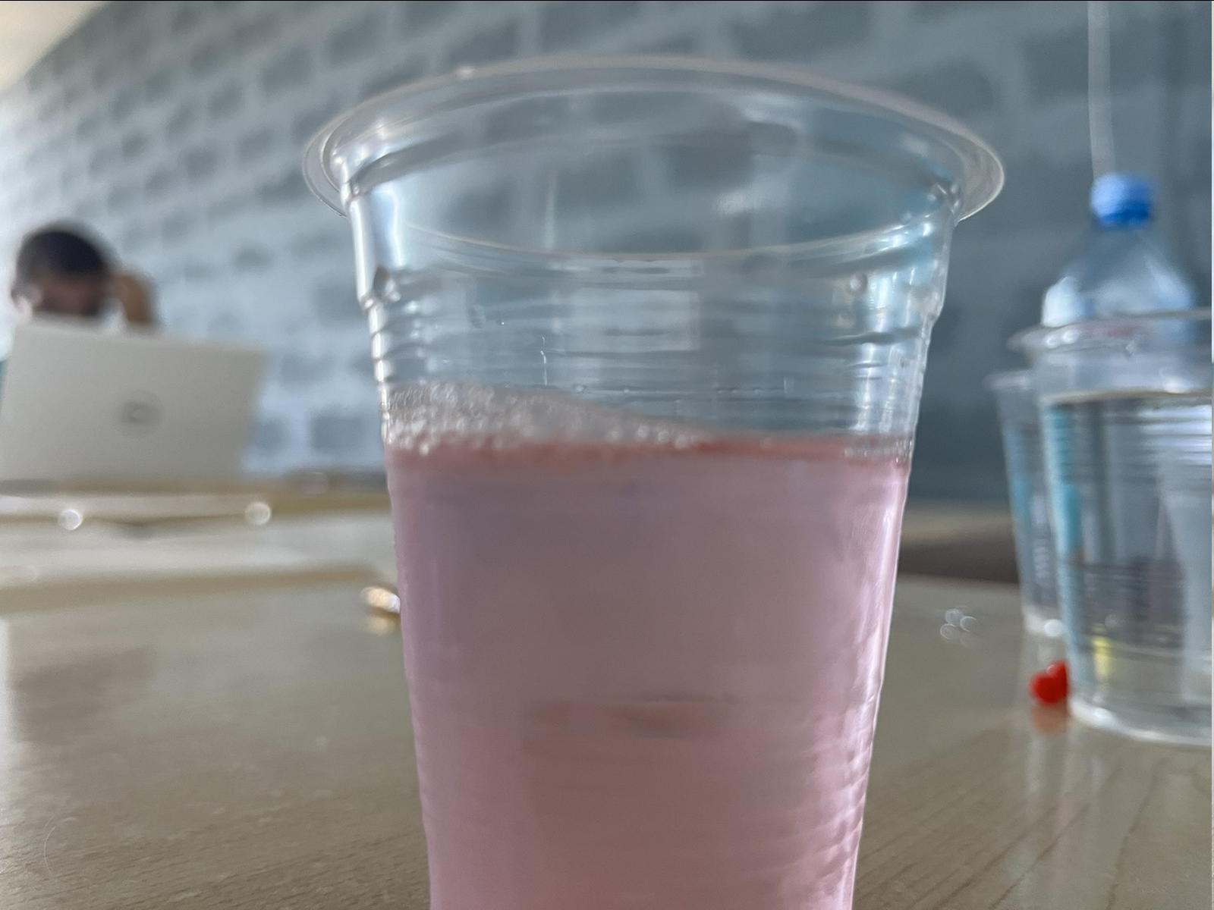
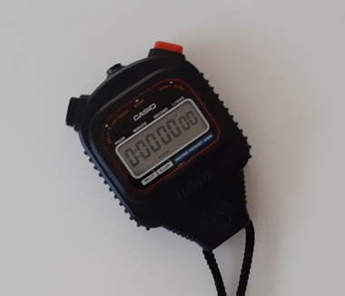
EQUIPMENT USED
Introduction
Theory
Hypotheses/setup
Experiment 1
Experiment 2
Experiment 3
Results
Cups
Pins
Timer
Soap
Water from the lab

Slide 9
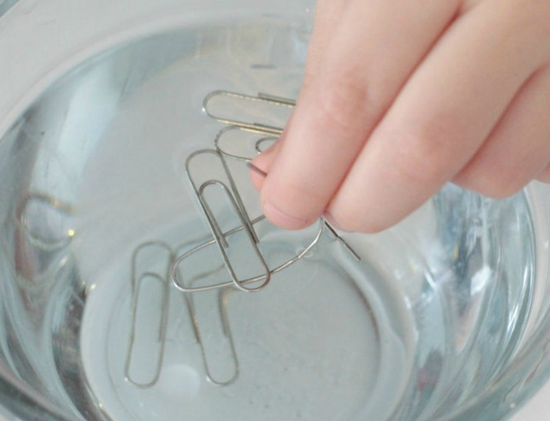
EXPERIMENTAL PROCEDURE I
Introduction
Theory
Hypotheses/setup
Experiment 1
Experiment 2
Experiment 3
Results
We started by placing the clip on top of the water surface without any soap to make sure that it will float without the soap, which indeed happen. Then we placed 5 paper clips for each ratio.
Note: When we removed the paper clip we refilled the cup to make to the same water level

Slide 10
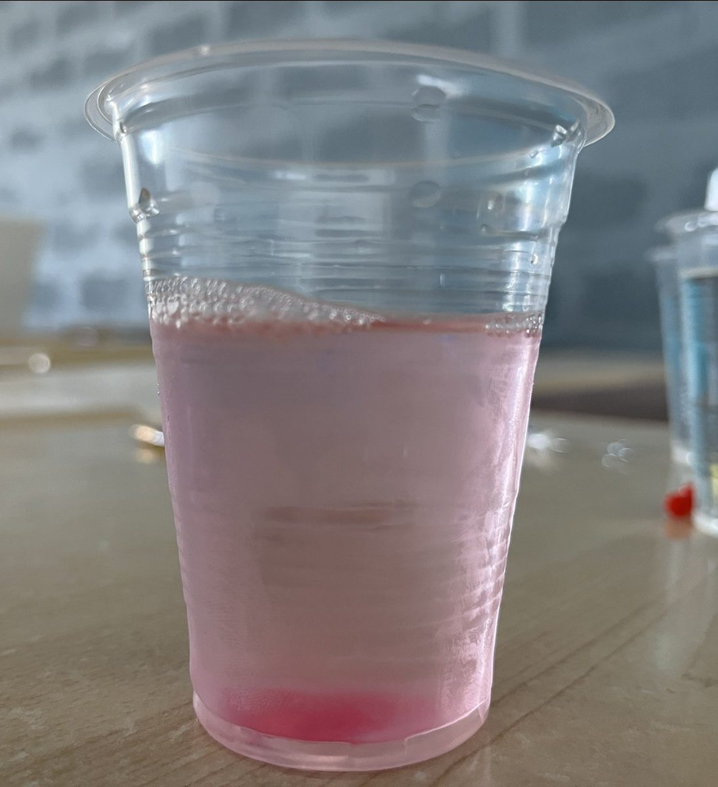
EXPERIMENTAL RESULTS I
Introduction
Theory
Hypotheses/setup
Experiment 1
Experiment 2
Experiment 3
Results
Smaller ratio (first row of cup)
time to bottom: 0,9 sec
Bigger ratio (third row of cup)
time to bottom: 1,2 sec

Slide 11
CONTROL OF VARIABLES I
Introduction
Theory
Hypotheses/setup
Experiment 1
Experiment 2
Experiment 3
Results
INDEPENDENT
DEPENDENT
CONSTANTs
Ratio of the soap
Time to find the bottom of the cup
1) Temperature of room
2) same kind of cups
3) same paper clips
4) shape of paper clips
5) water amount
6) temperature of water

Slide 12
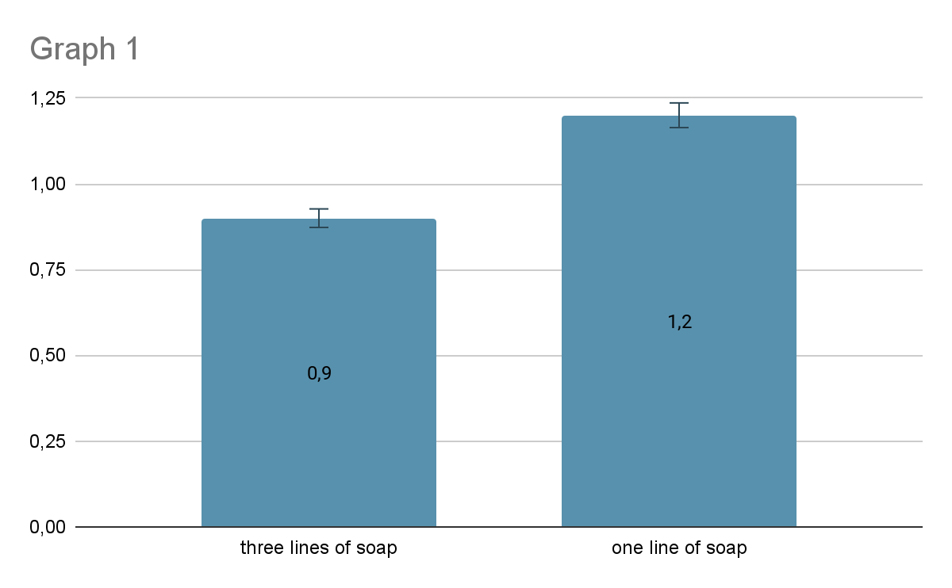
Introduction
Theory
Hypotheses/setup
Experiment 1
Experiment 2
Experiment 3
Results

Slide 13
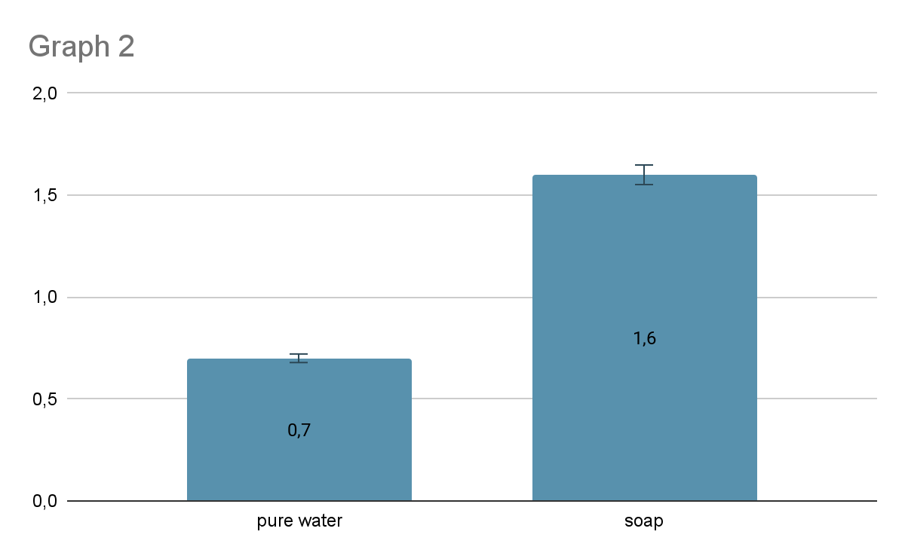
Introduction
Theory
Hypotheses/setup
Experiment 1
Experiment 2
Experiment 3
Results

Slide 14
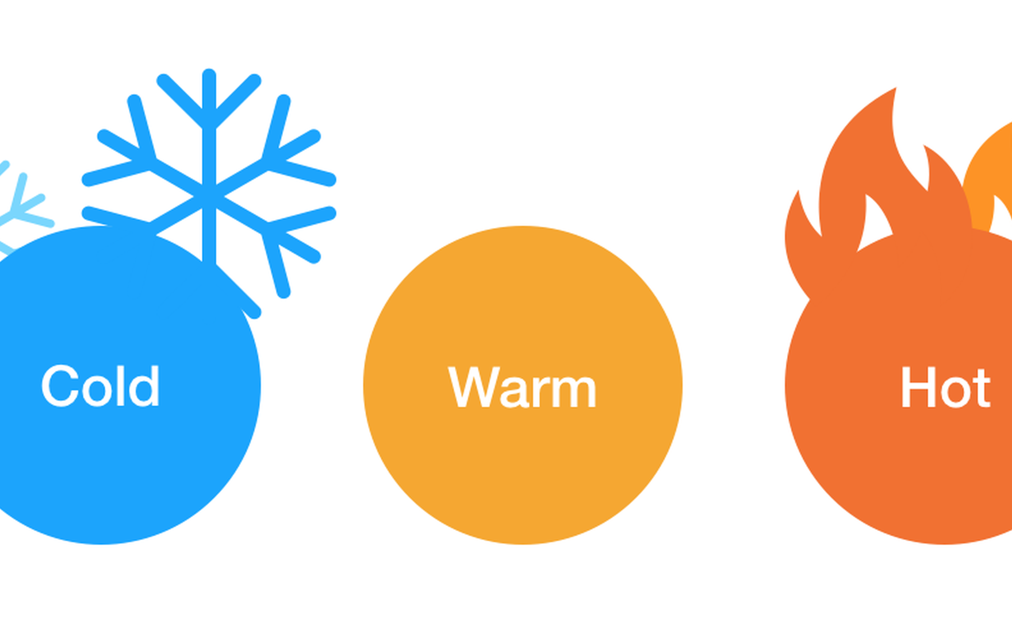
EXPERIMENTAL PROCEDURE II
Introduction
Theory
Hypotheses/setup
Experiment 1
Experiment 2
Experiment 3
Results
In this experiment we tested whether higher temperature in the water, can make the clip sink faster.
We used two types of water: Cold
Hot

Slide 15
CONTROL OF VARIABLES II
Introduction
Theory
Hypotheses/setup
Experiment 1
Experiment 2
Experiment 3
Results
INDEPENDENT
DEPENDENT
CONSTANTs
Temperature of water
Time of to get to the bottom of the cup
1)Same soap ratio
2)Same paper clips
3) Water amount
4) Room temperature
5) Shape of paper clips
6)Same cups

Slide 16
EXPERIMENTAL RESULTS
Introduction
Theory
Hypotheses/setup
Experiment 1
Experiment 2
Experiment 3
Results
II
Cold soap water : 0.9
Hot pure water: 0.6

Slide 17
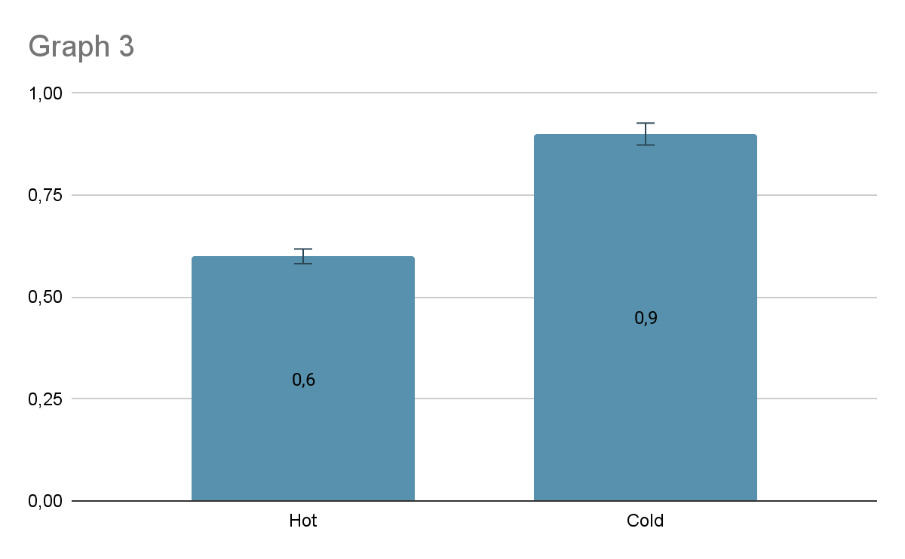
Introduction
Theory
Hypotheses/setup
Experiment 1
Experiment 2
Experiment 3
Results

Slide 18
CONCLUSIONS
Introduction
Theory
Hypotheses/setup
Experiment 1
Experiment 2
Experiment 3
Results
When the quantity of the soap increases, the time to get to the bottom also increases
The 1st hypothesis is Confirmed
The 2nd hypothesis is Confirmed

Slide 19
POSSIBLE ERRORS
Introduction
Theory
Hypotheses/setup
Experiment 1
Experiment 2
Experiment 3
Results
The measurements of water and soap were measured with the lines of the plastic cup, and therefore might not have been so accurate.
The use of the timer was by hand.

Slide 20
BIBLIOGRAPHY
https://en.wikipedia.org/wiki/Optical_phenomena
https://www.youtube.com/watch?time_continue=77&v=GH5W6xEeY5U&feature=emb_logo%0D
https://www.youtube.com/watch?v=GH5W6xEeY5U&t=77s
https://en.wikipedia.org/wiki/Electric_dipole_moment
https://wonders.physics.wisc.edu/measure-the-speed-of-light/
https://www.bbc.co.uk/bitesize/guides/zg7jng8/revision/3

Slide 21
Thank you for your attention!

Slide 22
APPENDIX

Slide 23
Theory
Introduction
Theory
Hypotheses/setup
Experiment 1
Experiment 2
Experiment 3
Results
In order for the paper click to sink in distilled water (without soap) it is mass has to be 0,072 grams (the mass of the paper clip).

Slide 24
W

