Slide 1
25.Red berries

Slide 2
Problem’s task
Well done
Good
Introduction
Needs improvement
Theoretical explanation
Setup
Experiments
Correlation
Conclusions

Slide 3
Problem’s task
The garden of Buckswood School has trees with red berries. Identify the exact species of the plant. Is it possible to conclude whether the trees were planted there by humans?
Are the fruits edible or poisonous?

Slide 4
Theoretical Part
Strong points
Weak points
Good authentification of the berries
Well organized slides
The presentation was well conceived
Really nice addition of the cladogram
Notig the steps required to identify these plants
Some of the explanations about the cladogram weren’t enough
Notes:
Strong points:
Good definition of terms (eg. crystallization)
Clear physical explanation of the phenomenon
Good visualization of the chemical reaction
Clear and relevant visual aids were used
Well chosen relevant parameters (diameter, mass, density)
Weak points:
Unclear organization – theory between the experiments
Some more text on the slides could have helped / Too many content (text) on the slides
The chemical reactions were a little too simplified
Didn’t make any quantitative predictions
Not fully explained the predictions of the hypotheses
Poor understanding of the theory

Slide 5
Experimental Part
Strong points
Weak points
She identified the plant correctly
Didn’t discover all the plant types
Didn't say if the plant was edible or not
Didn’t give information about the experimental setup or required materials
She didn’t see the seedlings around
Notes:
Strong points:
The experiment was done in a properly controlled manner.
The experiment reached clear results.
Use of multiple materials.
Had a well working setup.
Had great visual aids for the experiment.
Had some trial and error for her recipe.
Extreme control of the external factors allowed the team to obtain accurate results.
Weak points:
No hypotheses were drawn.
Lacking parameter: temperature (it influences results).
More quantitative data could have been used and mentioned.
Unlabeled graphs - points, labelled axis, connection to theory.
No errors mentioned.
Not explained why these materials were chosen.
Didn’t control many of the parameters (example).
Task of the problem was not fully fulfilled (explain why).
No quantitative parameters.
No picture of their own experimental setup was presented.

Slide 6
Discussion
topics
What could the small seedlings from around the trees represent?
What methods did you use to identify whether the plants were poisonous or not?
Do you think there are any correlations between the berries?
Do you think are any reasons because of which so many berries are found here?
Notes:
Clarifying questions:

Slide 7
Thank you for your attention!

Slide 8
Are the berries edible
Most poisonous berries grown in small clusters
Most poisonous berries are really small

Slide 9
Clarifying questions:
Have u studied all the red berry types in the garden? How many were there?
How did authenticate the berries, were there any special methods u used
How did u figure out if the berries were planted or not.
Have you noticed the small berry trees that grew around the garden?
Have you thought about seeing in which climate the berrys live in so you can determine if they were planted or not?

Slide 10
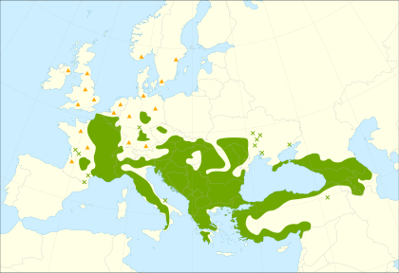
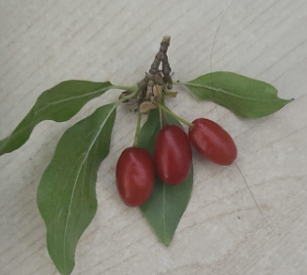
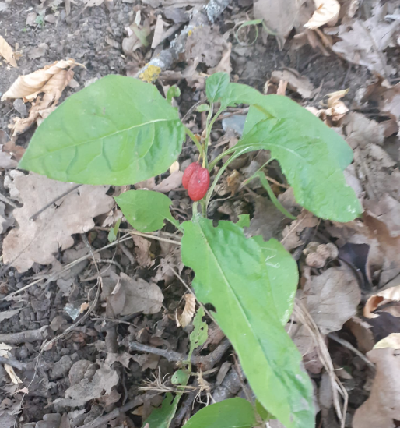
Cornelian cherry
They are specific to europa and the south west asia(hotter climates)
Not poisonous
Notes:
Clarifying questions:

Slide 11
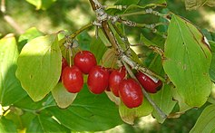
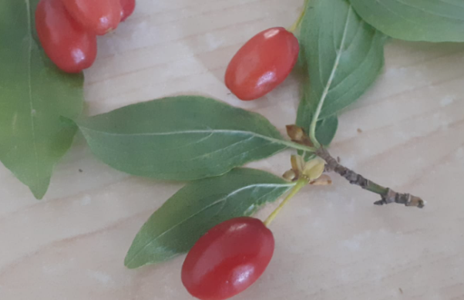

Slide 12
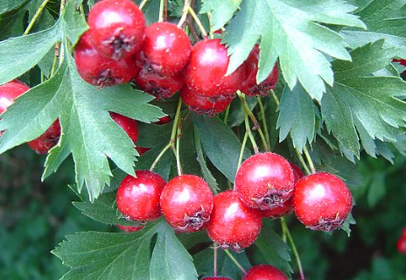
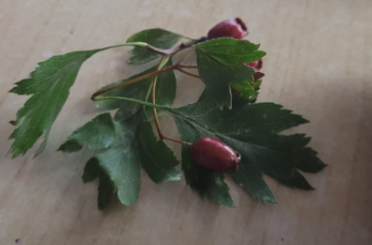
Crataegus berries(howthorn)
They are found in europe and west asia.
Not poisonous

Slide 13
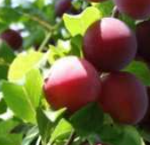
Cherry Plum berries
The plum berries are specific to this zone, so they most likely weren’t planted here and they didn t grew here.
Not poisonous
Notes:
Clarifying questions:

